Slide 1
Sleep Disorder
Classification
Using Random Forest & XGBoost on the Sleep Health and Lifestyle Dataset
John Pierre | Final Project | ITAI 1371 | May 2025

Slide 2
1
Motivation
Why did I choose this problem?
💤
🏥
🤖
Prevalence
Clinical Impact
ML Opportunity
Sleep disorders affect over 70 million Americans annually, with many cases undiagnosed or misdiagnosed by traditional screening methods. Traditional “Hustle” culture is a misguided social norm.
Untreated insomnia and sleep apnea are linked to cardiovascular disease, depression, and reduced workplace productivity.
Lifestyle and health features collected by wearables and surveys make sleep disorder prediction an ideal machine learning use case.
Sleep Disorder Classification | Final Project

Slide 3
2
Introduction
What am I trying to solve?
Problem Statement
Target Classes
Goal: Predict whether a patient has no sleep disorder, insomnia, or sleep apnea using lifestyle and health data. Task: Multi-class classification (3 classes) Dataset: Sleep Health and Lifestyle Dataset (Kaggle, ~400 records, 13 features) Models: Random Forest vs. XGBoost, with fairness auditing across demographic groups.
None
No diagnosed sleep disorder — patient sleeps normally.
Insomnia
Difficulty falling or staying asleep; disrupted sleep patterns.
Sleep Apnea
Repeated breathing interruptions during sleep; oxygen drops.
Sleep Disorder Classification | Final Project

Slide 4
3
Background
Review of the problem and existing state-of-the-art solutions
Sleep Disorders Overview
Tree-Based Models
Sleep disorders encompass a range of conditions affecting sleep quality, timing, and duration. Polysomnography (PSG) is the clinical gold standard but is resource-intensive and costly.
Random Forests and XGBoost excel on tabular data, handle mixed feature types, and provide built-in feature importance which make them ideal for interpretable medical classification.
Existing ML Approaches
Fairness in ML
Prior work has used SVMs, Naïve Bayes, and neural networks on PSG signals. Fewer studies address tabular lifestyle data, making this dataset a realistic, low-cost alternative.
Healthcare models must perform equitably across demographic groups. Auditing by Gender and BMI Category ensures predictions are not systematically biased against any subgroup.
Sleep Disorder Classification | Final Project

Slide 5
4
Methods
Choice of method and why it works
1
2
3
4
5
Data Cleaning
Feature Eng.
Random Forest
XGBoost
Evaluation
Fill missing values
Parse Blood Pressure
Remove duplicates
Label encode categoricals
StandardScaler
80/20 stratified split
n_estimators=100
max_depth=15
5-fold CV
Why 5-fold CV?
More reliable performance estimates
Small dataset
n_estimators=100
lr=0.1, depth=6
5-fold CV
Why 5-fold CV?
Better use of data
Hyperparameter tuning without data leakage
Accuracy, F1
ROC-AUC OvR
Fairness audit
Why Tree-Based Models?
Both RF and XGBoost handle mixed data types natively, are robust to outliers, provide feature importances for interpretability, and consistently outperform baselines on tabular medical data without requiring extensive hyperparameter tuning.
Sleep Disorder Classification | Final Project

Slide 6
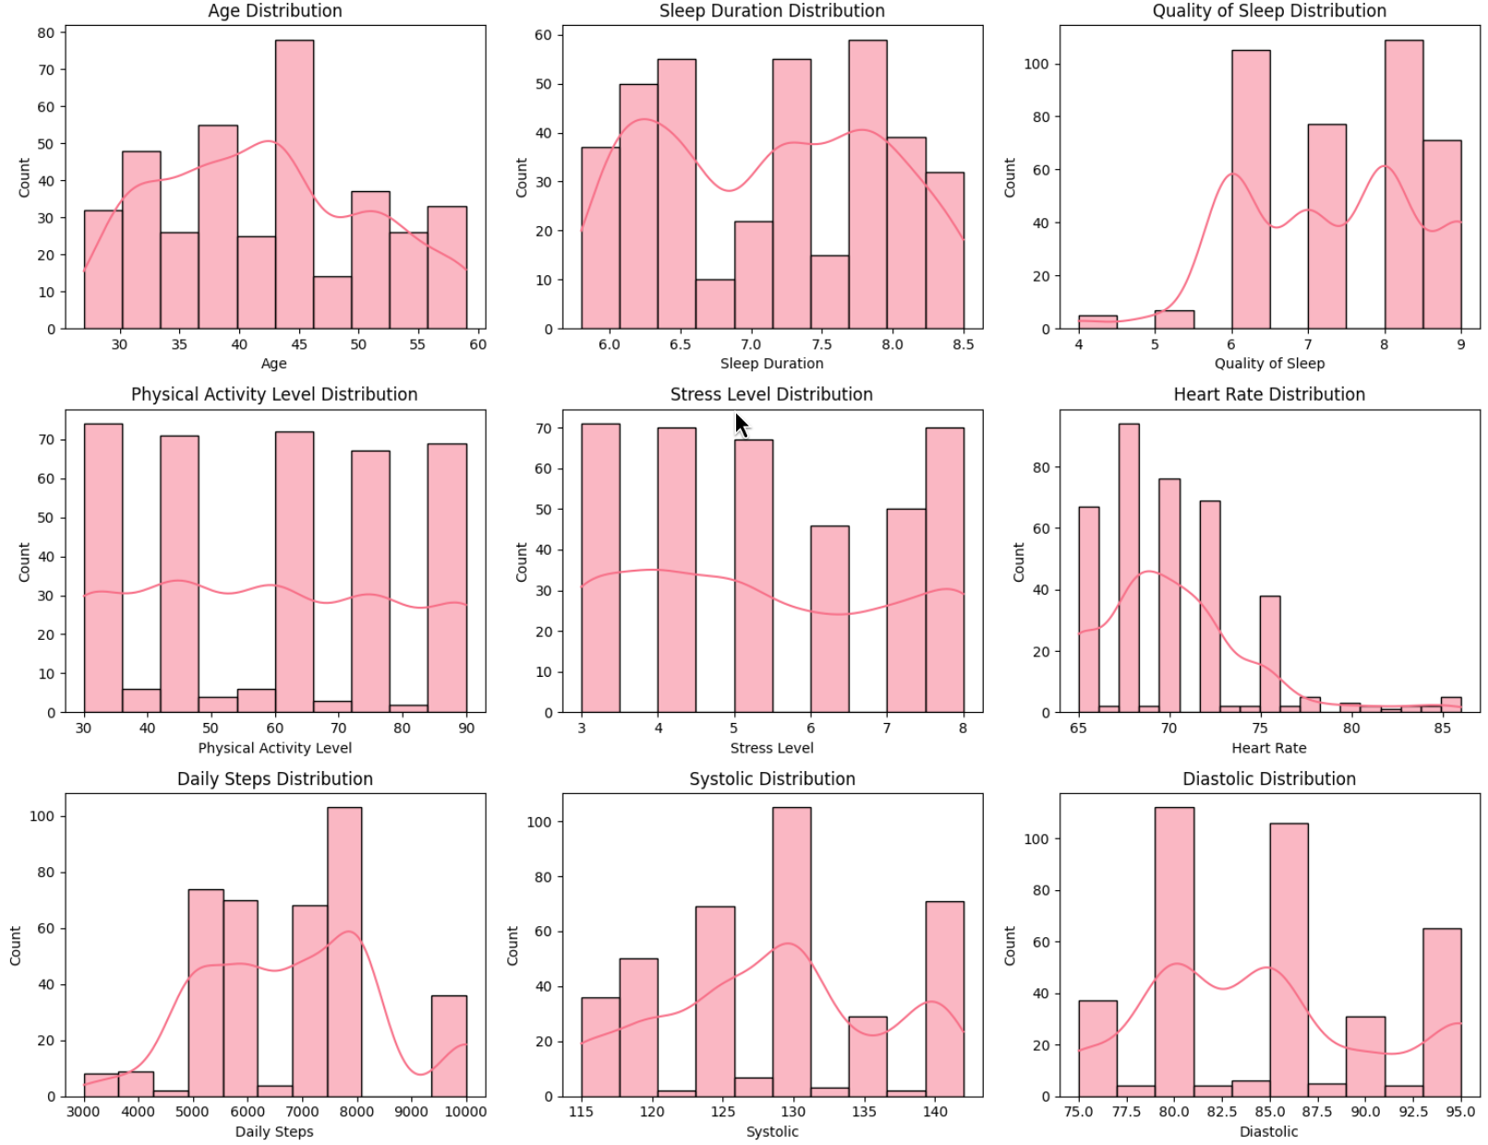
5
Visualizations
Sleep Disorder Classification | Final Project

Slide 7
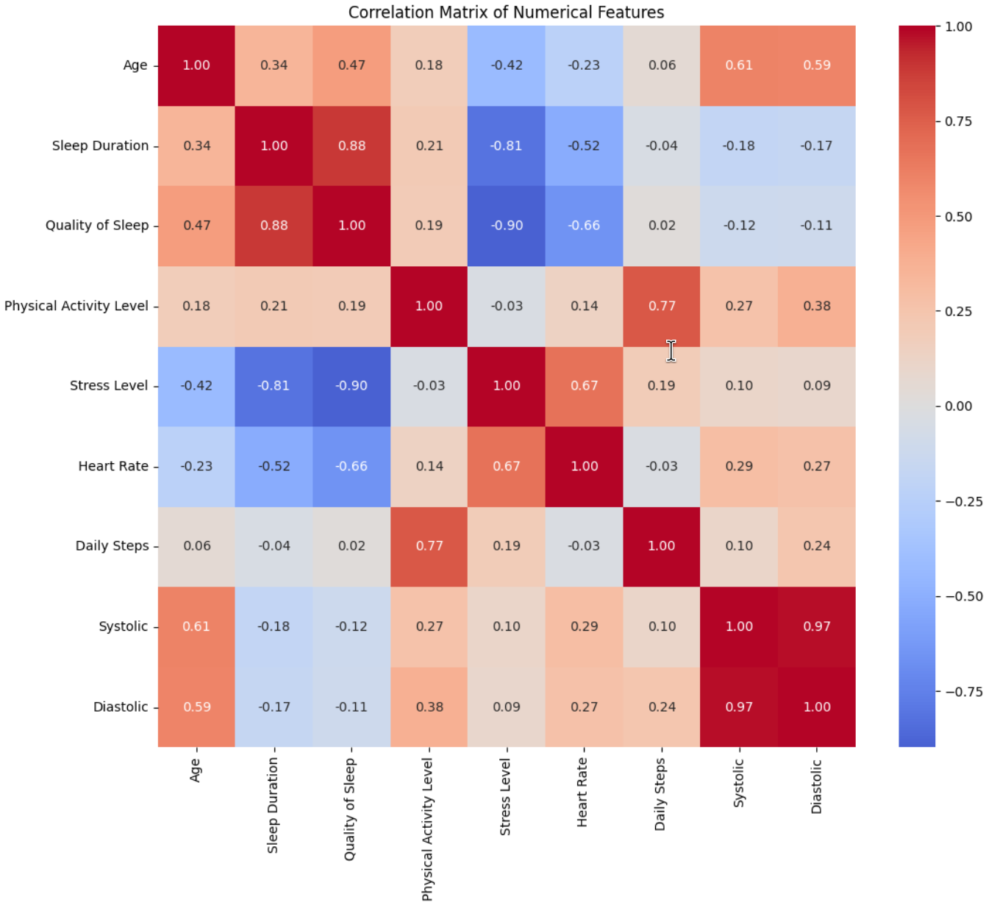
6
Visualizations
Sleep Disorder Classification | Final Project

Slide 8
7
Results
Model performance on the held-out test set
Performance Summary
Key Takeaways
Both models achieve strong accuracy on a 3-class problem
RF vs. XGBoost: RF outperforms XGBoost although only a minor difference
Top features: [e.g., Stress Level, Sleep Duration, BMI]
Fairness audit shows slight variance across gender and bmi groups
Metric | Random Forest | XGBoost
Accuracy | 0.9600 (96%) | 0.9467 (~95%)
Weighted F1 | 0.9599 | 0.9466
ROC-AUC (OvR) | 0.9982 | 0.9913
CV Mean ± Std | [0.8889 ± 0.0184] | [0.8862 ± 0.0219]
Both models achieve strong accuracy on a 3-class problem
Sleep Disorder Classification | Final Project

Slide 9
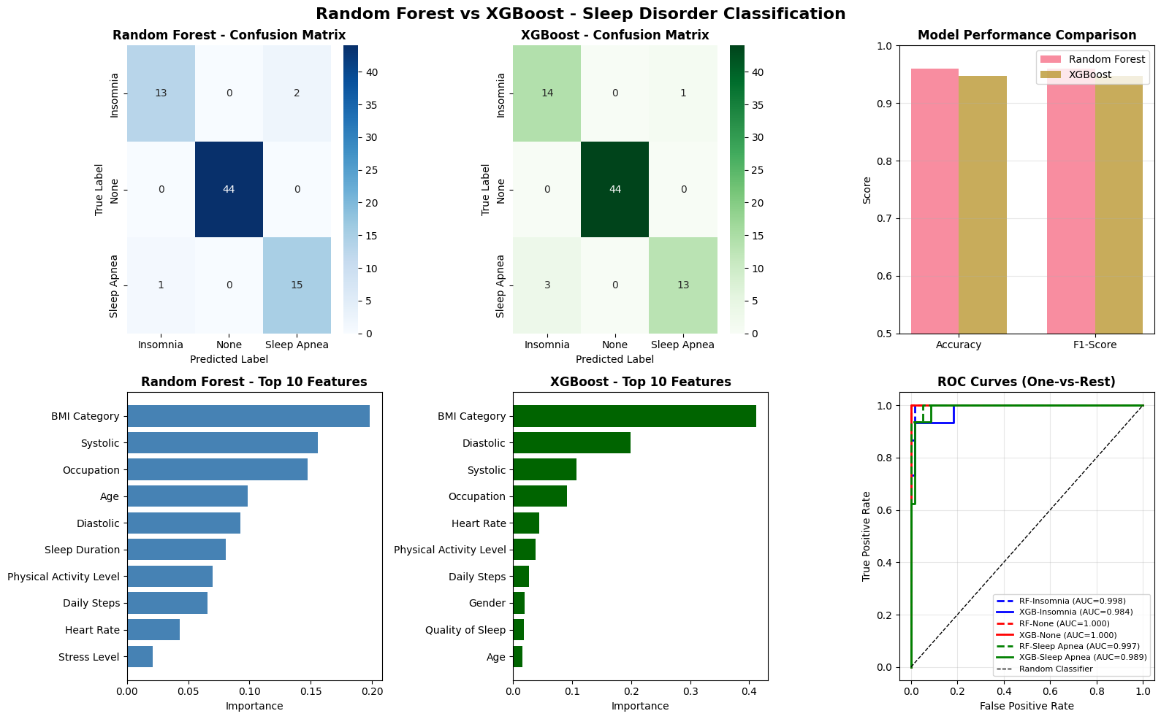
8
RF vs. XGBoost
Sleep Disorder Classification | Final Project

Slide 10
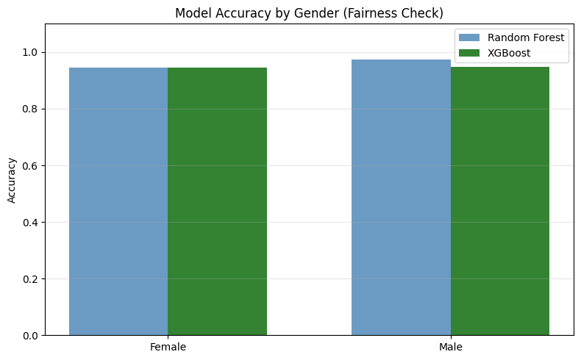
9
RF vs. XGBoost Fairness Check
Sleep Disorder Classification | Final Project

Slide 11
10
Discussion
Challenges encountered and how they were addressed
⚙️
Class Imbalance
🔧
Feature Engineering
The dataset had unequal representation across sleep disorder classes. Stratified splitting and weighted F1-score evaluation ensured fair model comparison.
The Blood Pressure column was stored as a string (e.g., '120/80'). We parsed it into separate Systolic and Diastolic numerical features.
📊
Model Stability
⚖️
Fairness Gaps
5-fold cross-validation was used to detect overfitting and confirm that test-set performance was consistent with training trends.
Initial fairness audit revealed minor accuracy differences by BMI category. Groups with fewer than 5 samples were flagged and interpreted with caution.
Sleep Disorder Classification | Final Project

Slide 12
11
Future Directions
Key areas for improvement and lessons learned
Larger Dataset
Hyperparameter Tuning
Real-World Deployment
Collect or augment with PSG or wearable sensor data to improve generalizability and reduce demographic sampling gaps.
Apply Bayesian optimization or Optuna for more principled model selection beyond default parameters.
Wrap the best model in a clinical screening tool with a user-facing interface and continuous model monitoring.
Deep Learning
Explainability
Explore LSTM or Transformer models if time-series sleep metrics (e.g., nightly wearable data) become available.
Integrate SHAP values for per-patient explanations — critical for clinical adoption and regulatory requirements.
Sleep Disorder Classification | Final Project

Slide 13
8
12
Conclusion
What Was Built
A 3-class sleep disorder classifier using Random Forest and XGBoost on real-world lifestyle data. This achieved high accuracy with minimal preprocessing.
What We Learned
Tree-based models are effective and interpretable for tabular health data. Feature engineering (BP parsing) and stratified splits were key to reliable results.
Broader Impact
Fairness auditing ensures equitable predictions across gender and BMI groups, a necessary step for any real clinical screening tool.
Thank you • Questions welcome

