Slide 1
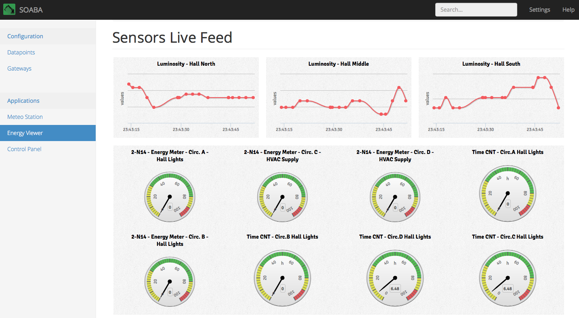
SOABA
SOA for Building Automation
João Pinho
MEIC-T Computer Science
Smart Environments
mail - jpe.pinho@icodebox.net
blog - pinho.icodebox.net
skype - jpe.pinho

Slide 2

Introduction
Building Automation System
KNX
LonWorks
X10
Market Needs:
EES – Web-based Enterprise Energy Management
EIS – Web-based Energy Information Systems

Slide 3
Motivation
Nowadays there are a huge number of protocols and vendor-specific devices in the area of Building Automation.
Technologies such as X10 are in the market since the 70’s, and since then many things have evolved.
Such diversity, is not always a good and can became a major problem when homogeneity is a matter of concern.

Slide 4
Case Study
An well established corporation contracted an installation of X10 for their entire head quarters in New York on the yearly 80’s, some decades later technologies such as KNX appeared and they decided to hire a KNX installation for their new building in San Francisco.
But when the KNX installers arrive at the building they notice that the building already has some LonWorks sensors scattered across some of the offices.
Faced with this scenario the building managers of the company, have now three distinct systems collecting data from their buildings, which are: (i) X10, (ii) KNX, (iii) LonWorks.

Slide 5
Proposed Solution
Development of a Gateway Driver for interaction with KNX devices.
The Gateway Driver is configurable from a XML file containing all the KNX device addresses and their underlying types.
The Gateway Driver will be accessible via HTTP by exposing a REST interface, receiving and sending serialized JSON data.
The Web Prototype App will make use of this REST interface to control and expose the Gateway Driver functionalities.

Slide 6
SOABA

Slide 7
Architecture Overview (1/2)

Slide 8
Architecture Overview (2/2)

Slide 9
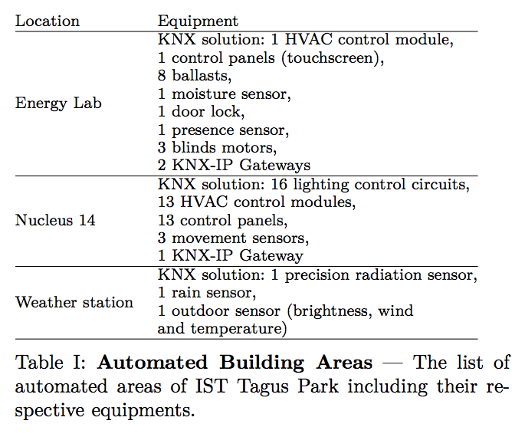
Evaluation
With the intention of evaluate the solution and also validate the proposed architecture, the implemented software is integrated in a real-world setting: the IST Taguspark building.

Slide 10
Contribute on BitBucket
The project is publicly available at:
https://bitbucket.org/jpinho/soaba
You can pull a copy for yourself using:
git clone git@bitbucket.org:jpinho/soaba.git
Want to help, talk with me for an heads up!

Slide 11
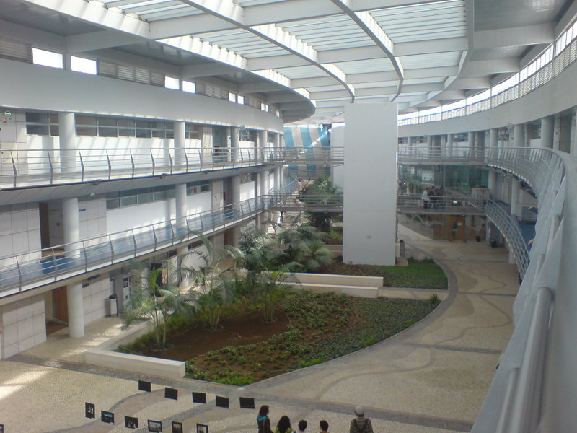
Live Demo on MIT - 2N14.28
?
Let’s see it working, shall we?
Questions will be answered on the go!

