Slide 1
Collider Physics at Texas A&M
Teruki Kamon, Alexei Safonov and David Toback
DOE Review
January 22nd 2007

Slide 2
Collider Program
Overview & People
Top 5 for 2005 and 2006: CDF and CMS
Who does what & Budgets
OJI Proposal: The CDF and CMS Tau program

Slide 3
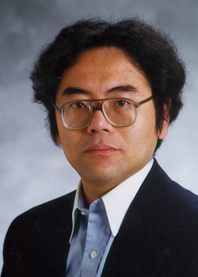
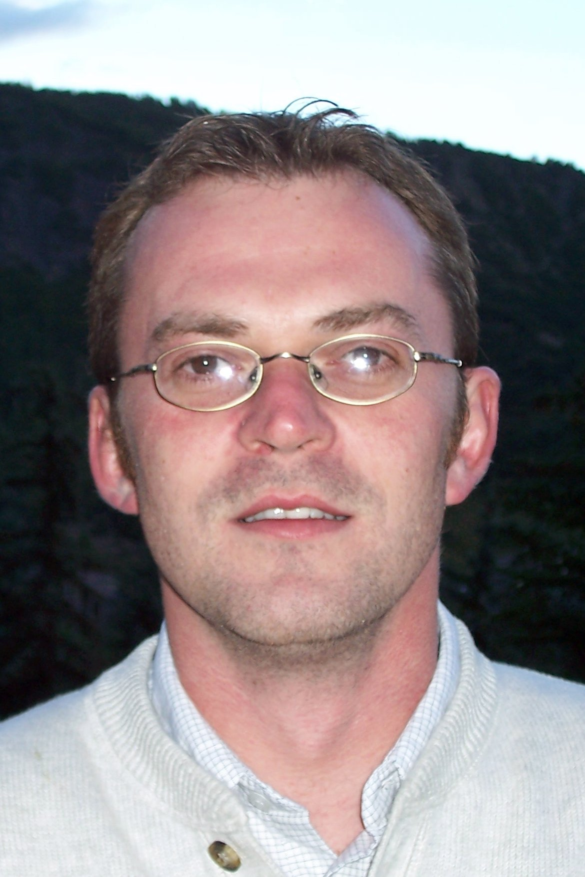
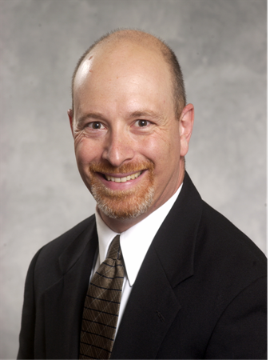
Full Time Professors
Teruki Kamon
Alexei Safonov
New Assistant Professor starts in Fall 2006
David Toback Promoted to Associate Professor with Tenure in 2005

Slide 4
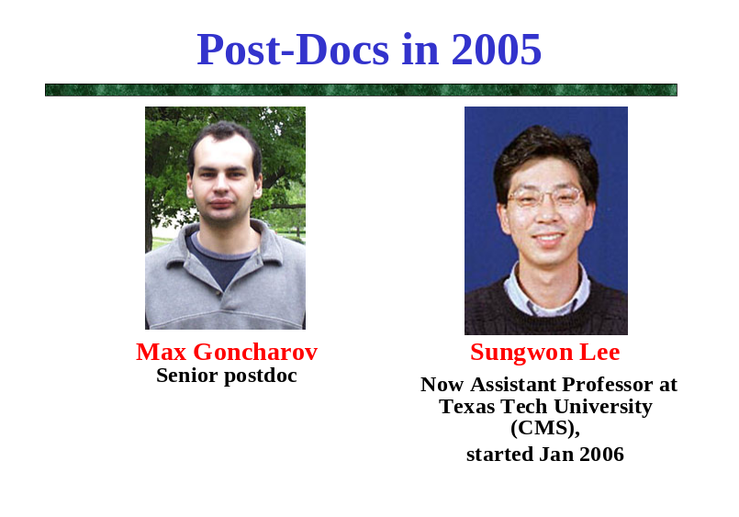
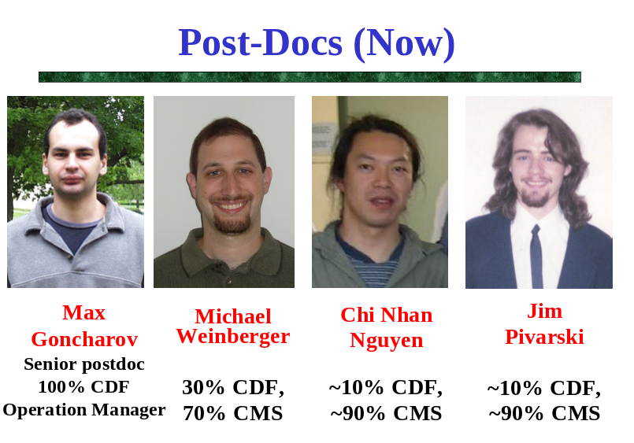
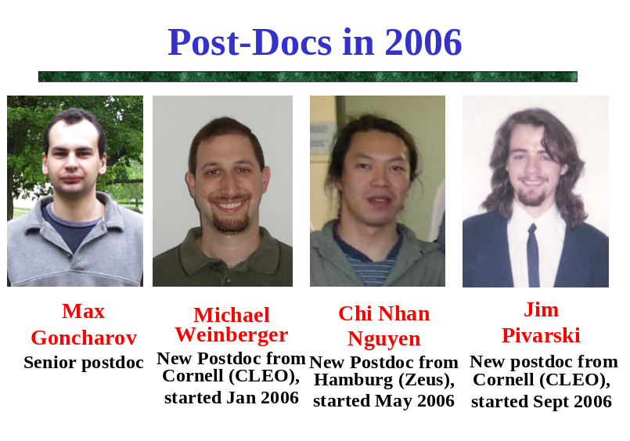
Post-Docs

Slide 5
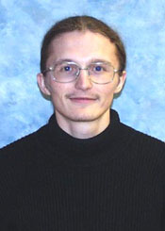
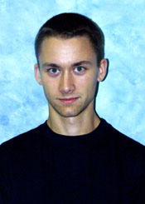
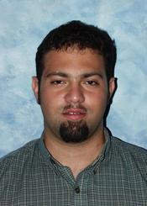
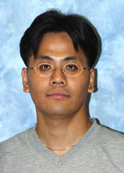
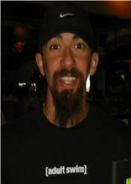
Post-Qualification Graduate Students
Vadim Khotilovich
Expected to graduate in 2007
Peter
Wagner
Full time at FNAL. Expected to graduate in 2007
Adam Aurisano
Full time at FNAL
Eunsin
Lee
Full time as TA since Jan 2006
Jonathan Asaadi
Full time since summer 2006
Notes:
Andrey Elagin and Dmitry Yakorev are in the queue and taking classes. Alfredo Gurrola is co-supervised with Prof. B. Dutta

