Slide 1
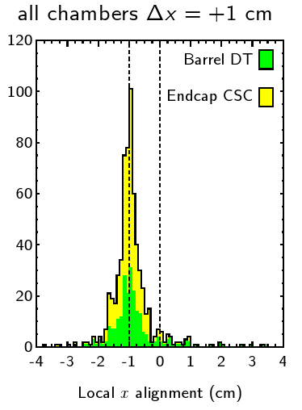
AlignmentProducer
One framework common to three algorithms (HIP, MillePede II, and Kalman) and all tracking systems: Pixel, Si-Strip, and Muon
  Share common aspects: derivatives, selecting parameters, database access, etc.
  Full-scale demonstraction for tracker (this week's CMS Times)
  Infrastructure works for muons

Slide 2
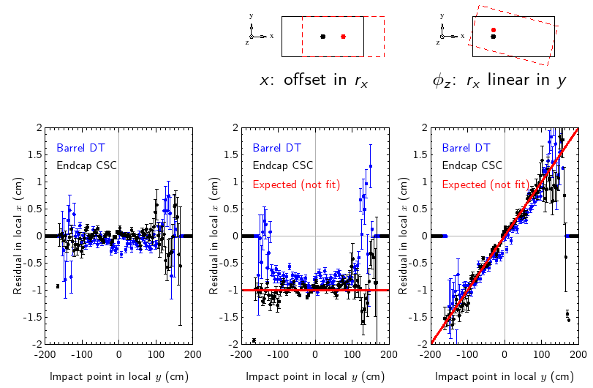
AlignmentProducer: HIP for Muons
Simplest algorithm, can be used to test the others
Correction = -residual
Tested with 10k Z->μμ

Slide 3
Kinds of Alignment Monitoring
DQM-based monitoring upstream of alignment process (reports an error if alignment used online is wrong)
Sanity checks in AlignmentProducer (convergence, improvement in residuals, overlap plots, pT)
Geometry Validation— compare output geometries from diﬀerent alignments: have the chambers moved?
Validation with reconstructed tracks: is it better?

Slide 4
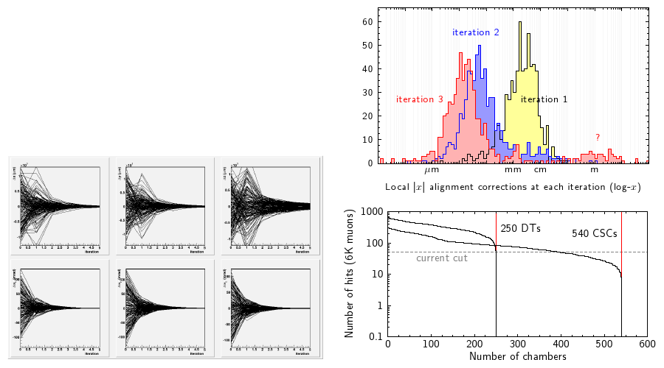
Sanity Checks in AlignmentProducer
Need to make sure that AlignmentProducer is working before submitting corrections to database
Can manually check alignment output

Slide 5
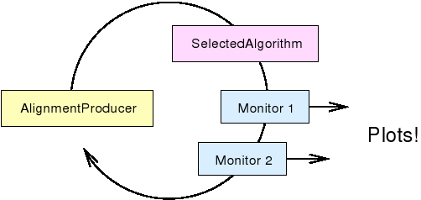
CommonAlignmentMonitor
  Histogram modules allow alignment groups to share plotting code without overwriting the same files
aligners type:
  hist = add("/iterN/subdir/", new TH1F(...))
framework manages:
iteration-aware subdirs in ROOT file
merging plots from parallel-processed jobs
(replaces "N")

Slide 6
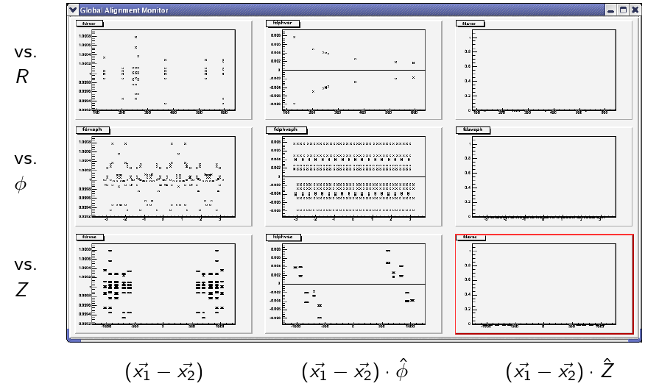
Monitoring Alignment Output at the Geometry Level
Dmitry Yakorev is developing a tool to compare positions/angles after survey, hardware, track-based alignments, as a function of time, etc.

Slide 7
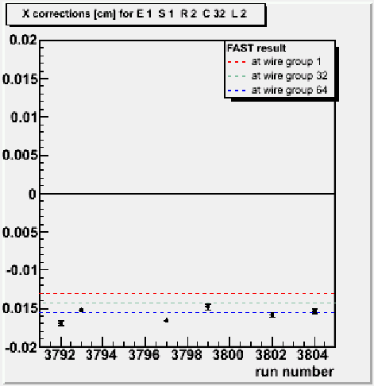
Validating Alignment with MTCC
Karoly Banicz (Purdue) simplified alignment procedure to measure CSC layer corrections
Re-discovered 100-1000 micron shifts (first seen at assembly sites)
Expanding to full algorithm
Test of full chain, including monitoring, in MTCC and upcoming Slice Test
Points: MTCC
Lines: assembly site
(-150 microns)

Slide 8
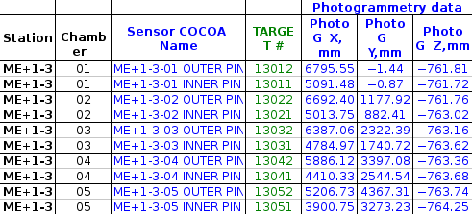
CSC Survey Measurements
Positions of all CSC alignment pins measured and analyzed by photogrammetry
Dmitry Yakorev (A&M) is converting these measurements into chamber positions/angles, following the DT example
2 pins: 5 d.o.f.

