Slide 1
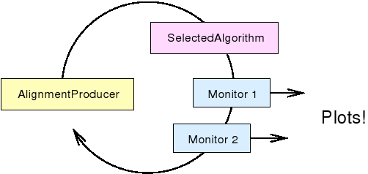
Generic approach to histograms in AlignmentProducer
  Histogram modules allow alignment groups to share plotting code without overwriting the same files
New package (soon): Alignment/CommonAlignmentMonitor
Already interest from other groups (muon and tracker) to use it
Closely tied to AlignmentProducer; accesses selected alignables, parameters, intermediate iteration data
Instrumented to accomodate new plots for each iteration and merging plots from parallel-processed jobs, without complicating the interface

