Slide 1
Alignment Status and Commissioning Plans
Jim Pivarski, Alexei Safonov (Texas A&M)
Karoly Banicz (FNAL)

Slide 2
Alignment Needs
Physics analysis alignment (10/100 pb⁻¹) :
  Full procedure using large datasets
  Necessary software tools
  Full systematics studies
Validation:
  Tests with real data to validate the procedure early
    Cosmics, beam halo
  Comparisons with other alignment information
    Photogrammetry, optical, and hardware alignment
Commissioning(0-10 pb⁻¹):
  Procedure that uses minimal collisions data
    Quick alignment of larger structures
    Cosmics and beam halo for internal alignment measurements
    Integration of other sources of alignment information (PG, HW)

Slide 3
Baseline Procedure
Baseline procedure for physics quality datasets has been stable for some time
  Based on the HIP algorithm
  I Aligns one station at a time (from the inside out)
Hierarchical code structure matches system design
  Fast alignment of large structures (~1000 muons)
  Built-in support for constraints from prior knowledge
    Photogrammetry, optical system
  Capable of combining measurements from different sources
Optimization of parameters is in progress for faster convergence and better accuracy
  Track-fitting parameters (APEs) tuned for each station
  Intelligent track selection to supress strongly scattering tracks
  Optimized track-fitting to better use structure of the detector and material distribution (pending tests)

Slide 4
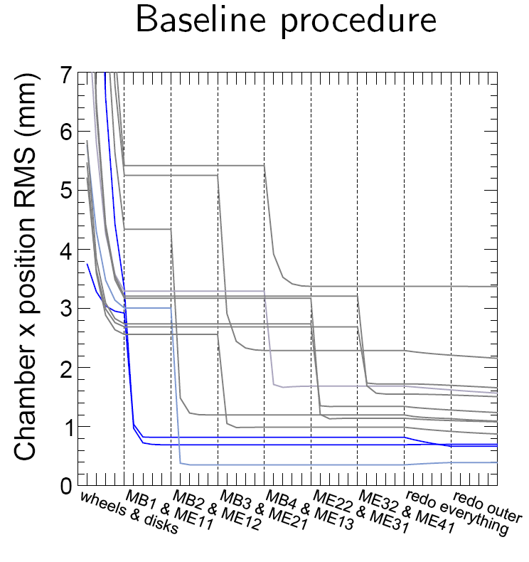
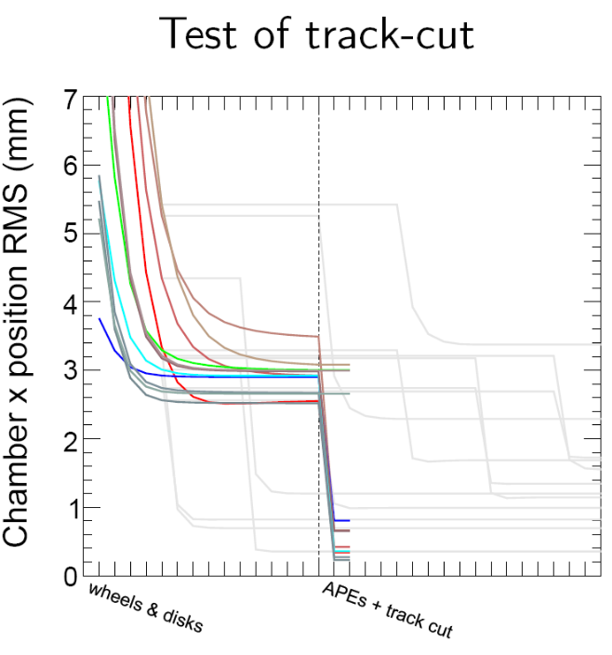
Improvements to Baseline Procedure
Illustration of improvements:
  “Intelligent track selection” (MC, 100 pb⁻¹)
Each line is a station’s resolution as a function of iteration
  Improved alignment reaches 300 μm for inner stations (which drive momentum resolution)

Slide 5
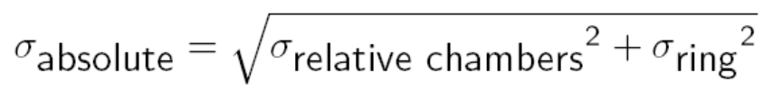
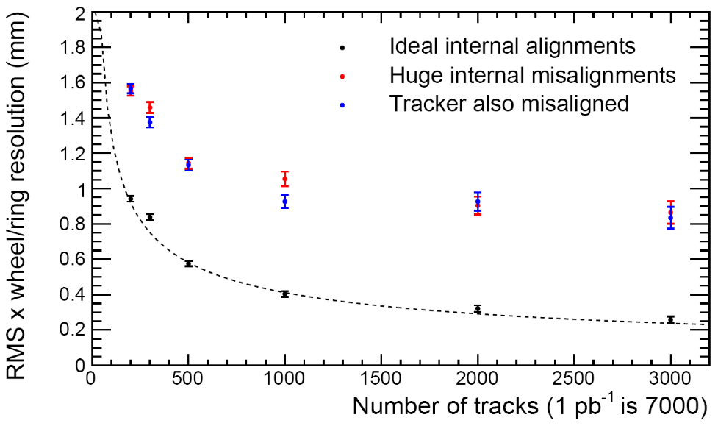
Considerations for Early Commissioning
Can’t accurately align all chambers with limited statistics
  But can quickly align large structures if internal alignment is known from other sources
      Although less important for momentum resolution in collision data
Track-based candidates:
  Beam-halo or collision tracks passing through overlap regions - EMU
  Cosmics for barrel
Non-track based:
  Hardware alignment and photogrammetry very useful for cross-checks and filling in gaps
    E.g. CSC z alignment, to which beam-halo is insensitive
Momentum resolution depends on absolute alignments, which are a combination of

Slide 6
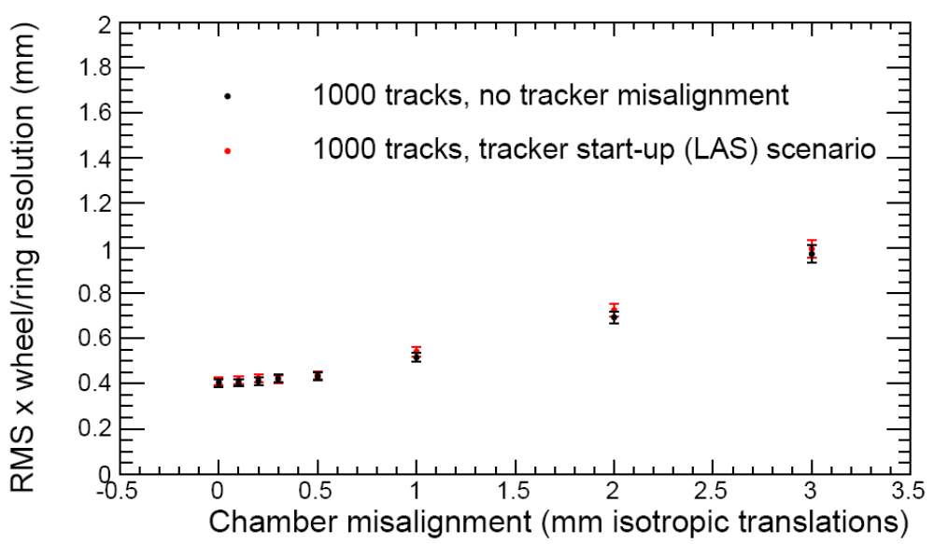
Large Structure Alignment
Alignment of large structures weakly depends on internal misalignments:
For ~1 mm chamber misalignments:
  RMS_{x,y}~0.6 mm, RMS_{z}~3 mm, RMS_{φ−z}~ 0.1 mrad
Tracker misalignment is negligible for such large solid angles

Slide 7
Commissioning Plan
CRAFT Tracker to Chamber Alignment (May):
    Near-IP Muons: ~1M in Barrel 0, ~10k in ME1/3
  Validation of the baseline procedure
    Sanity checks: residuals for tracker muons
  Comparisons with PG and HW alignment (ME1/3 & barrel)
    Exercise use of HW and PG as constraints
Beam halo internal ring alignment (June):
  Re-configured baseline procedure
  Similarly, cosmics could be used for Barrel
Collisions (July?):
  Ring alignment using internal alignment results
    Similarly, we will align wheels if internal alignment available
  Overlap tracks to cross-check internal alignment
  Comparisons with PG and HW alignment
  Use of PG and HW as constraints in baseline procedure
Next few slides provide details of the implementation

Slide 8
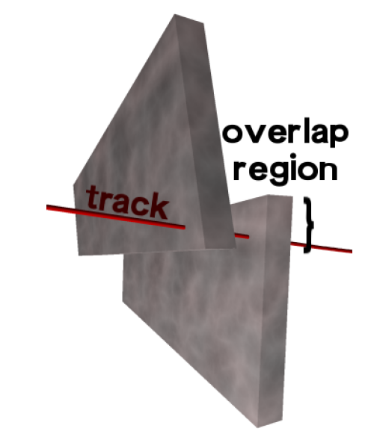
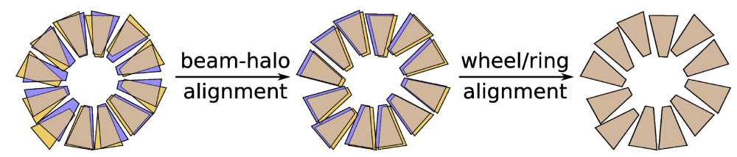
Internal Alignment with Beam Halo
No collisions alignment:
  Beam-halo through overlap regions (no ME1/3)
Few-collisions alignment
  Align rings relative to tracker with ~1000 GlobalMuons
  Complements beam-halo for a complete alignment
  Minimal track propagation, measure x,y,φ_{y},φ_{z}
  Beam-halo rate hard to predict
  With sufficient rate, good for layer alignment
  Chambers are aligned relative to one another within each ring
Chambers misaligned within ring, ring position unknown
Chambers aligned within ring, ring position unknown
Chambers aligned within ring, ring position known

Slide 9
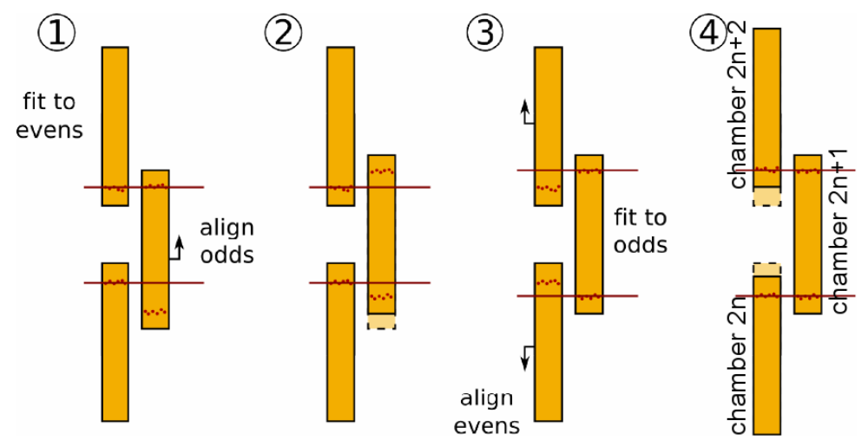
Internal Alignment with Beam Halo
CSC chambers in the same ring overlap
  Easy to align w.r.t. each other using tracks passing through overlap regions
Algorithm:
  Alternate and repeat, iterate
Will be done in the same framework
  Re-configured for local alignments
  Tightly refit tracks to even-numbered chambers
  Loosely fit to odd-numbered to get local extrapolation from even to odd

Slide 10
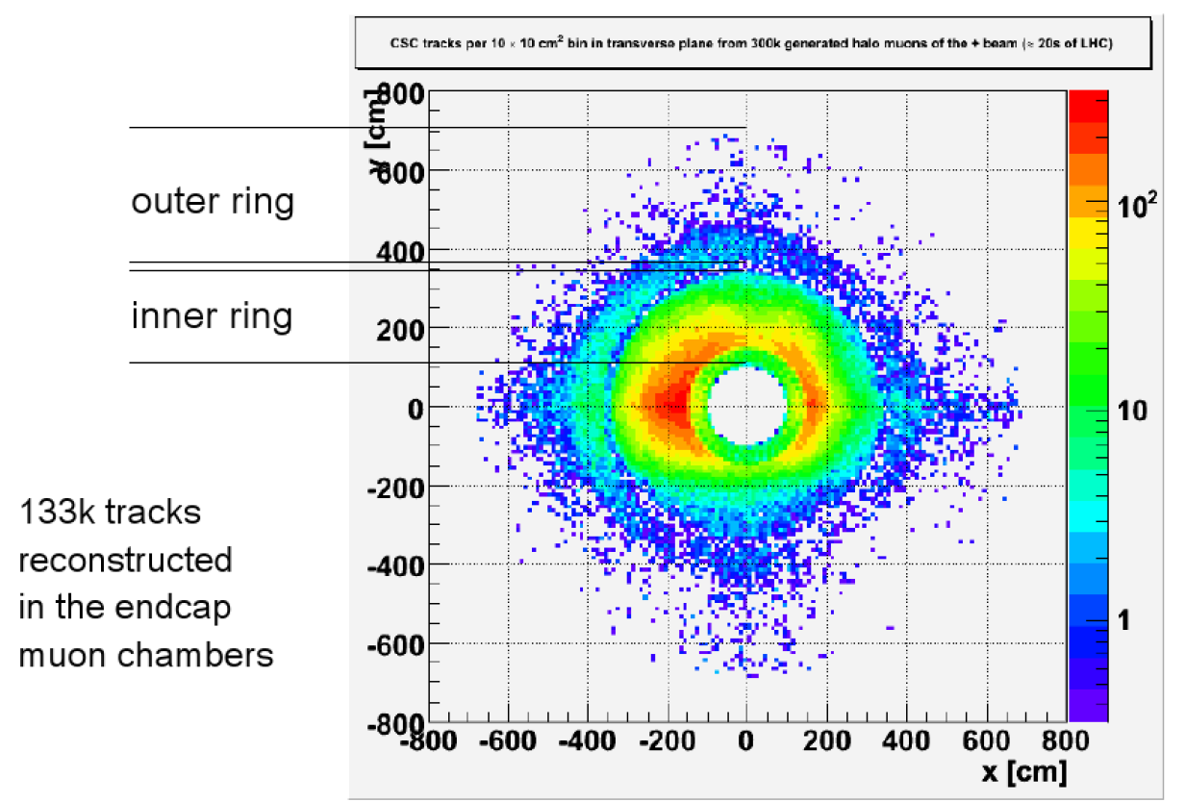
Beam Halo Rate
Beam halo rate is 6600 tracks/sec (known up to a factor of 100)
Rate of overlap tracks 6600 × 0.02 = 130 Hz
  2 hours to collect 1M muons
    Means 100’s of μm resolution
    8 days if we’re off by ×100
  Steeply falling function of energy and radius (better for internal rings)
(K. Banicz)
  Trigger proposed, HLT path is being defined now

Slide 11
Alignment Framework Status
Recent progress
  Parallelized 10/100 pb−1 procedure
  Added CSCRing as an alignable structure
  Tool for setting arbitrary patterns of hit weights (APEs)
  Improved track cut and alternate refitter for upcoming tests
  Mechanism for setting global coordinate system
  HLT paths and AlCa streams for beam-halo, cosmics
  Beam-halo and cosmic MC production cfg
  DB interface with human-editable files and monitoring plots – ½ done
Procedure status
  10/100 pb−1 GlobalMuons: baseline working, can be optimized further, studied in more detail
  Cosmic ray version of high-lumi GlobalMuons: need MC
  Beam-halo: procedure designed, being implemented
  1000 muon ring alignment: easy adaptation of GlobalMuon

Slide 12
Datasets and Procedures
AlCa Streams | L1 | HLT | AlCa Cuts | Procedure
“All Muons” | Single-muon | (Non-iso OR iso) | 10 GeV | Baseline tracker-to-chamber (absolute chamber positions); Structure Alignment; Layer alignment procedure
Muons in CSC overlap | Single-muon | (Non-iso OR iso) AND overlap | 5 GeV in CSC and overlap on track | Even-odd procedure (relative chamber alignment within ring)
All Beam-halo | Beam-halo | (Non-iso OR iso) | 5 GeV in CSC | Layer alignment procedure
Beam-halo in CSC overlaps | Beam-halo | (Non-iso OR iso) AND overlap | 5 GeV in CSC and overlap on track | Even-odd procedure (relative chamber alignment within ring)
Dedicated Cosmics | RBC | (Non-iso OR iso) | ? | Internal barrel alignment?
Single Muon trigger will be evolving with time
All Muons stream will be selecting all of these:
  Cosmic rays during CRAFT
  Very loose muons (single LCT) during commissioning
  Good muons in long term
Overlap muon samples will have to be split by station
AlCa cuts will start loose and will evolve with time
  Additional selections for now will be applied downstream

Slide 13
Pre-Requisites for PG and HW Comparisons
Results of HW and PG have to be in the standard form to be able to do comparisons
Specific requirements:
  Format of measurements (HW and PG):
    Layer positions corrected for shifts (Oleg’s calculations)
    Chamber positions must be defined as average position of layers (accounted for shifts)
    CSCAlignmentRcd, DTAlignmentRcd delivered to Conditions DB
We propose to make comparisons of alignment measurements during these periods:
  CRAFT, Beam halo data taking, Collisions
  Results of HW alignment measurements have to be uploaded to Conditions DB to make comparisons

Slide 14
Possible Comparisons with HW and PG
CRAFT Period Comparisons with HW:
  A direct comparison of chamber positions in global coordinates, as reported by HW alignment and track-based system using DB Comparison tool
  Effectively a test of the HW alignment in the barrel from chambers to tracker through the Link System
  Pre-requisite: HW alignment results have to be propagated down to layer positions
    Actually, that’s what AlignmentRcd holds
PG measurements:
  Some sort of fitting will be needed: fit the two geometries for compatibility up to a rotation and translation
    Accounts for PG (0,0,0) not being on tracker (0,0,0)

Slide 15
Possible Comparisons with HW and PG
Beam Halo Period:
Verification of relative chamber positions on each CSC ring
  Beam-halo measures x and y positions
  HW measures x (and z) with SLM lines
  Will use the same fit method to check compatibility of x-measurements
Comparison with PG:
  Fit to check compatibility of x- and y-measurements of chamber positions on the ring

Slide 16
Possible Comparisons with HW and PG
Collisions Data (first ~1000 muons):
Comparison with HW alignment:
  Assuming completed inner alignment measured with beam halo, we have full alignment (down to chambers), so does HW
  A direct comparison of chamber positions (defined as average layer positions) with the DB Comparison tool
Comparison with PG:

Slide 17
Suggested alignment scenarios
Chamber/Ring/Disk (C/R/D)
0 pb−1 beam-halo plus HW measurements
x y z φ_{x} φ_{y} φ_{z}
C 700 μm 2 mm 3 mm 3 mrad 0.8 mrad 0.65 mrad
R 200 μm 200 μm 230 μm 0.08 mrad 0.08 mrad 0.03 mrad
D 200 μm 200 μm 3 mm 1 mrad 1 mrad 0.03 mrad
1 pb−1 beam-halo plus GlobalMuon ring
x y z φ_{x} φ_{y} φ_{z}
C 700 μm 2 mm 3 mm 3 mrad 0.8 mrad 0.65 mrad
R 600 μm 600 μm 3 mm 1 mrad 1 mrad 0.1 mrad
10 and 100 pb−1 track-based (without improvements)
x y z φ_{x} φ_{y} φ_{z}
C 700 μm 2 mm 3 mm 3 mrad 0.8 mrad 0.65 mrad

Slide 18
Conclusions
Muon track based alignment system is functional:
  Flexible to allow relative (local on structures) and global (w.r.t. tracker) alignment due to hierarchical structure reflecting design of the muon system
  Ability to incorporate external alignment information in a consistent fashion as constraints or initial alignment
  When recent improvements included, expected to reach design accuracy with 100 pb⁻¹, further optimization ongoing
Updated alignment scenarios are conservative
  Do not include recent improvements
Presented commissioning plan makes best use of information as it becomes available

Slide 19
Startup Luminosities
Startup Luminosities
Each step lasts ~ 1 week
Bunches | β* | I_{b} | Luminosity | Pileup | Time for 1000 muons
1 x 1 | 18 | 10¹⁰ | 10²⁷ | Low | 4.1 years
43 x 43 | 18 | 3 x 10¹⁰ | 3.8 x 10²⁹ | 0.05 | 4.0 days
43 x 43 | 4 | 3 x 10¹⁰ | 1.7 x 10³⁰ | 0.21 | 21 hours
43 x 43 | 2 | 4 x 10¹⁰ | 6.1 x 10³⁰ | 0.76 | 5.9 hours
156 x 156 | 4 | 4 x 10¹⁰ | 1.1 x 10³¹ | 0.38 | 3.3 hours
156 x 156 | 4 | 9 x 10¹⁰ | 5.6 x10³¹ | 1.9 | 39 minutes
156 x 156 | 2 | 9 x 10¹⁰ | 1.1 x10³² | 3.9 | 20 minutes

