Slide 1
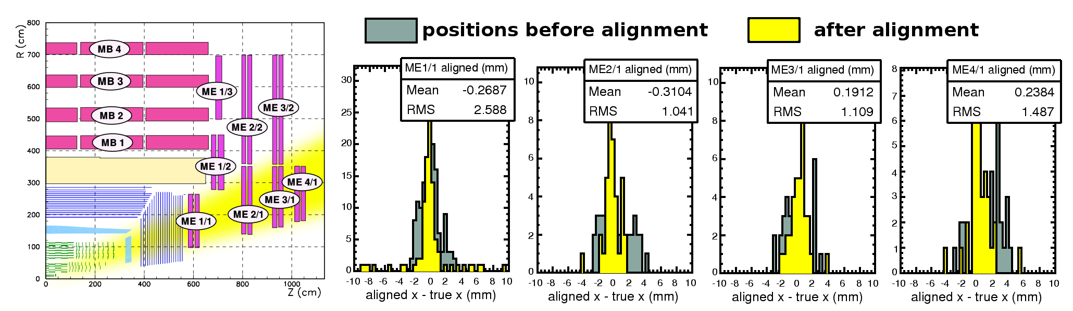
Alignment of the Muon System with the HIP Algorithm in S43
Jim Pivarski, Alexei Safonov (Texas A&M University)
Previous studies were done with W-> mu nu, Z -> mu mu
No improvement over initial scenario expected in 1 pb-1 (S43), but this exercise provided a good opportunity to explore track-based alignment reach with low-energy QCD muons
Conclusions: low-luminosity alignment optimized by a low pT cut (large statistics is better than clean tracks), and some stations at high eta are actually improved relative to 0 pb-1 scenario

Slide 2
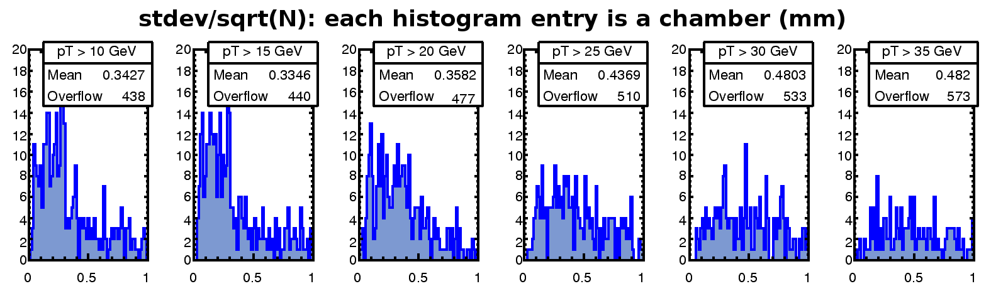
Alignment of the Muon System with the HIP Algorithm in S43
Data-based method to assess alignment quality:
standard deviation of residuals
for each chamber
sqrt(number of hits)
independent of translational misalignments
characterizes tension between large statistics and clean tracks
alignment correction is the mean of residuals, this is estimated error
Optimization of minimum pT:
Same trend observed by comparing aligned positions to true positions

Slide 3
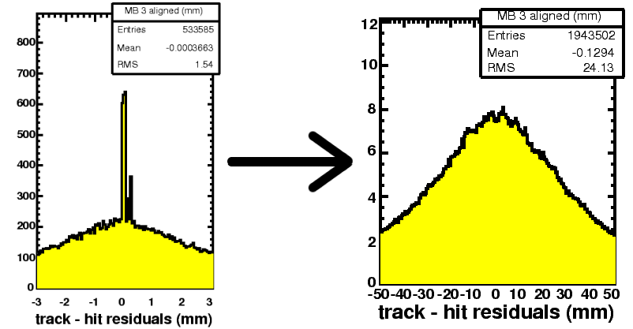
Alignment of the Muon System with the HIP Algorithm in S43
Found and fixed a number of bugs, e.g. corrected residuals distribution ->
Developed better diagnostics
Improved tools, now able to use stdev/sqrt(N) as a criterion for accepting an alignment correction
iCSA08 goals expressed for 10 pb-1 (S156):
few-hundred micron precision on innermost stations

