Slide 1
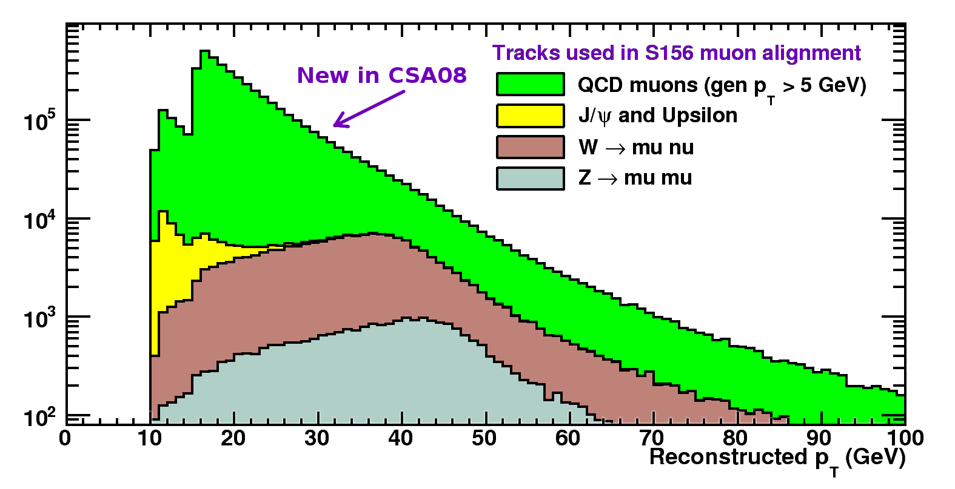
Alignment of the Muon System with the MuonHIP Algorithm
Aligns barrel and endcap chambers to tracker using globalMuons
Basic idea stable for > 1 year, but iCSA08 exercise allowed for new tests and bug-fixes:
optimized for inclusive spectrum (first QCD AlCaRecoMu samples!)
protected against rare pathological tracks (and reported to POG/DPG)
realistic study of effect of tracker alignment on muon alignment
Jim Pivarski
Alexei Safonov
(Texas A&M)

Slide 2
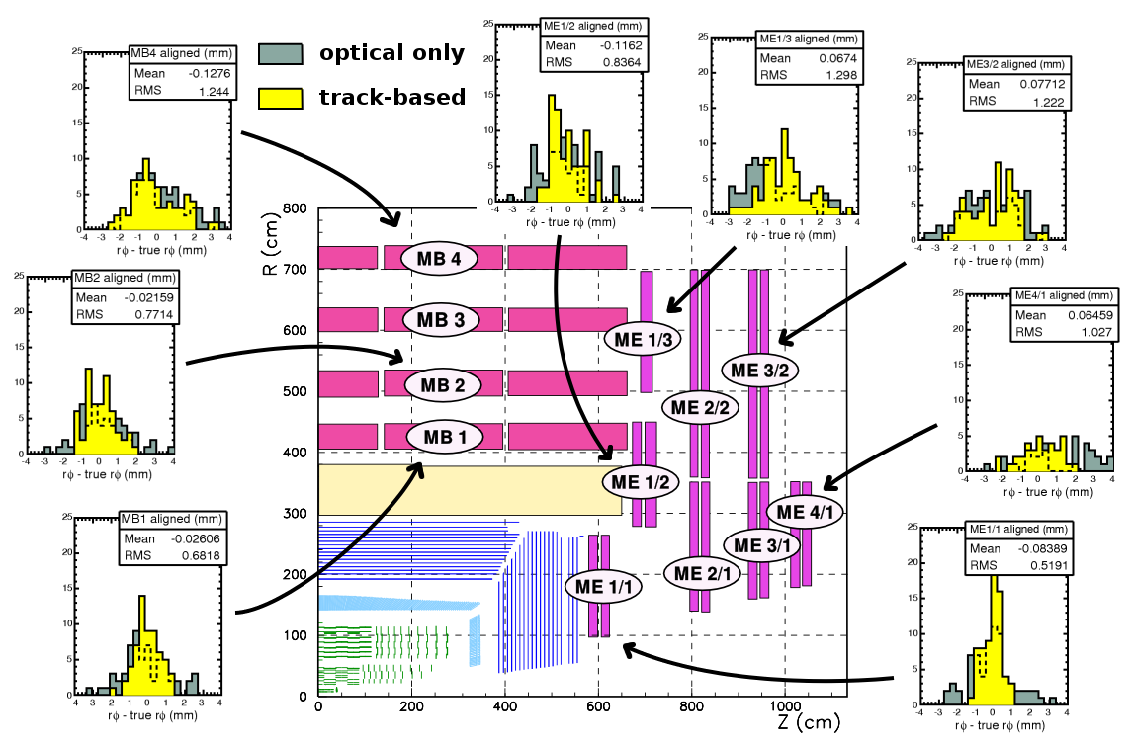
10 pb-1 goal: sub-millimeter resolution in innermost muon stations
Achieved: 680 microns in barrel, 520 in endcap
(scales to 200-300 with 100 pb-1)
Histograms of aligned chamber positions relative to true:

Slide 3
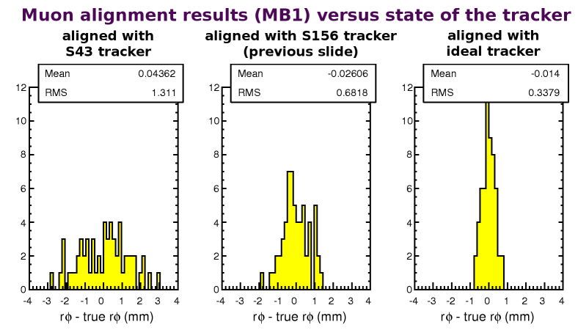
What we learned:
Alignment optimized by a low pT cut (10 GeV), because increased statistics overwhelms broadening of residuals due to multiple scattering
Muon barrel alignment is a strong function of tracker alignment
Effect is understood as sensitivity to tracker's curvature measurement
Scales with tracker-alignment's statistics
Might be able to exploit sensitivity to improve tracker alignment
Modest computing requirements (~2 hours on 17 CPUs)
Easy to coordinate schedule with tracker alignment to produce a combined alignment of the whole CMS tracking system

