Slide 1
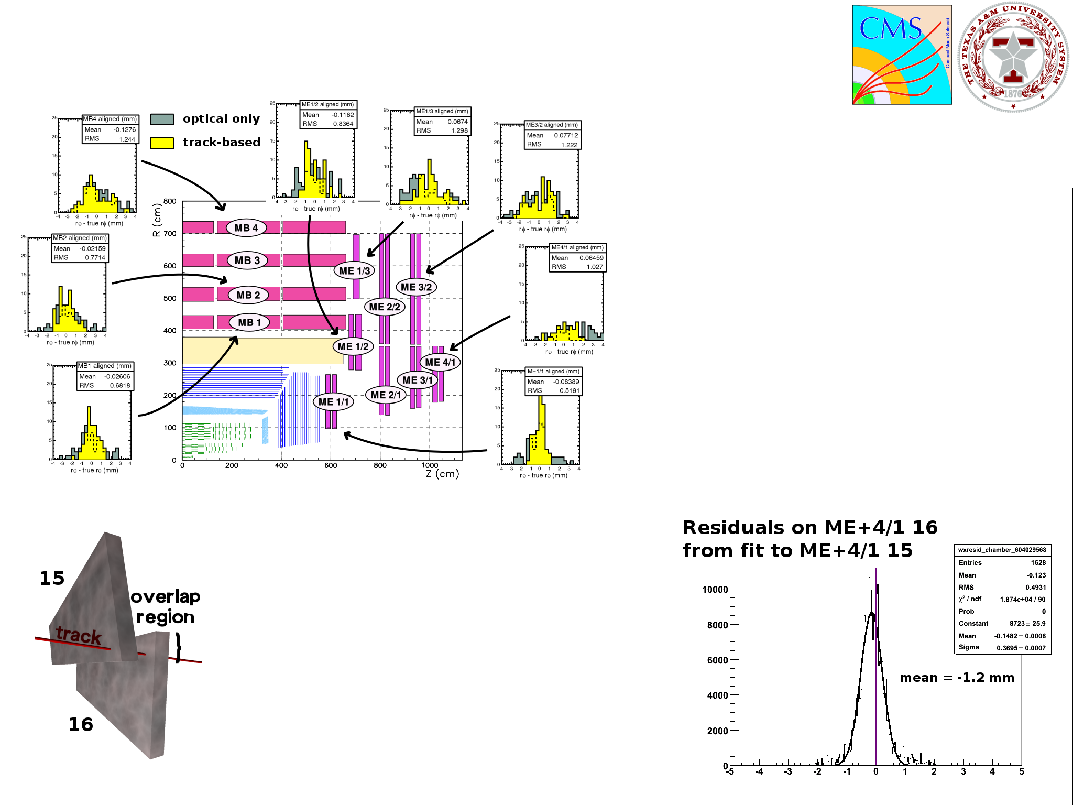
Track-based alignment results from MuonHIP
Jim Pivarski
Alexei Safonov (Texas A&M Univ)
Karoly Banicz (US-CMS)
MC Studies and CSA08
CSA study with a realistic inclusive momentum spectrum
Best resolution on inner stations
Strong dependence on tracker alignment, resolved dependencies in workflow
Moving on to alignment studies with zero-field cosmic rays in preparation for CRUZET-III
CSC Overlap Procedure
Tracks must pass through pairs of CSCs
Independent of tracker
Ongoing study in CRUZET I and II (example CRUZET residuals on right)
Opportunity to compare with optical measurement and photogrammetry

