Slide 1
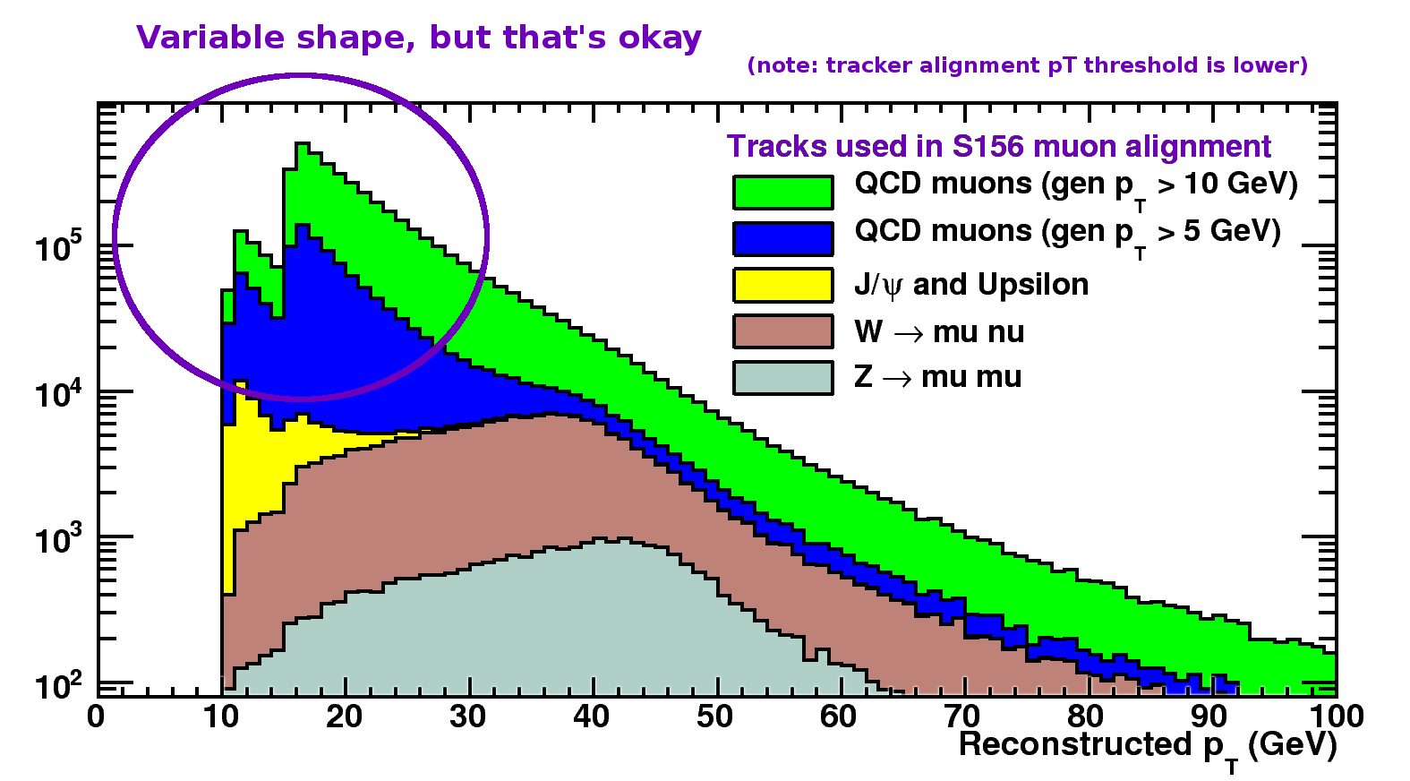
Most important for physics: well-understood threshold, efficiency, luminosity
Most important for track-based alignment: as many high-momentum tracks as the bandwidth will allow
tunable trigger threshold? No, not allowed (far too difficult to implement at L1)
"OR" of all existing thresholds? Good protection against dynamic prescaling of a single trigger
L1 triggers will be dynamically prescaled during a run if rate is too high (too much beam-halo, for example)

Slide 2
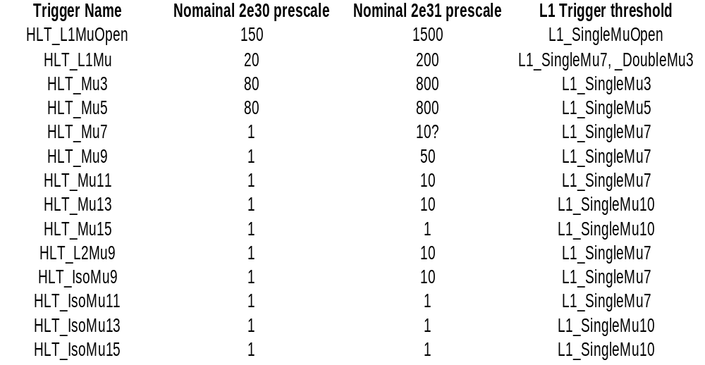
Only the L1 triggers are likely to vary in prescale in response to beam conditions
So our granularity is 3, 5, 7, 10 GeV
Assuming that the highest threshold will always have prescale = 1 and the others will be tuned to yield a constant rate, we'll always have muons above 10 GeV and we'll always have about 20 Hz

Slide 3
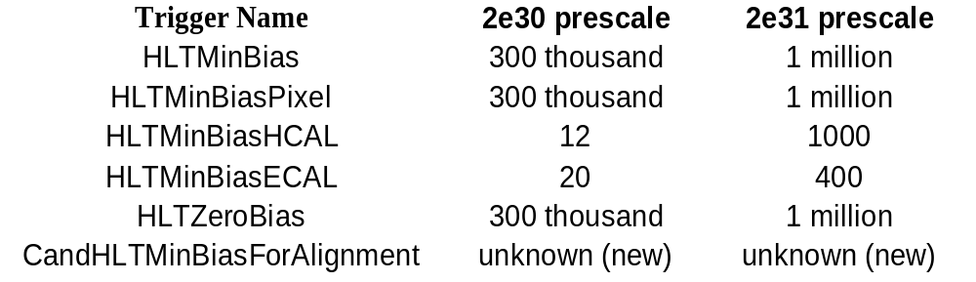
For MinBias, our triggers are:
Rate will be about 150 Hz
AlCa streams that start from "any single muon" trigger: TkAlMuonIsolated, MuAlCalIsolatedMu, MuAlOverlaps
AlCa streams that only want isolated muons: TkAlWMuNu
AlCa streams triggered on MinBias: TkAlMinBias (and MuCaliMinBias?)
Other AlCa streams select dimuon events for a mass constraint (e.g. J/psi, Upsilon, Z) and should use the relevant dimuon triggers, just like physics analyses.

