Slide 1

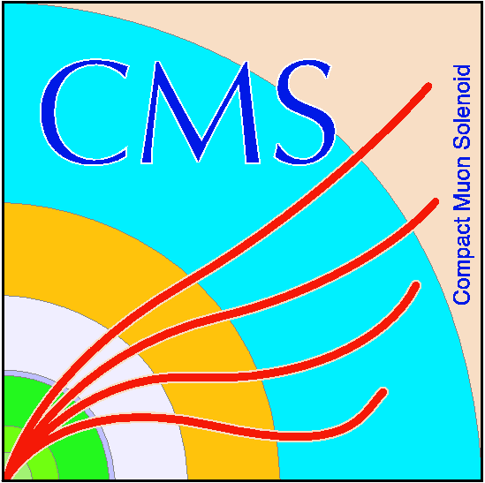
MuonHIP Alignment Plans for CRUZET-III
Alexei Safonov
Jim Pivarski
Texas A&M Univeristy
Karoly Banicz
US-CMS

Slide 2
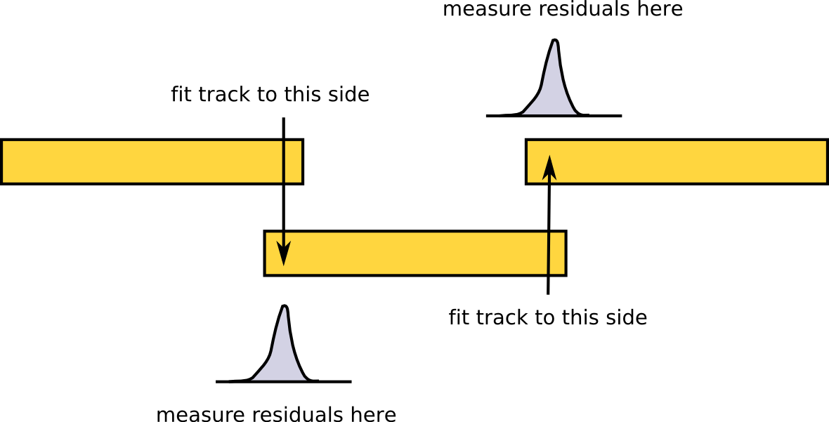
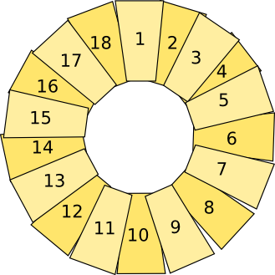
CSC Overlaps procedure
Goal: align endcap rings using overlap of neighboring CSC chambers
Studying convergence properties in CSA08 beam-halo MC
Found an important issue: if residuals from left-side and right-side are combined, fit only minimizes their mean (allowing ring to globally stretch)
Solution: align with residuals from one side only

Slide 3
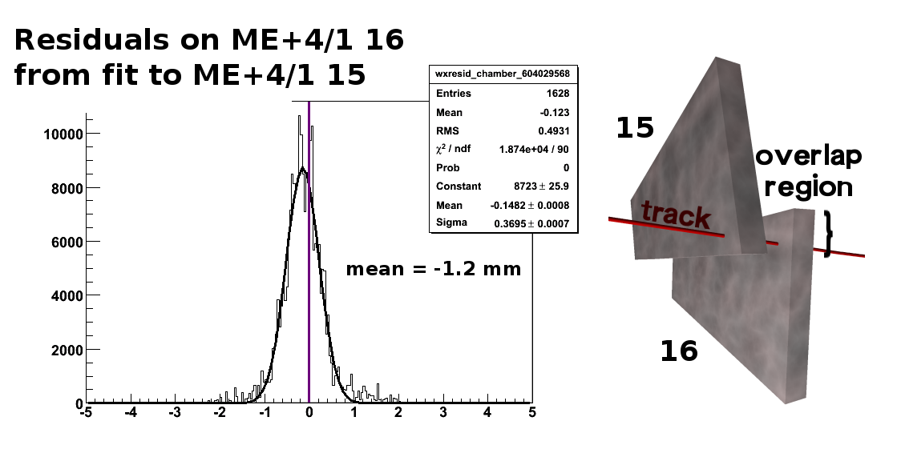
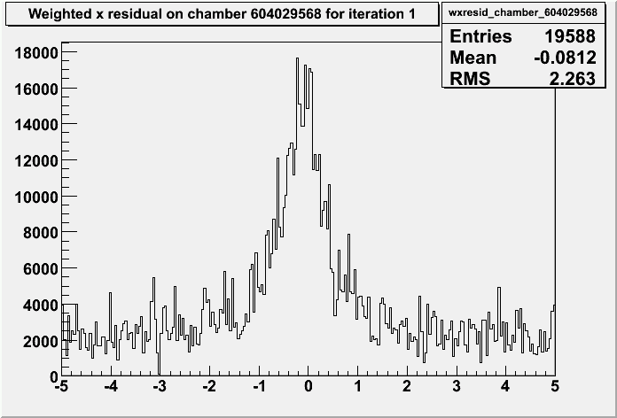
Overlaps in CRUZET-I and CRUZET-II
Constructed one-sided residuals, cleaned up backgrounds, working on understanding width
Can do alignment studies in real data before finishing full-ring convergence studies:
propagate measurement around ring: does it close (within error)?
are these residuals closer to zero with survey geometry than with ideal geometry?

Slide 4
Plans for CRUZET-III
Since the tracker will be available, we'll also be able to apply the MuonHIP algorithm (used in CSA08, aligns chambers to tracker)
Preparing with zero-field cosmics from CSA08 TkCosmicBOFF
Discovering (and reporting) tracking errors in B=0
Tracker-standalone matching inefficiency related to hard-coded B=4T in Runga-Kutta propagator (fixed in 2_0_9 and 2_1_0)
Muon hits dropped in refit: study in progress
Using robust linear fits to diagnose full tracking (and will continue to do so with real data)
AlCa stream in 2_1_0: ALCARECOMuAlZeroFieldGlobalCosmics

Slide 5
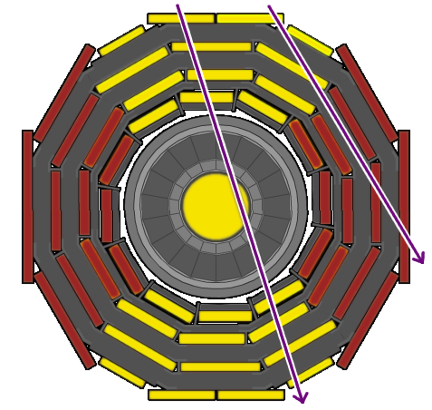
Coordination with other AlCa groups
MuonHIP depends on tracker alignment and muon calibration
(Useful to start work with a provisional tracker alignment/muon calibration, as we did in CSA)
Opportunity to collaborate with StandAloneMillePede group:
Only some chambers can be connected to the tracker through cosmics
Apply MuonHIP to these
Fix these as "tight survey constraint" in StandAloneMillePede, align others
Workflow becomes:
tracker align
MuonHIP
StandAlone II
muon calib
StandAlone
(independent)

Slide 6
Summary
CSC Overlaps procedure for all CRUZET datasets
MuonHIP for datasets with tracker (CRUZET-III+)
A lot of diagnostic work: B=0 is a relatively new case and we require high-efficiency, high-quality tracks
Workflows with dependencies, like CSA
May be able to combine MuonHIP and StandAlone to reach all chambers

