Slide 1
Misalignment Results from Zprime2MuAnalysis
Jim Pivarski
Jordan Tucker

Slide 2
Alignment studies in common framework
Added new functions to Zprime2MuAnalysis to apply misalignment
Allows us to revist misalignment studies with
  standard cuts
  standard dimuon mass reco (with brem photons)‏
  treatment of widths (RMS? sigma? restricted Gaussian fit? sigma.)‏
  new track reconstruction (CMSSW_2_0_9)‏
  quantify effect on TeV muon reconstructors (also in common framework)‏
What has changed since my last presentation on misalignment?
  (now using Zprime2MuResolution, for starters)‏
  startup and 10 pb-1 Estimated Scenarios were made more realistic
  CSA08 exercise: much more realistic tracker and muon alignment studies (alignment workflows coupled, inclusive muon spectrum, ...)‏
  improvements in muon alignment procedure (details in DPG)‏
  only 10 pb-1, no 100 pb-1 study (insufficient MC)‏

Slide 3
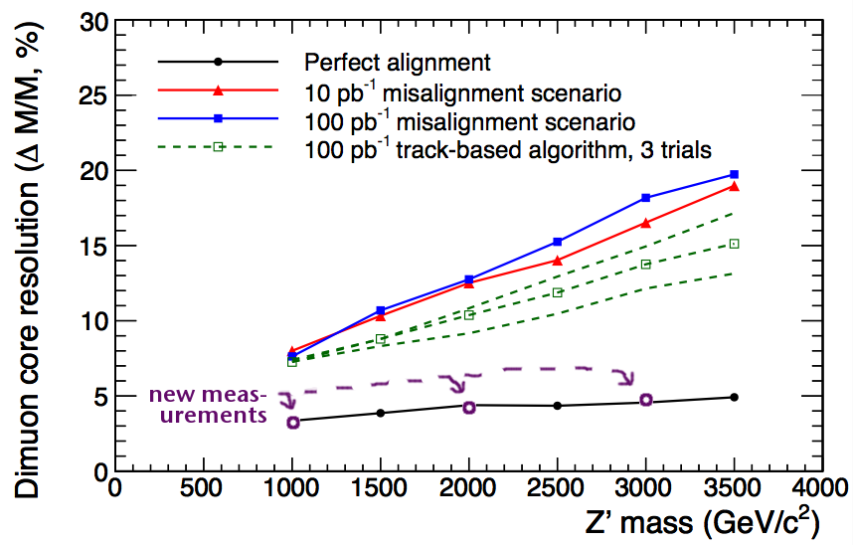
First: connect new study to old
Only new result expected to be the same as old: ideal geometry
  Verifies that difference in cuts, muon reco, etc. are not too significant
Old plot with new ideal values overlaid:

Slide 4
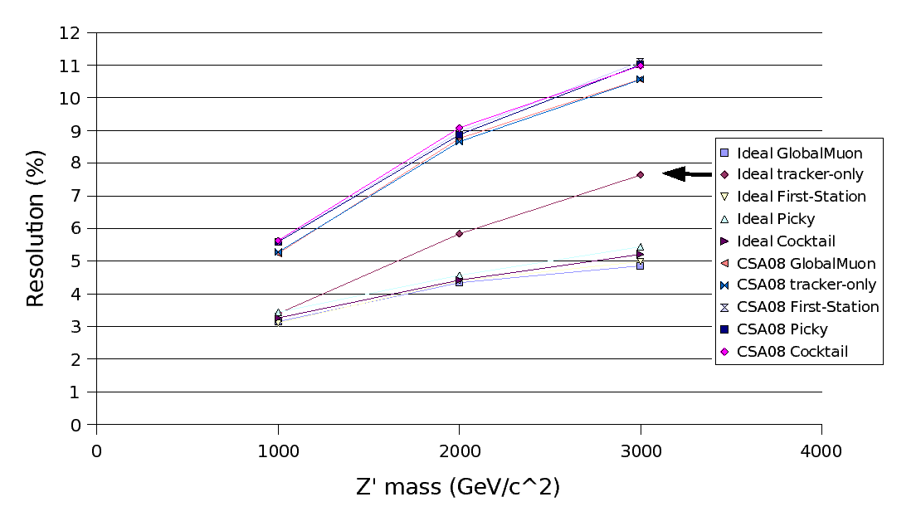
New dimuon resolution results
  Not much difference between the TeV reconstructors (this is gross width, not shape of tails)‏
  Benefit of adding muon system clear in ideal case, not in misaligned
  New 10 pb-1 alignment about 30% bettter than old 100 pb-1 (expected)‏

Slide 5
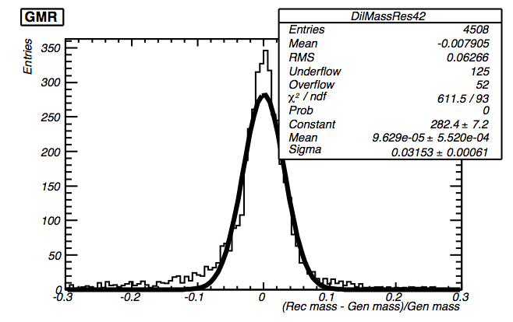
Typical dimuon resolution histogram
  Simple Gaussian fit with no restricted window is not an ideal representation of the width (missing photons in mass reco?)‏
  All histograms had this basic shape, with broadest distributions being the most Gaussian
  Low-resolution widths are overestimated (relative to a "core width")‏

Slide 6
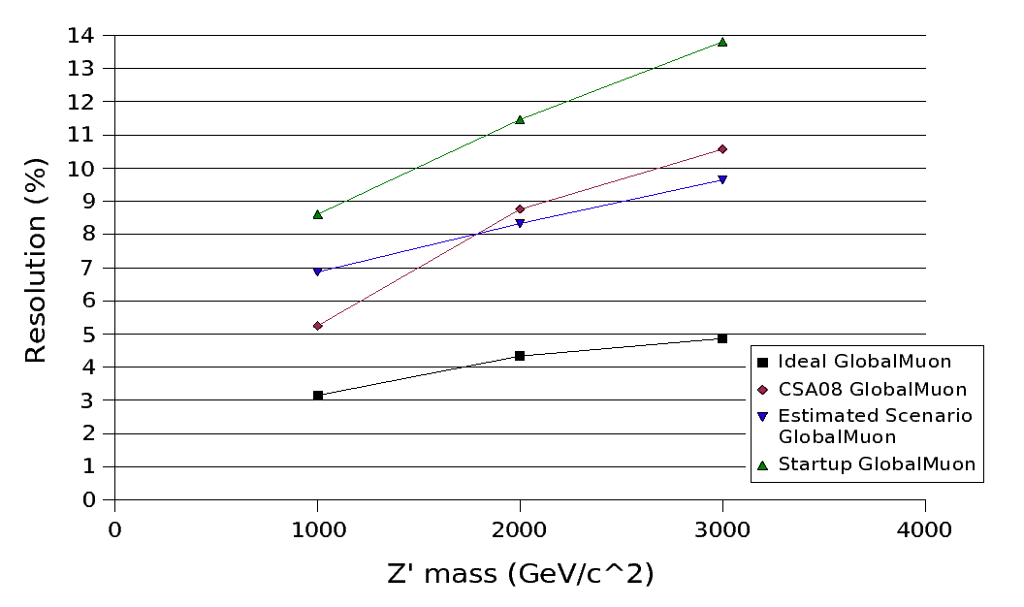
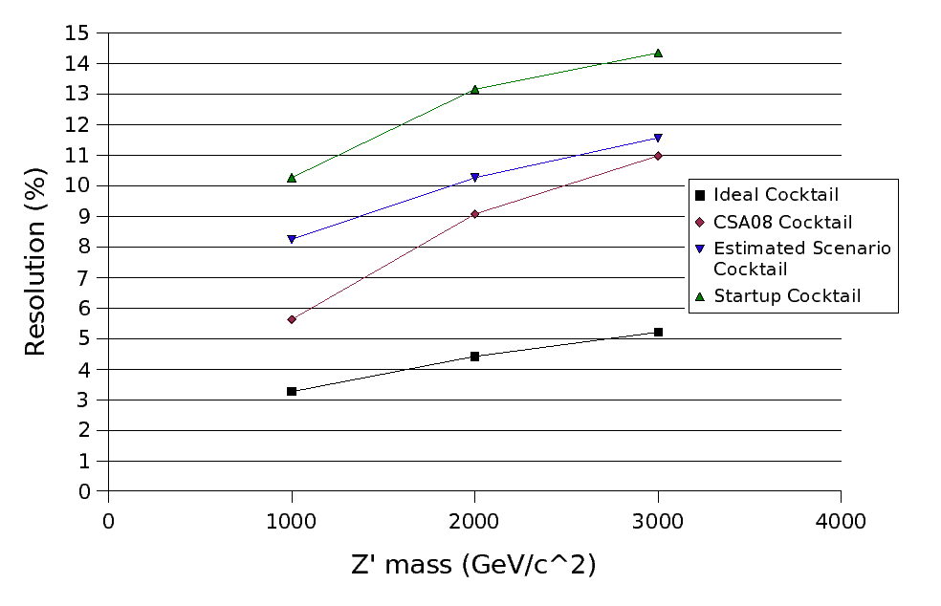
Closer look at GlobalMuon vs. TeV-reco
GlobalMuon curves
Cocktail curves
  stand-in for all TeV reconstructors (they're nearly the same as one another)‏
  No huge difference between GlobalMuon and Cocktail
  Muon Estimated Scenario is about right (intended to represent state of alignment after 10 pb-1: rough agreement with CSA08 result)‏
  10 pb-1 is a clear improvement over startup (survey-only)‏

Slide 7
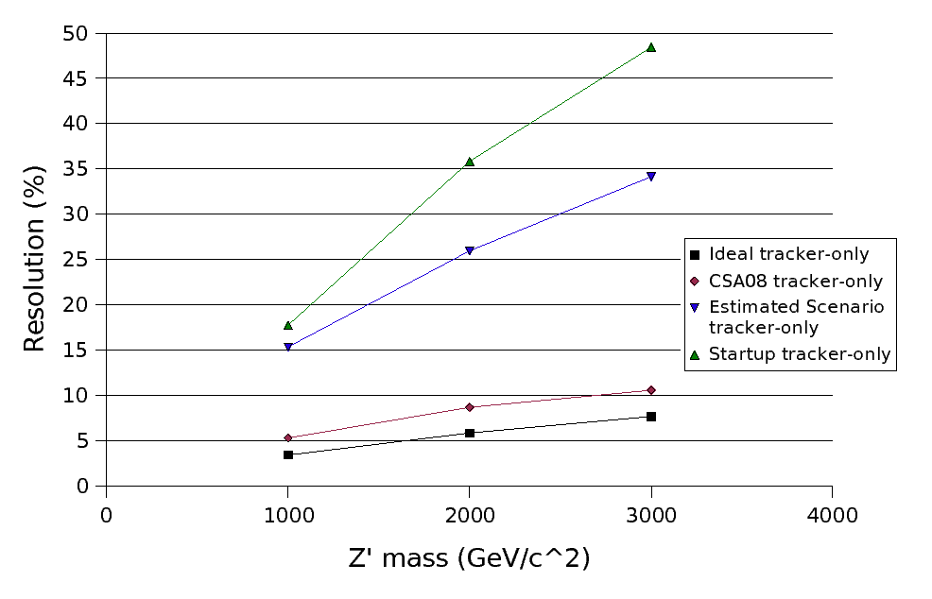
Closer look at tracker-only
Reveals a huge difference between tracker Estimated Scenario and CSA08 tracker alignment
  High quality of alignment from MinBias was a surprise to tracker alignment community

Slide 8
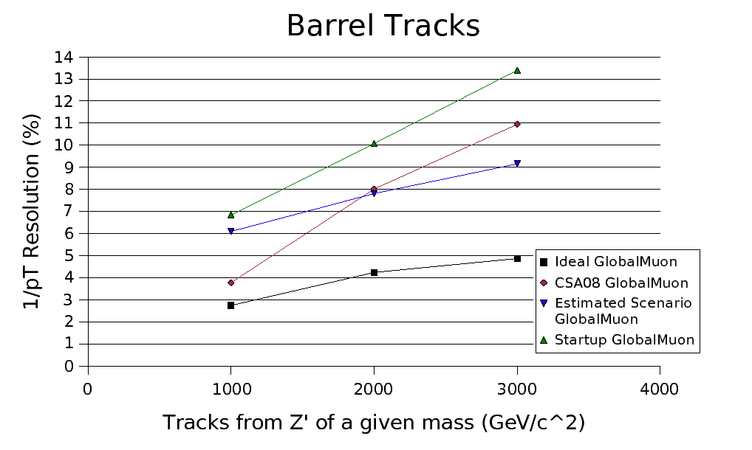
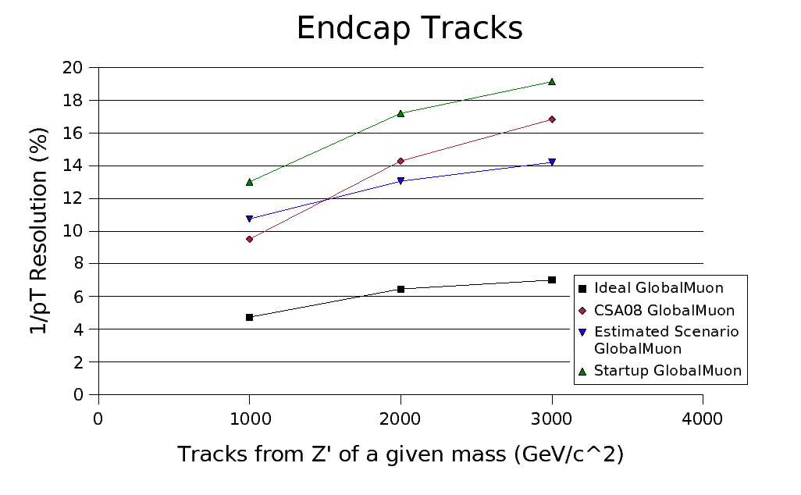
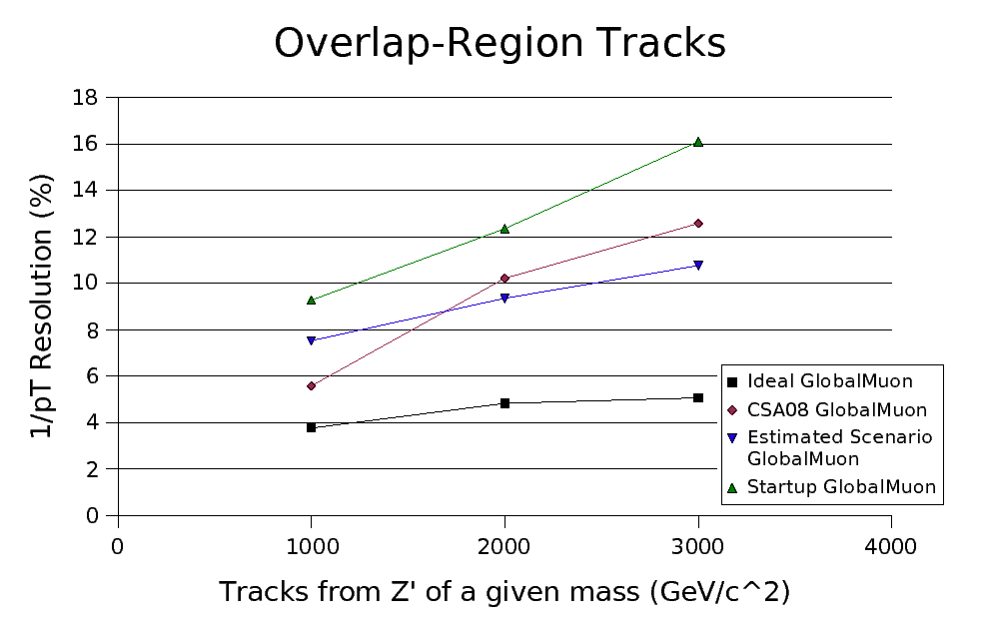
1/pT resolution of individual tracks
Mostly the same story, though curvature is best determined at low eta

Slide 9
Conclusions
  Functions to study misalignment are now a standard part of Zprime2muAnalysis
  We see the muon alignment improvements we were expecting relative to 2007 analysis note
  Tracker Estimated Scenario is not representative of the alignment that was achieved
  There are a lot more plots in the package, including charge misassignment
  I'll be using Zprime2muResolution for a more general study of effect of resolution on low momentum muons (e.g. at Z mass)‏
  Thanks, Jordan!

