Slide 1
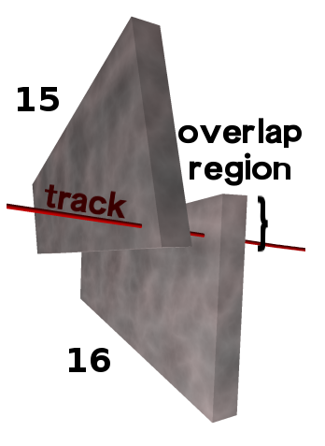
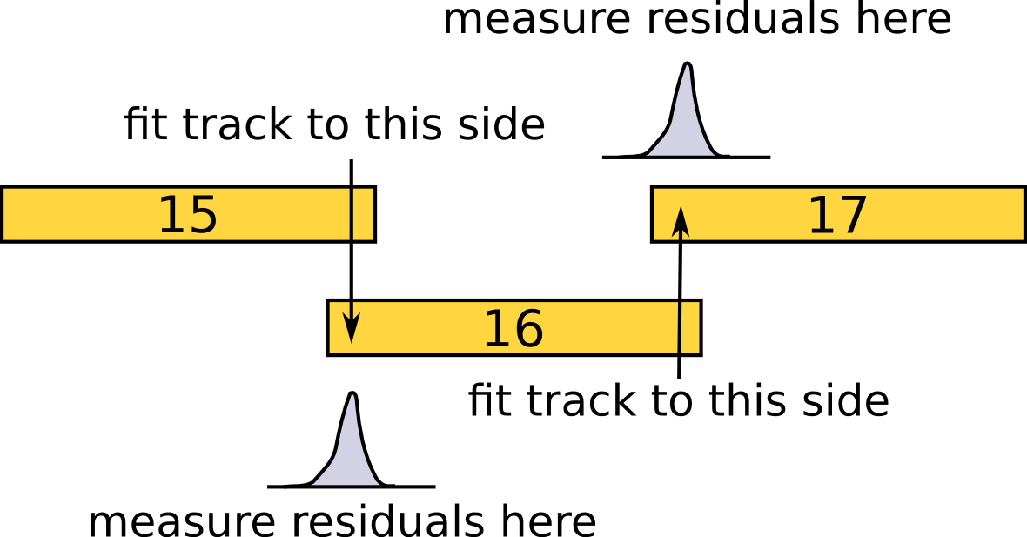
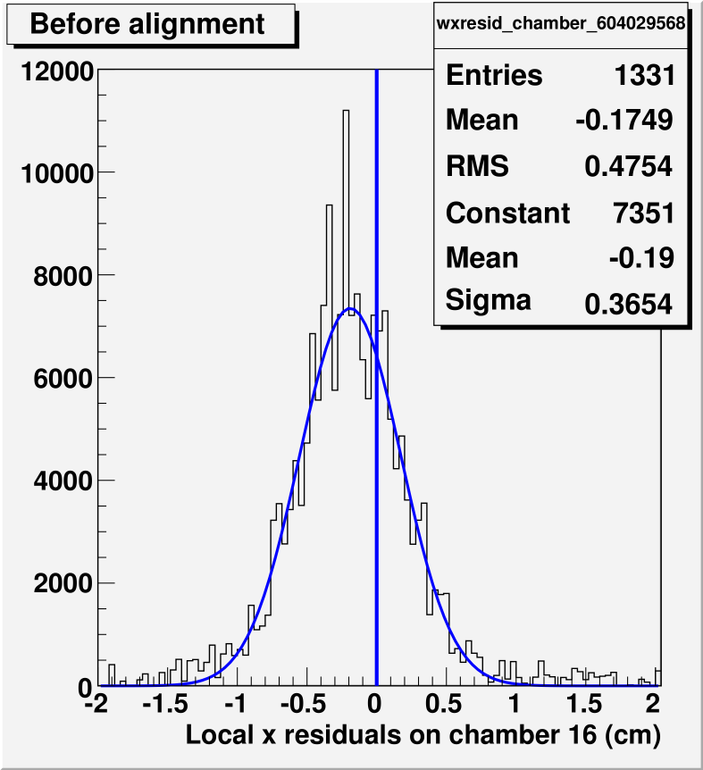
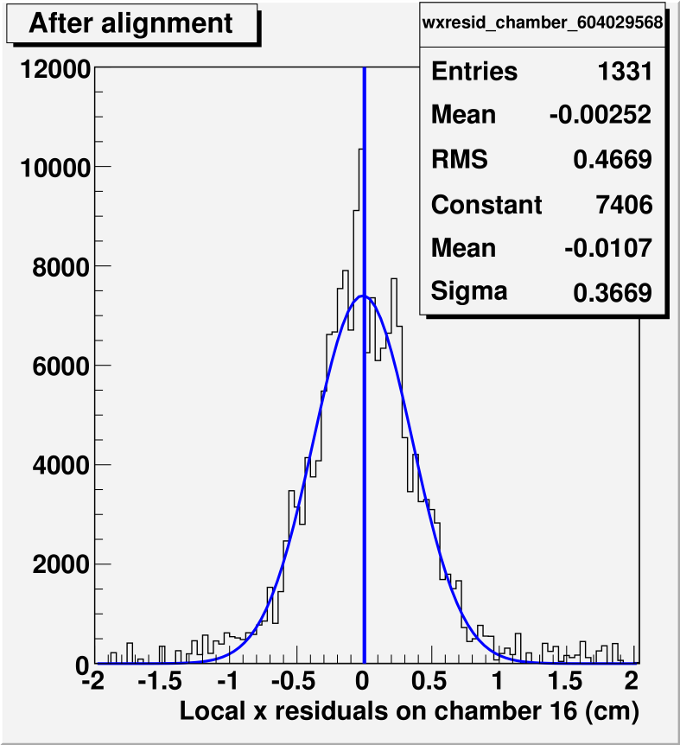
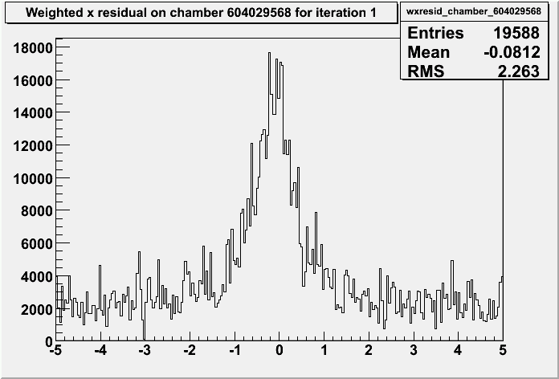
Method:
identify tracks passing through pairs of CSC chambers
fit track to hits in one chamber (15) and measure residuals in another (16)
align chamber (16) to minimize mean of residuals distribution
reverse direction of fit (e.g. 16 to 15)
Real alignment in CRUZET data
Guidance from beam-halo MC
Status: we can minimize residuals, determining whether this is a true alignment
These are all plots residuals on ME+4/1 chamber 16 from fits to chamber 15 in CRUZET:
First look, before cuts to distinguish
real 2-segment matches from fakes

