Slide 1
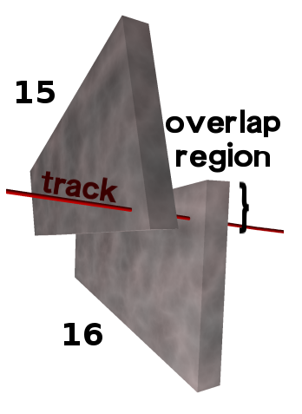
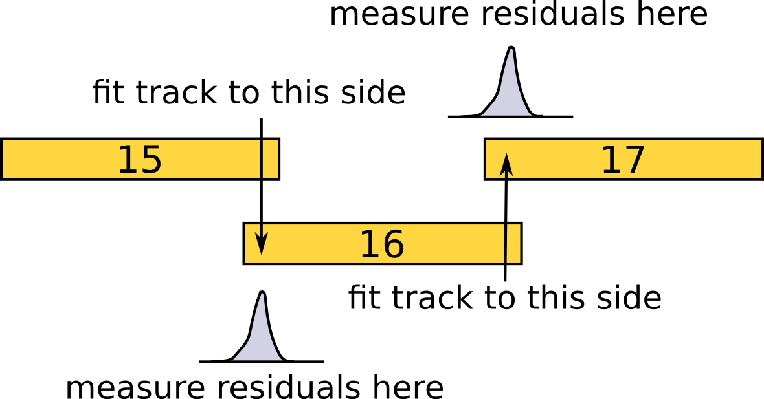
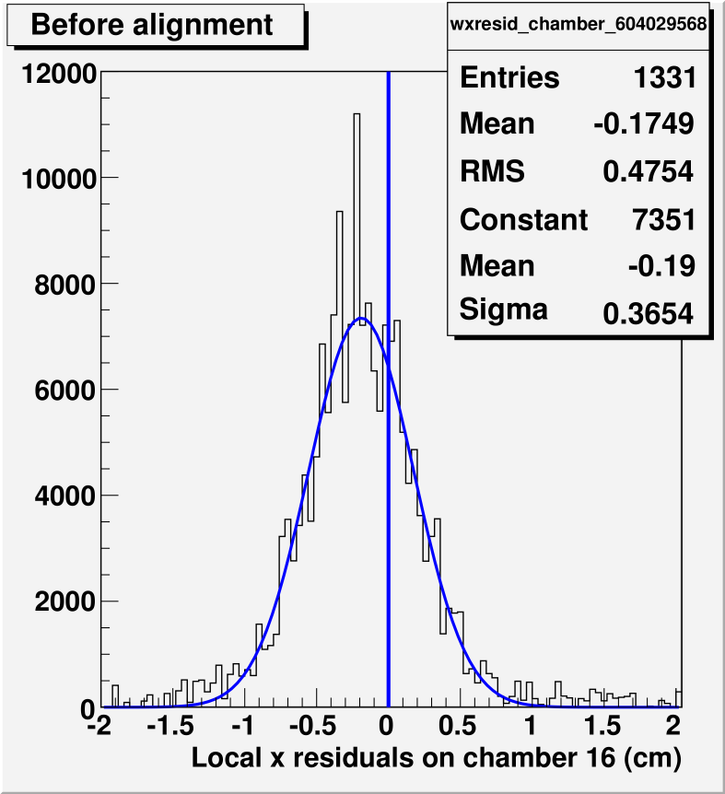
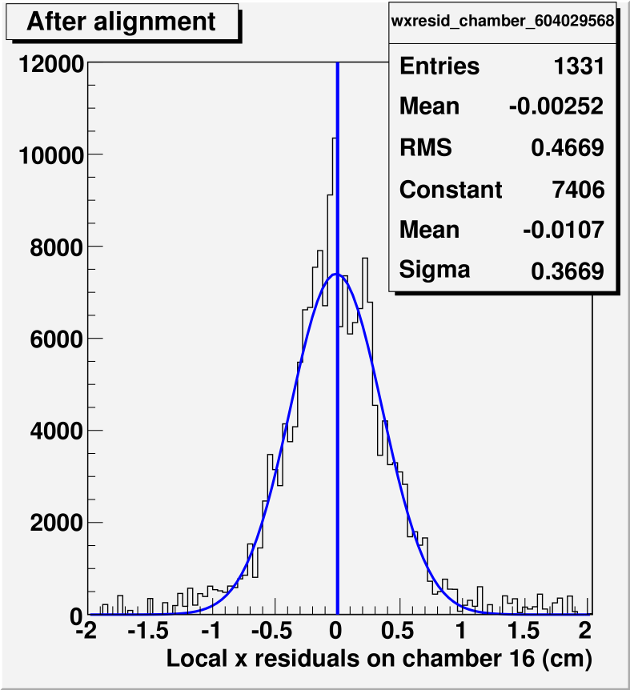
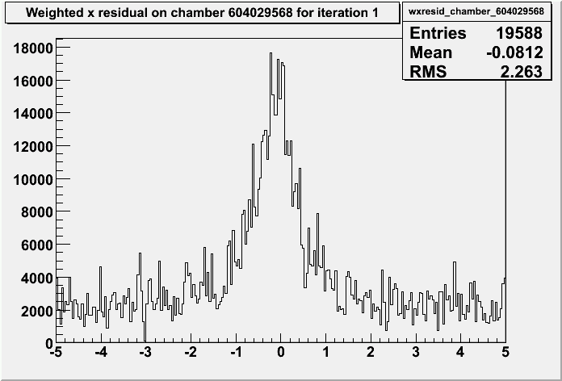
Method:
identify tracks passing through pairs of CSC chambers
fit track to hits in one chamber (15) and measure residuals in another (16)‏
align chamber (16) to minimize mean of residuals distribution
reverse direction of fit (e.g. 16 to 15)‏
Real alignment in CRUZET data
Guidance from beam-halo MC
Status: we can minimize residuals, determining whether this is a true alignment
These are all plots residuals on ME+4/1 chamber 16 from fits to chamber 15 in CRUZET:
First look, before cuts to distinguish
real 2-segment matches from fakes

