Slide 1
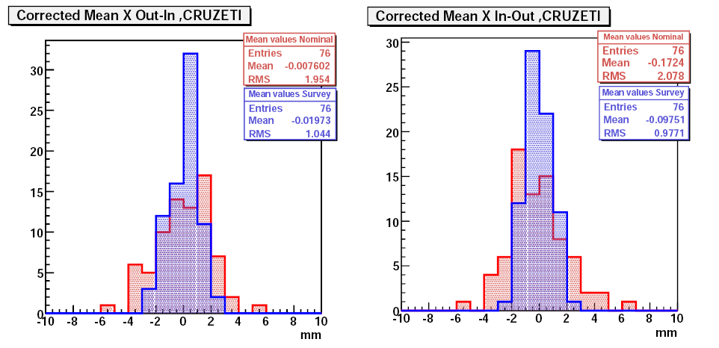
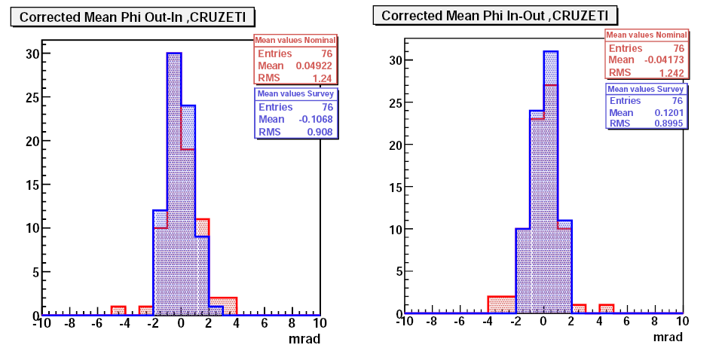
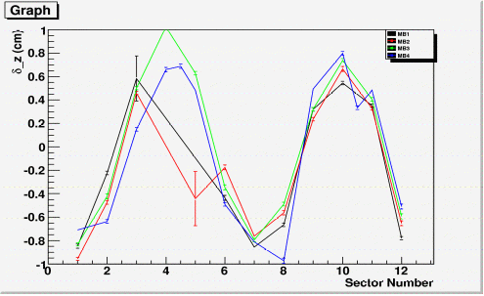
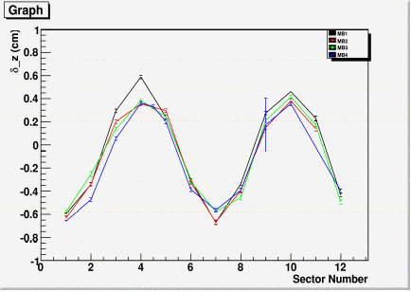
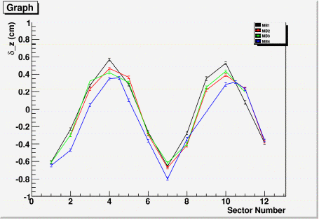
DT Muon Alignment
P. Martínez, F. Matorras (IFCA), A. Calderón (INFN)‏
Local X displacement
Three levels of alignment:
  Included in the current DB's
    Internal geometry of chambers
    Chambers inside the wheels
  Being validated
    Wheel-To-Wheel alignment (next page)‏
Non-Corrected
Corrected
Rotation w.r.t. Local y axis
Shape of the misalignment
From 2 mm to 1 mm improvement
Wheel 0
Wheel 1
Wheel 2
The correlation of local delta_Z with sector number indicates a gravitational sag

Slide 2
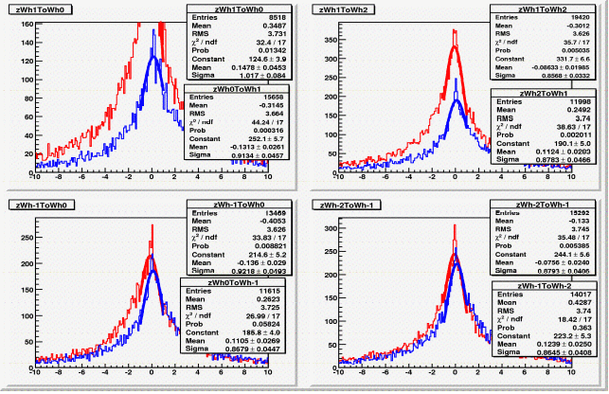
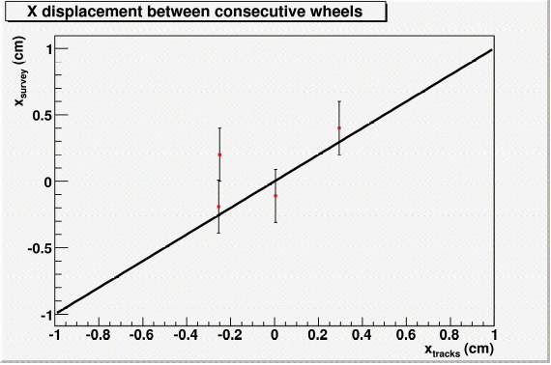
DT Muon Alignment
P. Martínez, F. Matorras (IFCA), A. Calderón (INFN)‏
Wheel to wheel alignment:
  Geometry produced using Survey measurements
  Geometry produced using only tracks
Comparison with survey: agreement within the errors except for YB-2 (under investigation)‏
Calculation of relative Z displacement between consecutive wheels Wn to Wn+1 and Wn+1 to Wn. Agreement to the 400 microns level.
Repeating wheel to wheel aligment with B field
Software status:
  The Millepede-like algorithm (MuonStandaloneAlgorithm package) is being ported to the common alignment framework
  Classes integrated in the common framework has been created to deal with 4DSegments: Derivatives, AlignmentParameters
  Final step (to do): rewrite the algorithm using these new tools

