Slide 1
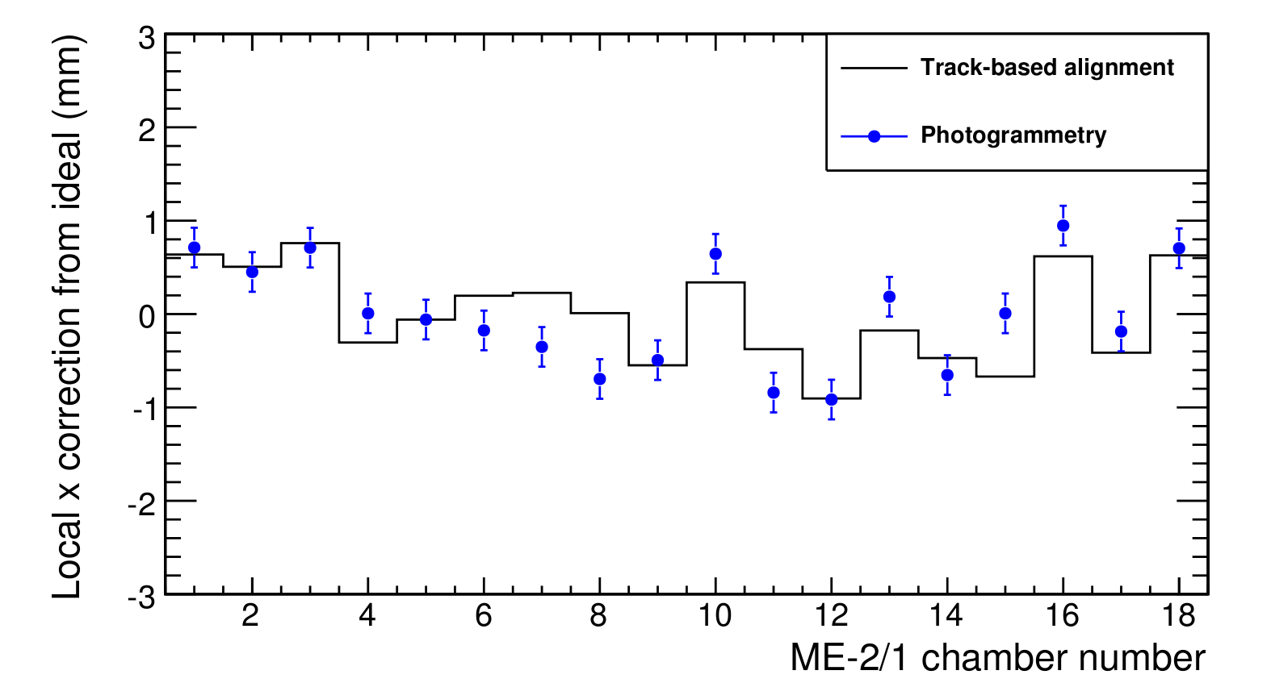
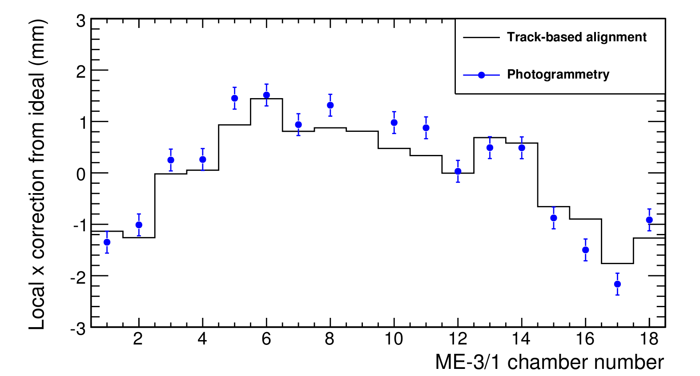
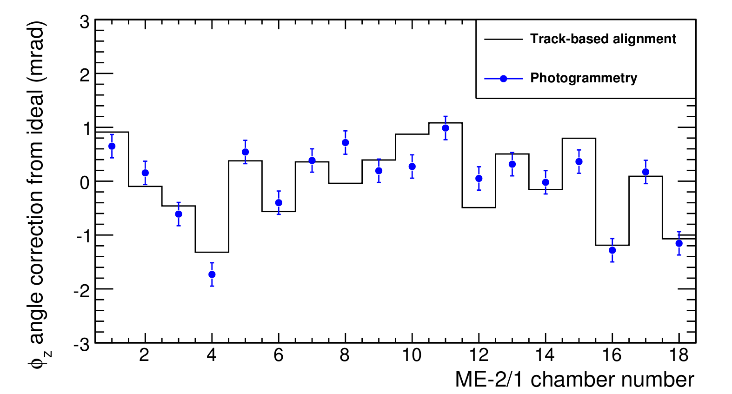
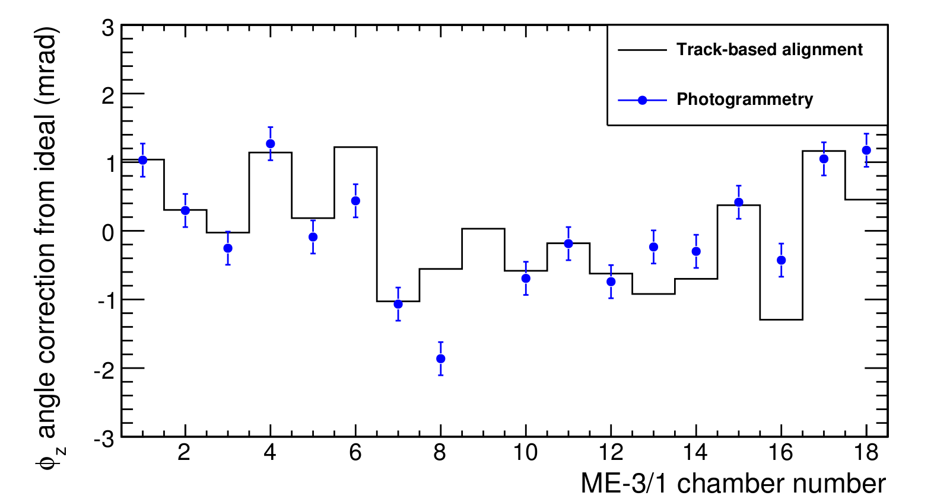
Overlay of track-based alignment results (histogram) and photogrammetry alignment results (blue points) for each chamber, relative to ideal positions
ME-2/1 (left) and ME-3/1 (right) included in test
rphi translational corrections (top) and phiz rotational corrections (bottom)‏
Beam-halo run 62232, no magnetic field

Slide 2
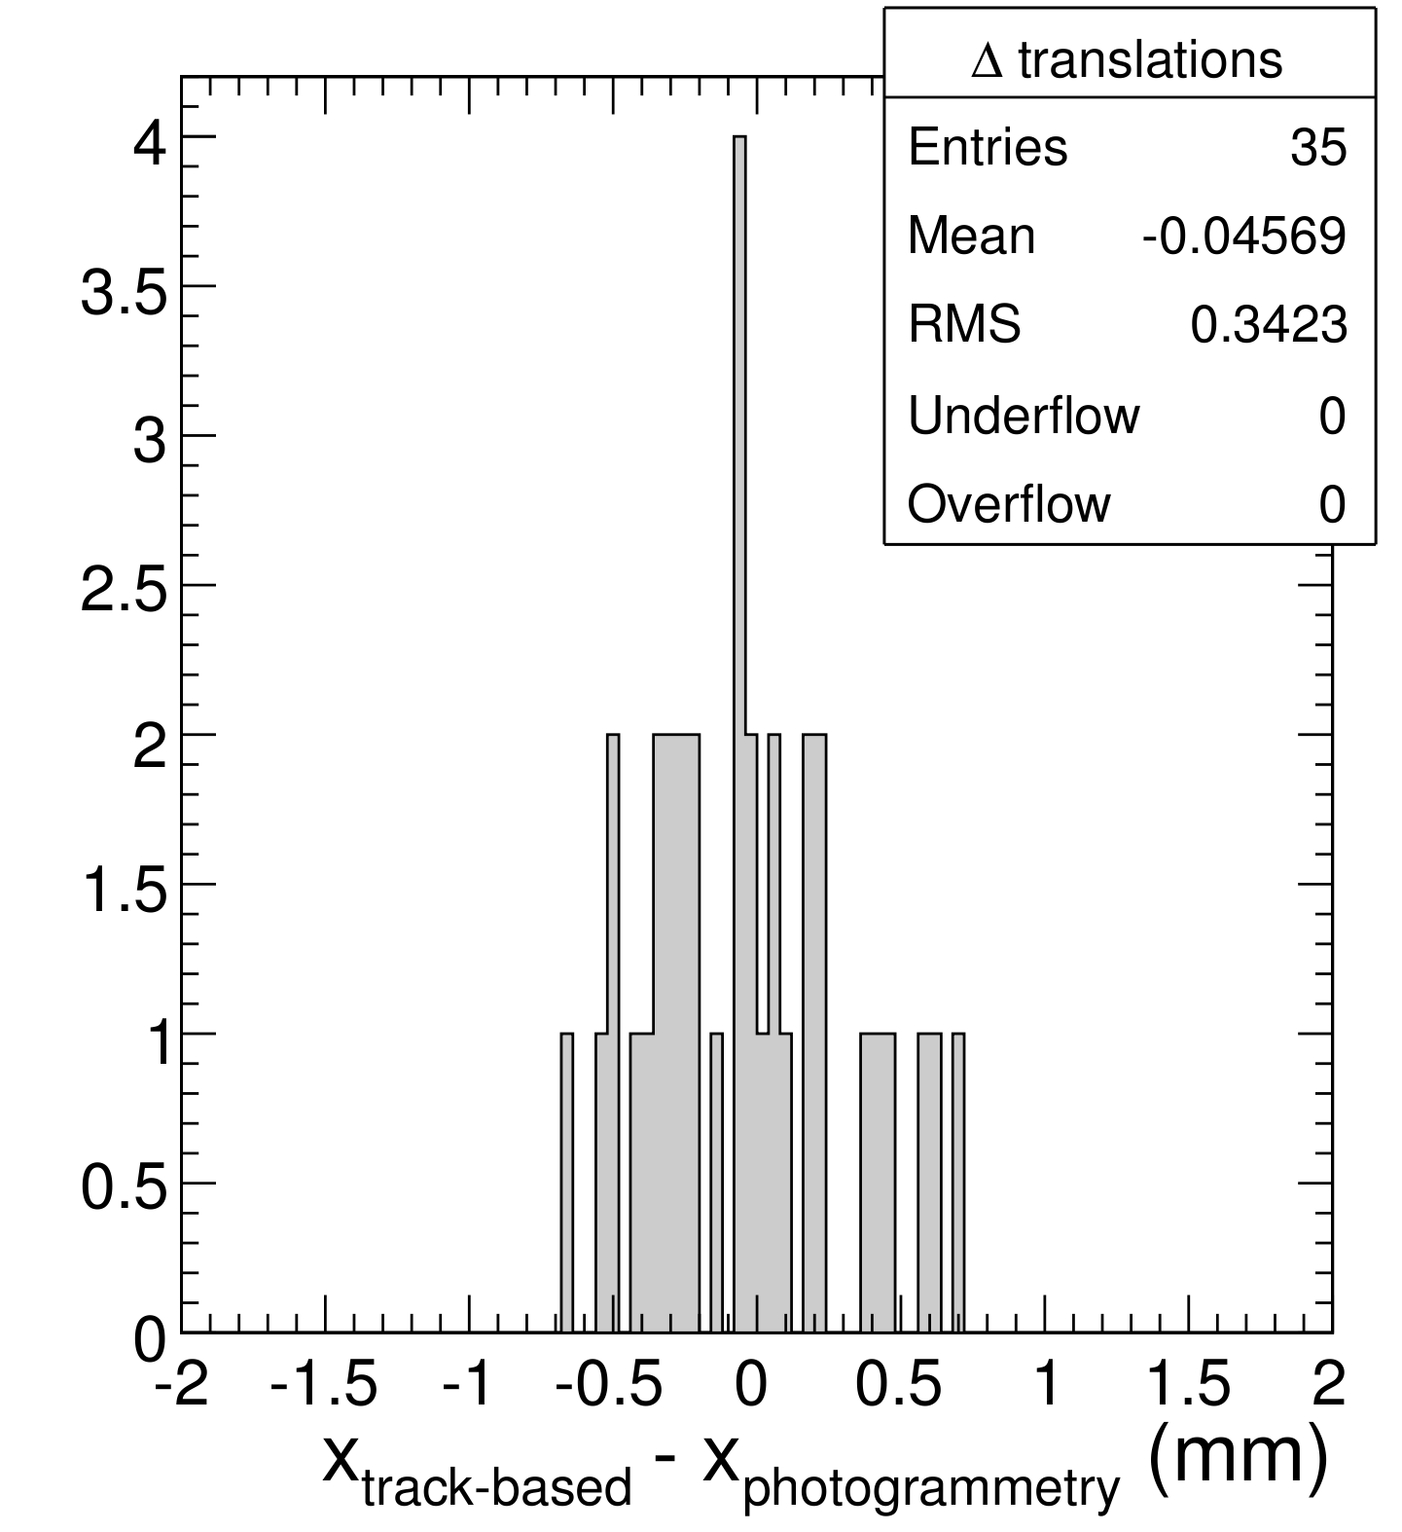
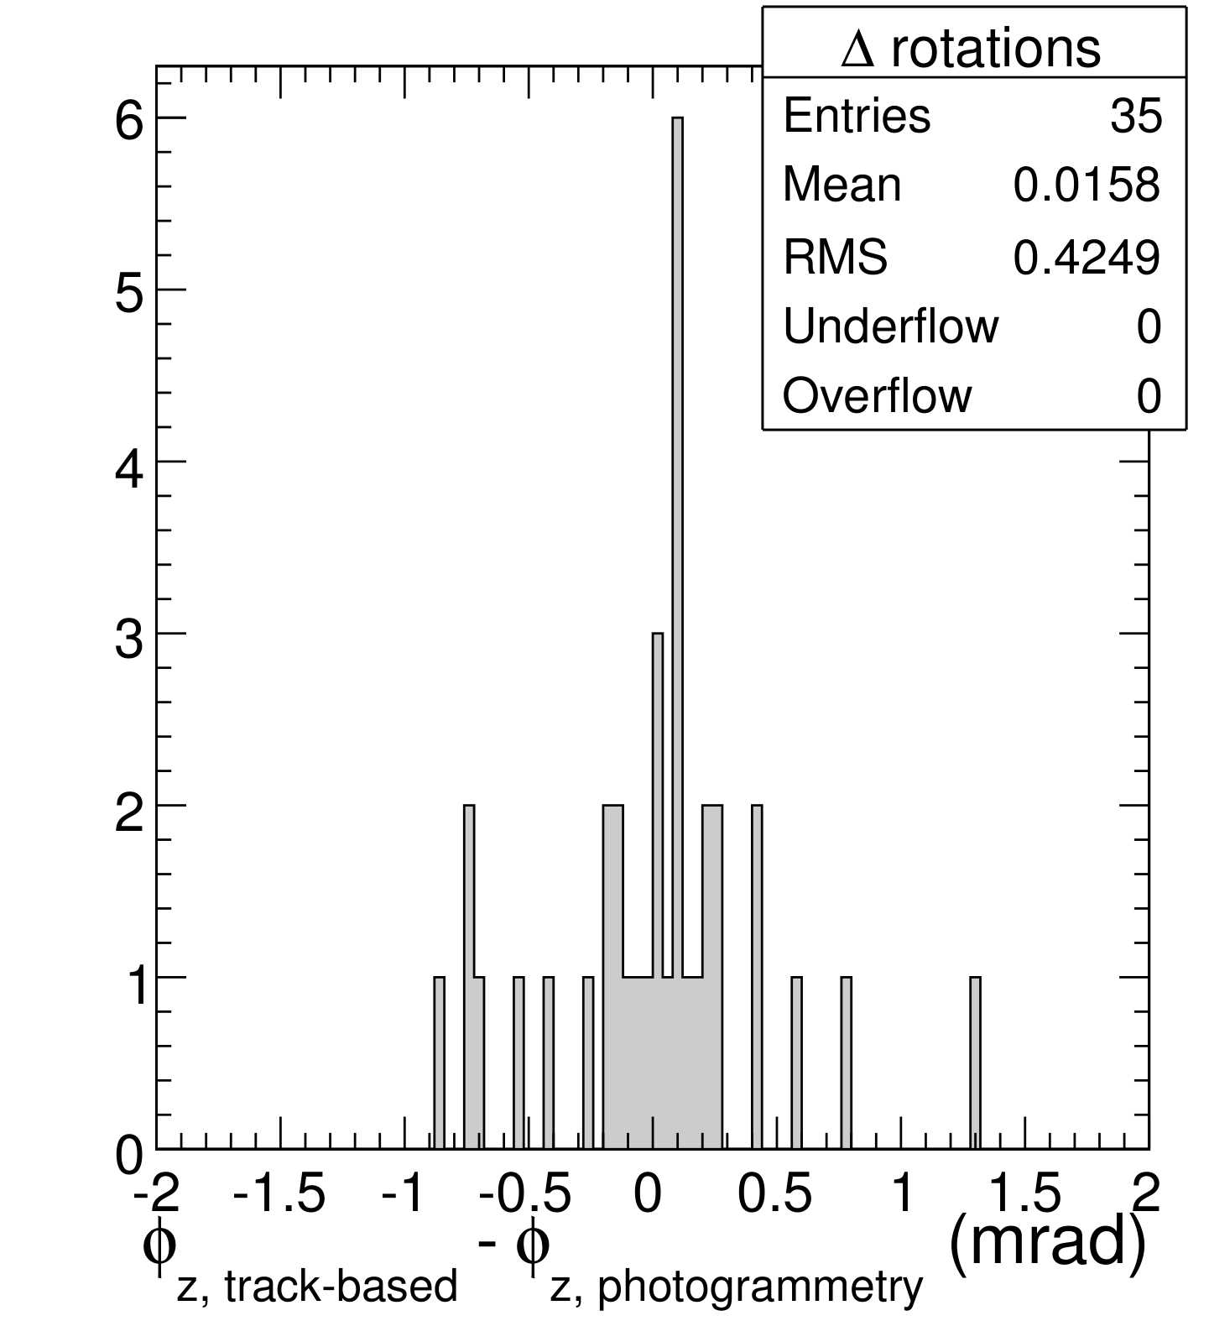
Summary of comparisons:
RMS difference between track-based and photogrammetry: 340 microns, 0.42 mrad
PG uncertainty is 210 microns, sqrt(340^2 – 210^2) = 270 micron uncertainty in track-based
Achieved resolution goals
However, ring self-consistency condition (“closure”) is not satisfied: currently under investigation in the CSC DPG

Slide 3
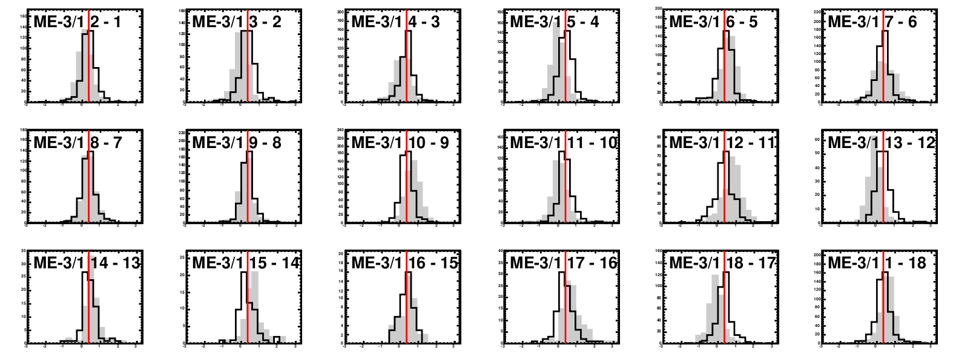
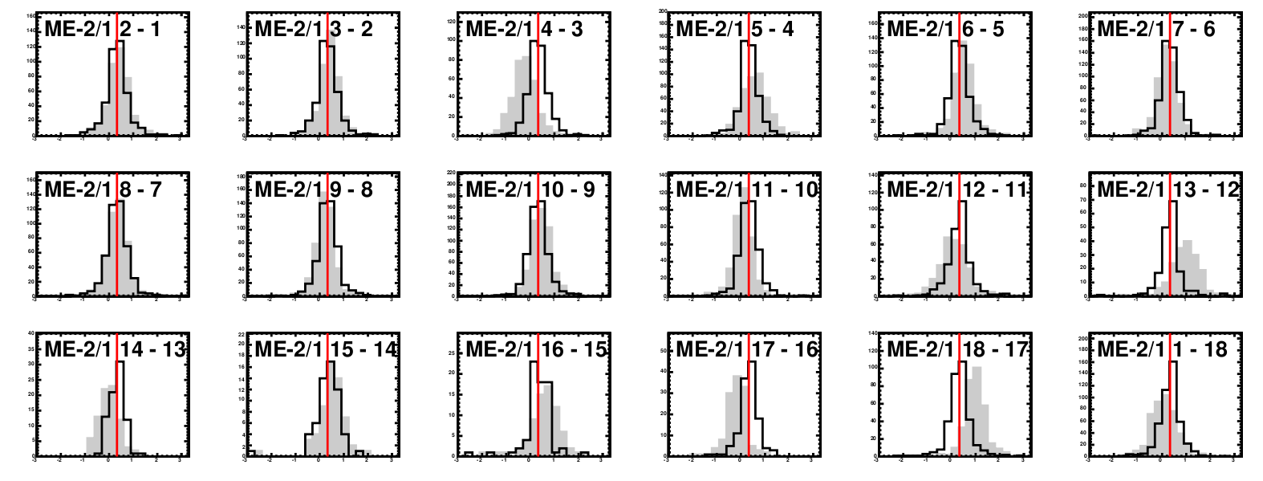
Backup, if anything: residuals distributions are well-understood.
Only mystery is that they cannot all be zeroed simultaneously (the closure error is distributed uniformly). Hollow is aligned, grey is before alignment, and red line is the common mean.

