Slide 1
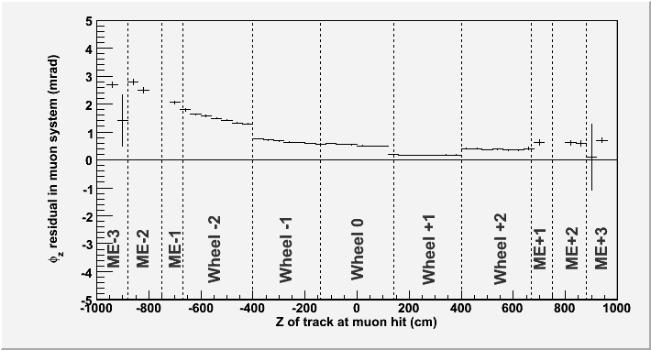
Alignment with globalMuon tracks
Jim Pivarski
Alexei Safonov
Texas A&M University
Produced an alignment of the muon system relative to the tracker on-time for CRAFT re-processing
But results contained some strange features that need to be studied more thoroughly
Subdividing the huge dataset to diagnose...
Discontinuities at wheel boundaries reveal true misalignment
Variation within wheel reveals an external source of bias
internal tracker misalignments
propagation/refitting systematics?
work in progress!

Slide 2
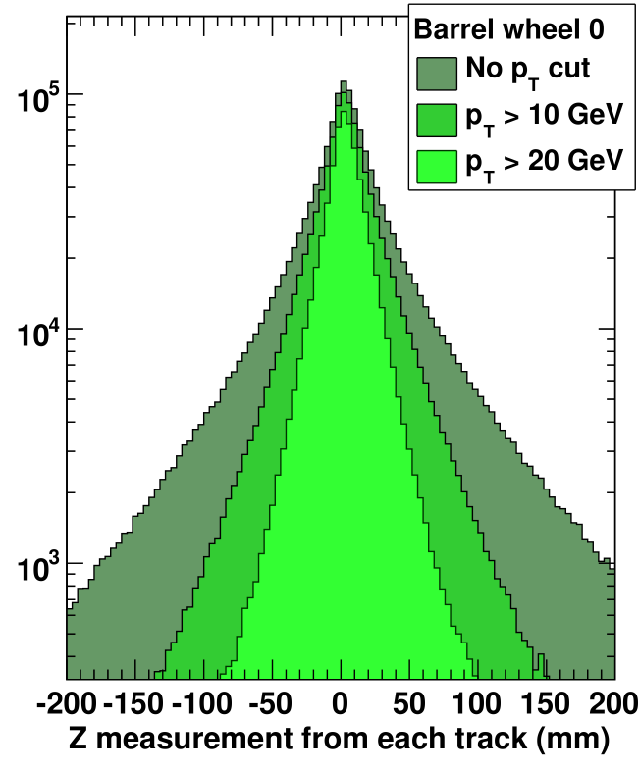
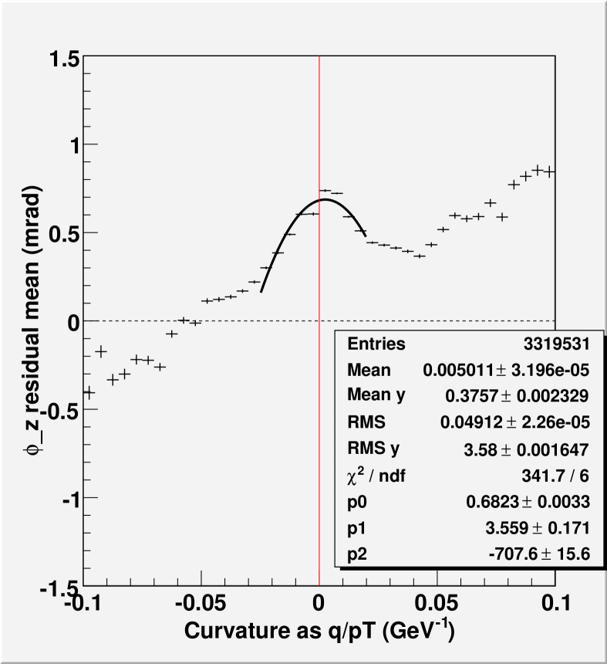
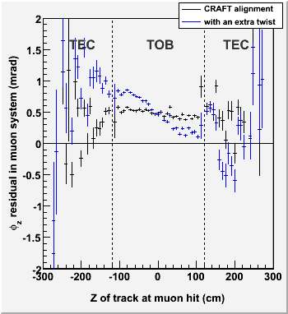
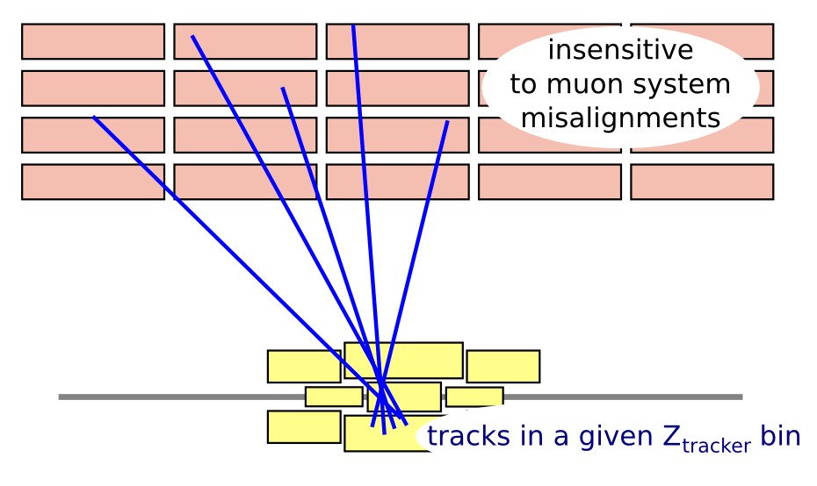
Interplay between muon alignment and other commissioning issues
CMS magnetic field:
allows us to select high-momentum muons, eliminating tails in residuals
can optimize alignment by extrapolating to infinite momentum
(q/pT = 0 in plot at right)‏
linear term in extrapolation yields information about scale of magnetic field (at the level of 0.005 Tesla)‏
Tracker alignment:
binning muon residuals by the track's position in the tracker, rather than the muon system, reveals misalignments in the tracker
take advantage of the muon system's long lever arm
plot at right: muon residuals with and without a twist in the tracker (one of the tracker's weak modes)‏

