Slide 1
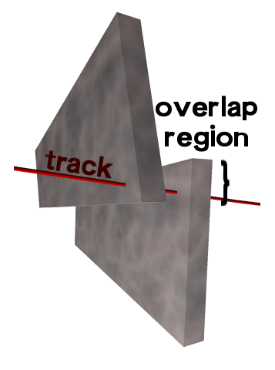
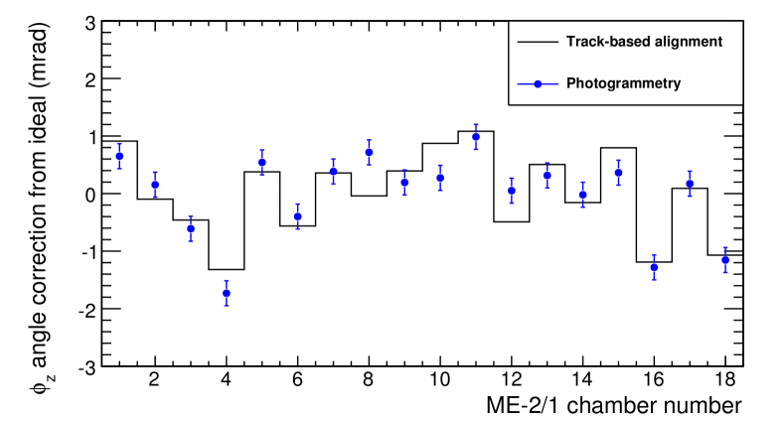
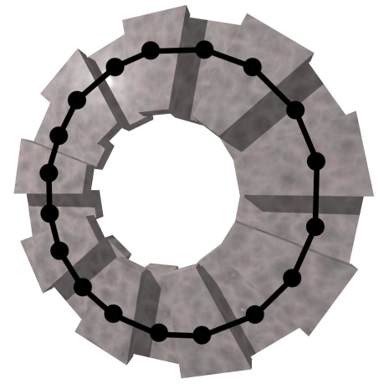
CSC Alignment with beam-halo muons
Select tracks that pass through overlap of two chambers
Determine relative position by requiring consistency between the two track segments:
r position (most important for momentum resolution)‏
 z: rotation in layer's plane (second most important)‏
 y: rotation around alignment pin axis
Align by solving system of 18 or 36 equations
DATA (33k events in 9 min)‏
Cross-check against photogrammetry
Note for speakers: 33k events in the overlap regions of minus endcap, not total

Slide 2
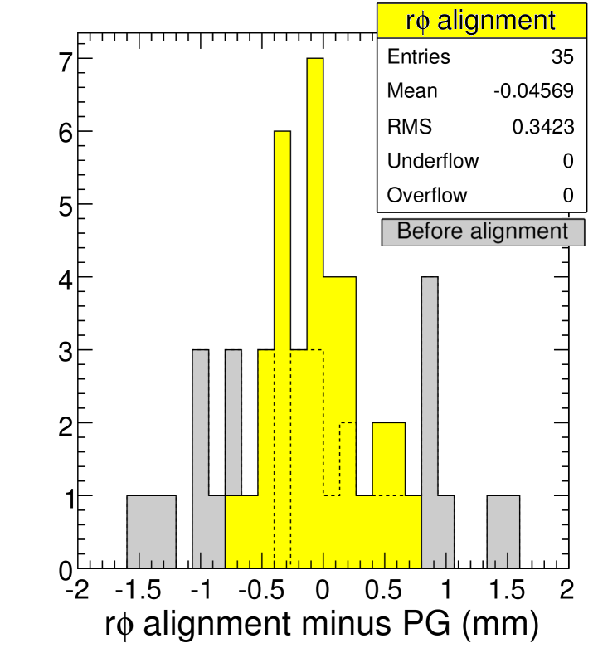
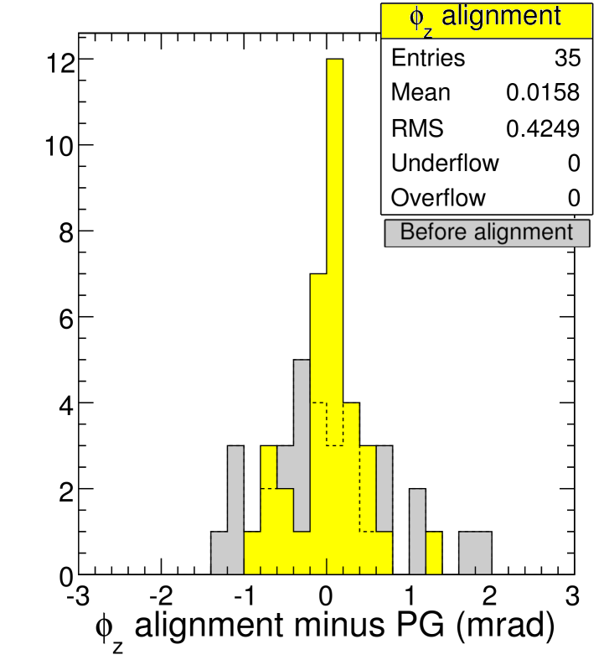
Accuracy determined from photogrammetry (PG)‏
Photogrammetry is alignment from a literal photograph of the detector: completely independent from tracks, 210 m r and 0.23 mrad z resolution
Chamber-by-chamber difference with respect to PG before (gray) and
after (yellow) alignment with tracks shows improvement (35 chambers below)‏
Track-based alignment accuracy: 270 m r and 0.35 mrad z
(from RMS of difference minus PG resolution in quadrature; no PG data for y)‏
DATA
DATA
Alignment goal:
200-300 microns
achieved with
9 min of LHC beam!

Slide 3
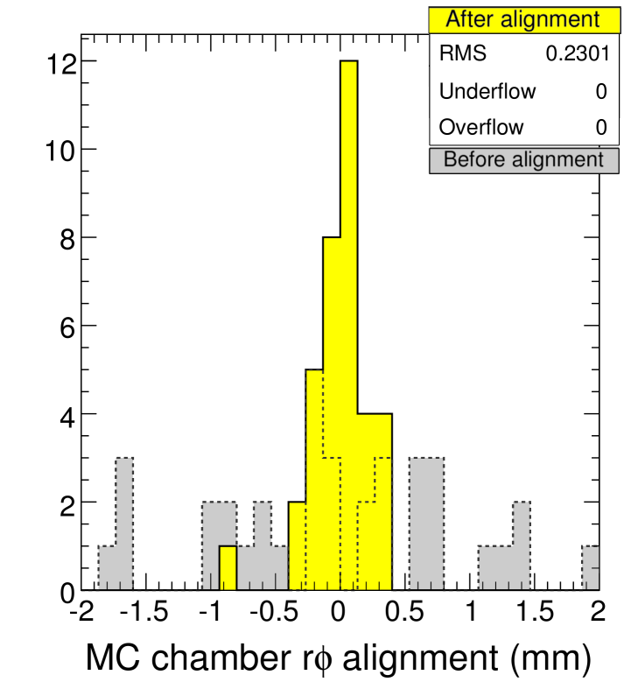
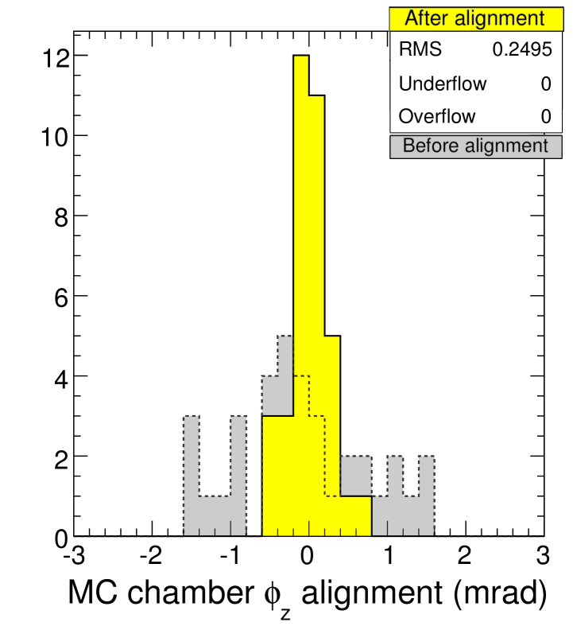
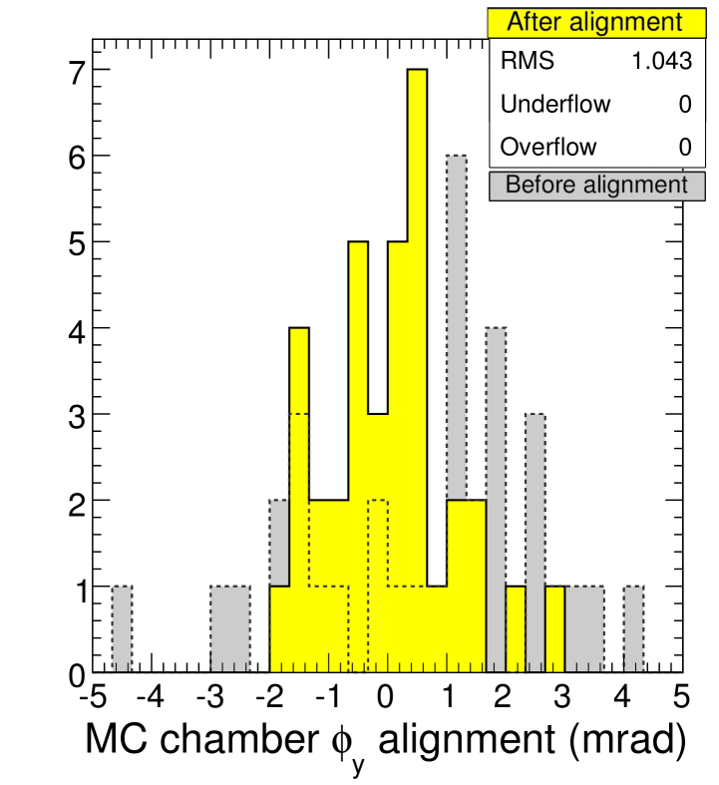
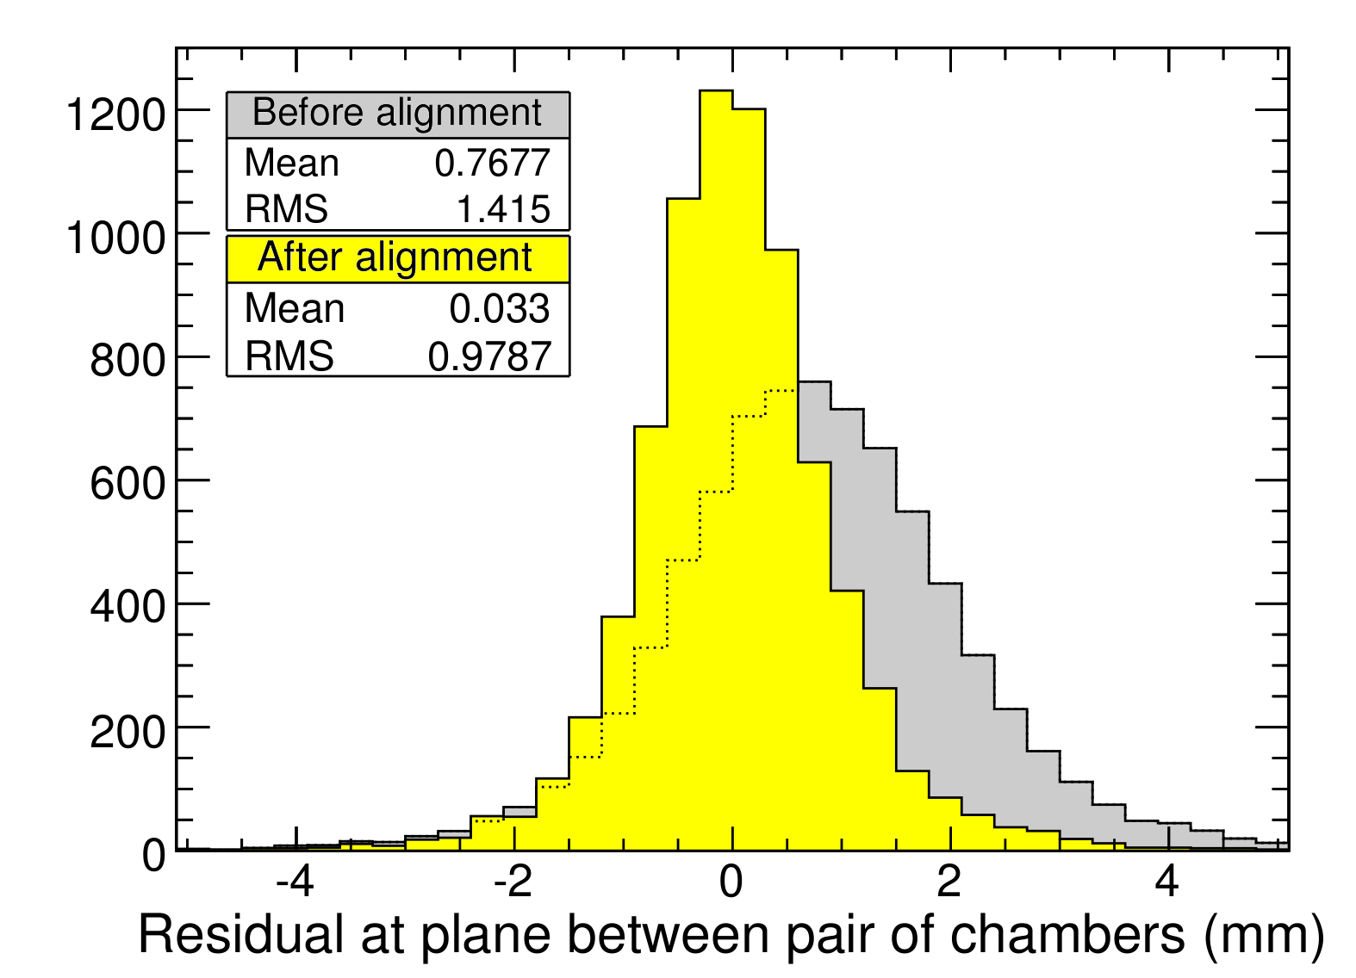
Simulation of procedure in beam-halo Monte Carlo
Roughly the same statistics, observe roughly the same resolutions
MC
MC
MC
Consistency of residuals
DATA
Sum of residuals around ring must
be zero (must form a consistent circle)‏
always zero in MC (for r z, and y)‏
offset of r residuals in data led to discovery of CSC description error (0.09% error in strip pitch angle)‏
Note to speakers: the fact that we had an error and later fixed it is not public, only the initial and final results

