Slide 1

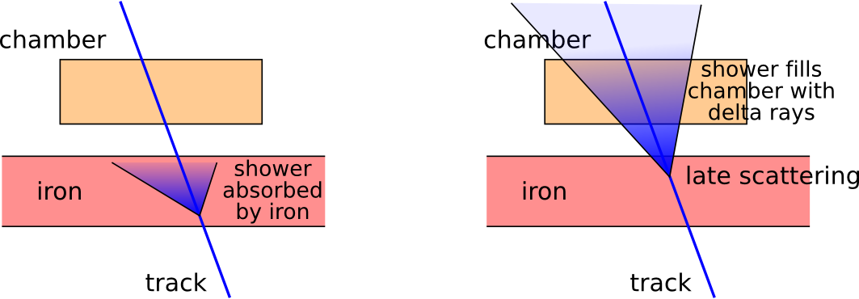
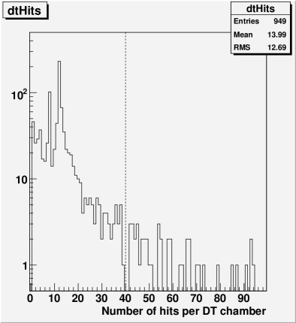
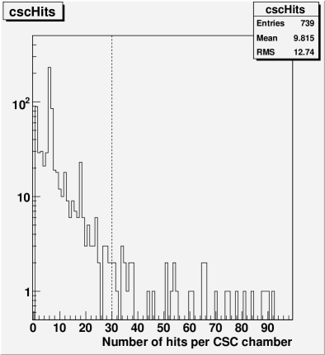
Delta rays from TeV muon showers vary from chamber to chamber, depending on how early the scattering event occurred in the iron
We can select clean tracks with a “number of hits per chamber” cut. Clean tracks will have dramatically better resolution than unselected TeV muons

