Slide 1

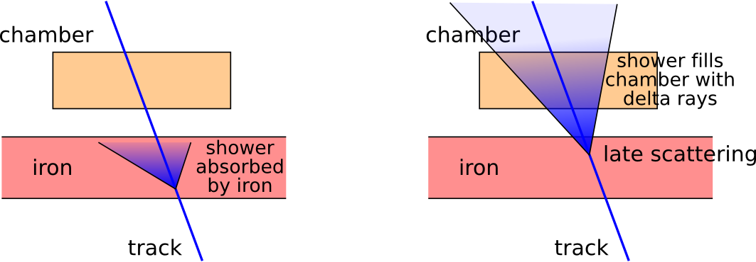
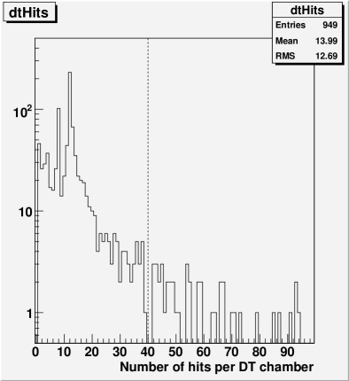
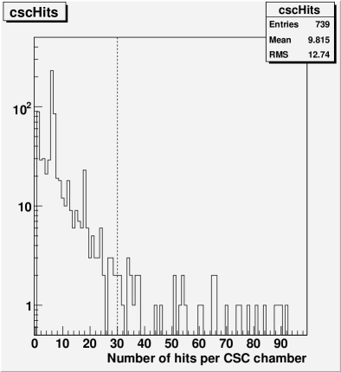
Delta rays from TeV muon showers vary from chamber to chamber, depending on how early the scattering event occurred in the iron
We can select clean tracks with a “number of hits per chamber” cut. Clean tracks will have dramatically better resolution than unselected TeV muons
muons from 2 TeV Z'

Slide 2
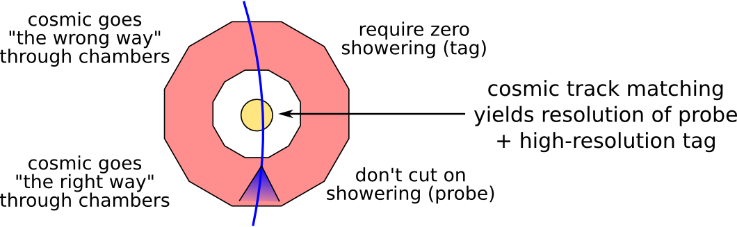
Top half of cosmic ray isn't a good test of resolution, since showers open the wrong way
Select zero showering in the top half to get high and well-modeled resolution
Error in cosmic track matching will be dominated by bottom leg, on which we don't apply special cuts
To first order, resolution of bottom leg is width of cosmic matching distribution
To second order, we can correct for resolution of top leg
Must assume phi symmetry to apply resolution to the rest of the detector

