Slide 1
Everything we might want to bless as public plots
Not an exhaustive list: what else should be added for our consideration?
Compiled by Jim Pivarski
Presented by ... ?
Friday and weekend: submit plots to HyperNews, possible initial discussion
Monday (Muon Alignment meeting): internally bless some of these plots
Wednesday (CMS-wide sign-off meeting): publicly bless the plots we propose
Next Monday: first chance for them to be publicly presented, at the LHC Alignment Workshop

Slide 2
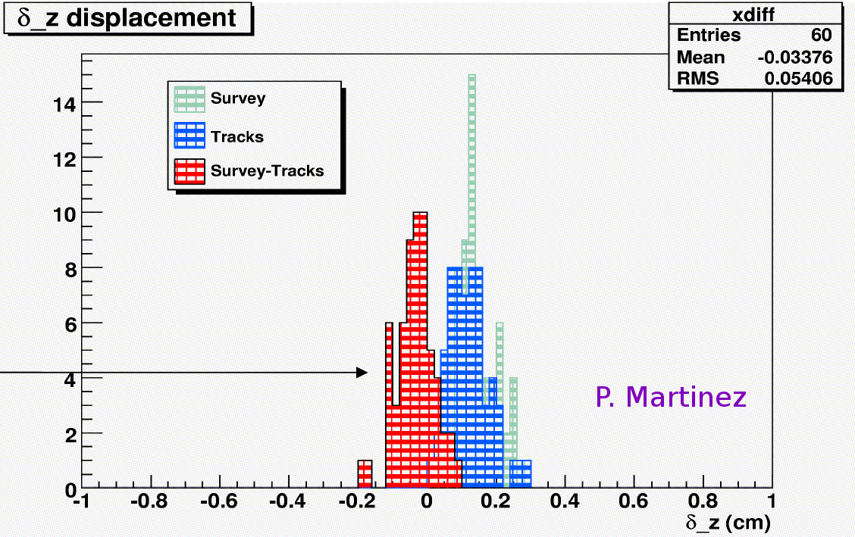
Internal DT alignment
Page 2
Pro: impressive agreement between independent alignment methods
Con: perhaps this plot could be redrawn such that it's easier to see how the survey and tracks overlap, or to only show the survey-minus-tracks difference
Is it available for all stations? Can a tracks/survey comparison be made in delta_x?

Slide 3
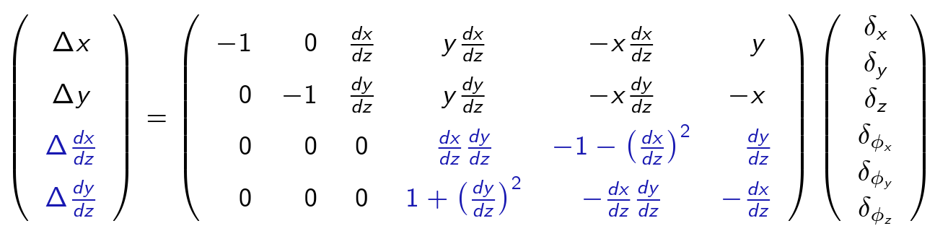
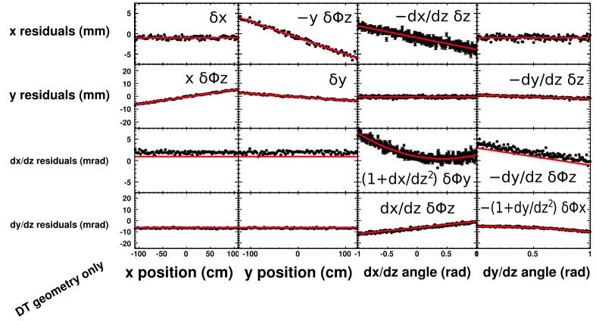
Plots about method (diagrams don't need to be signed-off)‏
Page 3
Alignment matrix: pro: shows how constrained the alilgnment is, con: might be a “trade secret” (though I doubt it)‏
Geometry-only residuals:
pro: shows matrix terms in a graphical way, introduces conventions for the real plots
con: curvature in box (3,3) leads to misleading apparent discrepancy in boxes (3,1), (3,2), (3,4)‏

Slide 4
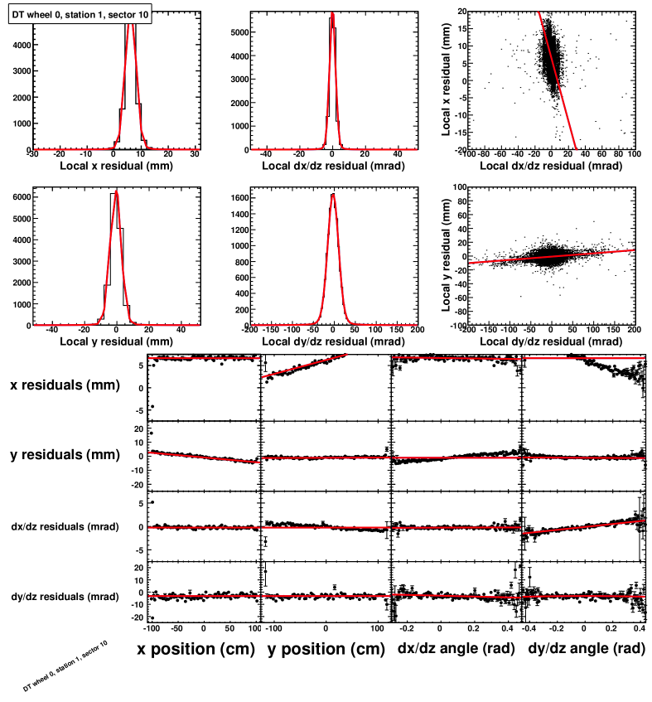
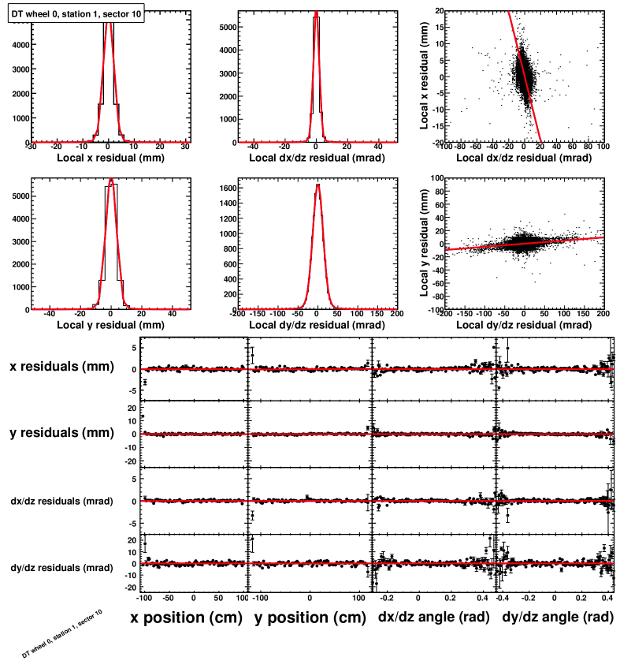
Sample fit results (these are Monte Carlo)‏
Page 4
Before (V4)‏
After
Pro: demonstrates how the machinery works, how detailed the fit model is, and how thoroughly we can monitor it
Con: busy/complicated plot, especially as it is necessary to show before and after

Slide 5
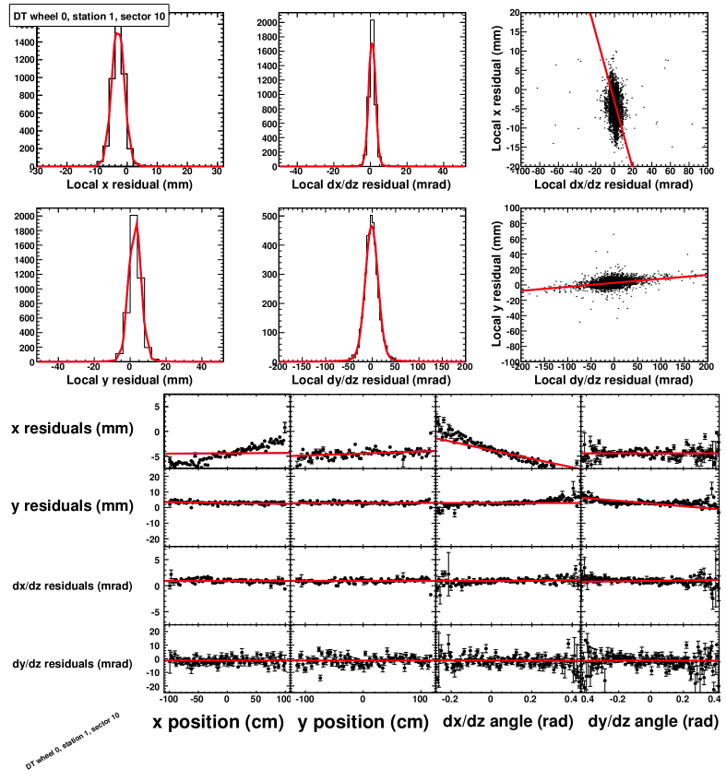
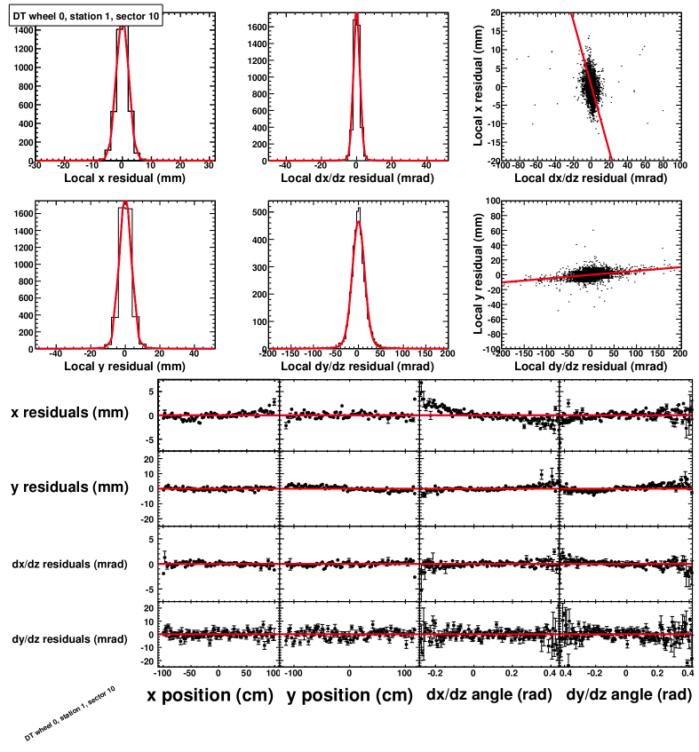
Sample fit results (these are real data)‏
Page 5
Before (V4)‏
After
We would probably only want either MC or real data, not both. Pro: this is real life, not a simulation, con: there's some tension in the z fit (boxes (1,3) and (2,4)).

Slide 6
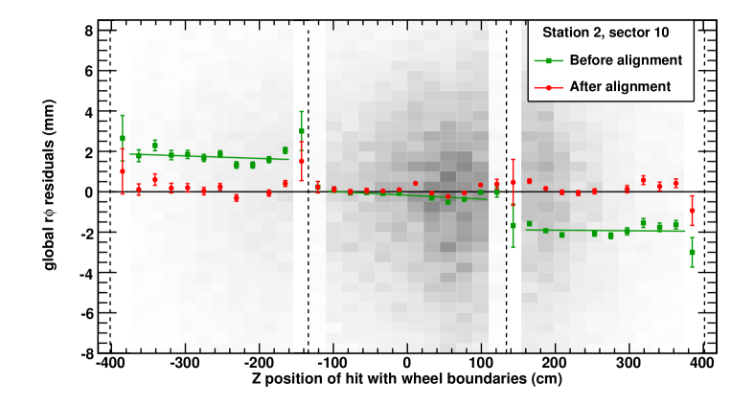
Example intermediate plot: residuals across chamber boundaries
This version has been redrawn to not show B-field errors, which is private.
The grey background is the raw hits distribution, to make sure that the profile is not fooling us. It's asymmetric because of the shaft.
Page 6
Pro: it adds credibility to the alignment result, seeing how the residuals break cleanly between chambers
Con: to an outside audience, it may not be that important

Slide 7
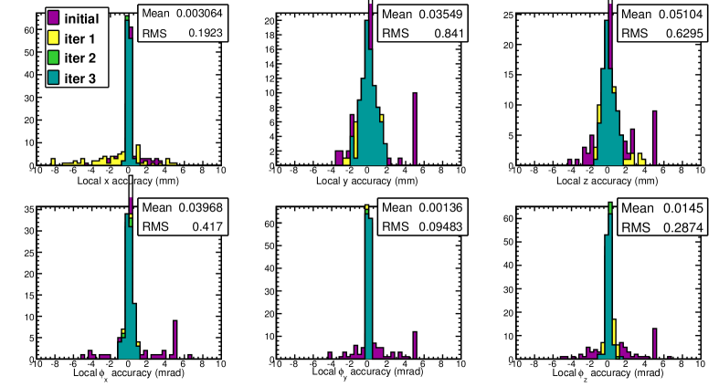
Monte Carlo results (cosmic rays)‏
Page 7
This plot would have to be cleaned up: only before and after (no intermediate iterations) and possibly a more Gaussian starting point (5 mm/5 mrad for half of the chambers was a diagnostic)‏
Pro: establishes the alignment reach for each parameter (there's no MC-truth to compare to in data) Con: doesn't include tracker misalignment, a key ingredient. It therefore represents the errors in the method, rather than the method+input

Slide 8
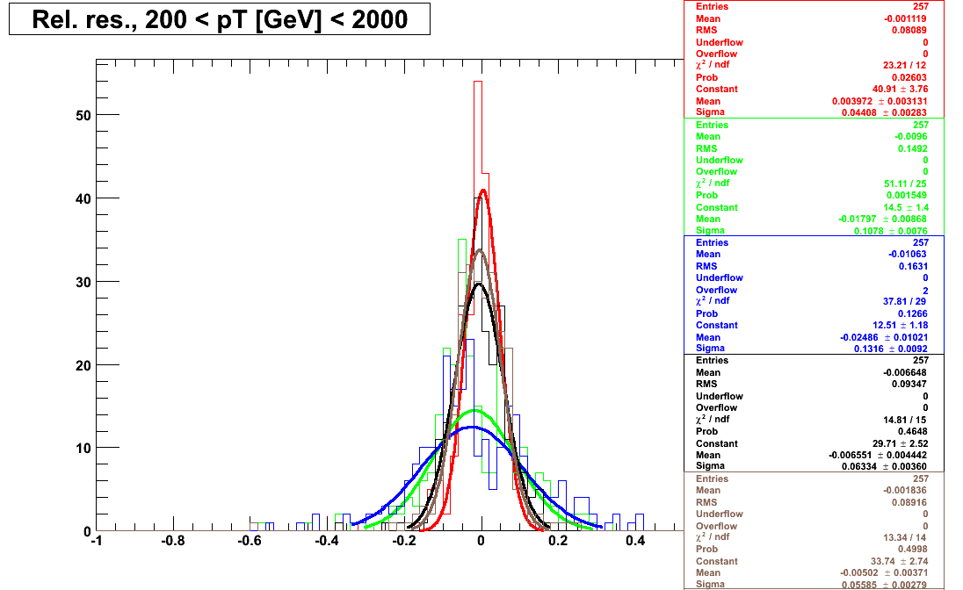
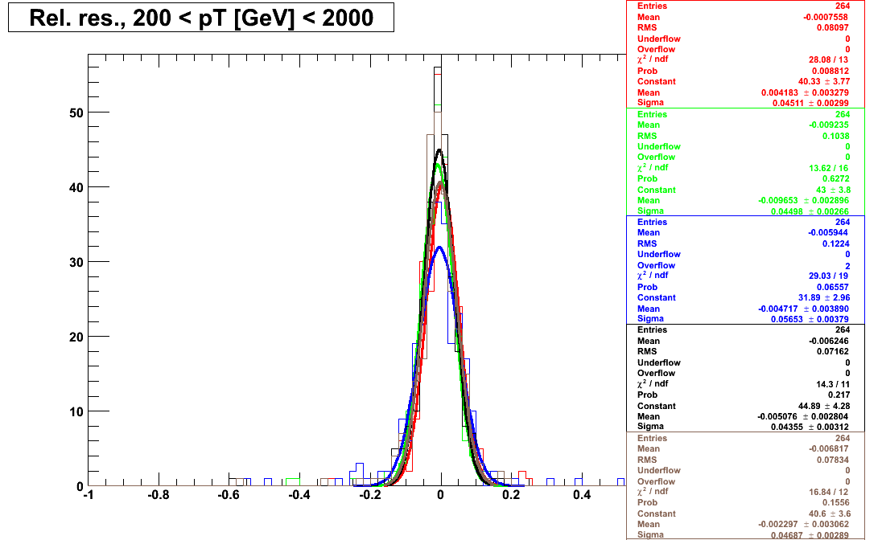
Split cosmic ray diagnostic (fractional curvature resolution)‏
Page 8
Before (V4)‏
After
Pro: demonstrates alignment improvement in a completely data-driven way (only difference between the two is muon alignment)‏
Con: a complicated plot; perhaps fewer reconstruction algorithms should be overlaid
Also, standard globalMuon reco (blue) shows that there are still problems after alignment (ideally, should be at least as narrow as tracker-only (red)). I would recommend only tracker-only (red) and first muon station (green). Juxtaposing this with the TDR plot of expected resolutions, globalMuon should be just beginning to overtake tracker-only at 200 GeV, just as the first muon station appears to be doing.
This, or a variant of it, would be the most important plot to present publicly: in a sense, it's the bottom line.

Slide 9
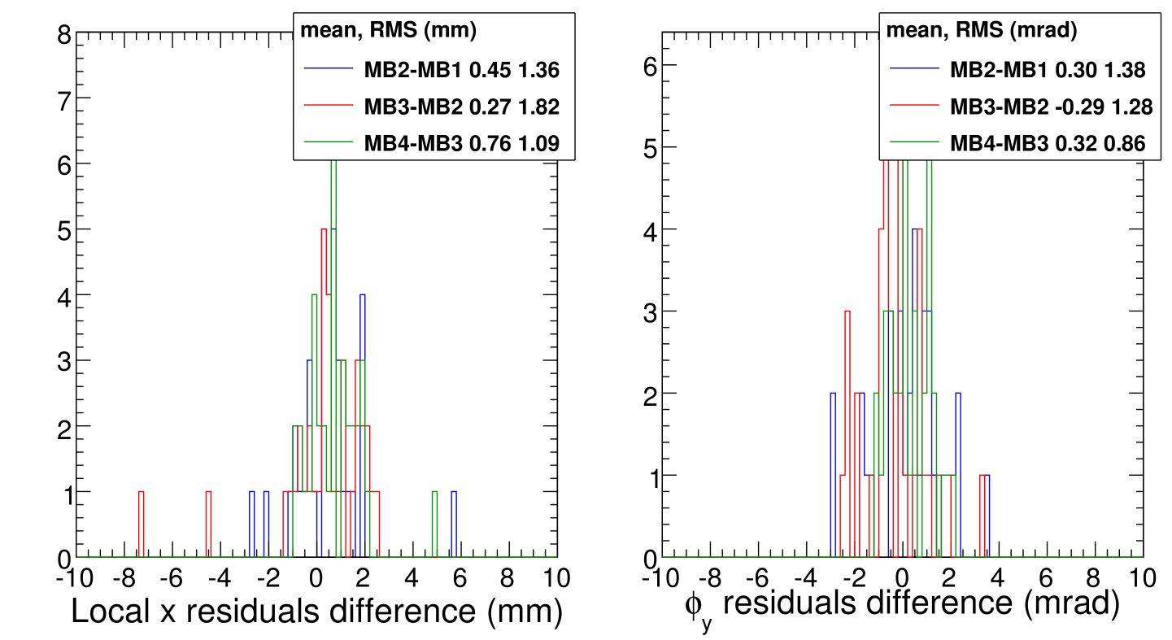
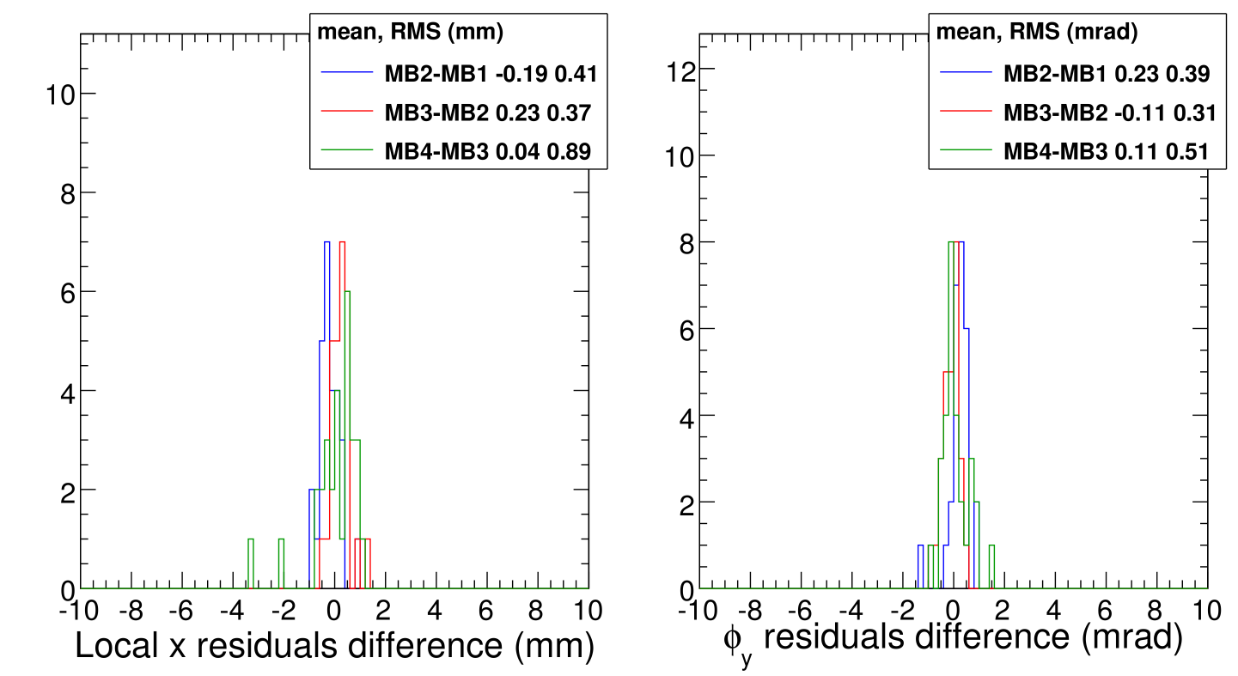
Residuals differences
Page 9
Before (V4)‏
We should have some form of validation which takes advantage of the fact that relative positions of chambers is an independent cross-check on absolute chamber alignment. It's an important step in analyzing the alignment: it gives us a handle on the uncertainty outside of the Monte Carlo.
They should be made easier to read by combining the three colors and possibly reducing the bin width and “Y” range.
Pro: tells us our position resolution in a data-driven way (as opposed to momentum resolution)‏
Con: the segment extrapolation method, which measures the same thing, should confirm this.
Also, the two outliers in MB4 are obvious.
After

Slide 10
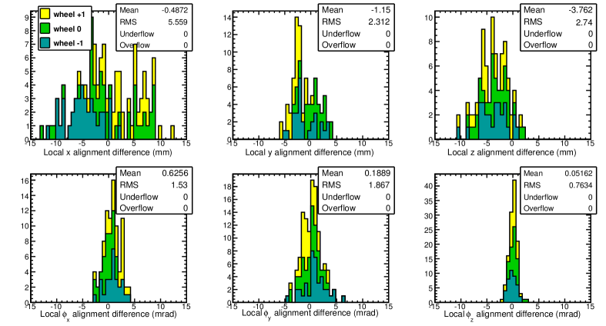
Values of alignment corrections (newest minus V4)‏
Page 10
I'm not convinced that we should show this publicly. The reason I include it here for consideration is that it is the answer to a natural question (“what are your alignment corrections?”) and compliments the relative corrections that can be inferred from the previous page. Pro: if I were in the audience, I would want to see this. Con: it shows that we had to make some rather large corrections. Maybe that's not a bad thing: the large corrections were justified by the clear improvement in momentum, and this shows that we have the ability to fix large errors, which is the point, after all.

Slide 11
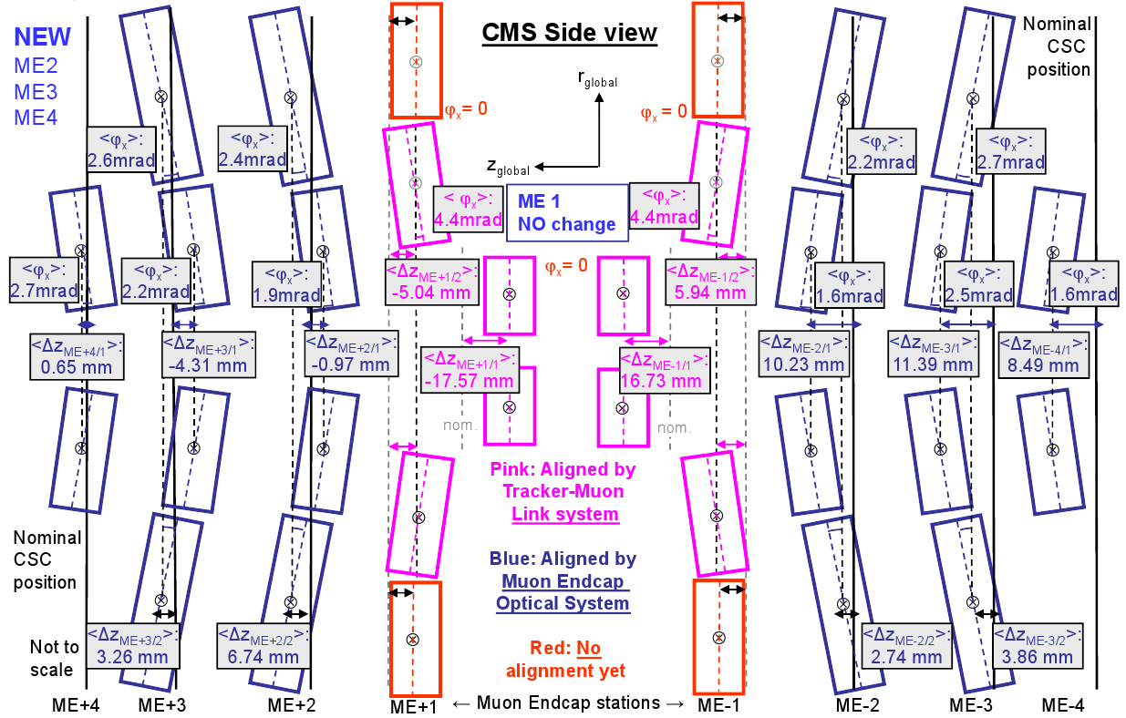
Hardware alignment
Page 11
Pro: an overview of everything, con: doesn't demonstrate correctness--- is there something that would be better to show?

