Slide 1
Introduction
The plots on the following pages are proposed for approval, to demonstrate the state-of-the-art muon alignment.
Outline
Internal alignment of DT chambers with tracks
Global alignment of DT chambers (relative to the tracker) with tracks
MC study of global track-based alignment
Segment-based cross-check of global alignment
Endcap alignment, bending of disks in magnetic field with hardware
Muon momentum resolution: data-driven measurement and MC studies
Everything here has been pre-approved by the Muon Alignment group and Muon POG, including suggested updates.
Information for speakers is included on the slides.

Slide 2
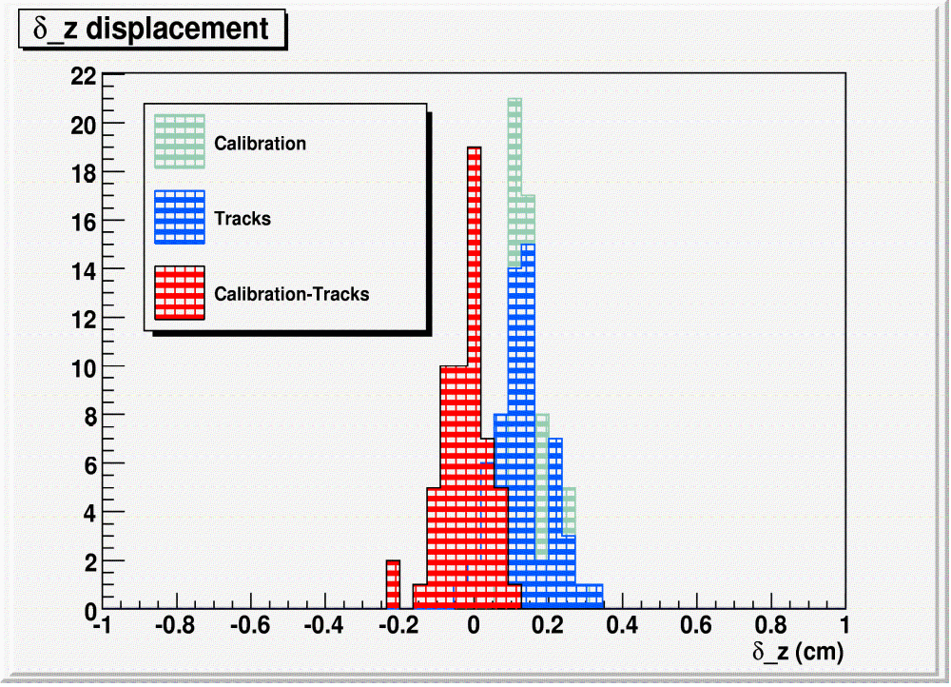
Internal DT alignment
Real Position
The distance between the superlayers is corrected using information from the calibration process and alignment with tracks
CMSSW Position
SL3
δz
SL1

Slide 3
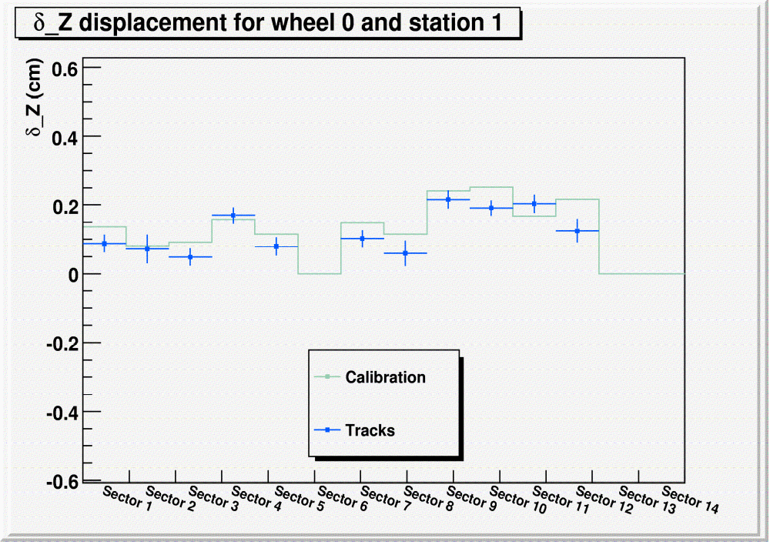
Internal DT alignment
Delta_z displacement as a function of the sector number for wheel 0 and station 1

Slide 4
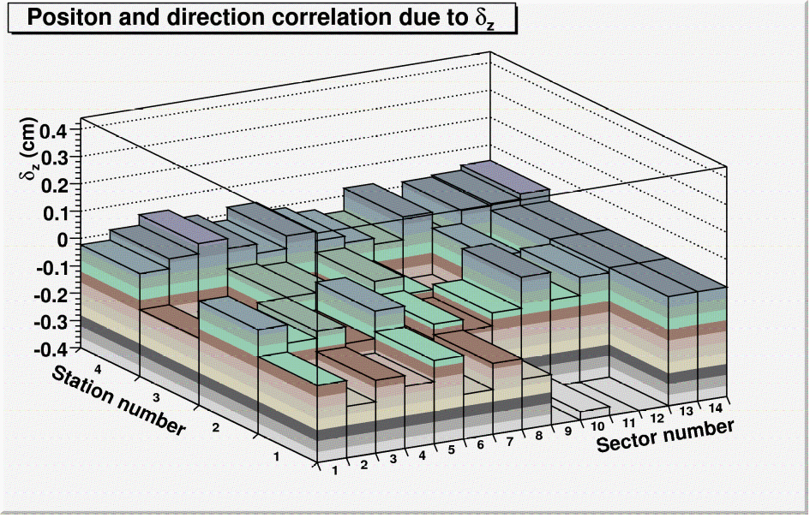
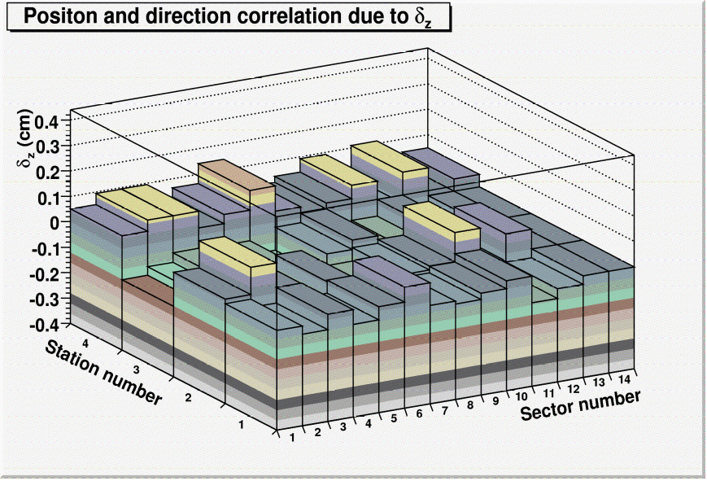
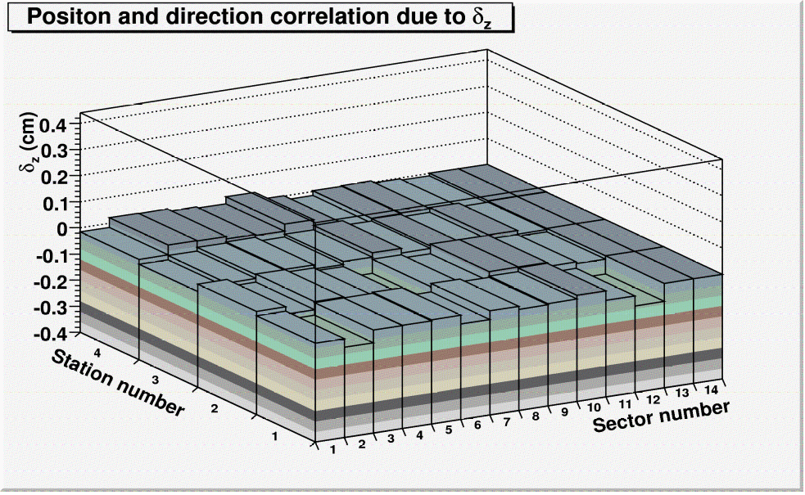
Internal DT alignment
V4
V4 + Calibration
What is plotted:
The δz between superlayers introduces a correlation between the r-φ residual (from superlayer to superlayer) and the direction of the segment.
In these plots the slope, called δz, of this linear correlation is shown as a function of station and sector.
A slope of 0 means the correlation effect disappears and that the internal δz alignment is good
V4 + Calibration + Tracks

Slide 5
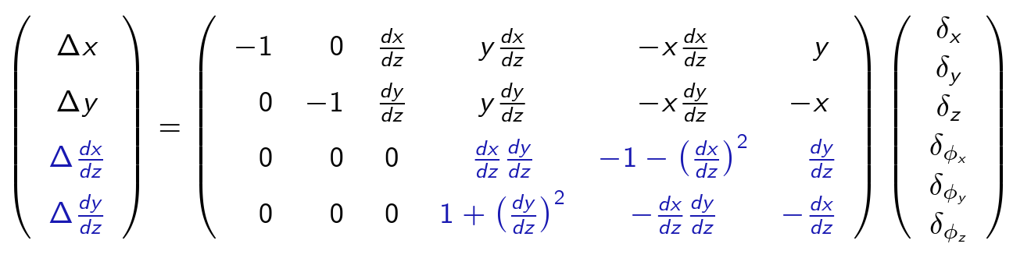
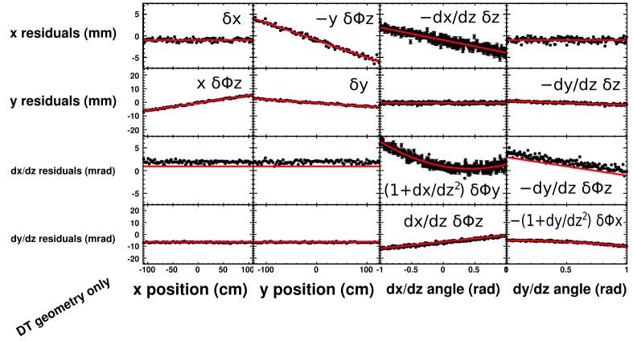
Plots about global alignment method (text describes all variables)‏
Four residuals: Delta x, Delta y (track-hit position difference)‏
Delta dx/dz, Delta dy/dz (track-hit angle difference)‏
Four “impact point” variables:
x, y position of track intersection
dx/dz, dy/dz entrance angle
Six alignable degrees of freedom: delta x, delta y, delta z, delta phix, delta phiy, delta phiz
Coordinates are local:
x ~ rphi, y ~ parallel to beamline for DTs,
z ~ radial for DTs,
phix,y,z angles are rotations around
each axis.

Slide 6
A helpful guide for this talk
(we'll make prettier diagrams for public talks)‏
Track
Local Z
Local Y
DT chamber
dx/dz ~ global phi
dy/dz ~ global eta
Local X ~ global rphi (into page)‏
Tracker
LHC beamline
Global Z

Slide 7
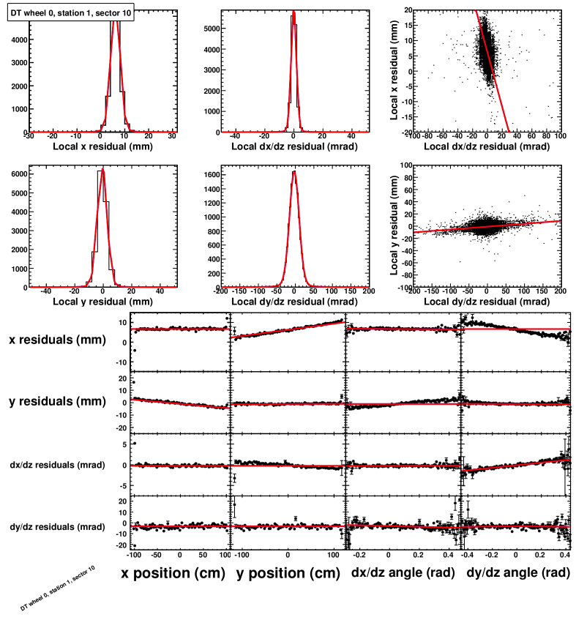
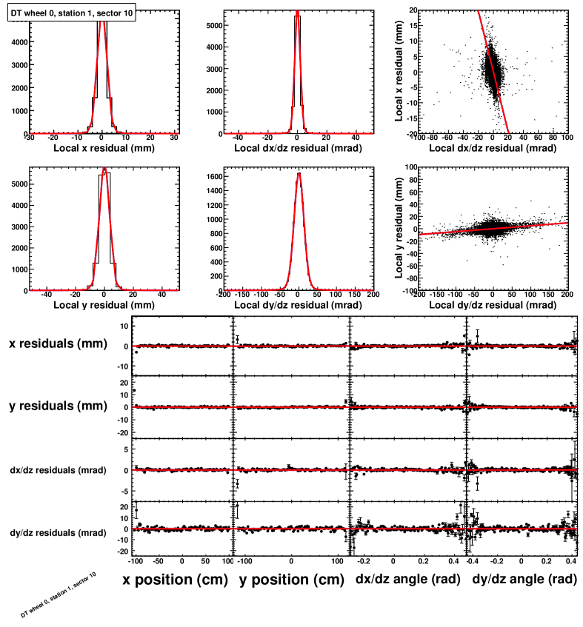
Sample fit results (these are Monte Carlo)‏
Before (V4)‏
After
Gaussian-Lorentzian convolution fits the residuals well, including correlations
“Residuals vs. position” (4 types of residuals and 4 coordinates for position = 16 plots)‏
become flatter and better centered after alignment. (Some misalignments appear in multiple plots because of correlations between the positions and entrance angles.)‏

Slide 8
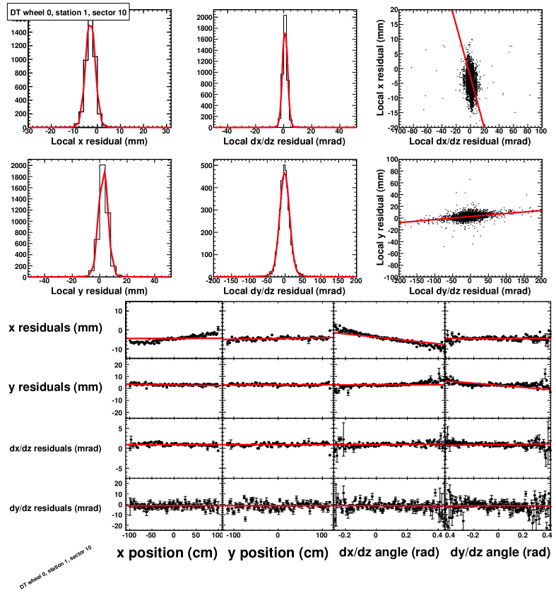
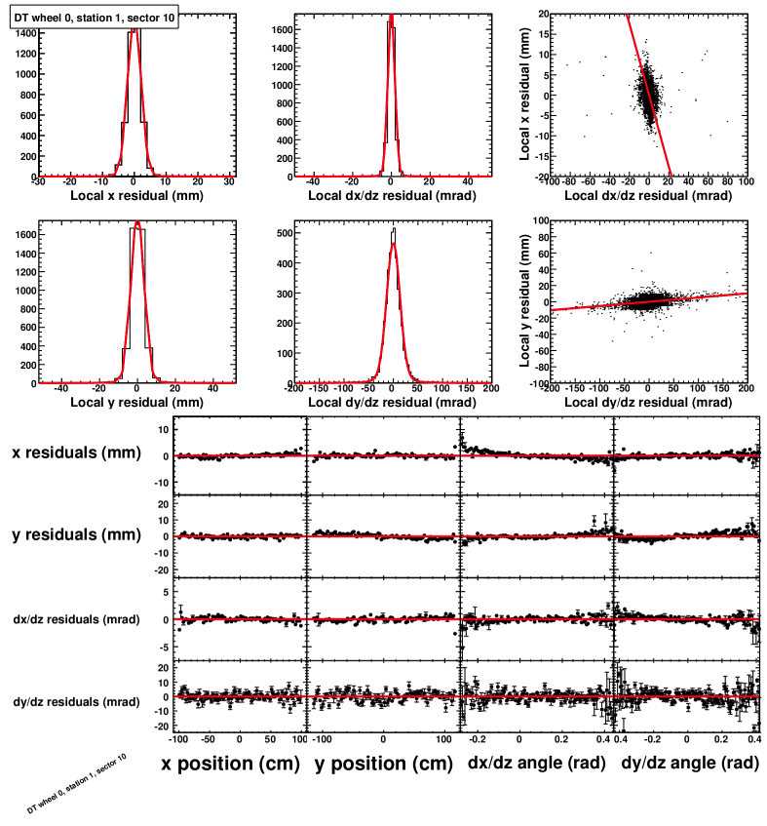
Sample fit results (these are real data)‏
Before (V4)‏
After
Gaussian-Lorentzian convolution fits the residuals well, including correlations
“Residuals vs. position” (4 types of residuals and 4 coordinates for position = 16 plots)‏
become flatter and better centered after alignment. (Some misalignments appear in multiple plots because of correlations between the positions and entrance angles.)‏

Slide 9
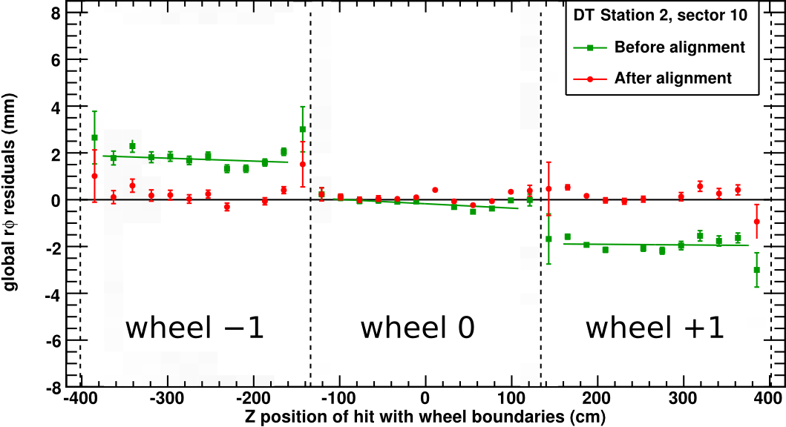
Example intermediate plot: residuals across chamber boundaries
These linear fits were not used in the alignment procedure itself; they are a guide for the eye. (The actual alignment fits have 16 parameters and are shown in projections on the previous page.)‏
Residuals were plotted without regard to which chamber they belong to, but exhibit sharp discontinuities at the chamber borders (something one expects from misalignments, not track source biases)‏

Slide 10
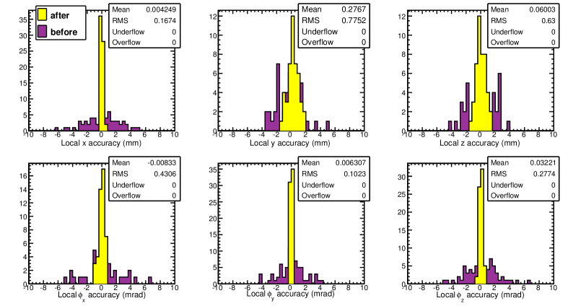
Monte Carlo results (cosmic rays)‏
Superceeded (see next page)‏
In this MC test, everything was the same as the real-data alignment except:
ideally aligned tracker, ideal magnetic field, ideal internal DT alignment.
The initial misalignment was random in sectors 7-12; sectors 1-6 were set to specific values for diagnostics. This plot shows sectors 7-12.
That's why it is superceeded on the next page.

Slide 11
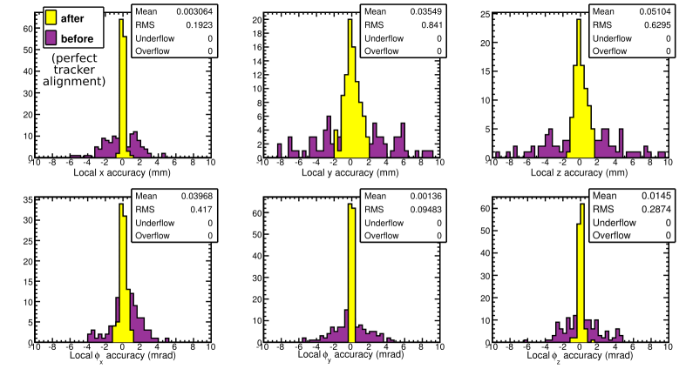
Monte Carlo results (cosmic rays)‏
In this MC test, everything was the same as the real-data alignment except:
ideally aligned tracker, ideal magnetic field, ideal internal DT alignment.
The initial misalignment was random in all chambers, and here we're showing all chambers. (Also, the initial y and z distributions were made twice as wide, to make the improvement more obvious.)‏

Slide 12
Introduction to segment validation
(next page)‏
Station 3 segment
Chamber in station 3
Station 2 segment extrapolated to station 3
Chamber in station 2
Find segments on pT > 50 GeV (straight) tracks
Measure difference in x (rphi) position, dx/dz (phi) angle between extrapolation and segment
Take a mean of all such comparisons (correcting for B-field with charge antisymmetry)‏
Plot them as a function of station pair (1-2, 2-3, 3-4) and sector number

Slide 13
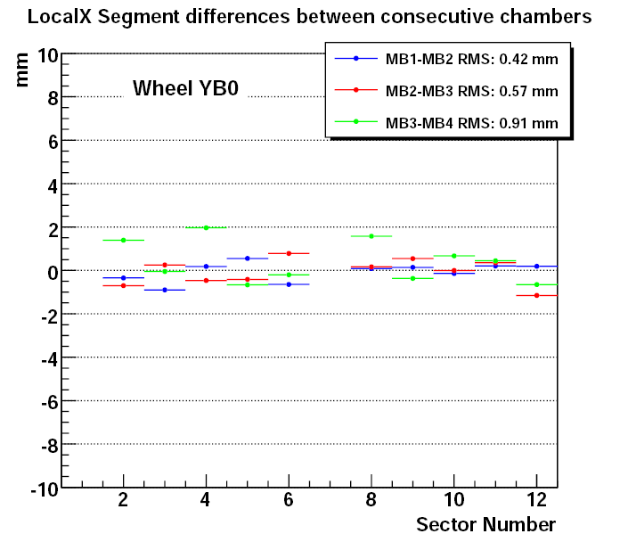
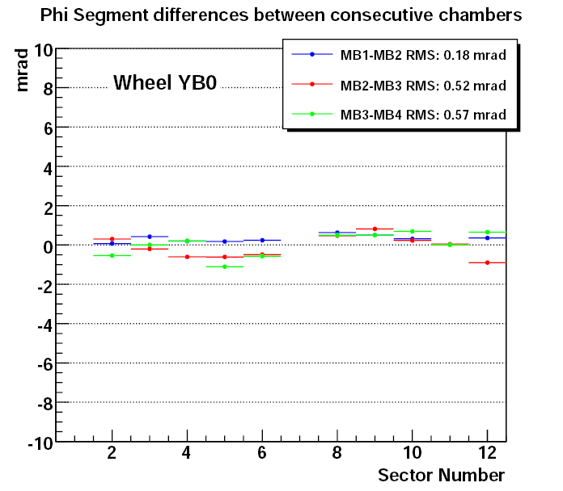
Each entry corresponds to the mean value of a Gaussian function fit
to the local_x (left plot) and phi (right plot) difference distributions
between segments propagated between consecutive DT stations inside
the same sector and wheel.
Uses SA, 1-leg tracks with Pt>50 GeV and at B=3.8T
Represents the relative local_x alignment (left plot) and Phi alignment (right plot)
between consecutive DT stations as a function of the sector number.
Similar for all wheels. Represents an independent, muon only validation of the
alignment

Slide 14
Muon Endcap Hardware Alignment
CMS Side view
Nominal
CSC
position
Not to
scale
B=3.8T
⊗
⊗
⊗
⊗
<ϕ_{x}>:
1.3mrad
<ϕ_{x}>:
1.3mrad
⊗
⊗
r_{global}
<ϕ_{x}>:
2.6mrad
<ϕ_{x}>:
2.4mrad
<ϕ_{x}>:
2.2mrad
<ϕ_{x}>:
2.7mrad
⊗
z_{global}
⊗
< ϕ_{x}>:
4.4mrad
<ϕ_{x}>:
4.4mrad
⊗
⊗
⊗
ϕ_{x}= 0
⊗
⊗
⊗
<ϕ_{x}>:
2.7mrad
<ϕ_{x}>:
2.2mrad
<ϕ_{x}>:
1.9mrad
<Δz_{ME+1/2}>:
-5.04 mm
<Δz_{ME-1/2}>:
5.94 mm
<ϕ_{x}>:
1.6mrad
<ϕ_{x}>:
2.5mrad
<ϕ_{x}>:
1.6mrad
⊗
⊗
<Δz_{ME+4/1}>:
0.65 mm
<Δz_{ME+3/1}>:
-4.31 mm
<Δz_{ME+2/1}>:
-0.97 mm
<Δz_{ME+1/1}>:
-17.57 mm
<Δz_{ME-1/1}>:
16.73 mm
<Δz_{ME-2/1}>:
10.23 mm
<Δz_{ME-3/1}>:
11.39 mm
<Δz_{ME-4/1}>:
8.49 mm
⊗
⊗
⊗
nom.
nom.
⊗
⊗
⊗
⊗
⊗
Pink: Aligned by
Tracker-Muon
Link system
Blue: Updated !
Aligned by
Muon Endcap
optical & analog
(Z sensors) System
Red: No
alignment yet
⊗
⊗
Nominal
CSC
position
⊗
⊗
⊗
⊗
<Δz_{ME+3/2}>:
3.26 mm
<Δz_{ME+2/2}>:
6.74 mm
⊗
⊗
<Δz_{ME-2/2}>:
2.74 mm
<Δz_{ME-3/2}>:
3.86 mm
<Δz_{ME+1/3}>:
-4.08 mm
<Δz_{ME-1/3}>:
4.08 mm
ME+4
ME+3
ME+2
ME+1
← Muon Endcap stations →
ME-1
ME-2
ME-3
ME-4

Slide 15
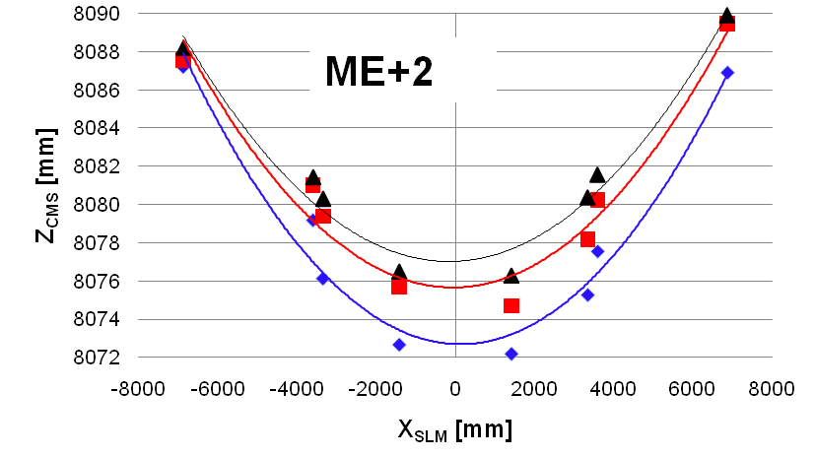
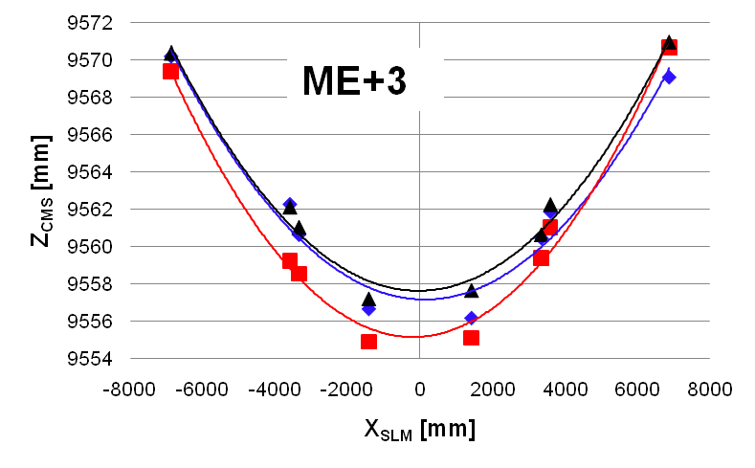
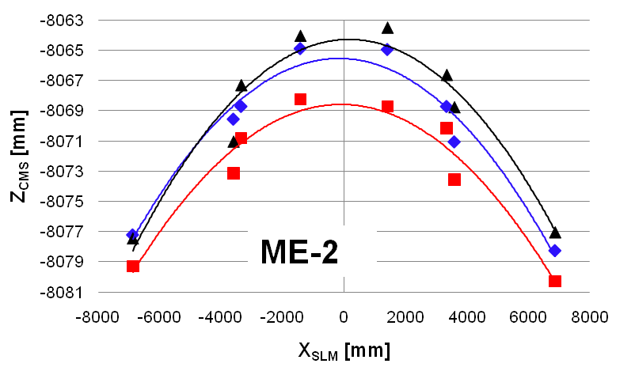
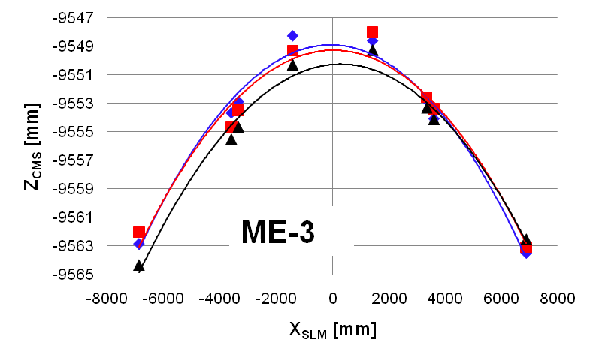
Disk bending at B=3.8T
SLM1
SLM2
SLM3
B=3.8T
Parabolic fits are a guide for the eye: not expected to be exact.

Slide 16
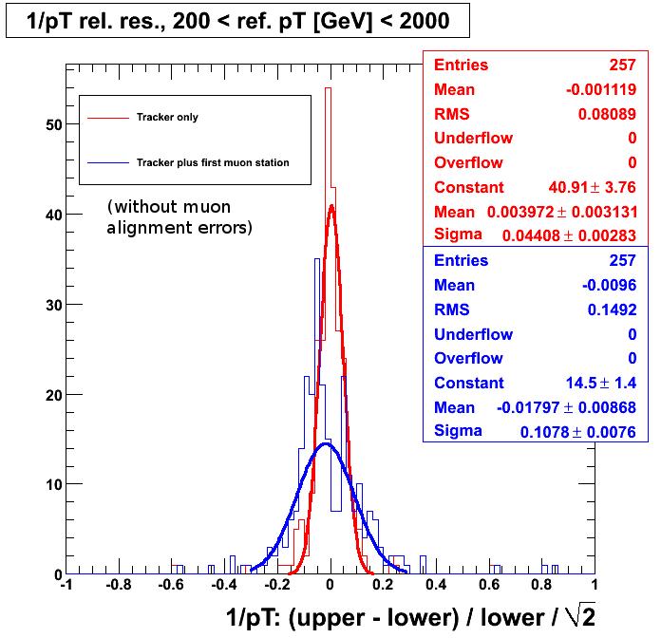
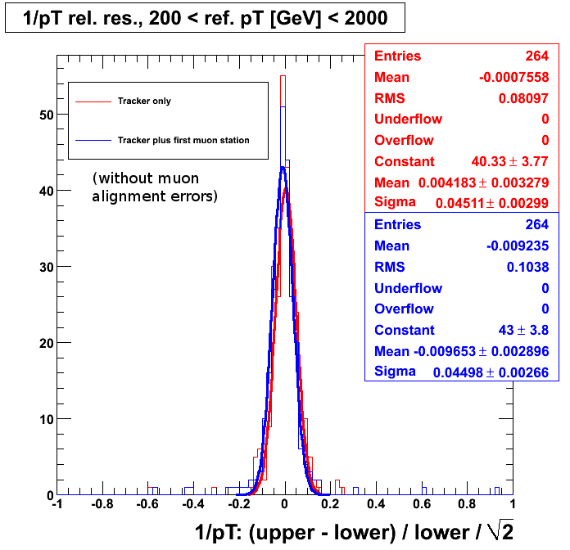
Cosmic rays with pT > 200 GeV are all close to 200 GeV
Split cosmic ray diagnostic (fractional curvature resolution)‏
Before alignent (V4): 10.8%
After alignment: 4.5%
1/pT of upper half of a cosmic ray track is compared with the lower half: difference is purely instrumental. Note that the fractional uncertainty in 1/pT equals the fractional uncertainty in pT (by error propagation formulae valid when distributions are Gaussian.
Only muon alignment is changed between these two plots. (Tracker-only differs slightly because of cuts: it must be identified with an existing globalMuon track.)‏

Slide 17
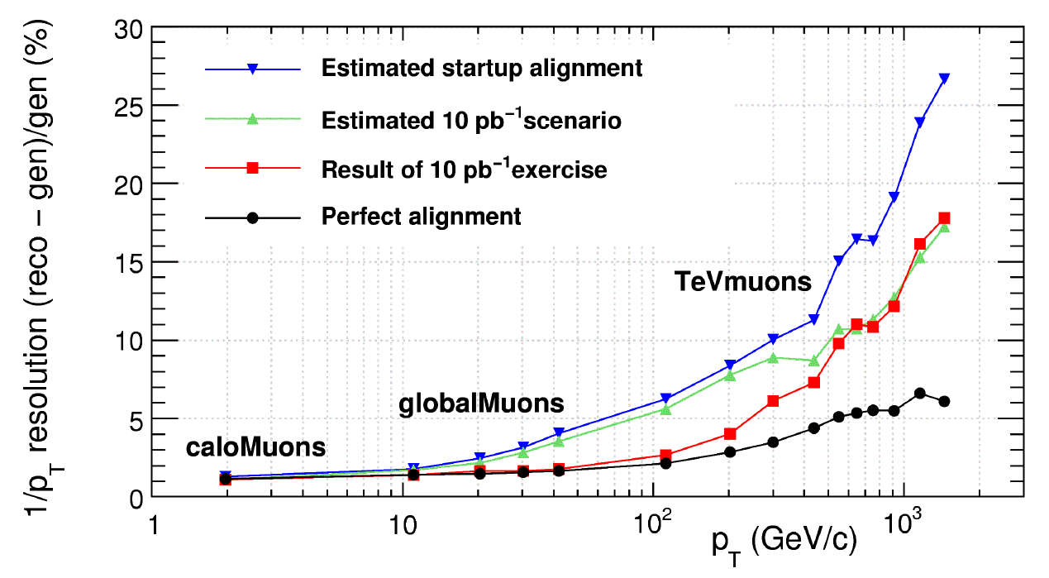
Resolution for physics from MC studies
“TeVmuons” is first muon station algorithm, just like cosmic splitting analysis
“Estimated startup alignment” should indicate “pre-CRAFT”
“Result of 10 pb-1 exercise” is CSA08

Slide 18
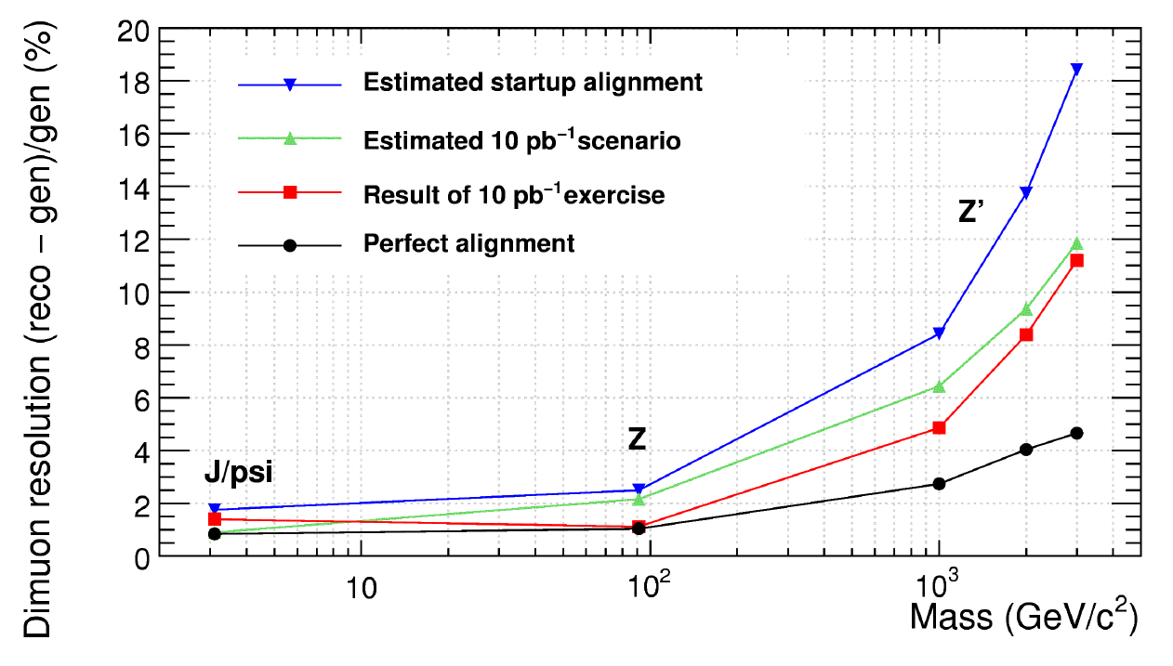
Resolution for physics from MC studies
“TeVmuons” is first muon station algorithm, just like cosmic splitting analysis
“Estimated startup alignment” should indicate “pre-CRAFT”
“Result of 10 pb-1 exercise” is CSA08

