Slide 1
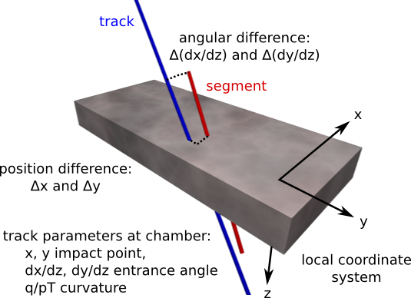
Local Muon Alignment Conventions

Slide 2
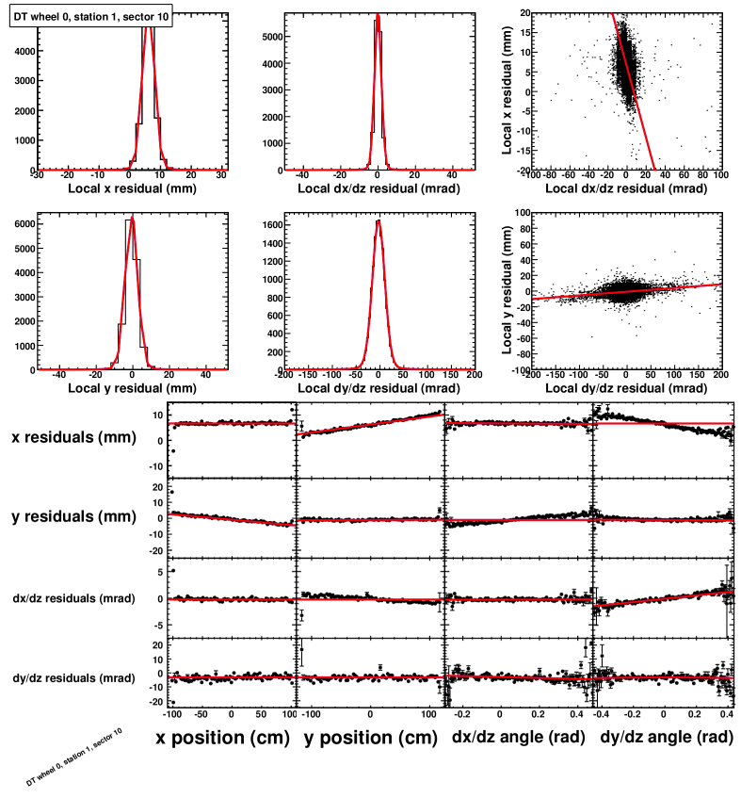
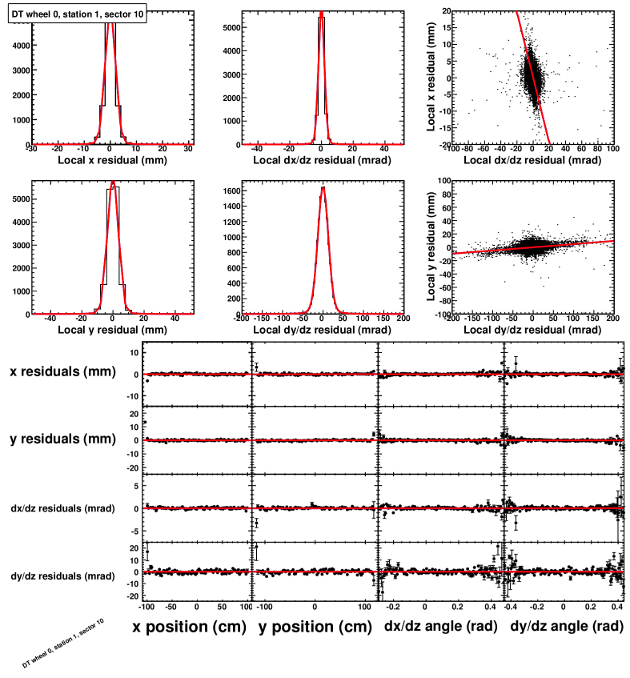
Sample fit results (these are Monte Carlo)‏
Before (V4)‏
After
Gaussian-Lorentzian convolution fits the residuals well, including correlations
“Residuals vs. position” (4 types of residuals and 4 coordinates for position = 16 plots)‏
become flatter and better centered after alignment. (Some misalignments appear in multiple plots because of correlations between the positions and entrance angles.)‏

Slide 3
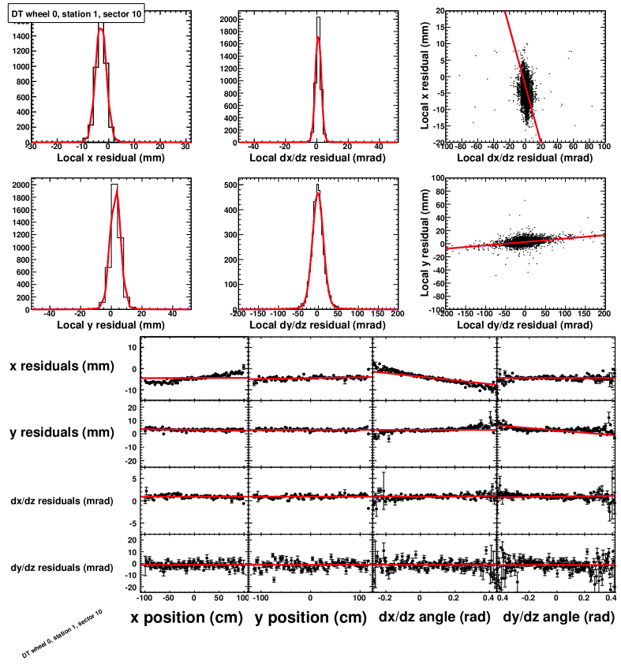
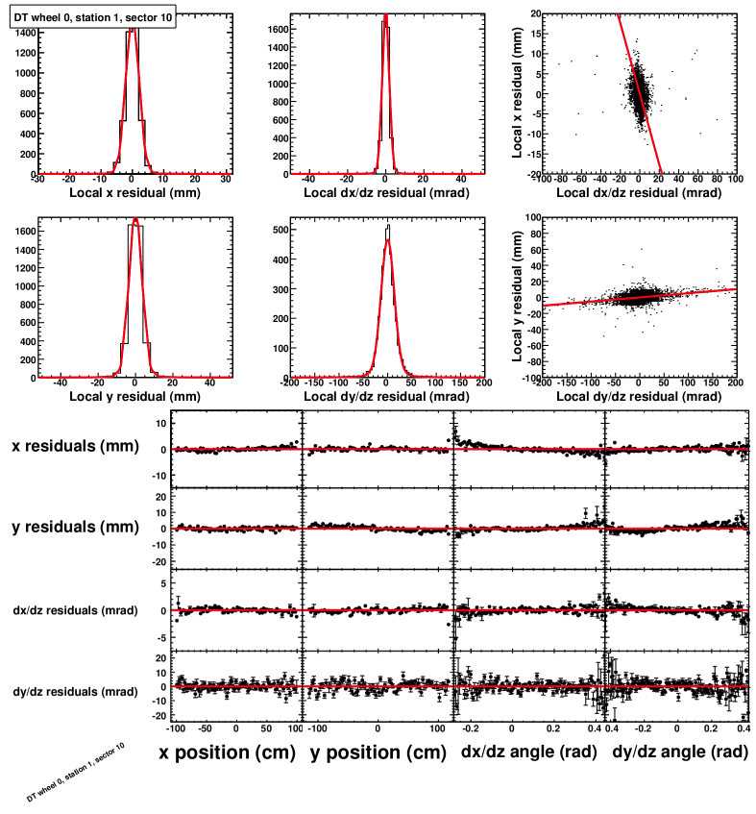
Sample fit results (these are real data)‏
Before (V4)‏
After
Gaussian-Lorentzian convolution fits the residuals well, including correlations
“Residuals vs. position” (4 types of residuals and 4 coordinates for position = 16 plots)‏
become flatter and better centered after alignment. (Some misalignments appear in multiple plots because of correlations between the positions and entrance angles.)‏

Slide 4
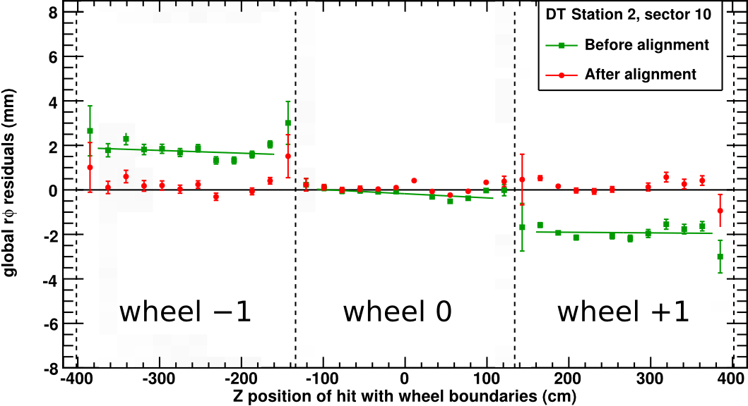
Example intermediate plot: residuals across chamber boundaries
These linear fits were not used in the alignment procedure itself; they are a guide for the eye. (The actual alignment fits have 16 parameters and are shown in projections on the previous page.)‏
Residuals were plotted without regard to which chamber they belong to, but exhibit sharp discontinuities at the chamber borders (something one expects from misalignments, not track source biases)‏

Slide 5
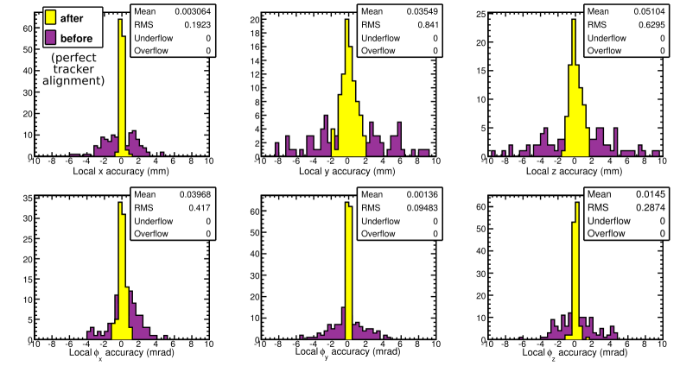
Monte Carlo results (cosmic rays)‏
In this MC test, everything was the same as the real-data alignment except:
ideally aligned tracker, ideal magnetic field, ideal internal DT alignment.
The initial misalignment (purple) was random in all chambers (sigma = 2 mm x, 4 mm y and z, 2 mrad for all angles) and the “accuracy” is aligned position minus true position (yellow), with an x width of 200 microns (goal was 100-300 microns).
Over/underflow demonstrate that no chambers were “lost” (1 chamber = 1 histogram entry)‏

Slide 6
Introduction to segment validation
(next page)‏
Station 3 segment
Chamber in station 3
Station 2 segment extrapolated to station 3
Chamber in station 2
Find segments on pT > 50 GeV (straight) tracks
Measure difference in x (rphi) position, dx/dz (phi) angle between extrapolation and segment
Take a mean of all such comparisons (correcting for B-field with charge antisymmetry)‏
Plot them as a function of station pair (1-2, 2-3, 3-4) and sector number

Slide 7
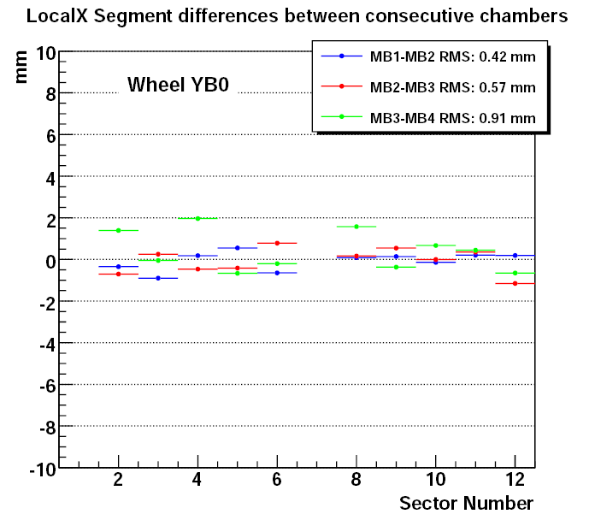
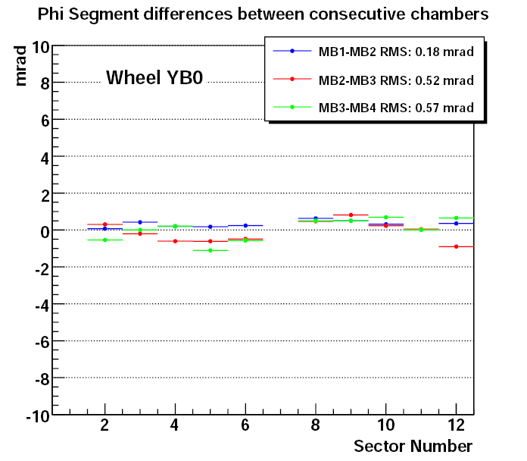
Each entry corresponds to the mean value of a Gaussian function fit
to the local_x (left plot) and phi (right plot) difference distributions
between segments propagated between consecutive DT stations inside
the same sector and wheel.
Uses SA, 1-leg tracks with Pt>50 GeV and at B=3.8T
Represents the relative local_x alignment (left plot) and Phi alignment (right plot)
between consecutive DT stations as a function of the sector number.
Similar for all wheels. Represents an independent, muon only validation of the
alignment

Slide 8
Muon Endcap Hardware Alignment
CMS Side view
Nominal
CSC
position
Not to
scale
B=3.8T
⊗
⊗
⊗
⊗
<ϕ_{x}>:
1.3mrad
<ϕ_{x}>:
1.3mrad
⊗
⊗
r_{global}
<ϕ_{x}>:
2.6mrad
<ϕ_{x}>:
2.4mrad
<ϕ_{x}>:
2.2mrad
<ϕ_{x}>:
2.7mrad
⊗
z_{global}
⊗
< ϕ_{x}>:
4.4mrad
<ϕ_{x}>:
4.4mrad
⊗
⊗
⊗
ϕ_{x}= 0
⊗
⊗
⊗
<ϕ_{x}>:
2.7mrad
<ϕ_{x}>:
2.2mrad
<ϕ_{x}>:
1.9mrad
<Δz_{ME+1/2}>:
-5.04 mm
<Δz_{ME-1/2}>:
5.94 mm
<ϕ_{x}>:
1.6mrad
<ϕ_{x}>:
2.5mrad
<ϕ_{x}>:
1.6mrad
⊗
⊗
<Δz_{ME+4/1}>:
0.65 mm
<Δz_{ME+3/1}>:
-4.31 mm
<Δz_{ME+2/1}>:
-0.97 mm
<Δz_{ME+1/1}>:
-17.57 mm
<Δz_{ME-1/1}>:
16.73 mm
<Δz_{ME-2/1}>:
10.23 mm
<Δz_{ME-3/1}>:
11.39 mm
<Δz_{ME-4/1}>:
8.49 mm
⊗
⊗
⊗
nom.
nom.
⊗
⊗
⊗
⊗
⊗
Pink: Aligned by
Tracker-Muon
Link system
Blue: Updated !
Aligned by
Muon Endcap
optical & analog
(Z sensors) System
Red: No
alignment yet
⊗
⊗
Nominal
CSC
position
⊗
⊗
⊗
⊗
<Δz_{ME+3/2}>:
3.26 mm
<Δz_{ME+2/2}>:
6.74 mm
⊗
⊗
<Δz_{ME-2/2}>:
2.74 mm
<Δz_{ME-3/2}>:
3.86 mm
<Δz_{ME+1/3}>:
-4.08 mm
<Δz_{ME-1/3}>:
4.08 mm
ME+4
ME+3
ME+2
ME+1
← Muon Endcap stations →
ME-1
ME-2
ME-3
ME-4

Slide 9
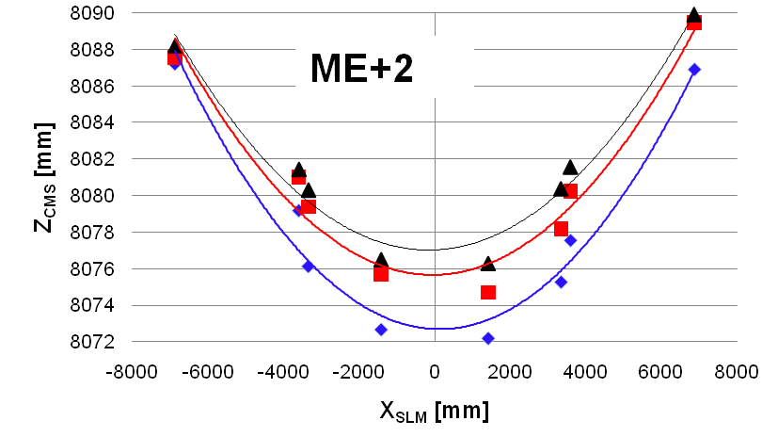
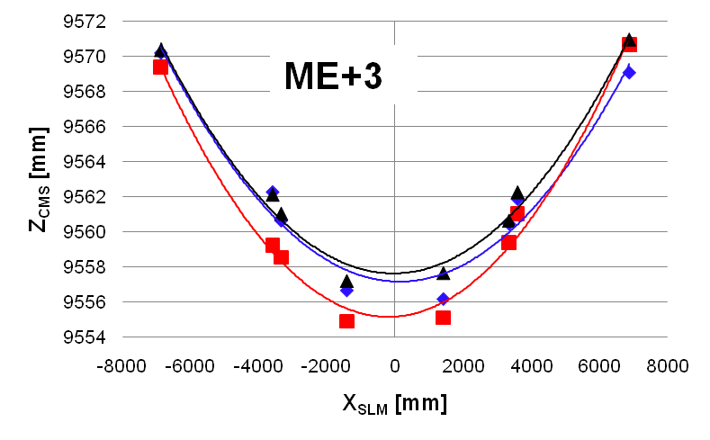
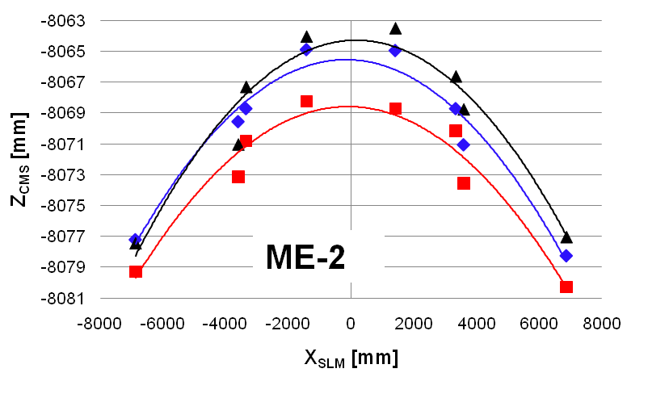
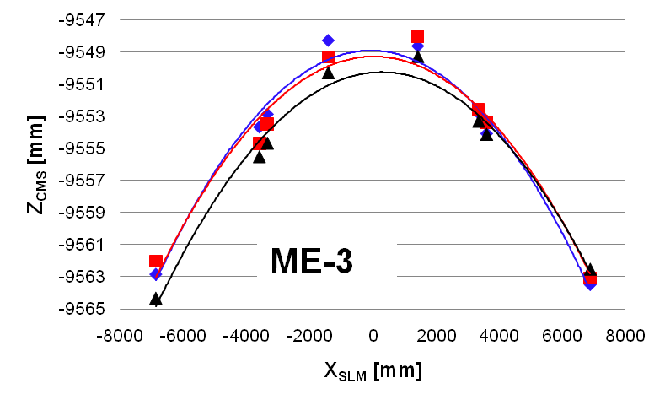
Disk bending at B=3.8T
SLM1
SLM2
SLM3
B=3.8T
Parabolic fits are a guide for the eye: not expected to be exact.

Slide 10
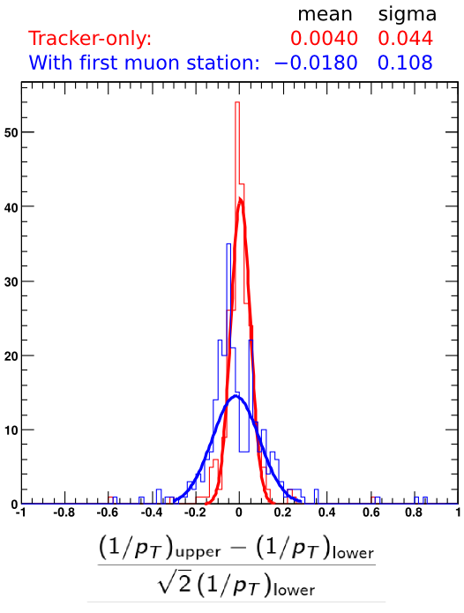
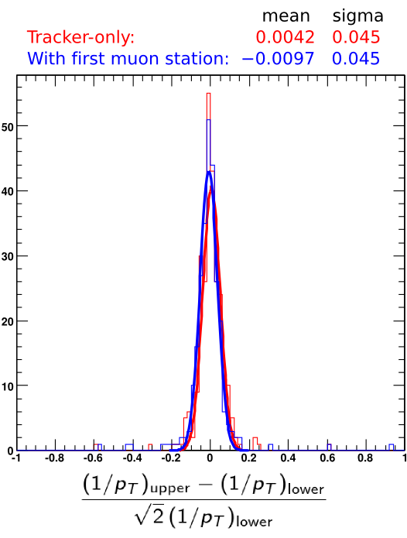
Split cosmic ray diagnostic (fractional curvature resolution)‏
Cosmic rays with pT > 200 GeV: are all close to 200 GeV
Alignment produced with 100-200 GeV: independent
Before CRAFT alignent
After alignment
1/pT of upper half of a cosmic ray track is compared with the lower half: difference is purely instrumental. Note that the fractional uncertainty in 1/pT equals the fractional uncertainty in pT (by error propagation formulae valid when distributions are Gaussian).
Only muon alignment is changed between these two plots. (Tracker-only differs slightly because of cuts: it must be identified with an existing globalMuon track.)‏

Slide 11
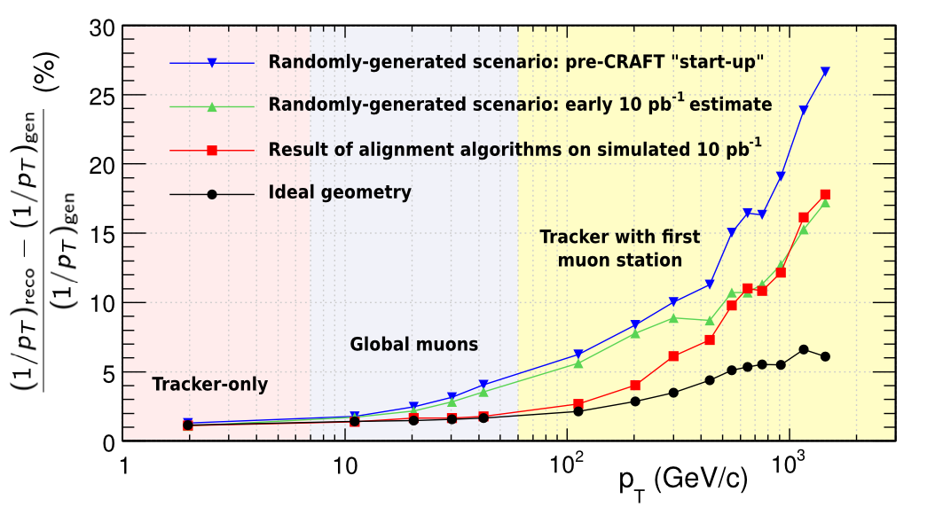
Resolution for physics from MC studies
Track reconstruction method optimized by pT (at high pT, use only first muon station to avoid hit confusion from muon showering)‏
MC simulations yield much better results than early estimates

Slide 12
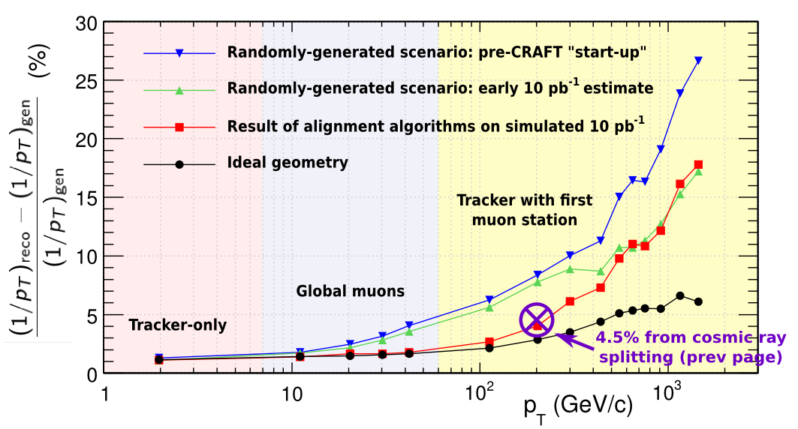
Resolution for physics from MC studies
Overlaying resolution observed in CRAFT: compares favorably with 10 pb-1 simulation
Same track reconstruction algorithm, equivalent definition of resolution (assuming top-bottom detector symmetry and independence), but cosmic ray alignment and diagnostics only apply to central barrel (wheels -1, 0, +1), where pT resolution is best. MC study sampled whole detector more uniformly.

