Slide 1
Muon Endcap
Hardware Alignment
CMS Side view
Nominal
CSC
position
Not to
scale
⊗
B=3.8T
⊗
⊗
⊗
<ϕ_{x}>:
1.3mrad
<ϕ_{x}>:
1.3mrad
⊗
⊗
r_{global}
<ϕ_{x}>:
2.6mrad
<ϕ_{x}>:
2.4mrad
<ϕ_{x}>:
2.2mrad
<ϕ_{x}>:
2.7mrad
⊗
z_{global}
⊗
< ϕ_{x}>:
4.4mrad
<ϕ_{x}>:
4.4mrad
⊗
⊗
⊗
ϕ_{x}= 0
⊗
⊗
⊗
<ϕ_{x}>:
2.7mrad
<ϕ_{x}>:
2.2mrad
<ϕ_{x}>:
1.9mrad
<Δz_{ME+1/2}>:
-5.04 mm
<Δz_{ME-1/2}>:
5.94 mm
<ϕ_{x}>:
1.6mrad
<ϕ_{x}>:
2.5mrad
<ϕ_{x}>:
1.6mrad
⊗
⊗
<Δz_{ME+4/1}>:
0.65 mm
<Δz_{ME+3/1}>:
-4.31 mm
<Δz_{ME+2/1}>:
-0.97 mm
<Δz_{ME+1/1}>:
-17.57 mm
<Δz_{ME-1/1}>:
16.73 mm
<Δz_{ME-2/1}>:
10.23 mm
<Δz_{ME-3/1}>:
11.39 mm
<Δz_{ME-4/1}>:
8.49 mm
⊗
⊗
⊗
nom.
nom.
⊗
⊗
⊗
⊗
⊗
Pink: Aligned by
Tracker-Muon
Link system
Blue: Updated !
Aligned by
Muon Endcap
optical & analog
(Z sensors) System
Red: No
alignment yet
⊗
⊗
Nominal
CSC
position
⊗
⊗
⊗
⊗
<Δz_{ME+3/2}>:
3.26 mm
<Δz_{ME+2/2}>:
6.74 mm
⊗
⊗
<Δz_{ME-2/2}>:
2.74 mm
<Δz_{ME-3/2}>:
3.86 mm
<Δz_{ME+1/3}>:
-4.08 mm
<Δz_{ME-1/3}>:
4.08 mm
ME+4
ME+3
ME+2
ME+1
← Muon Endcap stations →
ME-1
ME-2
ME-3
ME-4

Slide 2
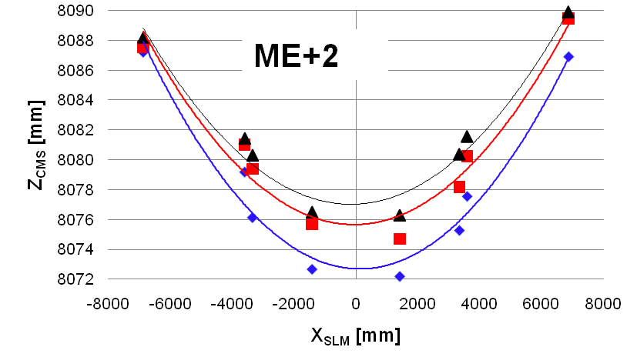
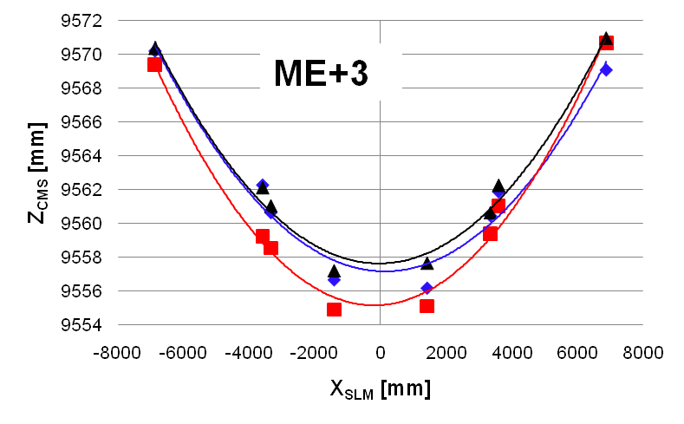
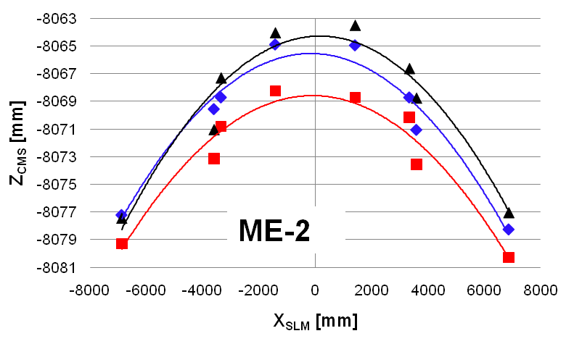
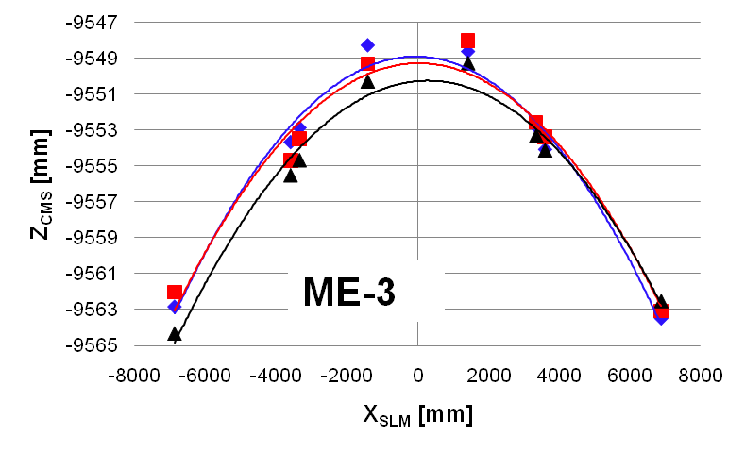
Disk bending at B=3.8T
SLM1
SLM2
SLM3
B=3.8T

