Slide 1
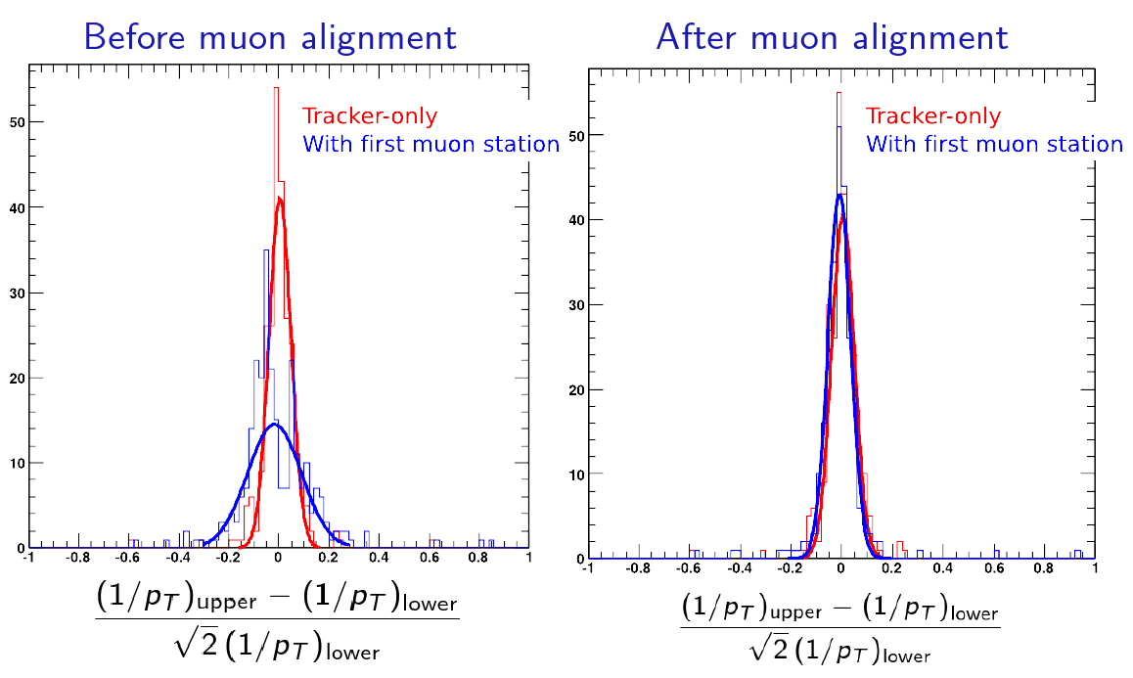
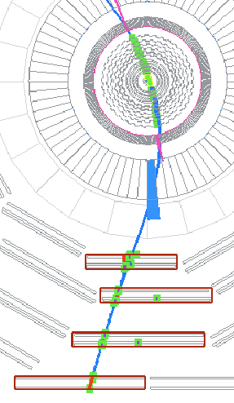
Triggers for Alignment: Tracker Cosmics
Non-beamspot pointing tracks help to resolve degeneracies in alignment
They are also very useful for data-driven track resolution, e.g. cosmic track splitting diagnostic (plot on right)‏
Status:
RPC trigger hardware and emulator exist (in 3_1_0_preX)‏
HLT algorithm is being optimized: currently, L2 muon is propagated into the tracker and matched to regional tracker hits
Efficiency for cosmic rays and fake rates in InclusiveMu (muons from min-bias/QCD) are being studied
Intended for both tracker alignment and DT alignment
Yohann Tschudi

Slide 2
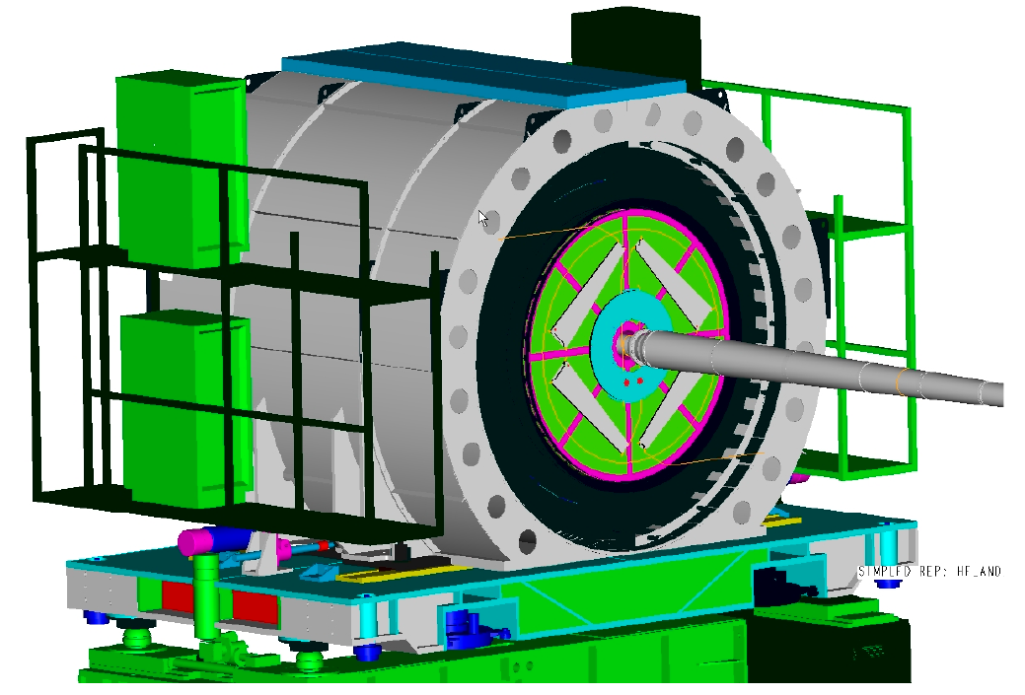
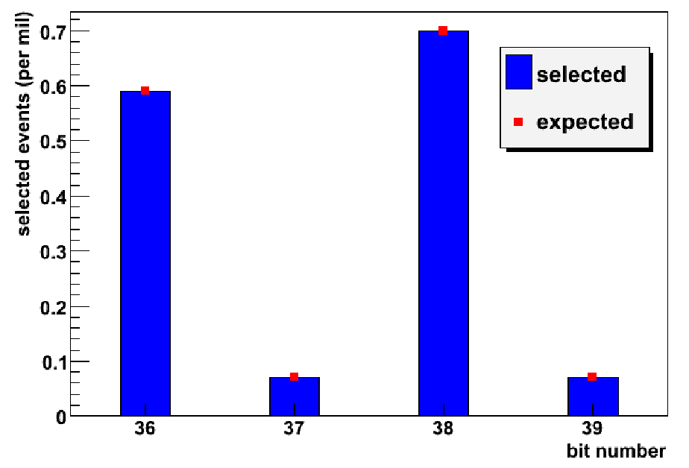
Triggers for Alignment: Tracker Beam-Halo
Scintillator paddles on front and back of the tracker select forward and backward beam-halo based on timing of hits.
Mirror-image coincidence required within timing resolution of paddles (3 ns)‏
Status:
Trigger hardware and emulator are in place
Study of efficiency and fake rates is underway
Simulations yield good agreement with geometrical acceptance
Forward BH
Backward BH
Gaelle Boudoul

Slide 3
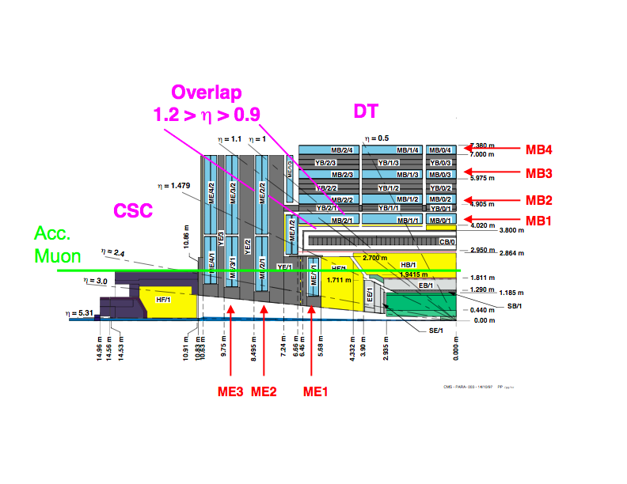
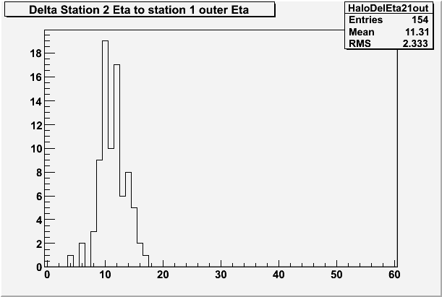
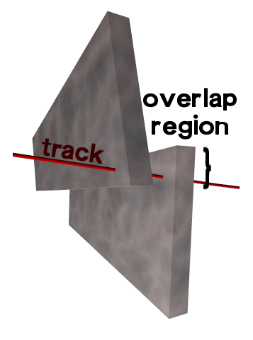
Triggers for Alignment: CSC Beam-Halo
Selects horizontal muons by requiring apparent eta to differ from one station to the next
Status:
Trigger hardware, emulator, and monitoring are all in place
Validating both online data and MC release samples, including special HLT algorithms that select tracks in overlaps of pairs of CSCs, for CSC alignment
Joseph Gartner

