Slide 1
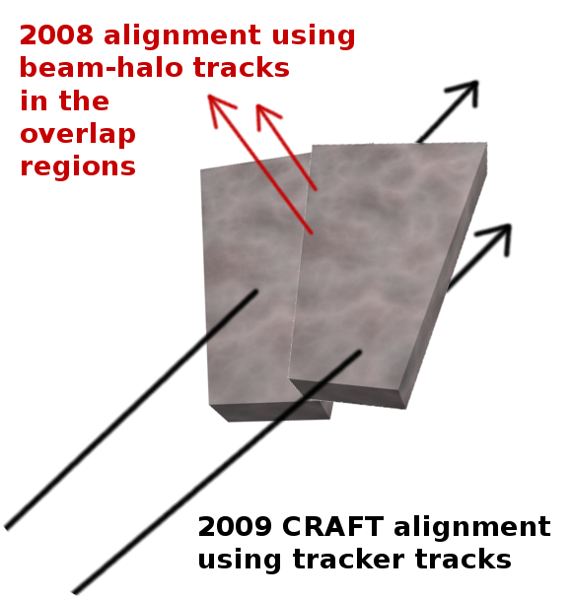
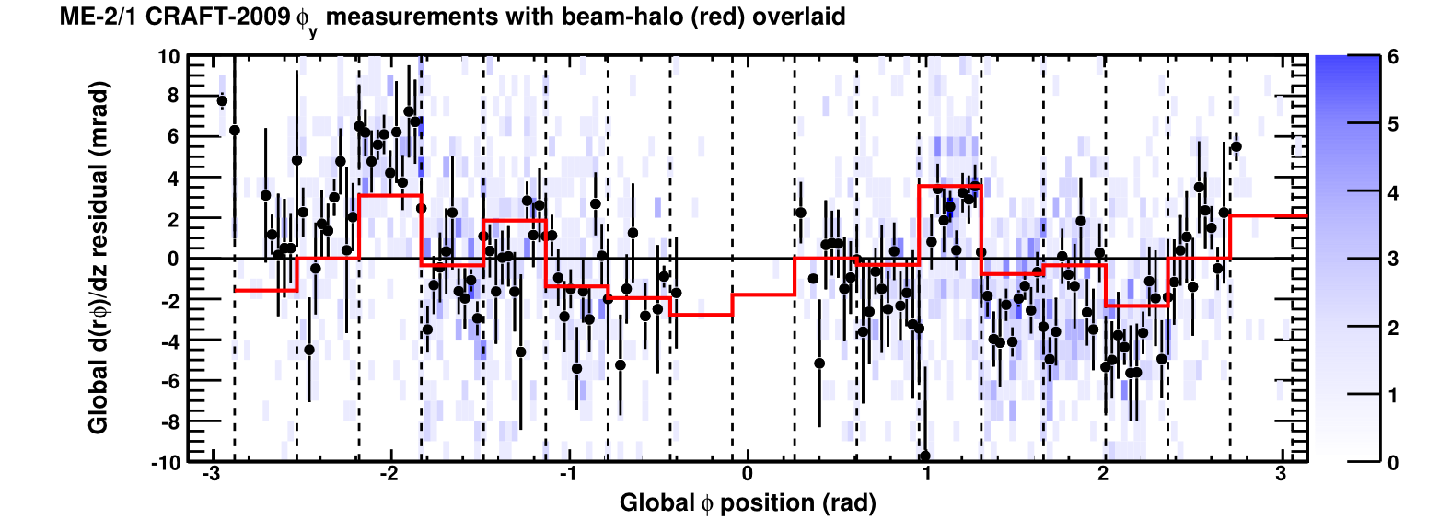
CSC Alignment
Small fraction of cosmic rays pass through tracker and CSC chambers: apply tracker-to-muon chamber alignment technique
Diagnostic plot below: angular residuals vs. phi
2D distribution is blue, profile is black, dashed lines separate CSC chambers
Alignment results from 2008 beam-halo overlaid in red for comparison
Cross-check of very different alignment techniques

