Slide 1
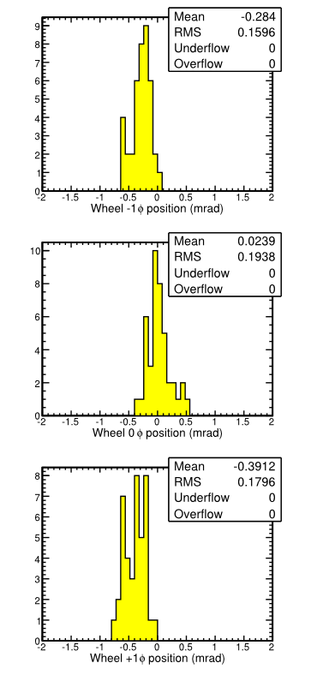
DT Alignment
Automated procedure applied to CRAFT-09 Prompt RECO, using offline CAF (normal operating mode)‏
Much smaller changes between 2008 and 2009 than between unaligned state and first alignment
No evidence of chamber rotations larger than 0.5 mrad (RMS)‏
Chamber translations are correlated by wheel:
collective rotation around the beamline ~0.2 mrad
collective translation parallel to beamline ~1.7 mm
wheel 0 was stationary relative to tracker
2008 -> 2009 phi position differences shown on right, separated by wheel
Tested sensitivity to 2008 -> 2009 tracker alignment changes: 440 microns in muon chamber rphi positions (RMS)‏

Slide 2
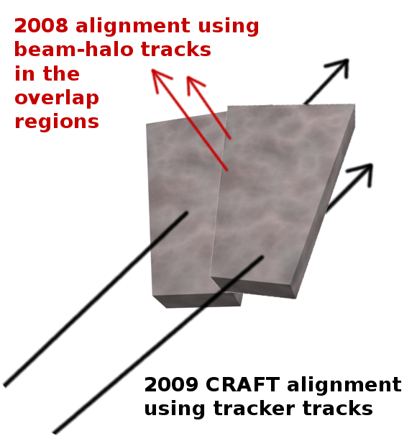
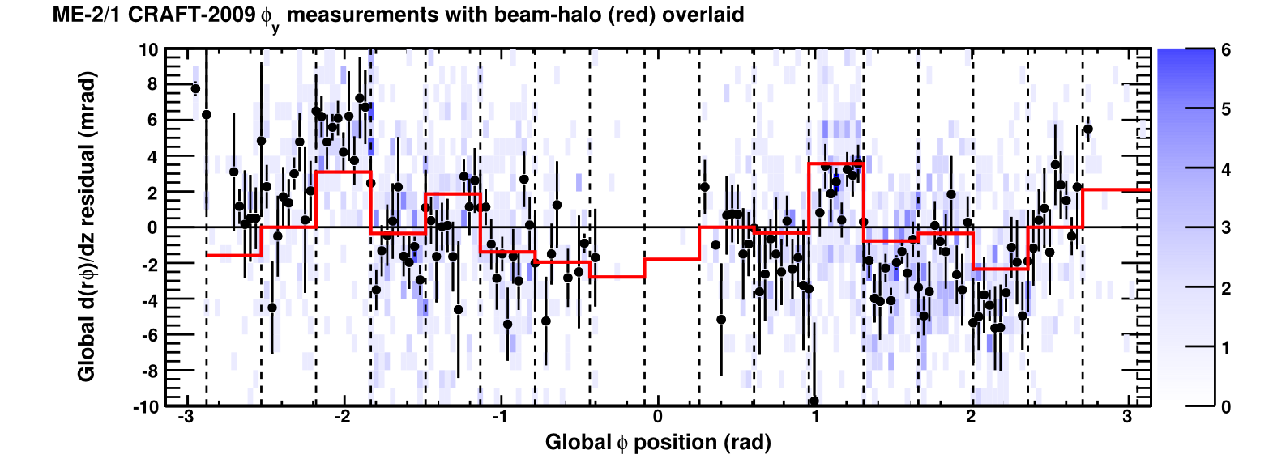
CSC Alignment
Small fraction of cosmic rays pass through tracker and CSC chambers: apply same tracker-to-muon chamber alignment technique
Diagnostic plot below: angular residuals vs. phi
2D distribution is blue, profile is black, dashed lines separate CSC chambers
Alignment results from 2008 beam-halo overlaid in red for comparison
Cross-check of very different alignment techniques

