Slide 1
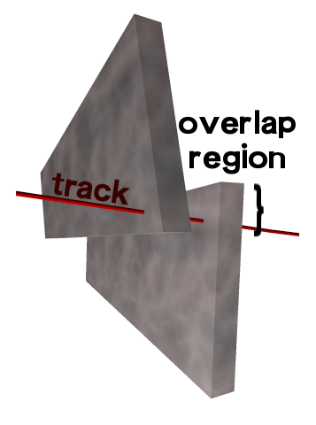
Muon Alignment Projects for the September/October Exercise
Beam-halo + 5 pb-1 ring alignment
Cosmics + 50 pb-1 (or more) chamber alignment
Beam-halo and 5 pb-1 are both used to align chambers relative to one another in rings with very little data, using the tracks that pass through the overlapping edges
The 5 pb-1 are then used to align the rings as rigid bodies relative to the tracker
Results of tracker alignment and APEs will be a part of this study
Prepares CSCOverlapsAlgorithm code for data, last used in a 2_1_X environment
First alignment pass with high-momentum (pT > 100 GeV) cosmic rays, especially for radial positions of DT chambers
Realign all chambers with 50 pb-1, inheriting radial positions from cosmics alignment (radial positions are particularly sensitive to B(x) and dE/dx errors in 20 < pT < 100 GeV tracks)‏
Results of tracker alignment and APEs will be a part of this study

Slide 2
Samples required
Beam-halo: MuAlBeamHaloOverlaps (testing cmsDriver-compatible configuration file to submit a request)‏
Cosmic rays: MuAlGlobalCosmics and MuAlCalIsolatedMu (requested by G. Boudoul)‏
InclusiveMuon (we will select small and large subsamples offline): MuAlOverlaps and MuAlCalIsolatedMu
W -> mu nu and Z -> mu mu: MuAlCalIsolatedMu
Approximate resolution goals:
Beam-halo/5 pb-1: 400 microns in x for all CSC chambers
Cosmics/50 pb-1: 400 microns in x for all chambers

Slide 3
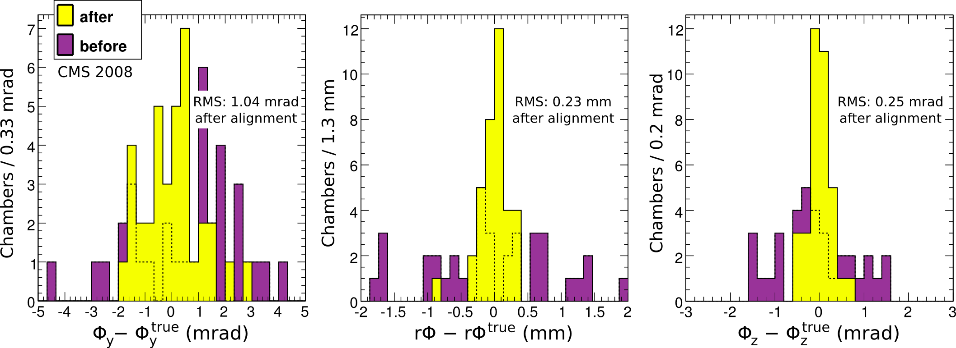
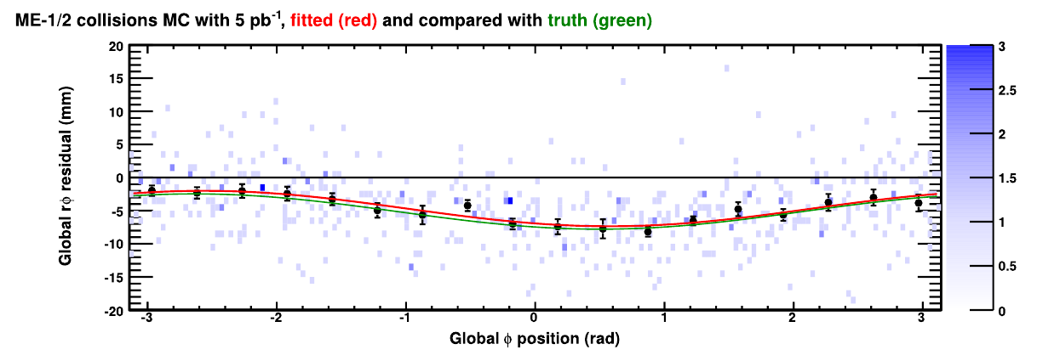
Beam-halo/5 pb-1 workflow from previous exercises
Alignment of chambers relative to one another with beam-halo
Aligned position
minus true position
before (purple)‏
and after (yellow)‏
alignment
Alignment of rings relative to the tracker with 5 pb-1
Rphi residuals
versus phi
const + sin(phi) + cos(phi)‏
-> ring X-Y position and phi_z angle

Slide 4
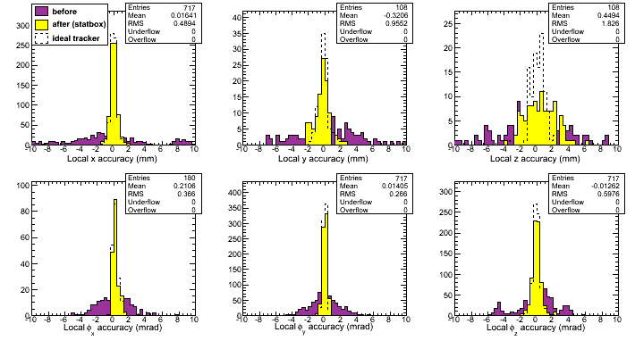
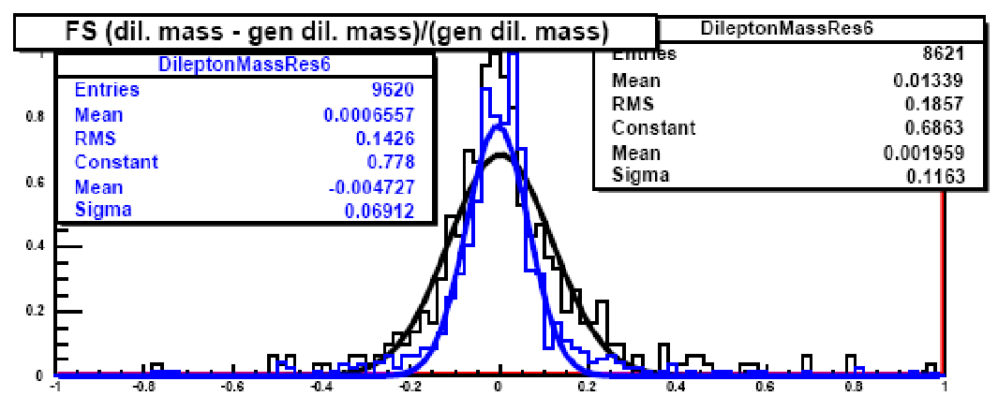
Cosmics/50 pb-1 workflow from previous exercises
Aligned position resolution (from MC truth)
Aligned position
minus true position
before (purple)‏
and after (yellow)‏
alignment
Simulations of Z' resolution (from subsequent tests by physics groups)
First muon station:
blue: 50 pb-1
black: STARTUP

