Slide 1
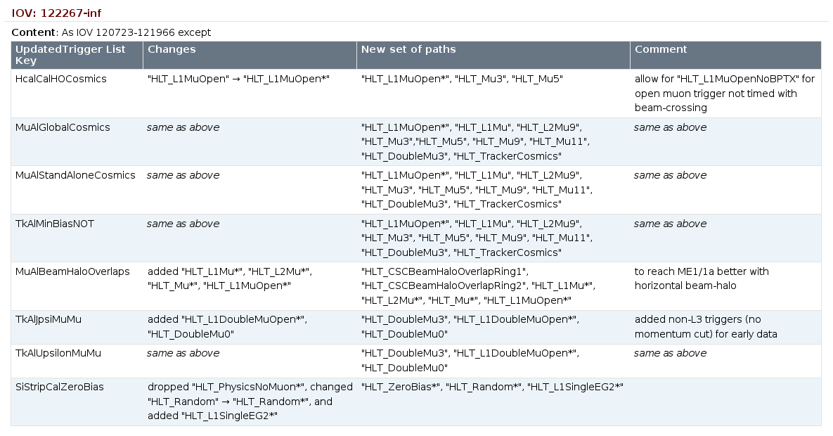
Changes to AlCaRecoTriggerBits
Starting at Monday at 1:30 AM CET, which is run 122268 (DB IOV: 122267-inf)‏
Summary:
Loosening L1MuOpen to include L1MuOpenNoBPTX (for cosmics not in time with beam)‏
Loosening MuAlBeamHaloOverlaps selection for better coverage of ME1/1
Adding non-L3 triggers for TkAlJpsiMuMu and TkAlUpsilonMuMu
New set of triggers for SiStripCalZeroBias

