Slide 1
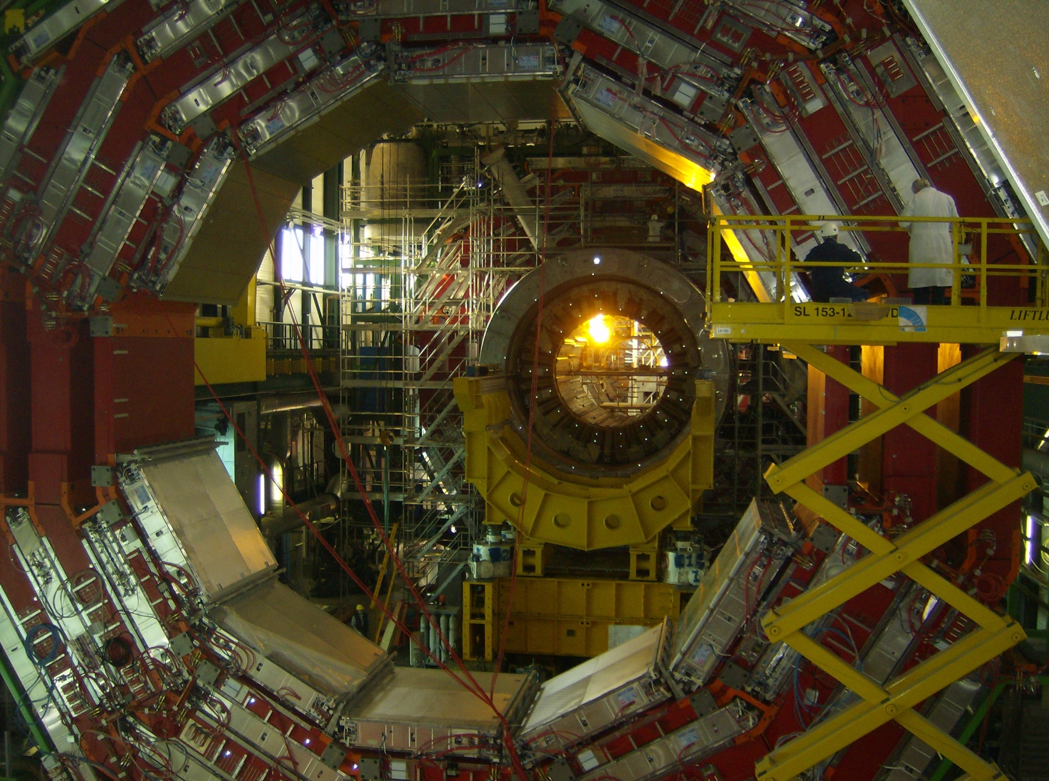
Muons and New Physics
Searches with CMS

Slide 2
Introduction: Why muons?
Leptons provide a powerful discriminant against huge QCD backgrounds
Long-term A&M projects: search for Higgs and SUSY with multi-tau signatures
  The most distinct multi-tau signatures have at least one muon in the final state (μ + τ−jets)‏
  But h → ττ and τ-coannihilation SUSY require 5-10 fb⁻¹ of integrated luminosity
A&M projects with early data: new resonances in muon channels, h → aa → 4μ and Z' → μμ

Slide 3
A&M Muon Contributions to CMS
To accomplish our physics goals, we need
  High performance in muon reconstruction at CMS
  Expertise in muon reconstruction
We have vested interests in ensuring muon readiness:
  Led installation and commissioning of the low-voltage system for the Endcap Muon system (EMU)‏
  Software and database support of EMU operations, e.g. design and support of equipment database
  Track-based muon alignment system, a key component in muon reconstruction, and one of the most visible tasks in CMS

Slide 4
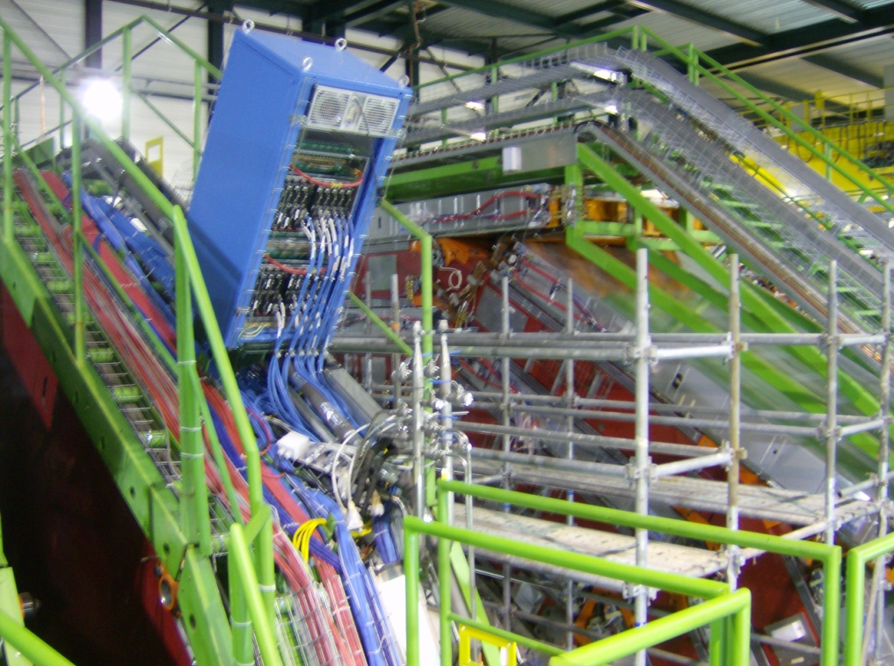
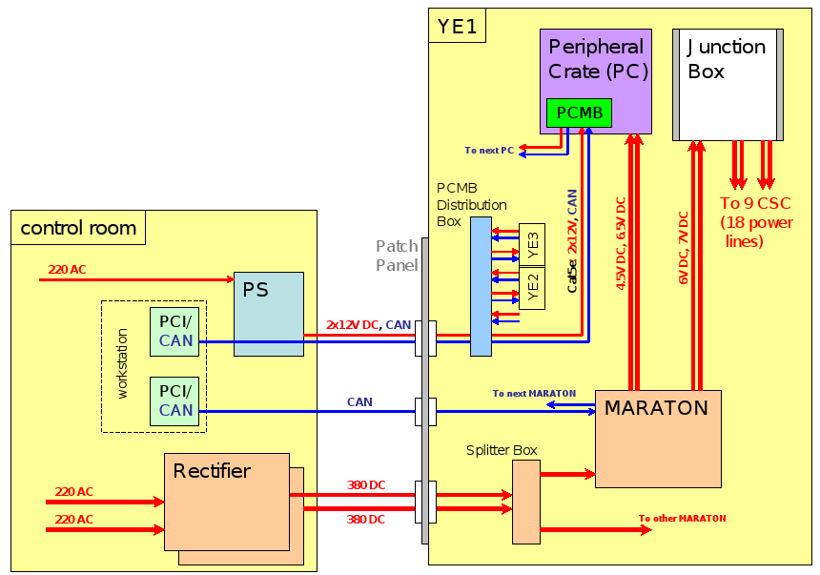
EMU Low-Voltage System
Provides low-voltage power to all EMU electronics
  Self-diagnosing
  Communicates via an independent network
Developed entire system (A. Golyash)‏
Lead naturally to SLHC (see Jason's talk)‏

Slide 5
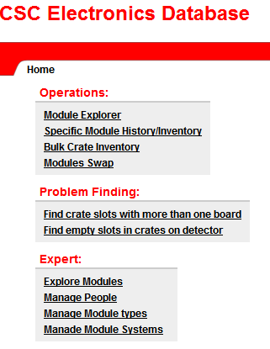
EMU Equiptment Database
Over 5000 electronic modules of 56 types
  Organized tracking of locations and history is essential
Solution: database with web-based interface
  Practical browsing, searching, and updating
  Complete inventory of Peripheral Crates and low-voltage, adding high-voltage
(V. Khotilovich)‏

Slide 6
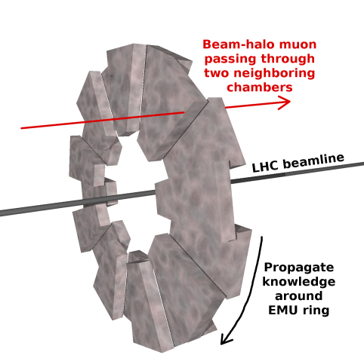
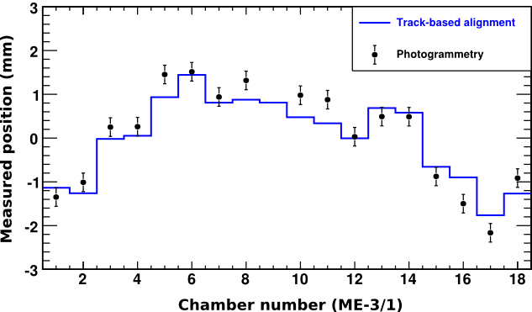
Track-based Muon Alignment (1/3)‏
Alignment of EMU chambers
  Determine relative positions of neighboring chambers by matching track segments
  Propagate this knowledge around each EMU ring
Aligned EMU rings with beam-halo muons from the 2008 LHC run
  Perfect agreement with independent photogrammetry

Slide 7
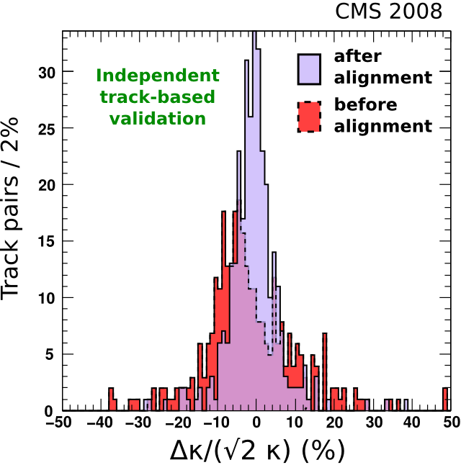
Track-based Muon Alignment (2/3)‏
The barrel muon system also needed alignment improvements, so we extended our work
  Despite fierce competition with a European group, our results and algorithm became the CMS standard
Aligned whole system with
cosmic rays in 2008 & 2009
One of the first CMS papers
with data (hep-ex/0911.4022)‏
2009 CMS Achievement
Award for Commissioning

Slide 8
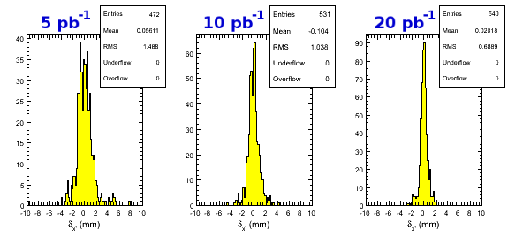
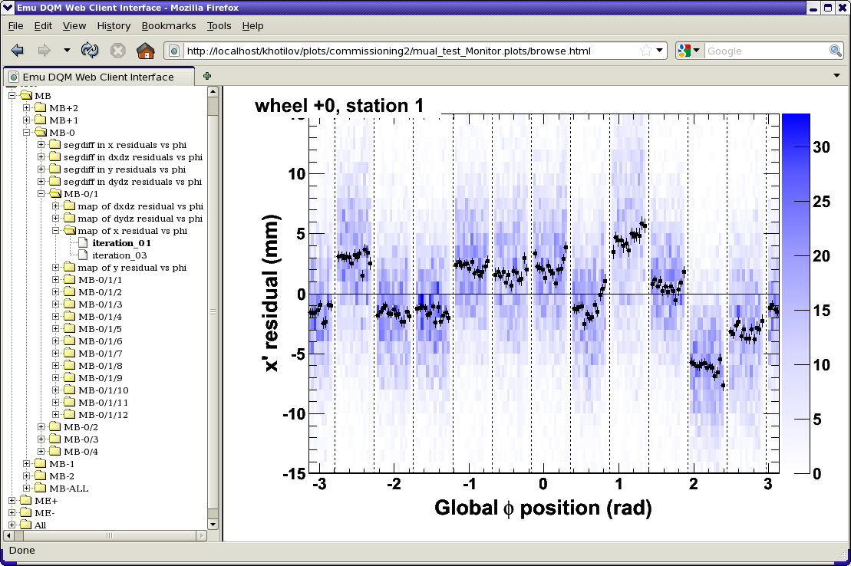
Track-based Muon Alignment (3/3)‏
Routine alignment production, deeper investigations
(A. Tatarinov)‏
Developing infrastructure
(V. Khotilovich)‏
  Automated plotting of alignment diagnostics, record-keeping

Slide 9
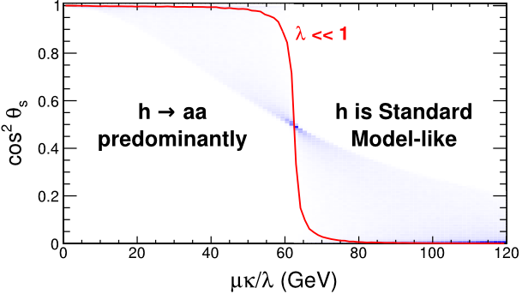
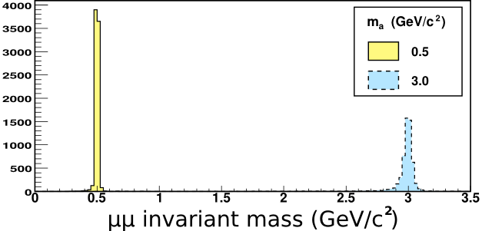
Early physics: h → aa → 4μ (1/2)‏
Previously unexplored region of NMSSM:
CP-odd Higgs mass m_{a} below 2m_{τ}, so a → μμ
  Incisive study of parameter
  space, phenomenology
  (with UK theorist S. Belyaev)‏
  Realistic detector
  simulation (A. Tatarinov,
  1st year grad student)‏
Produced hep-ph
paper, developing
CMS analysis

Slide 10
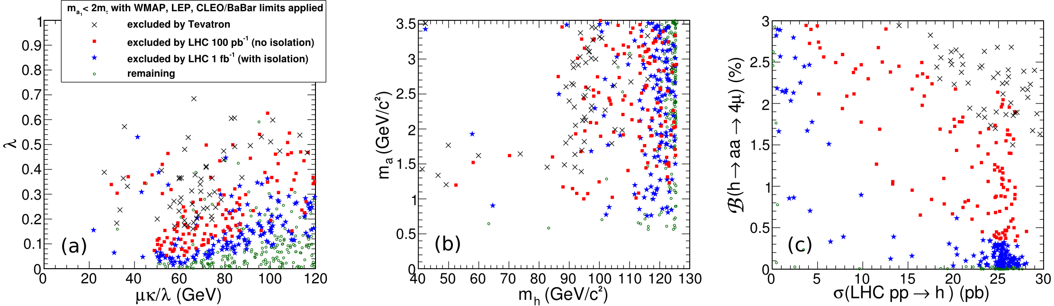
Early physics: h → aa → 4μ (2/2)‏
Extends beyond Tevatron reach with 0.1-1 fb⁻¹
Relies on LHC's strengths in the early period:
  Top-down: high energy more important than high lumi
  Clean signal, well-understood muon reconstruction from cosmic ray studies

Slide 11
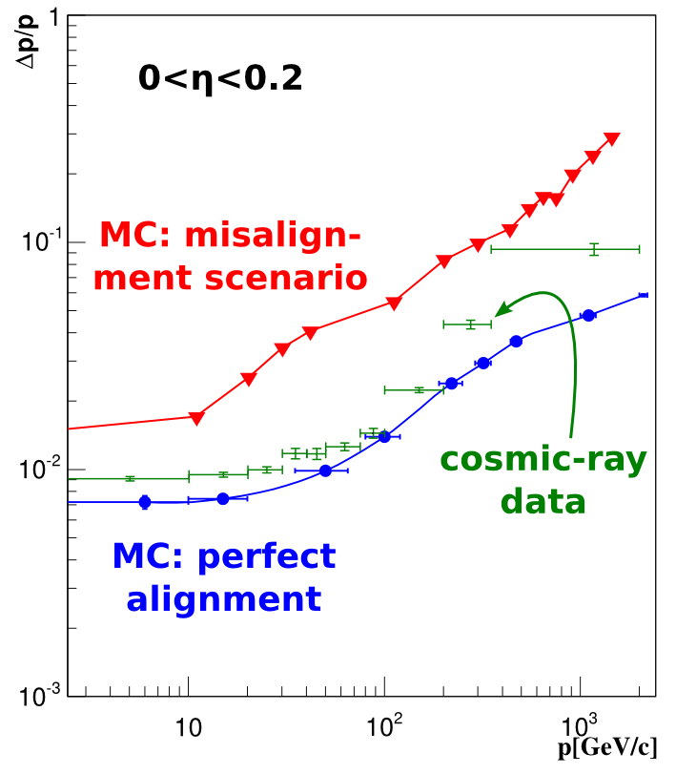
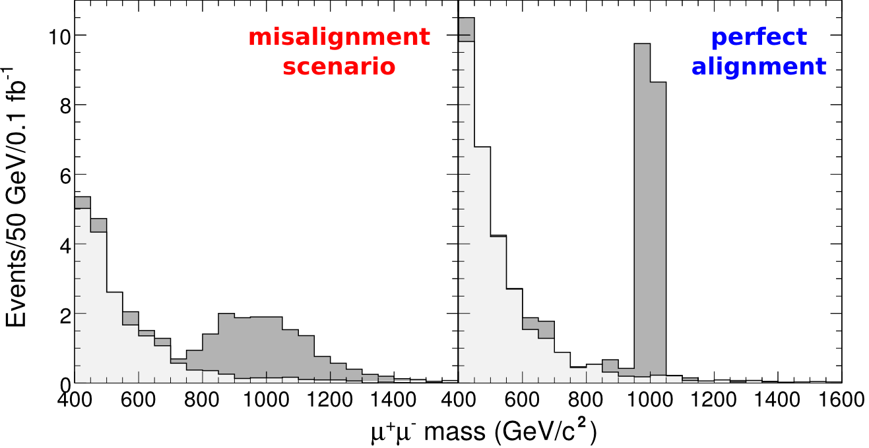
Early physics: Z' → μμ
One of the flagship analyses at CMS
  Many different beyond-the-Standard Model motivations for new Z' boson
We play a crucial role in this analysis through our muon alignment work

Slide 12
Conclusions
Muons are important for our near- and long-term physics goals
We are actively supporting the muon system
  Built low-voltage infrastructure
  Maintaining equiptment database
  Providing muon alignment for track reconstruction
Early physics analyses with muons
  h → aa → 4μ: from phenomenology to results
  Z' → μμ: key players in CMS flagship analysis

