Slide 1
Evidence for global distortion of the tracker from muon residuals
Markus Stoye, Roberto Castello,
Ernesto Migliore, and Jim Pivarski

Slide 2
Outline
Weak modes in alignment
Diagnosis with external information: muon residuals
Attempts to correct the geometry
How this affects the cosmic charge ratio

Slide 3
How can the geometry still be distorted after alignment?
Tracker alignment minimizes all track-fit chi^2 by varying module positions and track parameters
Ambiguities arise if a variation in track parameters can be compensated by a variation of module positions (as a global distortion): “weak mode”
Tracker-to-muon alignment propagates these global distortions to the muon system
The CRAFT alignments have determined relative positions of nearby detector elements with high precision, not necessarily the global shape

Slide 4
How can the shape be resolved?
Some weak modes of the tracker are not weak for the combined tracker + muon system
  Other methods: resonance mass constraints, secondary vertex direction-of-flight, etc.
  All methods to remove tracker weak modes require external information, by definition
To use the muon system as a constraint, we must separate the effects of possible tracker global distortions from possible muon misalignment

Slide 5
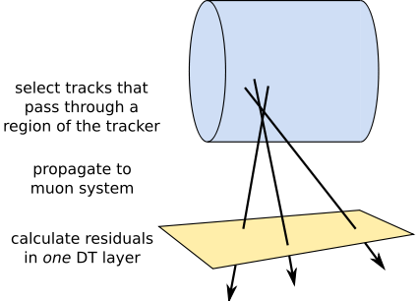
Diagnostic method 1: single layer
Tracker-only track fit
Plot muon residuals on only one layer of one chamber
Dependence on track momentum cannot be attributed to muon detector misalignment

Slide 6
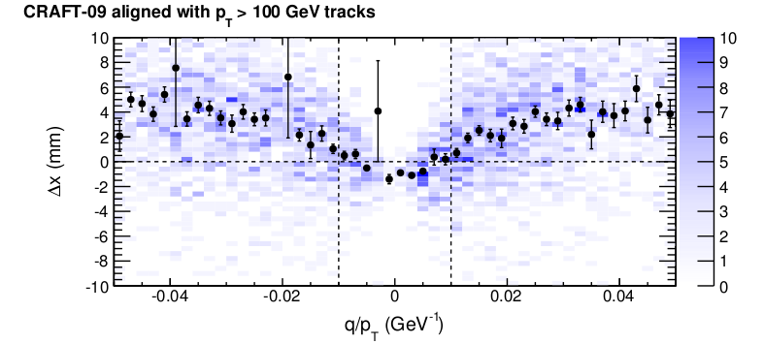
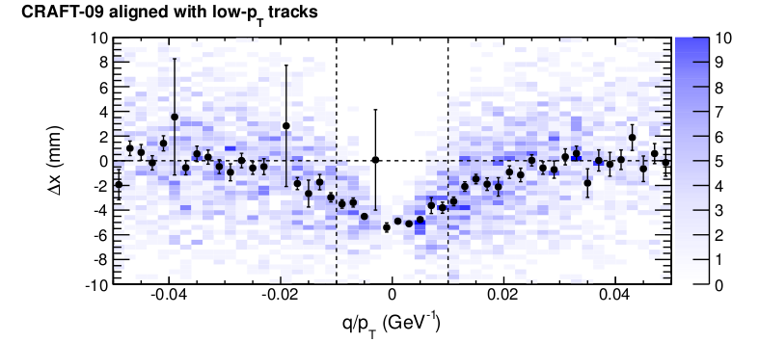
Muon residuals vs. q/pT
Allow for a constant offset in residuals (equivalent to muon alignment with high vs. low-pT tracks)‏
Effect of B-field and/or material budget errors are both antisymmetric in this plot (opposite q -> opposite Delta x)‏
Observed effect is symmetric with a scale of 1/100 GeV

Slide 7
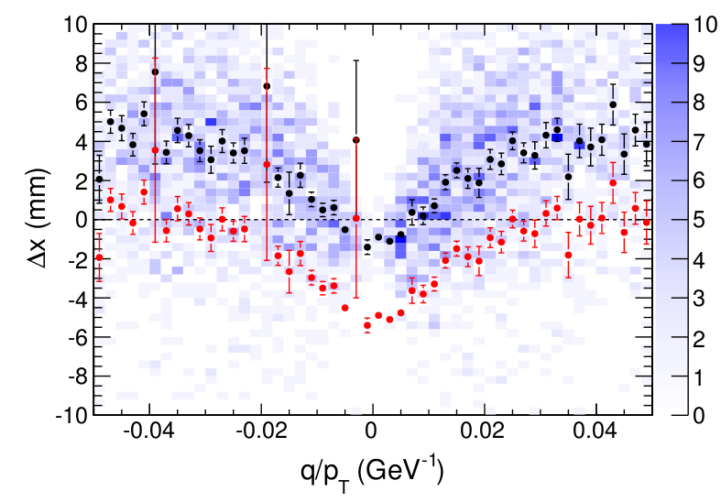
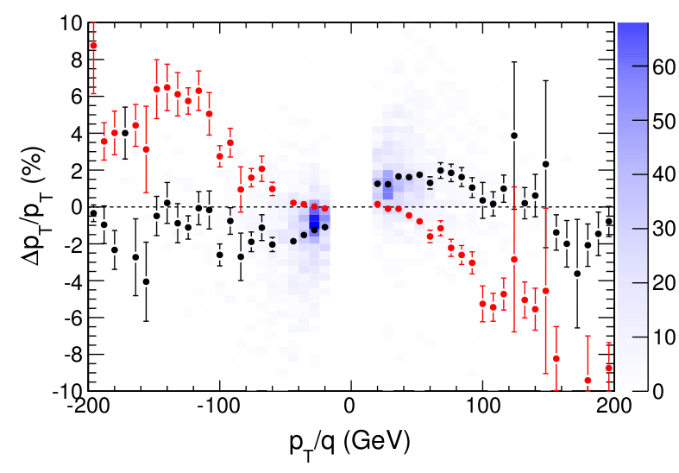
Potential implication for momentum
Observed muon residuals bias implies a momentum scale bias (via d(Delta pT)/d(Delta x))‏ between high and low momenta
Allowing layer position to float changes the shape of bias function, but not the approximate scale

Slide 8
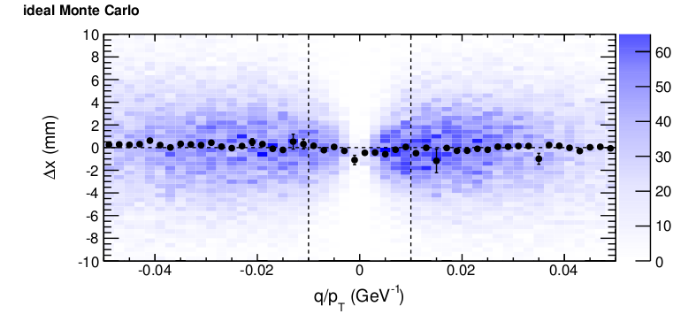
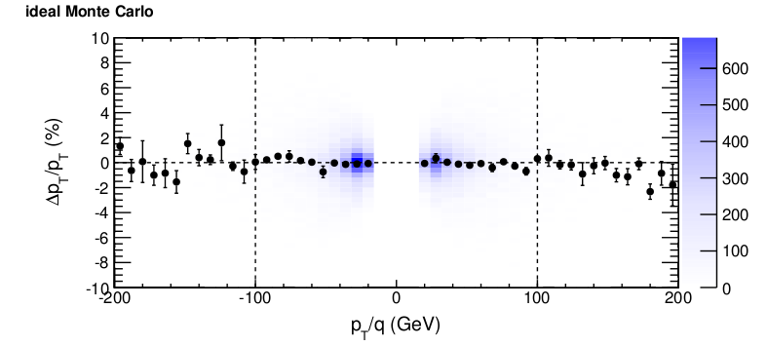
Sanity check: ideal Monte Carlo

Slide 9
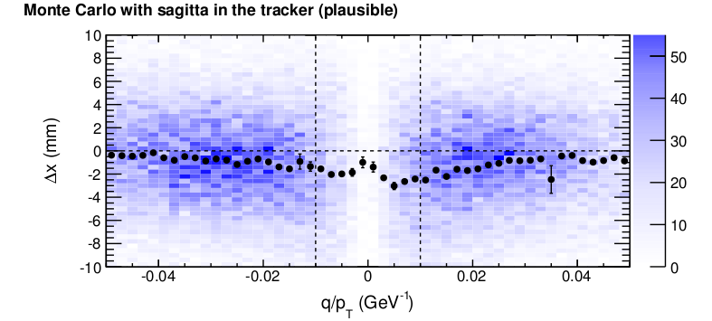
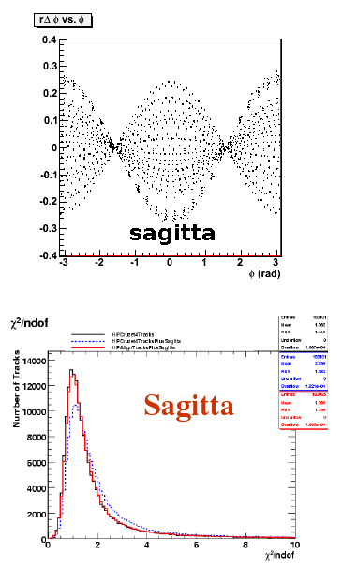
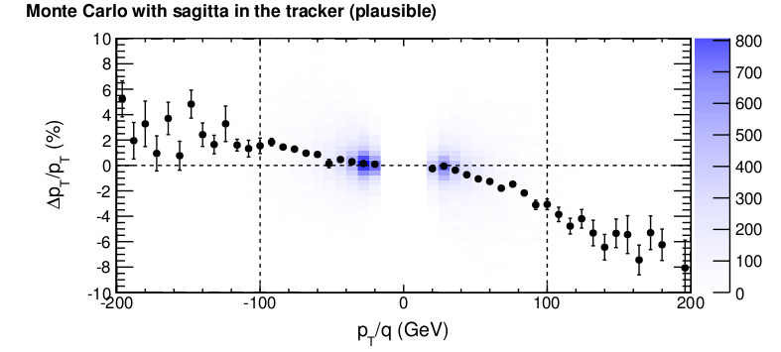
Test MC with “sagitta” weak mode
This is the weak mode that grew naturally in the realistic MC scenario

Slide 10
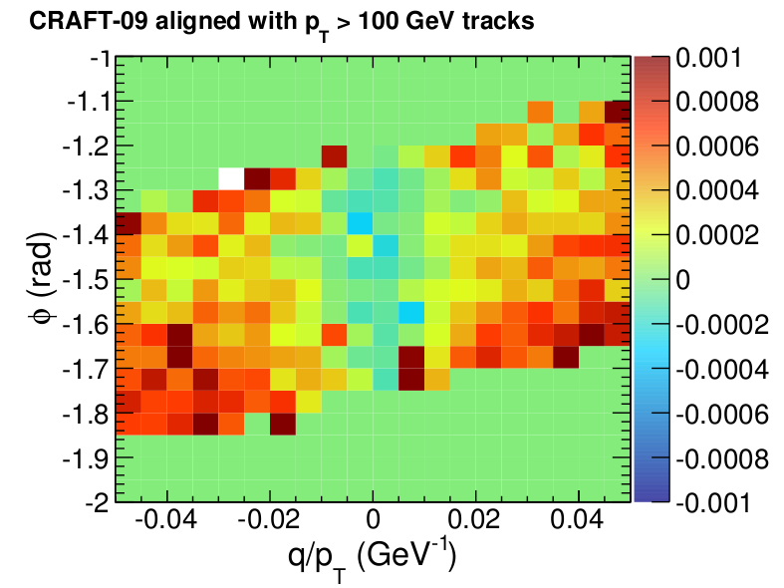
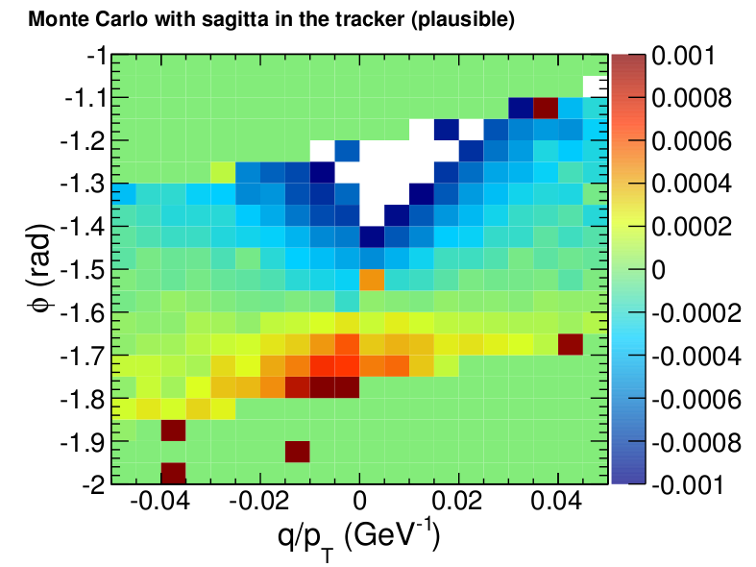
“Sagitta” mode is the wrong shape
Residuals versus phi and q/pT reveal a different shape
We'll need more phi information to solve this

Slide 11
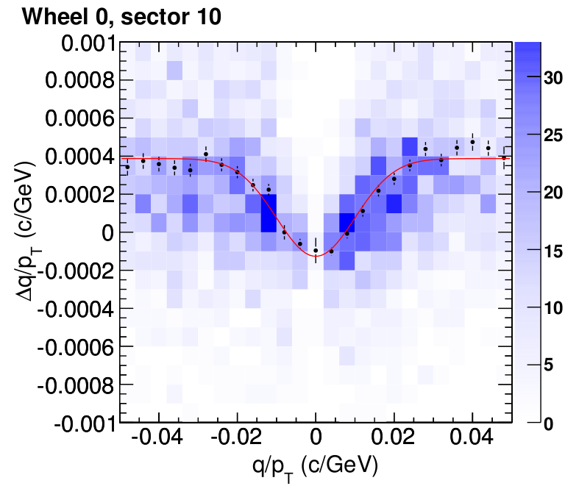
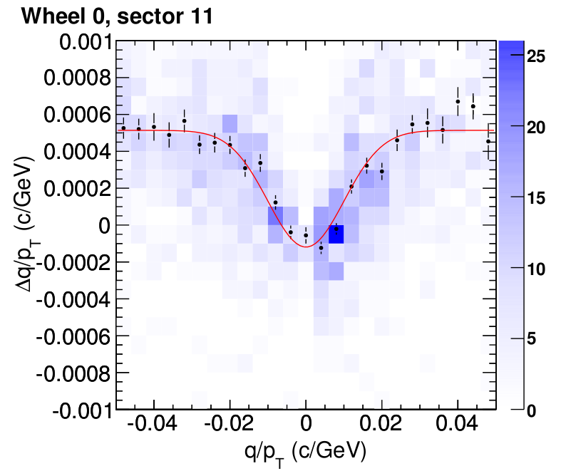
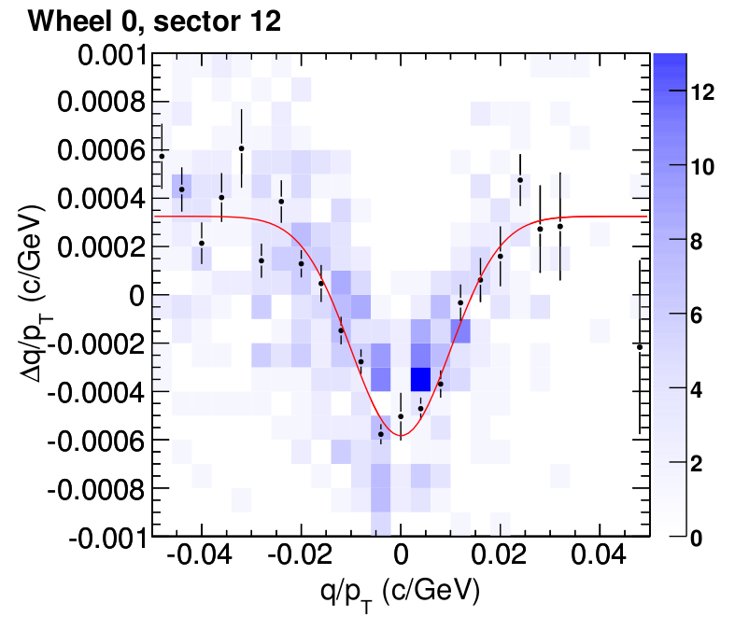
Diagnostic method 2: all DTs
Fit every Delta x vs q/pT distribution to constant + Gaussian (fixed width = 1/100 GeV)‏
They're all good fits; height of Gaussian peak is the difference in bias between low- and high-momentum tracks
Also works for Delta(q/pT) vs q/pT (above)‏

Slide 12
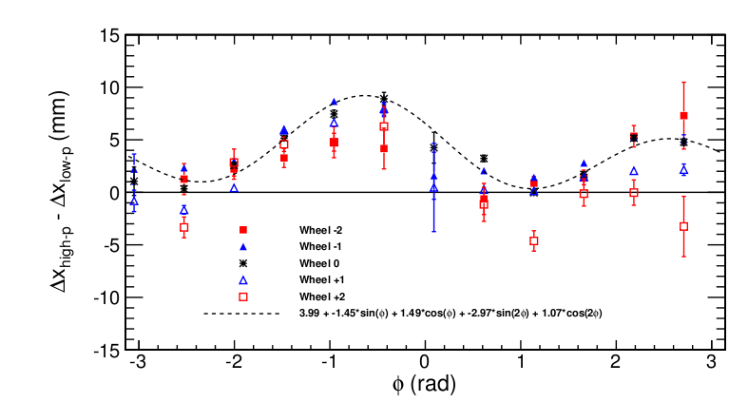
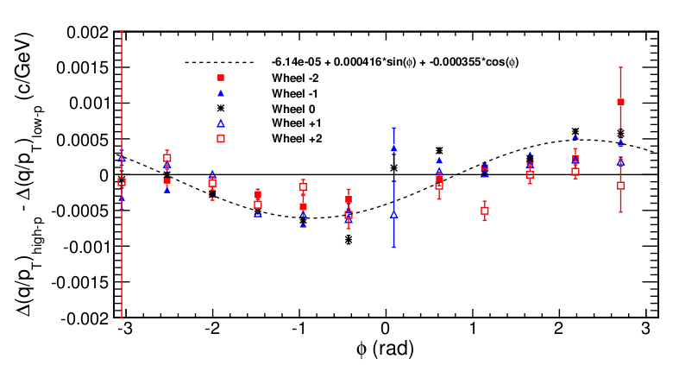
Diagnostic method 2: all DTs
Plot all Gaussian heights versus phi and wheel number of DT chambers
Delta x distribution dominated by constant and sin(2 phi + c)‏
Delta(q/pT) distribution is nearly pure sin(phi + c)‏
Same data, expressed two ways (2 phi -> 1 phi in transformation not yet understood)‏
Bottom plot is difference in momentum bias

Slide 13
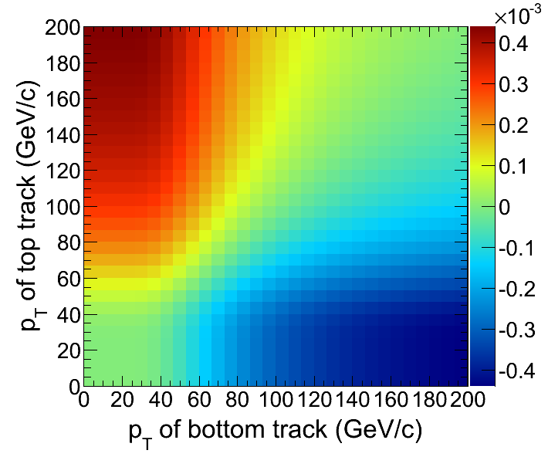
Why no effect in charge splitting?
Top-minus-bottom bias in tracker-tracks is 0.3 +- 0.3% (Delta q/pT over nominal q/pT)‏ for pT > 200 GeV tracks
Peak of bias curve (prev page) is near top of CMS and trough is near bottom of CMS
But those are differences in curvature bias between high and low momentum tracks
Both top and bottom legs of a split cosmic have nominally the same momentum
Color scale: difference in curvature of two tracks, one (“top”) at phi=2 and the other (“bottom”) at phi=-1
split cosmics on the diagonal

Slide 14
Attempts to correct the geometry
Correction must be a smooth global pattern with
(1) negligible tracker-track chi^2 sensitivity
(2) different effect on muon residuals for high- and low-momentum tracks
Method: impose a curvature bias to all tracks in a Millepede alignment; result minimizes chi^2 while modifying track parameters

Slide 15
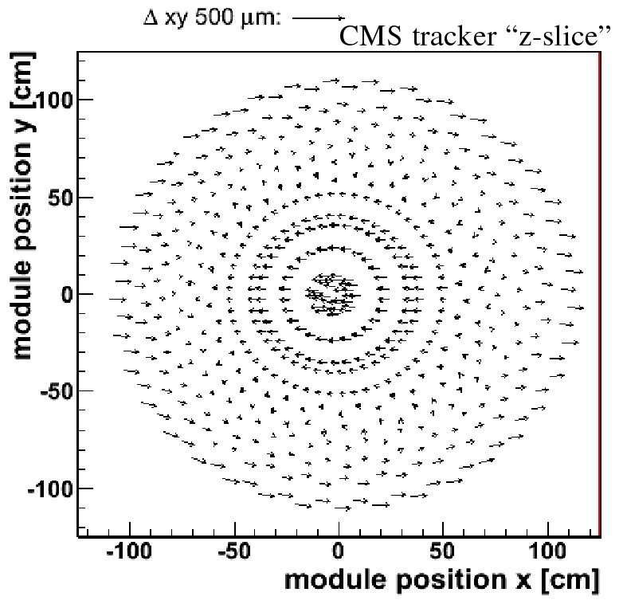
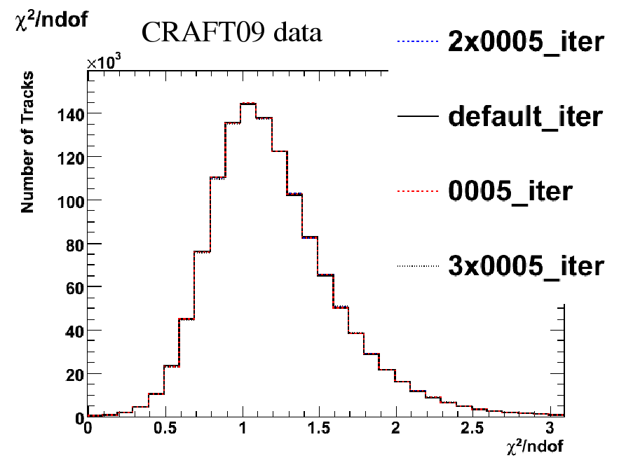
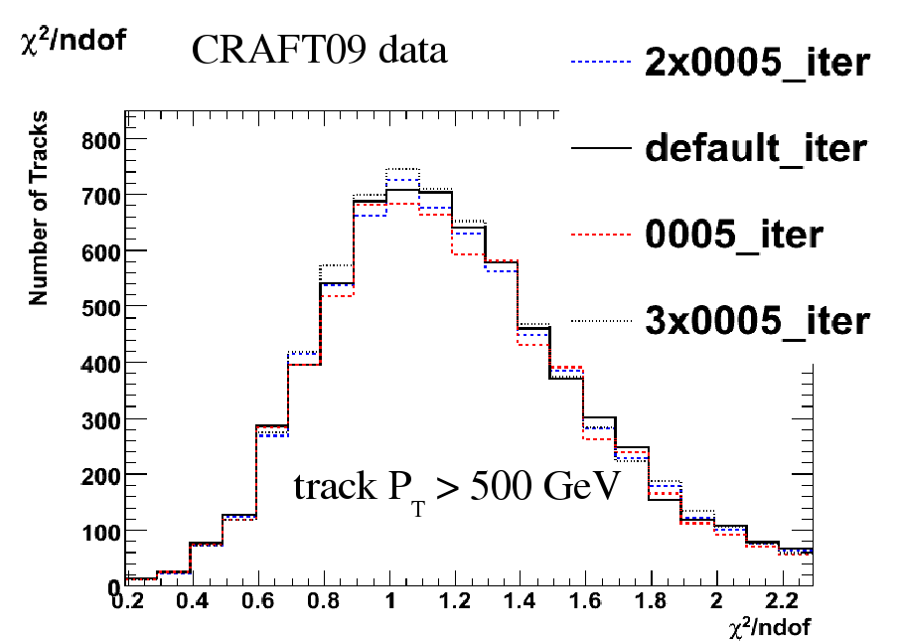
Millepede-generated deformation
Chi^2 invariant (even for high momentum tracks)‏
Generated same shape with three amplitudes, optimizing CRAFT-09 tracks each time

Slide 16
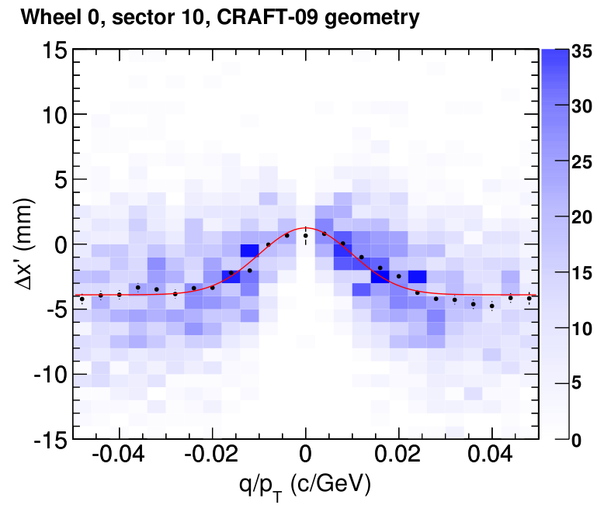
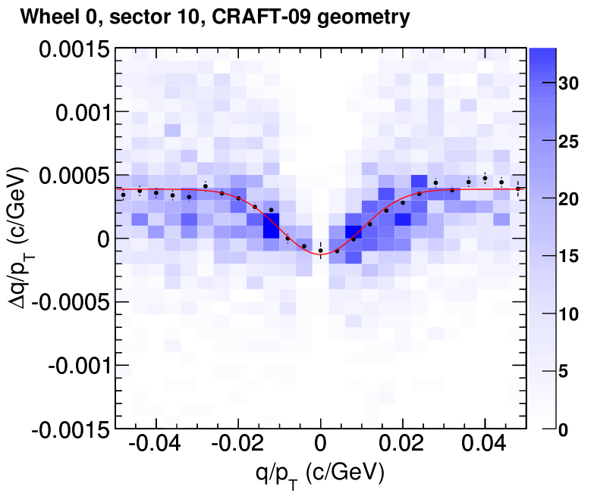
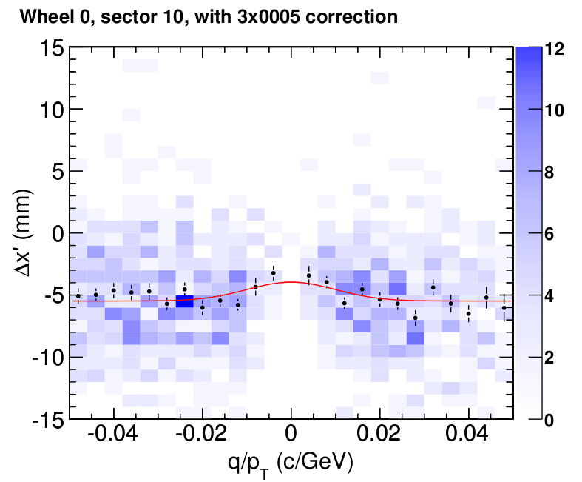
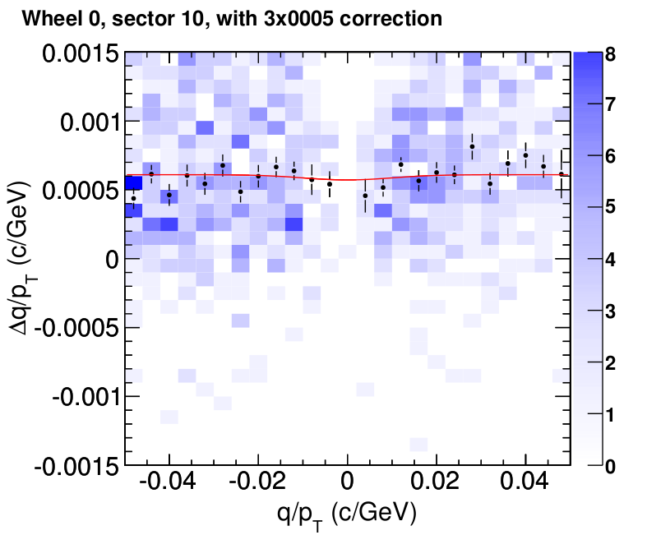
Effect on muon residuals
residuals
BEFORE
BEFORE
curvature bias
residuals
AFTER
AFTER
curvature bias

Slide 17
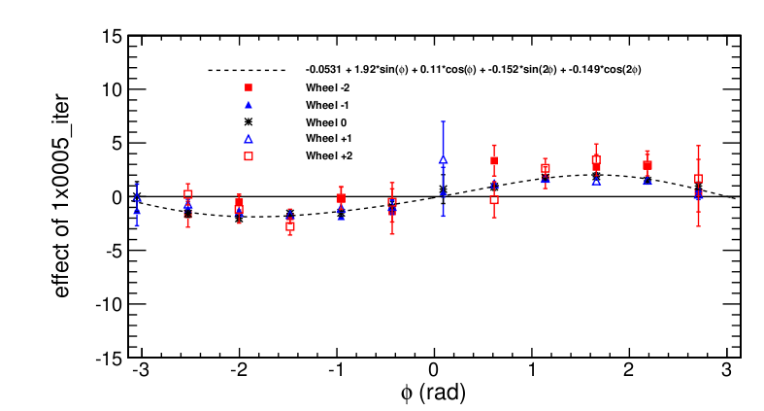
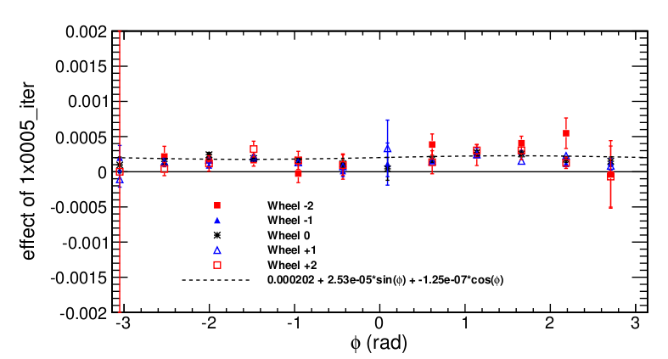
Effect on residuals: phi dependence
Showing how the change in geometry changes the plot
Top: (Delta x)_high-p minus (Delta x)_low-p
Bottom: same for Delta(q/pT)‏
  Curvature bias applied in Millepede results in constant-in-phi curvature change, different for low and high momenta

Slide 18
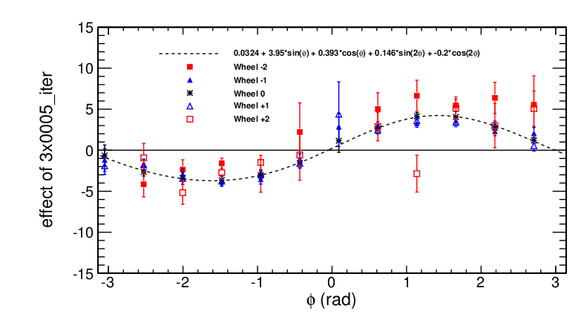
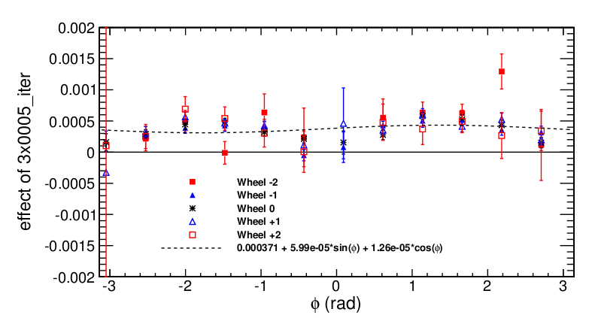
Effect on residuals: phi dependence
Showing how the change in geometry changes the plot
Top: (Delta x)_high-p minus (Delta x)_low-p
Bottom: same for Delta(q/pT)‏
  Curvature bias applied in Millepede results in constant-in-phi curvature change, different for low and high momenta
This is 3x the amplitude of the previous page

Slide 19
Slide 11 again, the effect that must be cancelled
Observation: same “mode-N, mode-(N+1)” effect
We need to cancel a sin(phi + c) bias in Delta(q/pT), and we have produced a constant bias
  Analyze this mode: how does it work? Parameterize it?
  Generalize Millepede procedure to sin(phi)‏

Slide 20
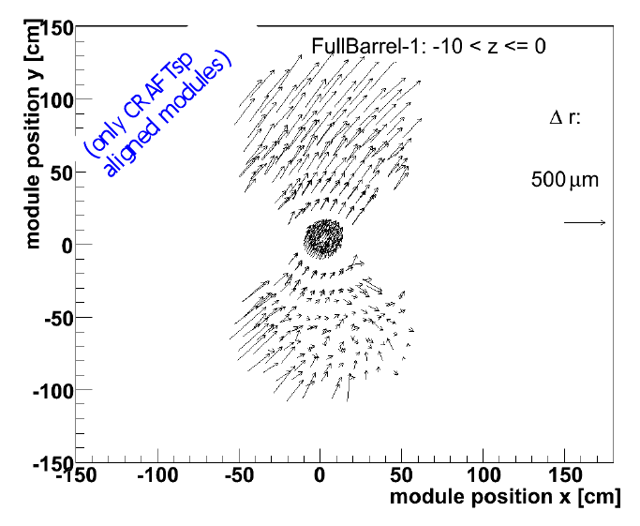
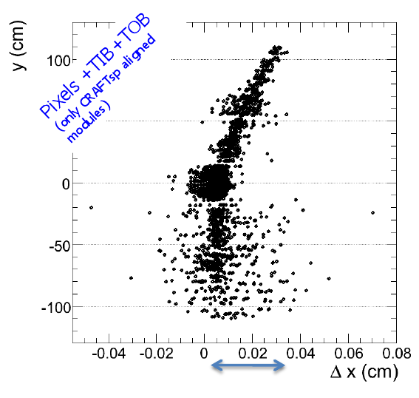
SuperPointing alignment
Alignment with only SuperPointing tracks (near-normal incidence on module planes) yields a similar shape to the Millepede-generated mode
If this is cause of the bias, then it was not a weak mode but a incidence-angle related bias

Slide 21
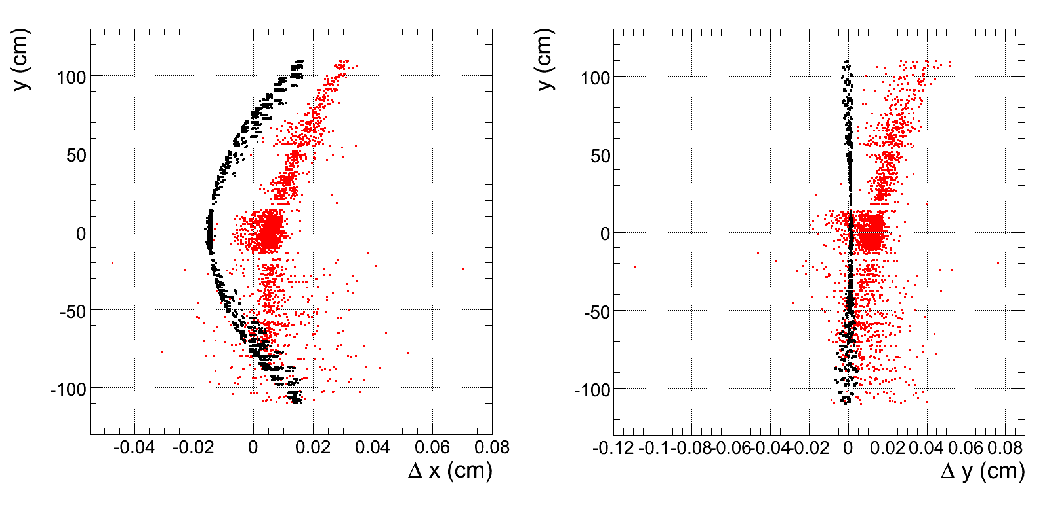
Analysis of the Millepede-generated and SuperPointing geometries
Differences with respect to CRAFT in x and y
Millepede-generated
SuperPointing

Slide 22
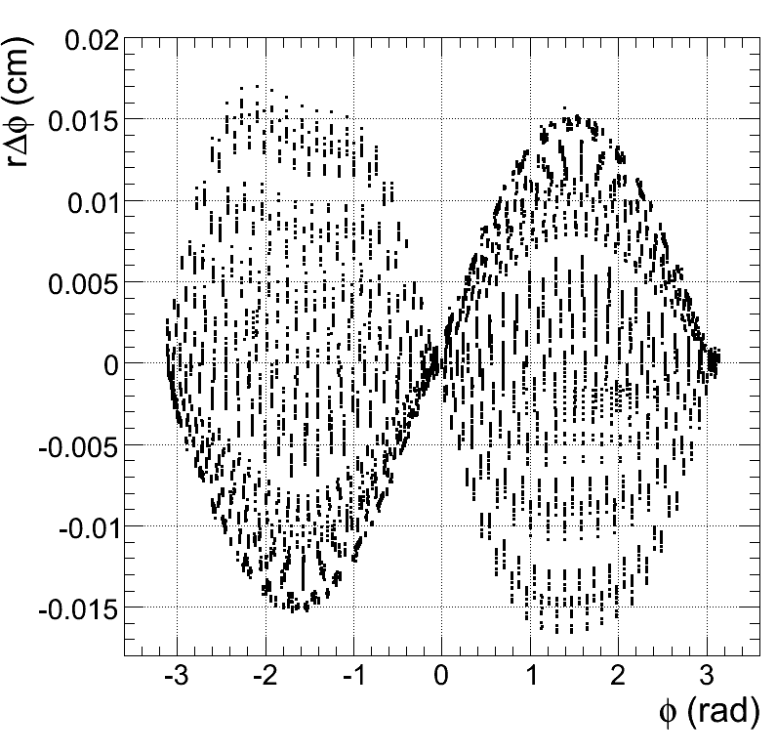
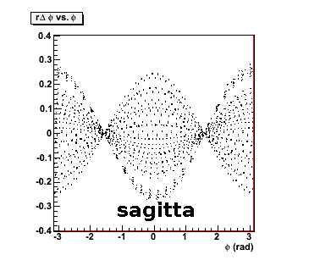
Analysis of the Millepede-generated and SuperPointing geometries
Millepede-generated mode (left) looks a lot like sagitta with a pi/2 phase...

Slide 23
How this affects the charge ratio
(1) Bin migration: if muons move into the next-higher bin, antimuons move into the next-lower bin
Steeply-
falling
momentum
distribution
introduces
ratio bias

Slide 24
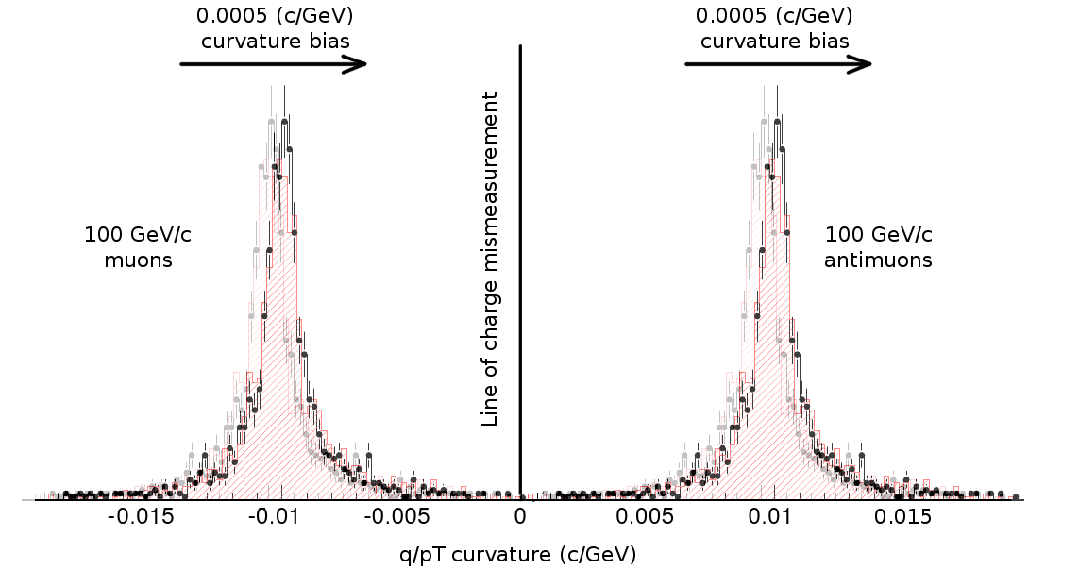
How this affects the charge ratio
(2) Charge mismeasurement: muon and antimuon effects are opposite (this is to scale)‏
PAS Fig. 2 possibly not applicable to 100+ GeV muons

Slide 25
Conclusions
Weak modes are an inherent part of alignment, and can only be resolved by external information, e.g. resonance masses, secondary vertex direction-of-flight, or muon residuals
We observe a strong effect in muon residuals, with a different shape than the weak mode in the Monte Carlo misalignment scenario
  What is in the Monte Carlo is just an example
Ongoing studies to try to correct it in data
Weak modes could affect curvature of charge ratio tracks: how much impact would a ~0.0005 c/GeV curvature bias have on the result?

