Slide 1
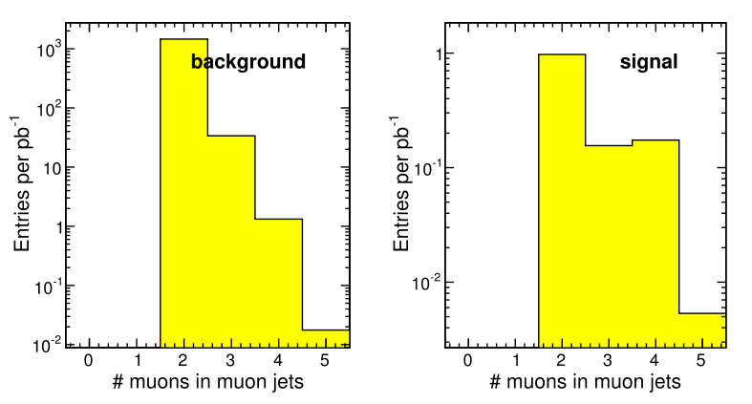
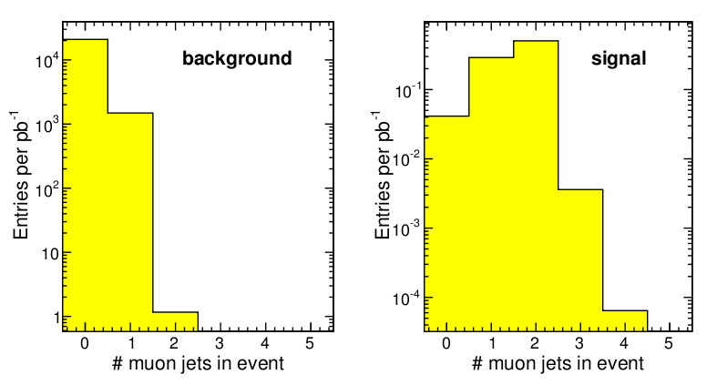
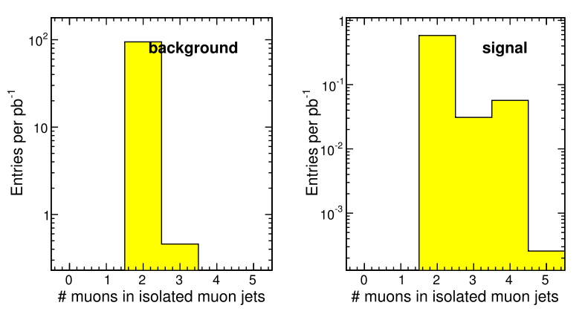
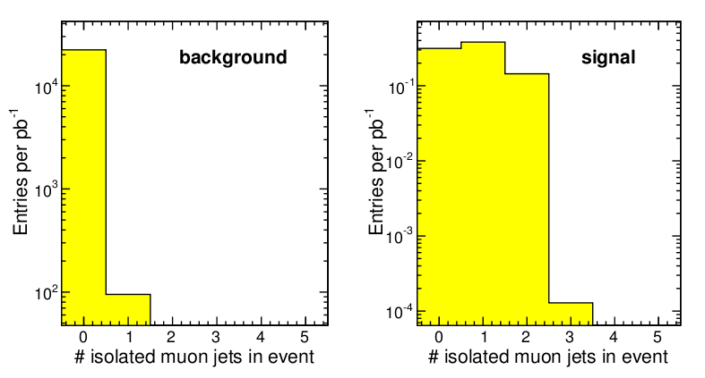
Number of muon jets is the strongest cut against background: background events can often have 3-4 muons, but not clustered into disjoint bundles. (Isolation cut doesn't count the muons, so we see that 3-4 muons in background is highly correlated with hadronic activity--- probably tracks misidentified as muons by pointing close to the real muon segments.)‏
How fast does this fall off? Need full backgrounds study...
Models with more than one muon bundle are good for us
!!!
Dark photon
Dark Higgs
Perhaps we can assume that one muon-producing b-jet is independent of another...

