Slide 1
This set of transparencies is only a carrier of plots, not a real talk. It seemed like the easiest way to get a lot of plots to you with explanations--- if they were all put in an e-mail, it would be hard to keep track of which is which. I understand that there is more here than you would want to use.
First, some pointers to other talks that you should know about:
Lepton Jets as a Signature for Dark Matter by Chaouki Boulahouache, Exotica, March 16
http://indico.cern.ch/materialDisplay.py?contribId=2&materialId=slides&confId=87421
I found out about this last night, when Chaouki introduced himself.
Suppression of fake dimuons, I and II by Dmytro Kovalskyi (UCSB) and Nick Kypreos (UF), two active members of muon POG. Mingshui Chen is also at UF. This is the ME1/1a issue.
http://indico.cern.ch/conferenceDisplay.py?confId=88576
Dimuon efficiencies correlations, Gavin Hesketh in Quarkonia--- just interested in J/psi.
http://indico.cern.ch/conferenceDisplay.py?confId=83369

Slide 2
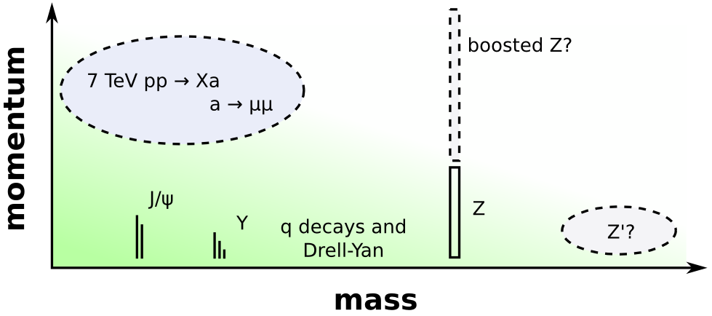
Motivations: PAMELA-inspired dark matter, hidden Higgs, and just because it's unexplored.
For the third motivation, this is where we live in dimuon space:

Slide 3
Do you think these lists are missing anything?
Approach: use standard muon efficiency, backgrounds, and resolution studies wherever possible, and concentrate only on the ways in which muon jets differ:
Making sure isolation requirements don't cancel each other out
Is eff(mu1, mu2) = eff(mu1)*eff(mu2) in the same chamber/different chambers?
ME1/1a triplets (active area of study; benefit from others' work)‏
Vertex and mass resolution for nearly collinear tracks is a special case
Tools:
pat::MultiMuonCandidate framework for groups of nearby muons (grouping, vertexing, non-overlapping isolation, etc. have already been defined in an object that can be studied in FWLite)‏
Cosmic air showers and high-intensity beam-halo may already provide a rich source of nearby muons (we don't need a physics signal to study detector performance)‏
J/psi is our standard candle (we should check our results against Quarkonia group's), and Ks allows for tests of displaced muon jets in the tracker (turning off the muon requirement)‏
Independence of the tracker and muon system for cross-checks

Slide 4
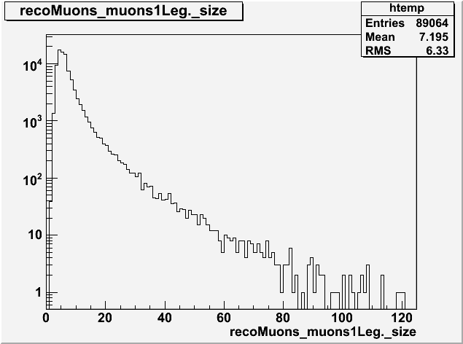
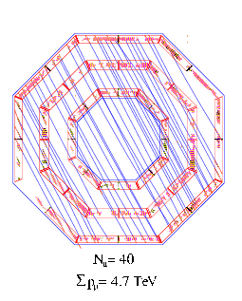
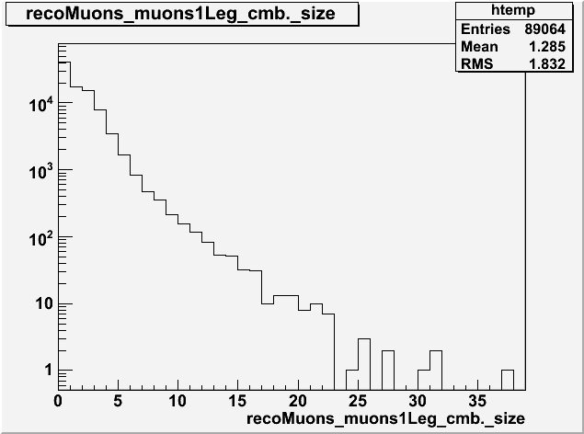
Plots that I've sent before, for completeness:
Example of an air shower in CMS: we want events with two or three muons in a single chamber, to test performance under multi-muon conditions
Number of muons per event in the muon system
On the right are the distributions, showing that there should be quite a few events with only a few muons.
Martijn should be familiar with these plots from when he worked with D. Bourilkov (sp?) on the muon bundle CRAFT analysis.
Number of muons per event in the tracker

Slide 5
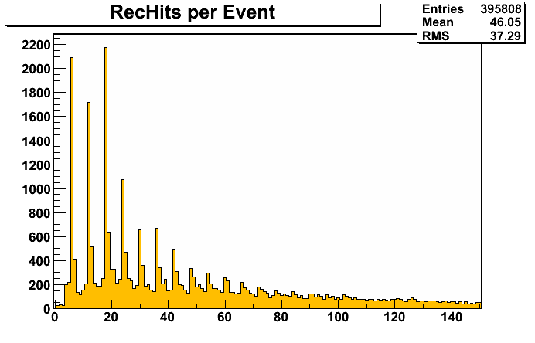
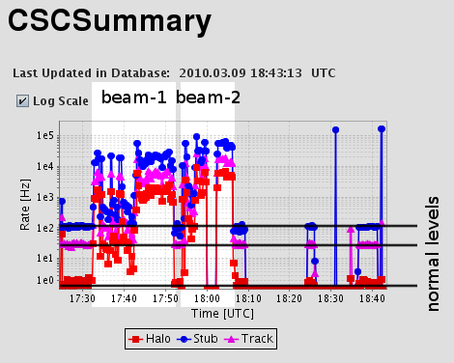
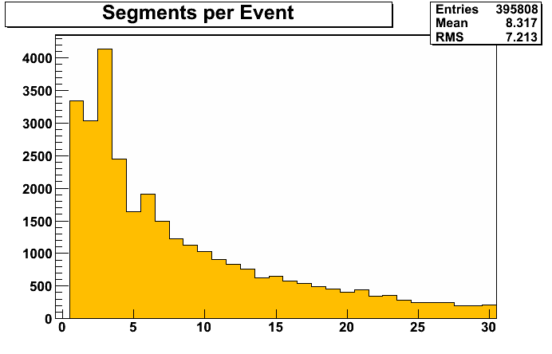
In principle, we should be able to do the same thing with the burst of beam-halo muons we got from the LHC on March 9. If the muons are produced in multi-muon groups from multi-pion decays upstream (an untested assuption), then we may be able to see multiple muons per CSC chamber and quantify the CSC performance.
Log-scale timeline of beam-halo rate in the CSCs: we got about 1 million events in 40 minutes

Slide 6
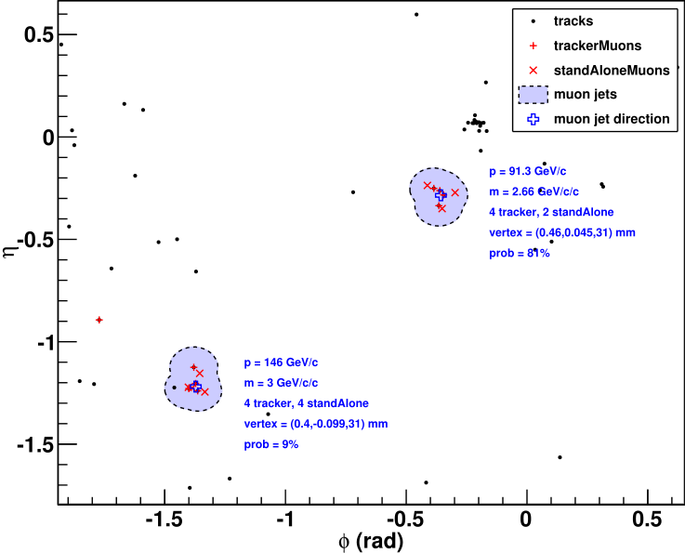
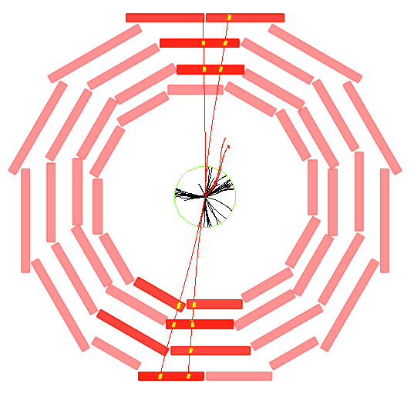
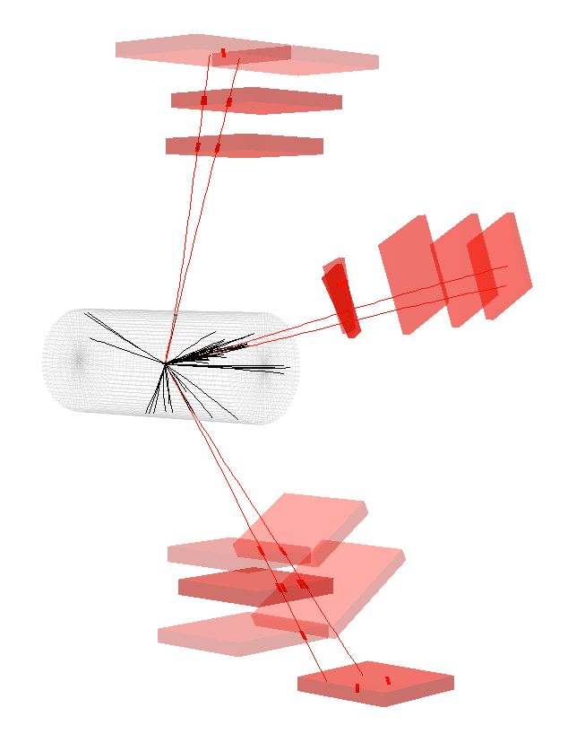
Event displays: Sergei has a lot more of them. The eta-phi plane shown here demonstrates how the grouping algorithm works, combining trackerMuons into blobs with a conesize of 0.2.
The trackerMuons and standAloneMuons are formed into groups independently, so that the trackerMuon count and standAloneMuon count can be used to cross-check each other. In this example, the top-right jet saw 4 trackerMuons but only 2 standAloneMuons, in this case because the conesize was too small. In general, though, there's a problem with standAloneMuons having as low as 50% efficiency for sufficiently close-by muons.
A problem for us, that is, if we want to use these muons independently.

Slide 7
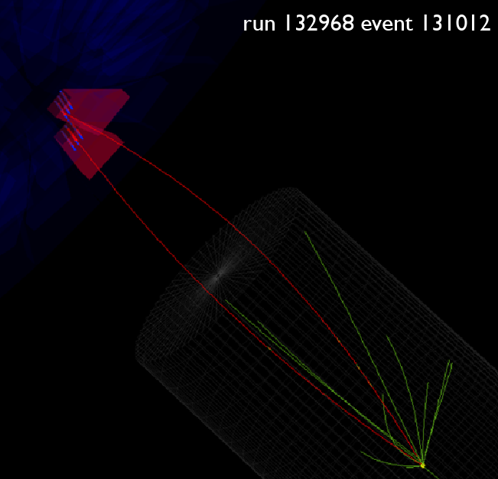
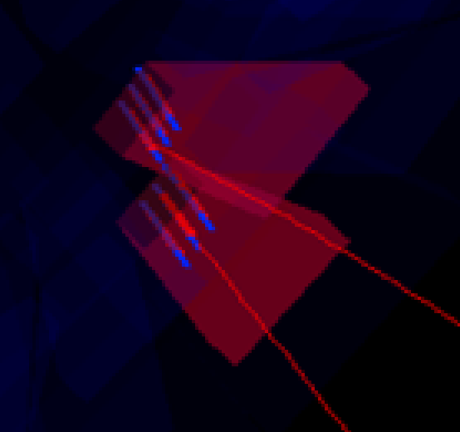
This event display, from real data, should be attributed to Nick Kypreos. It's an example of an ME1/1a triplet, and from this perspective, you can see how artificial it is: one track is a real muon, generating a real segment in each of the two CSCs. Each of those real segments create two fake segments in their corresponding chambers, and another track in the event gets matched to one of them.
On the bottom-left is a close-up.

Slide 8
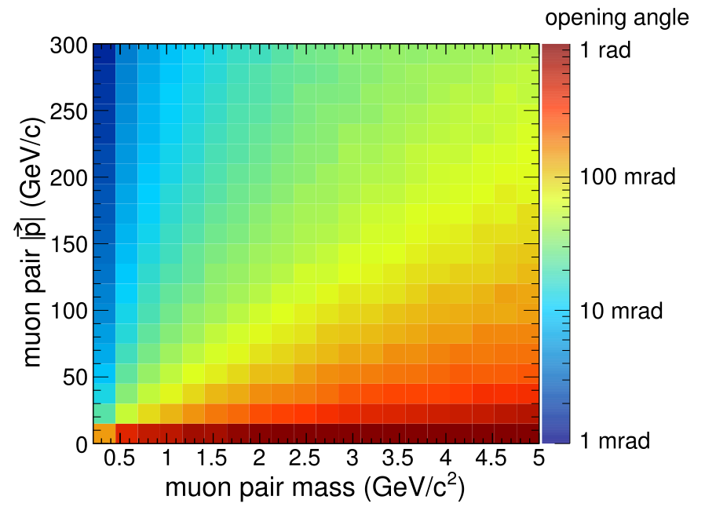
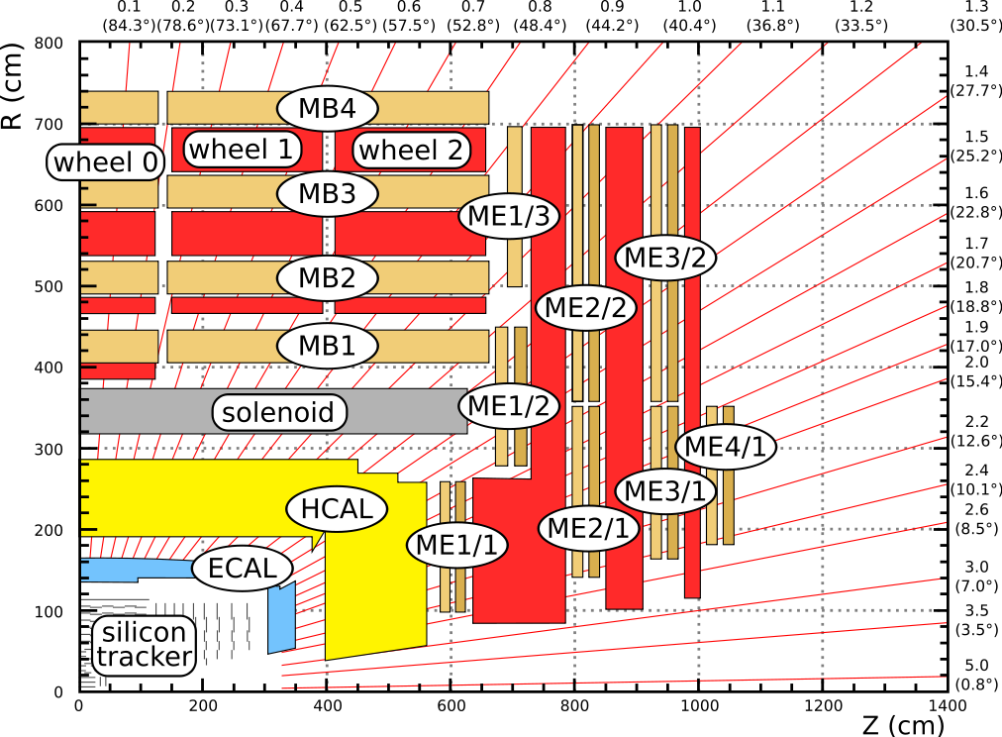
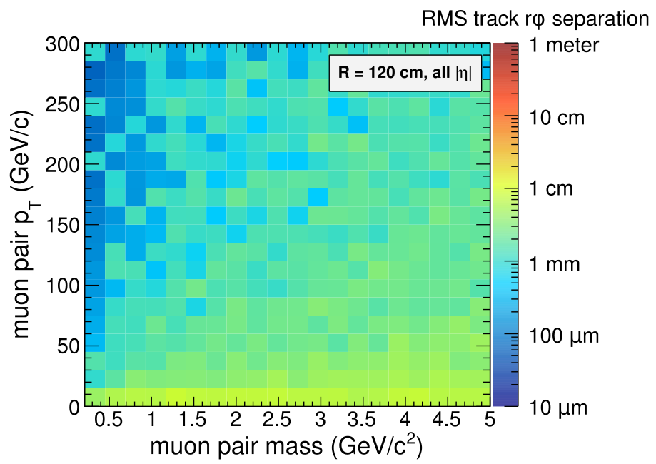
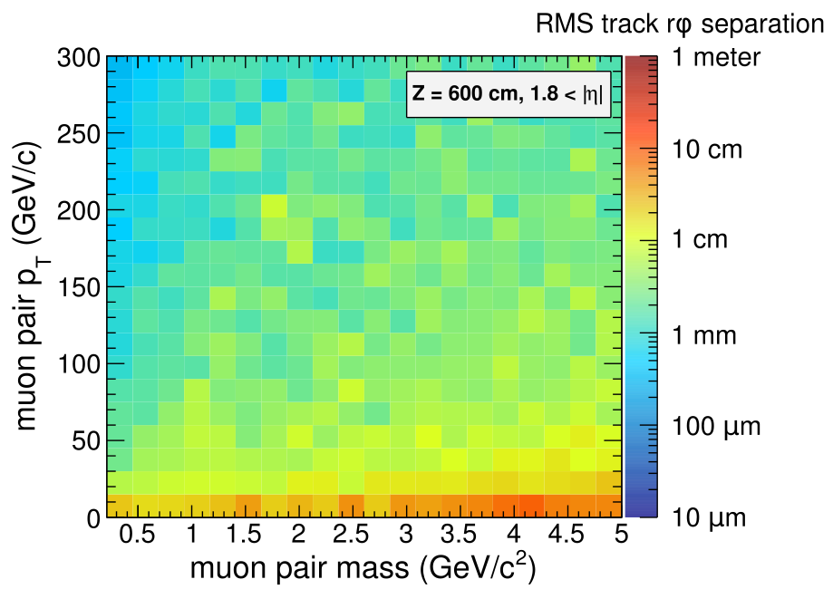
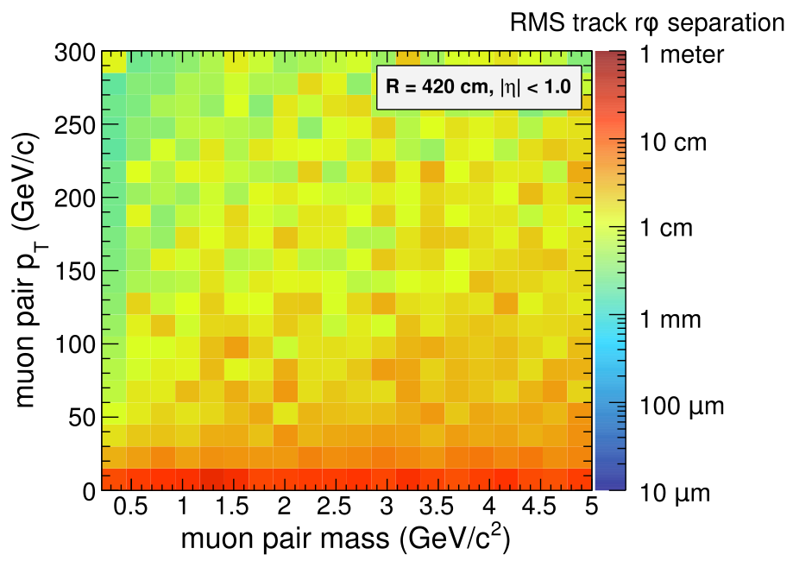
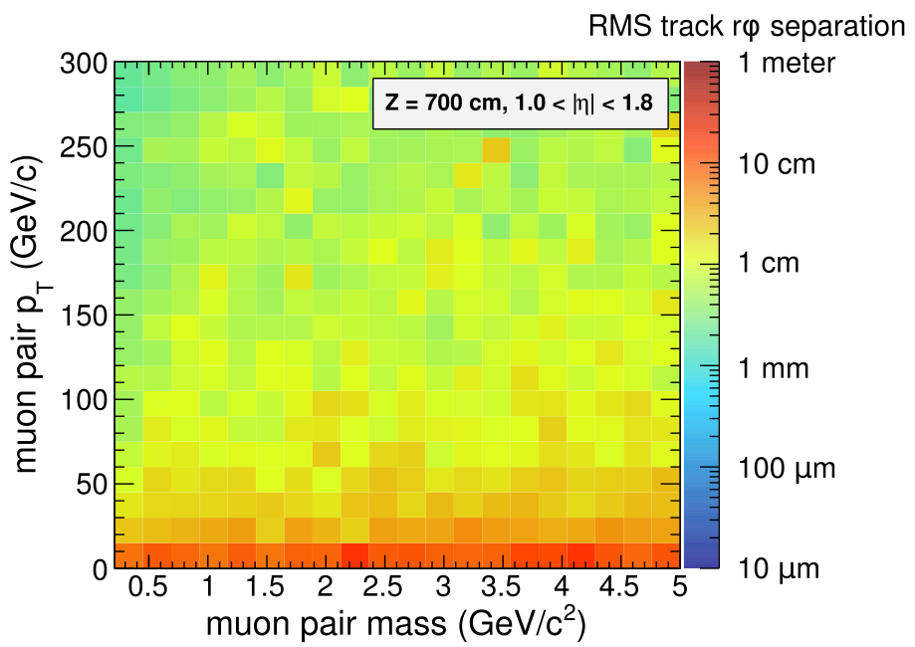
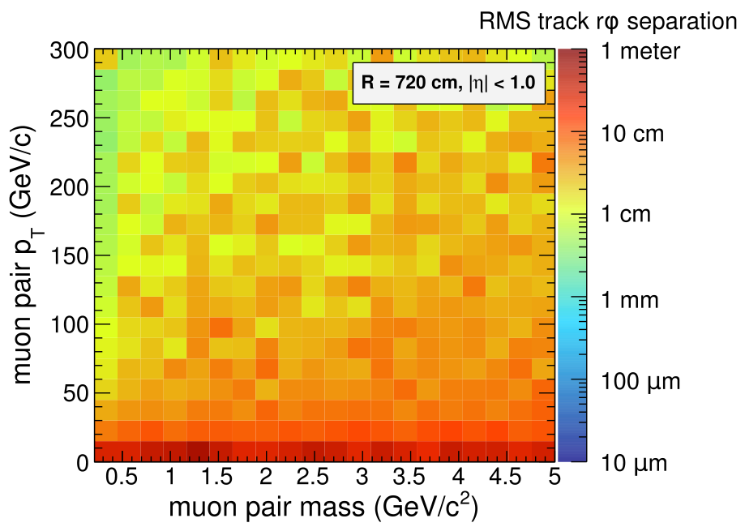
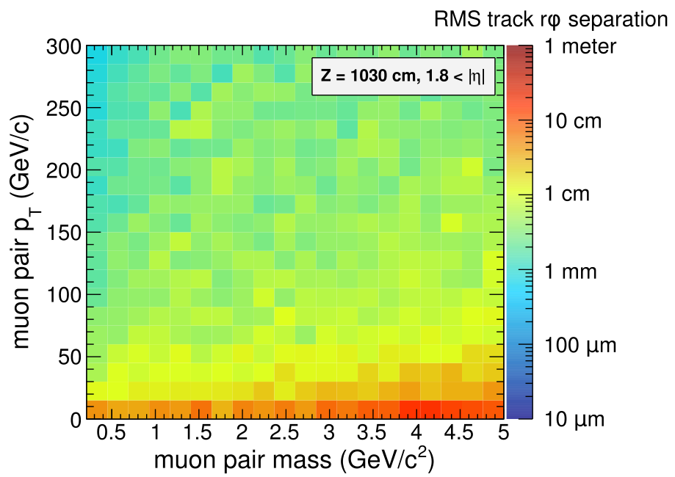
These are plots of how far apart two muons will be at various surfaces in CMS as a function of mass and pair momentum. They serve as maps of roughly what kind of performance we can expect from muon pairs entering a particular region.
The mass-momentum to
opening angle plot
I sent yesterday

Slide 9
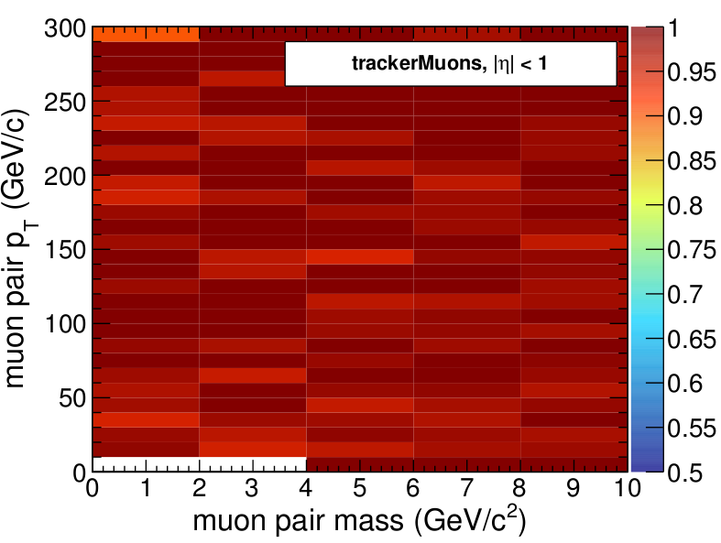
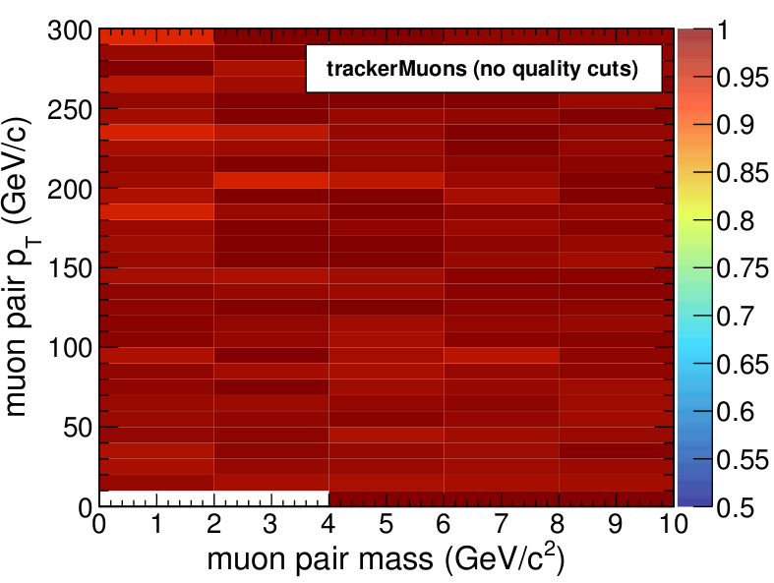
Efficiency studies: probability of finding exactly two trackerMuons in opposite-sign dimuons, given pT > 5 GeV and |eta| < 2.4 for each generator-level muon. This can be studied in detail later, but there are no major issues. Same thing when “TMOneStationAngTight” is applied.
Adding realistic underlying event and pile-up could change
the “exactly two” results (by giving more muons), as could
tighter cuts on muon quality.
Different eta regions ---->

Slide 10
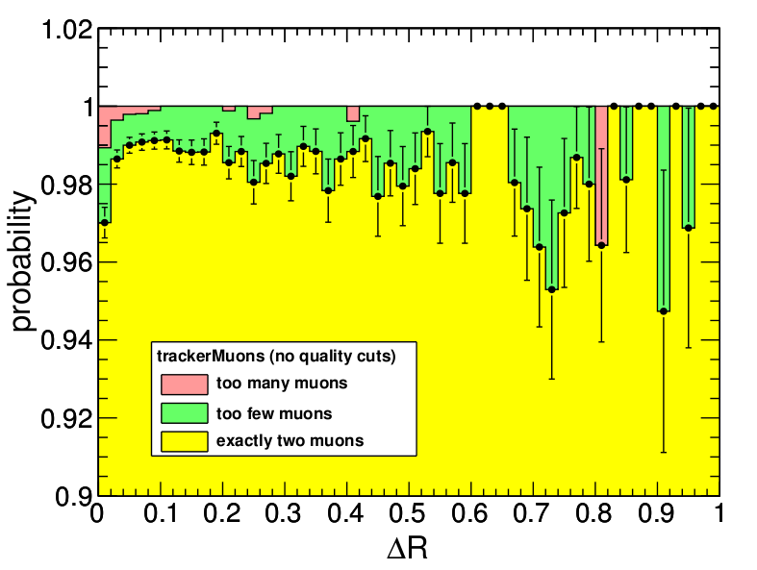
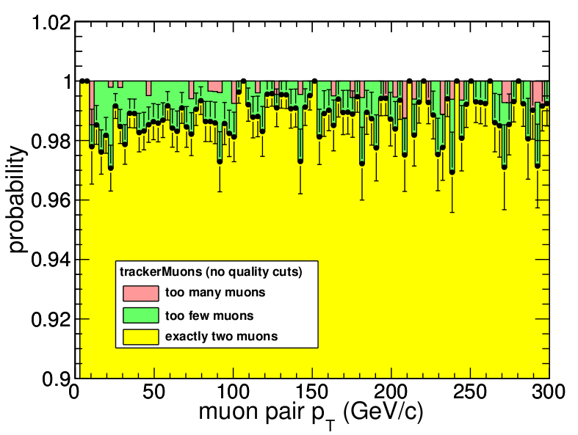
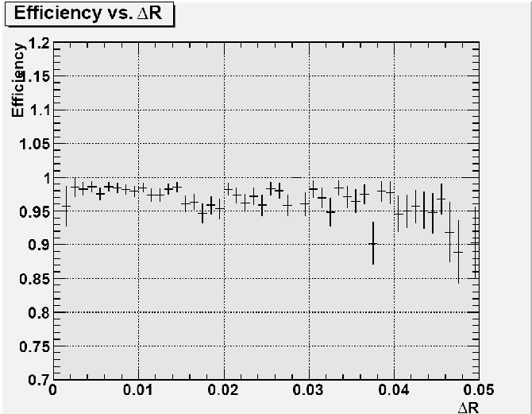
We do see a dip in probability for reconstructing the correct number of muons (two) when the muons get very close to each other. This is from an oppositely-charged dimuon gun sample without any underlying event/pile-up: just the muons. We should only be focusing on qualitative features, because the exact efficiency depends on the distribution of momenta and opening angles of the sample, and this is an artificial sample.
Note that the “too many muons” increases as Delta R -> 0, not just the “too few muons”. These un-arbitrated muons may be pointing to the same segments, but the tracker also has to create too many tracks for this to happen.
C.f. C. Boulahouache's efficiency vs Delta R (grey plot). Since he's using globalMuons-or-trackerMuons-or-standAloneMuons, not excluding “too many muons”, and using a more realistic model, it's hard to compare.

Slide 11
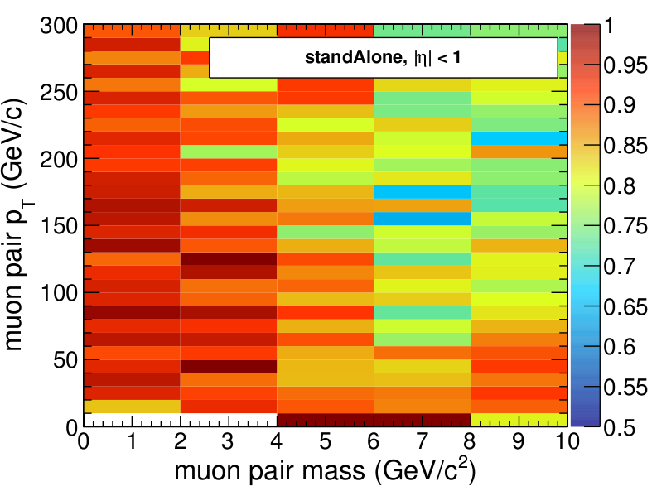
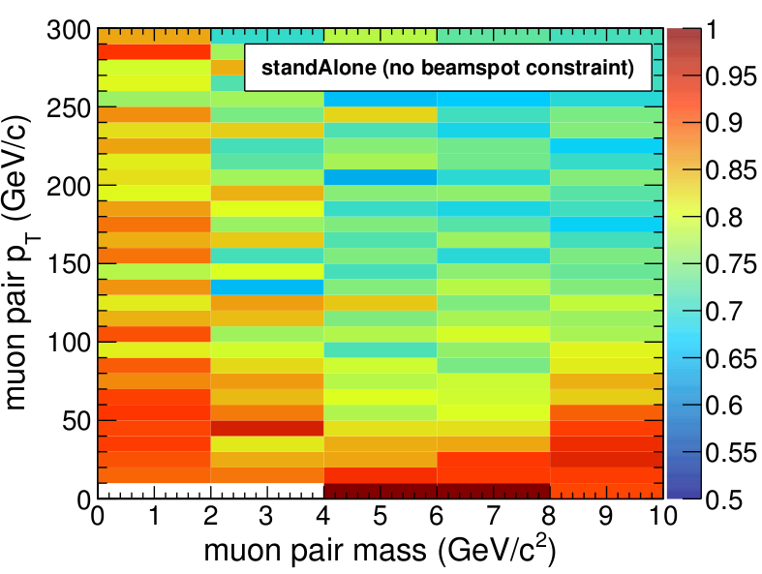
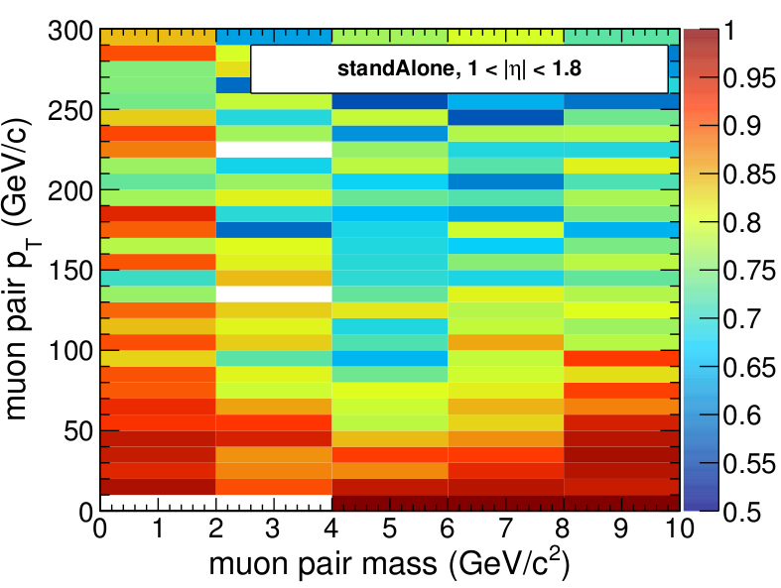
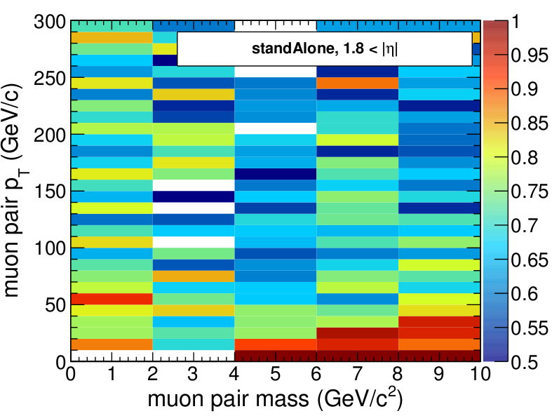
Efficiency studies: with standAloneMuons, it gets interesting. StandAloneMuon pair efficiency can be as low as 50%, but not at the point where the opening angle is minimum (mass -> 0, momentum large). The minimum is when there is a non-negligible opening angle. This is because the efficiency loss happens when the
tracks actually overlap, and for that, you need an initial
opening angle with a “cowboy” (a.k.a. “fish”) topology of the
two tracks. That could also explain the 50%.

Slide 12
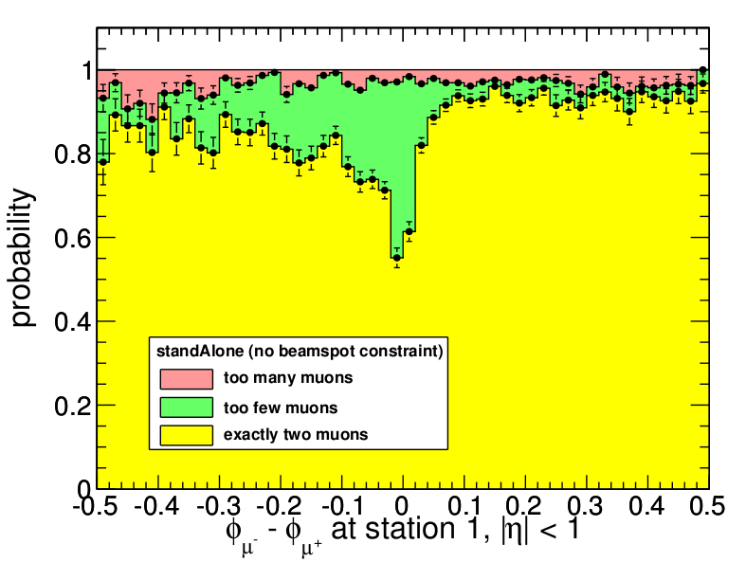
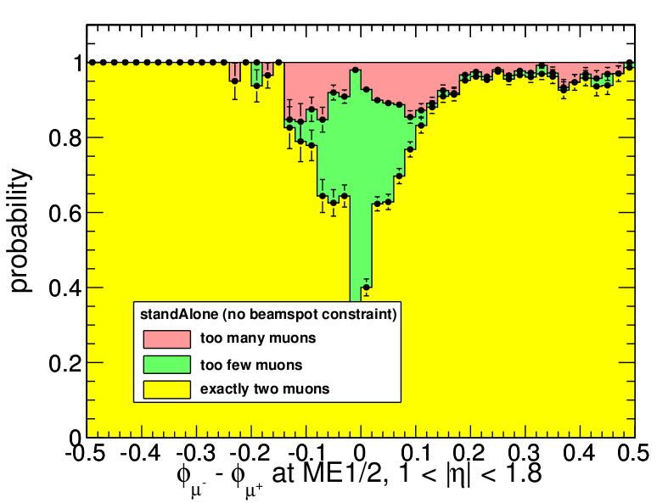
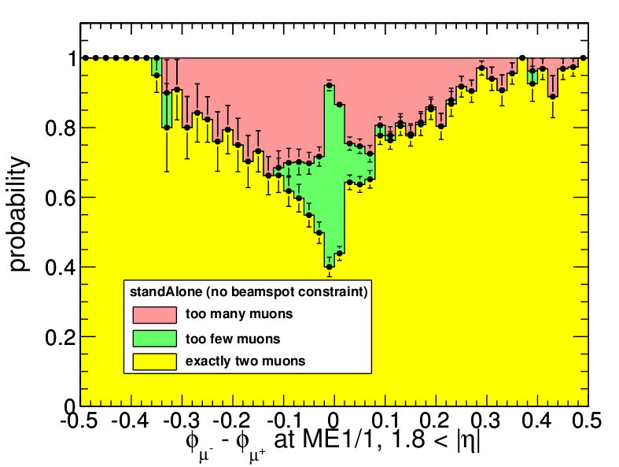
To verify the claim made on the previous page, I propagated the generator-level muon trajectories to the muon system and plotted efficiency versus the separation of the two muons at the muon station. It's asymmetric because I always plot muon-minus-antimuon, which separates “seagulls” from “cowboys”. When the muons are at their closest, too few (0 or 1) are reconstructed (usually 1). When they're a little farther apart, too many are reconstructed, since there's an ambiguity in the way the segments can be put together, allowing for scattering between stations.

Slide 13
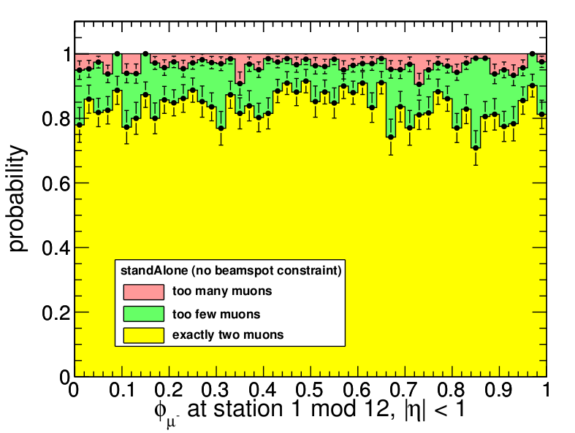
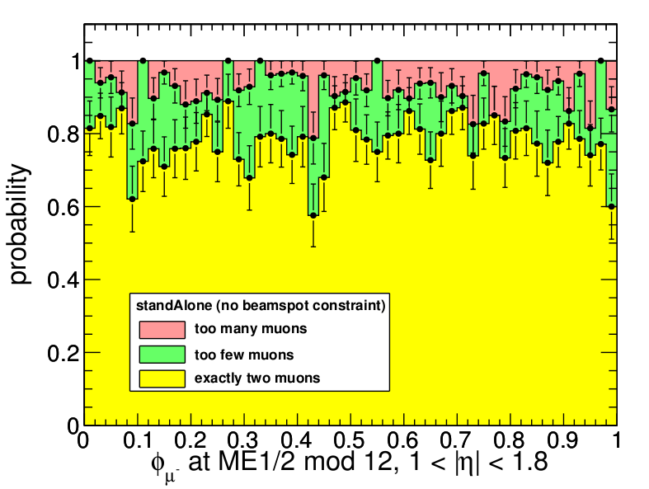
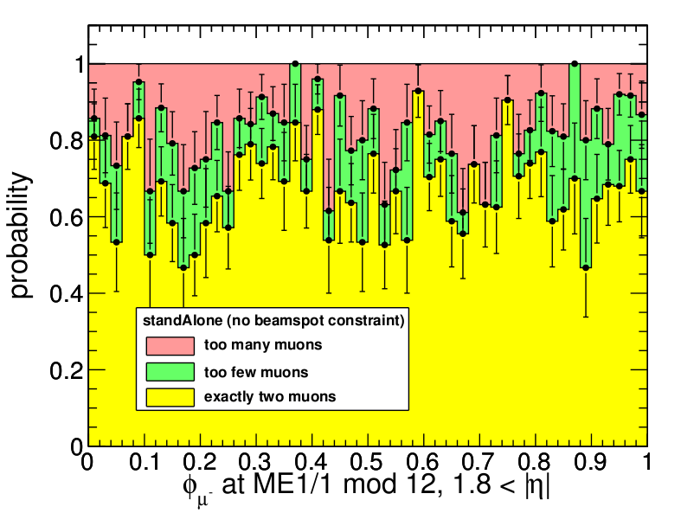
I also would have expected the efficiency to dip at the borders between the muon chambers. Muon chambers have a 12-fold phi segmentation in the barrel and 18 or 36 in the endcap (36 for all propagation surfaces shown here). I plot efficiency versus propagated muon phi, folded by 12. If there were large inefficiencies at the barrel chamber edges, we would see a dip at 0 and 1; if there were large inefficiencies at the endcap chamber edges, we would see three dips in the endcap plots. The standAloneMuons seem to be good at compensating for a gap between chambers in one station with the other three stations.

Slide 14
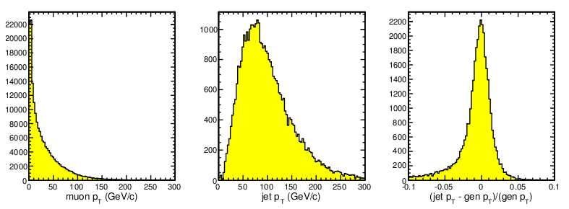
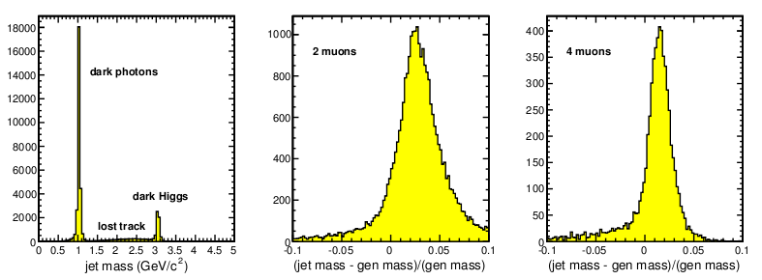
A realistic model: muon jets from a SUSY DM scenario with an extra U(1)_dark of 1 GeV (and an extra 3 GeV Dark Higgs to give it mass), Dark Higgs -> U_dark U_dark -> 4 muons
High momentum is typical because the associated WIMP needs high q^2. This simulation includes realistic pile-up (~3 interactions per event) and has a cross-section of 0.84 pb.
A (4%) mass bias! Interesting--- not expected from tracking resolution, even taking into account that 1/pT is Gaussian, not pT. (I did a toy MC with these effects and did not see the bias.)‏
Running muon jet finder “out-of-the-box.”

Slide 15
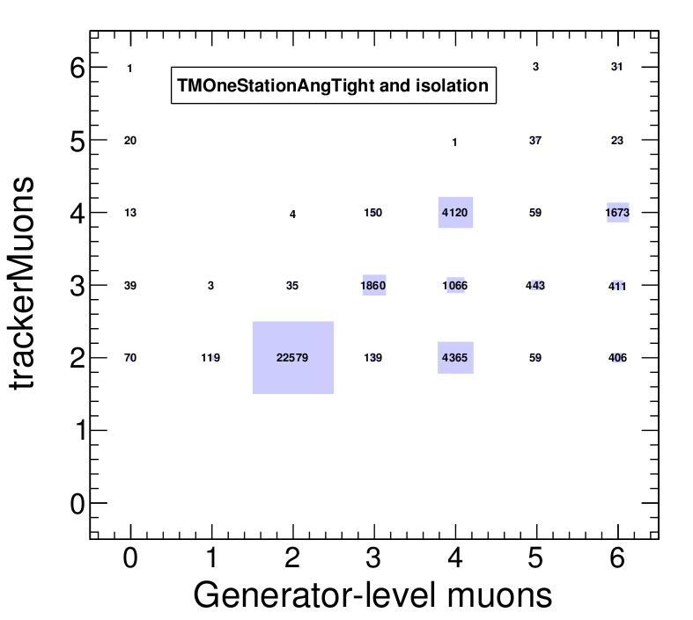
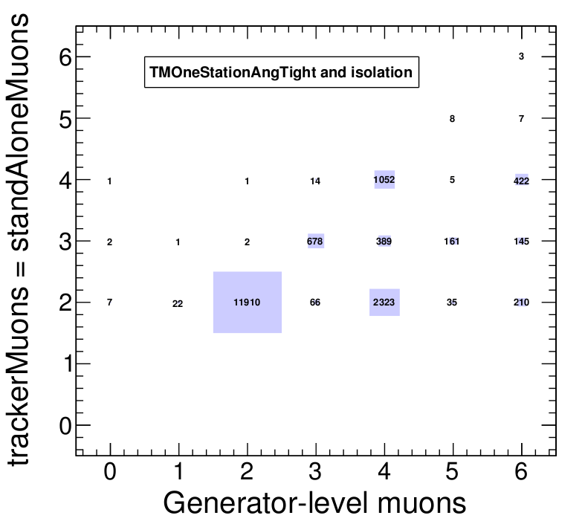
Using tracker and muon system independently:
Muon jets are identified using trackerMuons and standAloneMuons separately, then the number of muons observed in each are compared. The probability that the trackerMuon count is correct is in the high 90%'s, and the probability that the standAloneMuon count is correct is about 50%. Requiring them to agree brings the efficiency down to 50%. That might change with the SET algorithm, and maybe we'll need it to control backgrounds, but in its current state, it's not clear how useful this cross-check will be.
Backgrounds just from pile-up; TMOneStationAngTight and isolation both helped with this
with pT > 5 GeV and |eta| < 2.4
with pT > 5 GeV and |eta| < 2.4

Slide 16
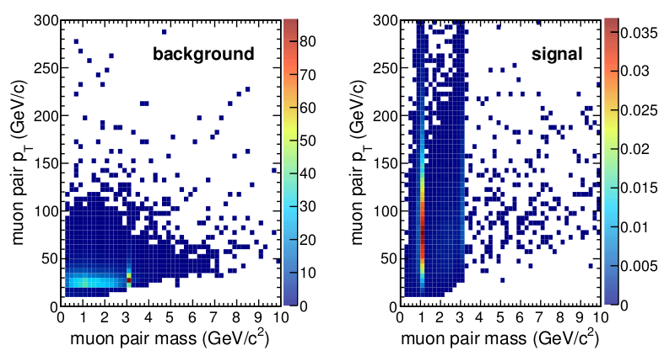
Broad-outline backgrounds study: Sergei will produce the definitive backgrounds study, but without a quick check, we don't even know the sensitivity of our analyses even within an order of magnitude. Compare InclusiveMu15 (110 nb) and extra-U(1)_dark (0.84 pb) with a cone size of 0.3. Leading muon pT > 15 GeV (required by InclusiveMu15), all others 5 GeV. Using TMOneStationAngTight.
Color scale is “muon jets per pb-1”, which is a number in pb. We need to apply cuts.
from cone size

Slide 17
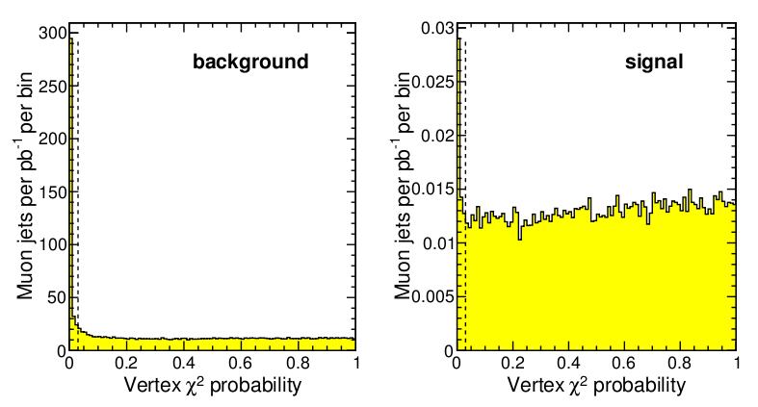
Vertex chi^2 probability for muons in jet. It's zero when we've grouped muons that don't belong together, which happens more often in the background (especially decays in flight).
This cut is probability > 3%.

Slide 18
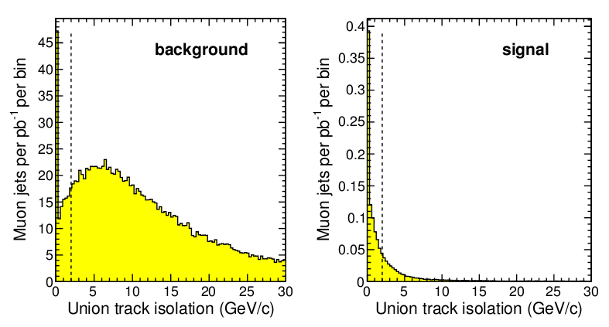
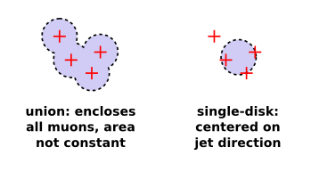
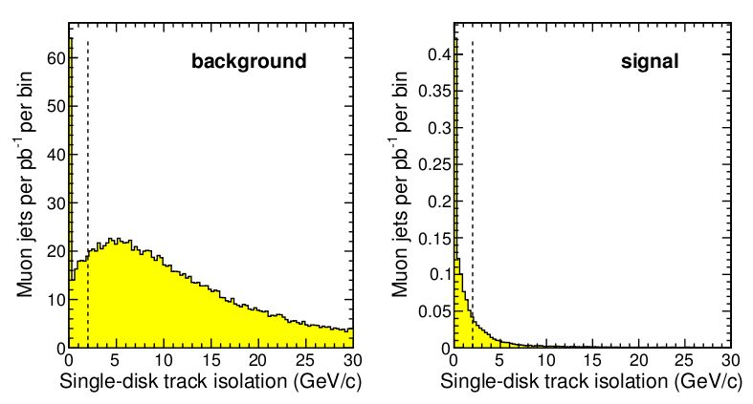
Track isolation: scalar sum of pT of tracks in a cone around the muons, excluding all muon tracks associated with the jet.
Two ways of defining “cone” region:
Although the results are nearly the same, the single-disk method has a definite advantage in that it has a constant area, and therefore a predictable random overlap with underlying event.
Radius is 0.3 in both cases.
The cut shown here is track pT in cone < 2 GeV.

Slide 19
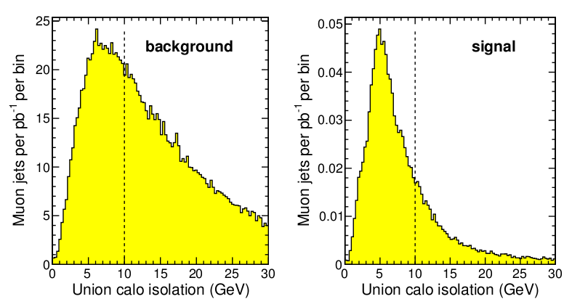
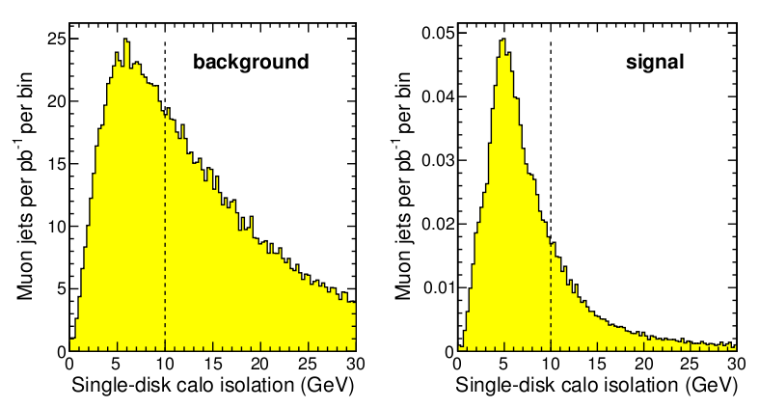
Calorimeter isolation: scalar sum of ET of all CaloTowers in the cone, with the appropriate noise subtraction.
Two ways of defining “cone” region:
Radius is 0.3 in both cases.
The cut shown here is calo ET in cone < 10 GeV.

Slide 20
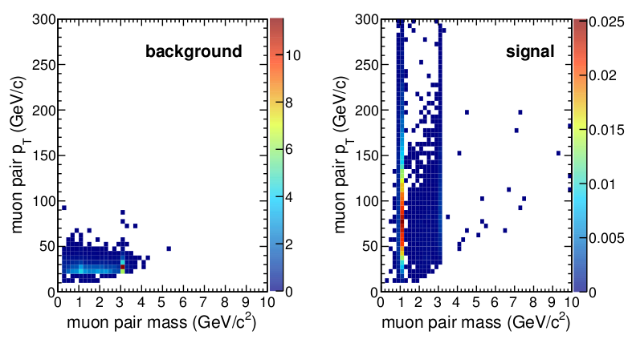
The vertex probability cuts only about 1/4, the isolation cuts about a factor of 10, and now we can expect to see a ~1 pb * (50% efficiency from the cuts) signal peek out of the high-momentum end of the spectrum. Moreover, resonances in the signal stick out more.
If the signal has more than one muon jet, that's perfect, because requiring two jets completely eliminates the background (we'll need higher-statistics background MC to study it).
Also, if the signal predicts displaced vertices, that's also a background-killer.
cleaner
signal, too!

Slide 21
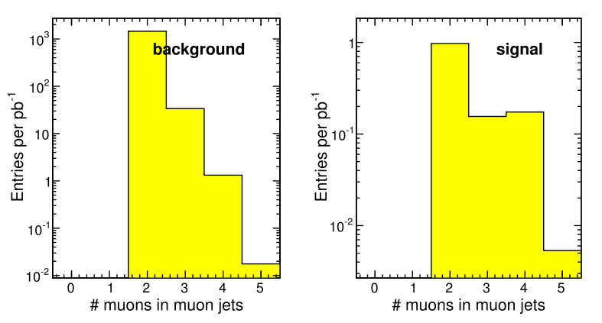
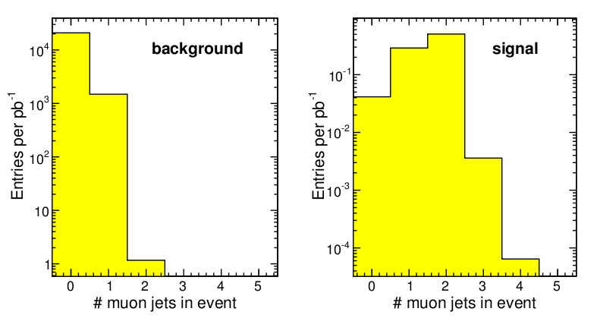
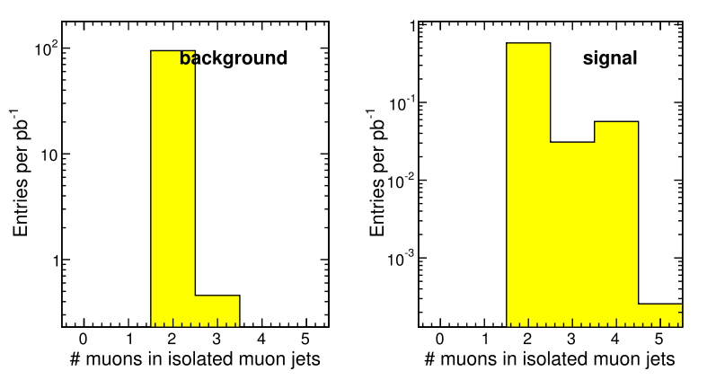

Number of muon jets is the strongest cut against background: background events can often have 3-4 muons, but not clustered into disjoint bundles. (Isolation cut doesn't count the muons, so we see that 3-4 muons in background is highly correlated with hadronic activity--- probably tracks misidentified as muons by pointing close to the real muon segments.)‏
How fast does this fall off? Need full backgrounds study...
Models with more than one muon bundle are good for us
Dark photon
!!!
Dark Higgs
Perhaps we can assume that one muon-producing b-jet is independent of another...

