Slide 1
Proposed Muon Alignment
Alexei Safonov
Aysen Tatarinov
Vadim Khotilovich
Jim Pivarski

Slide 2
Status of Deliverables
DTAlignmentRcd, CSCAlignmentRcd, and GlobalPositionRcd thoroughly vetted before posting on Monday for POG tests
Followed the procedure presented and walked-through on May 7
CSC constants additionally presented in detail in CSC-DPG
Recipe tested with collisions muons
(You may want to rephrase this...)‏

Slide 3
DT Alignment
First step: alignment from hardware system (presented last Wednesday)‏
Second: correct for difference in choice of coordinate systems with global offset
Third: alignment of individual outlying chambers with tracks
You need to get plots from Aysen showing (track x – HW x) vs phi for (a) muon = (0,0,0), (b) Sasha's record, and (c) Aysen's. They all have x ~ y ~ 0; the main difference is that Sasha's has a 0.75 mrad rotation around the beamline and Aysen's has a 0.30 mrad rotation in the same direction.
Should mention that it was performed with cosmics

Slide 4
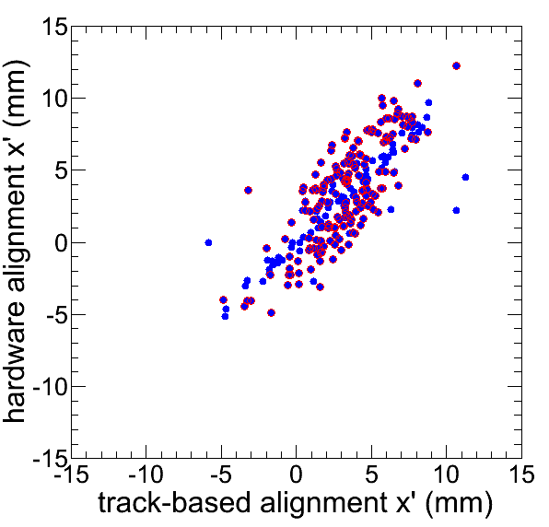
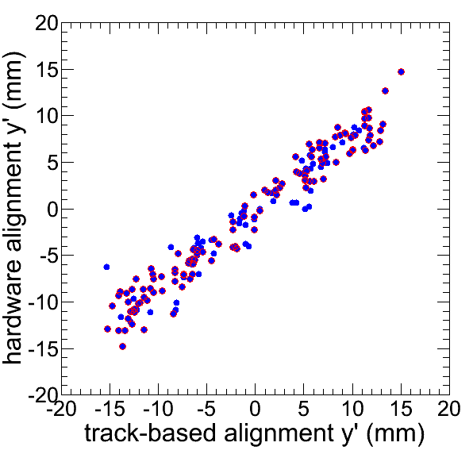
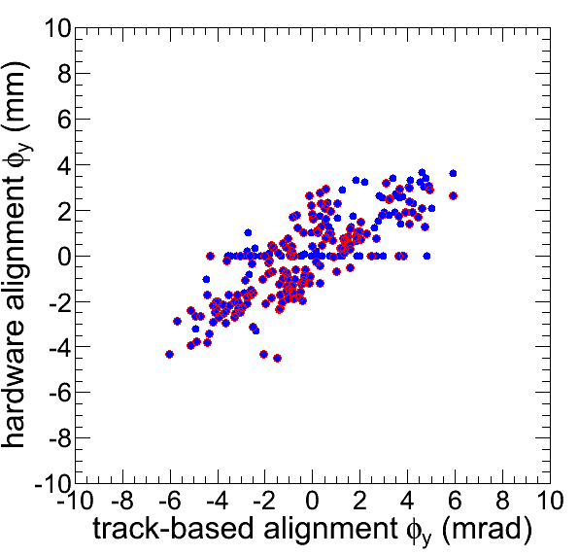
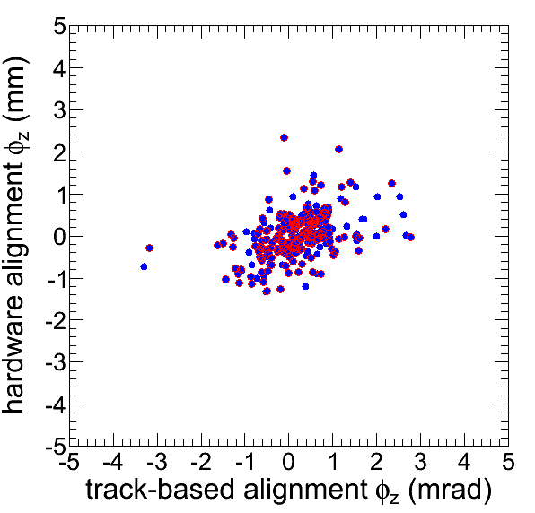
DT Alignment
After small global rotation, ~2 mm agreement between HW and track-based
We propose to update x, y, phiy, phiz for chambers with 2-sigma differences in x
Red: 2-sigma differences in x

Slide 5
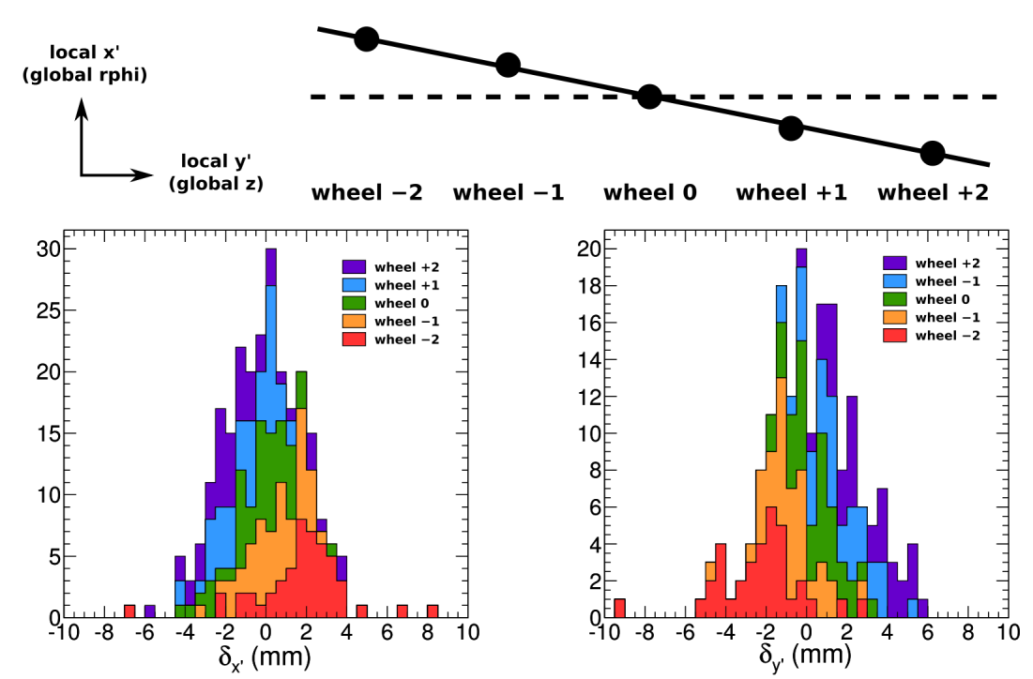
Systematic trend in differences
Note: this one effect doesn't explain both x and y, since y is second-order in this simple rotation
Only ~1 mm differences per wheel

Slide 6
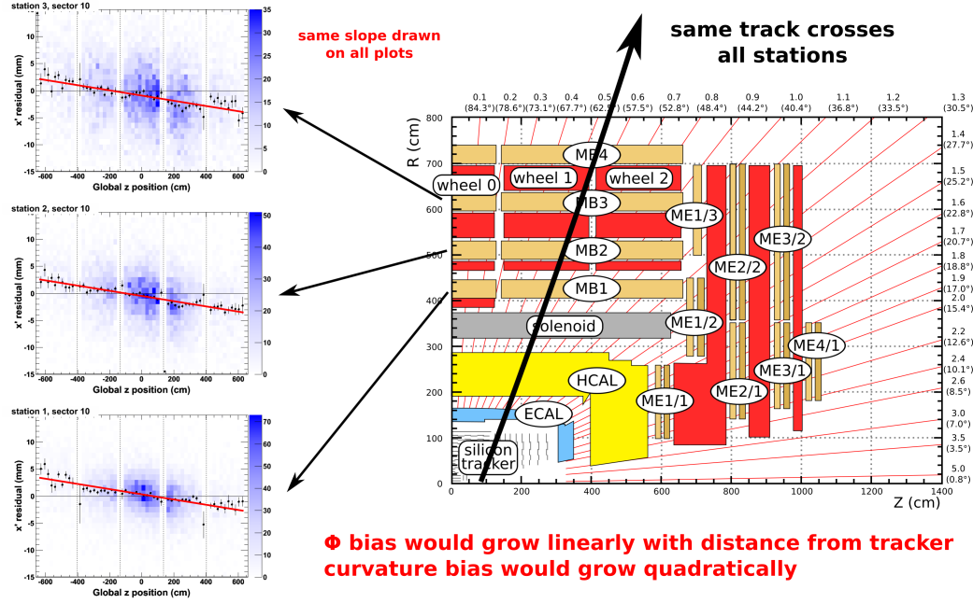
Cannot be interpreted as track bias

Slide 7
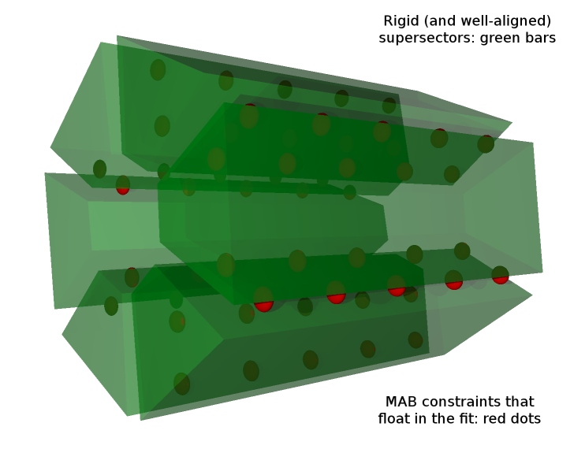
Geometric interpretation

Slide 8
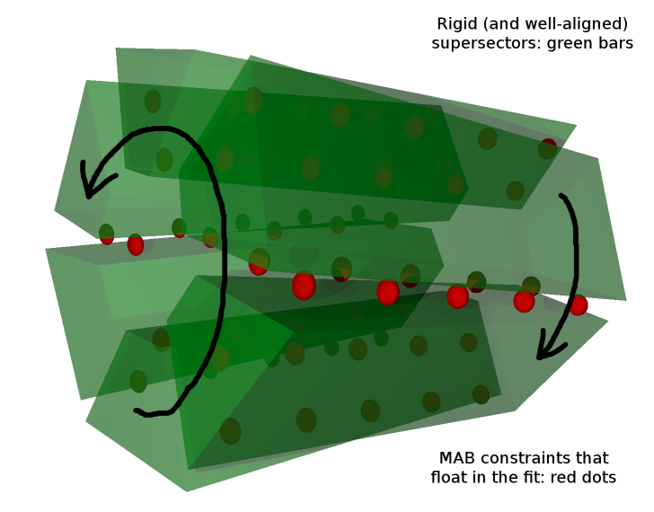
Geometric interpretation

Slide 9
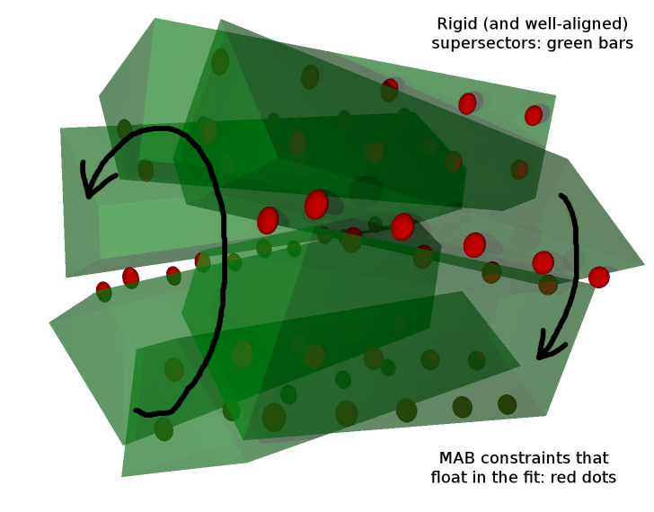
Geometric interpretation
Global twist of hardware alignment system could be chi^2 invariant (or weakly constrained) in the measurements

Slide 10
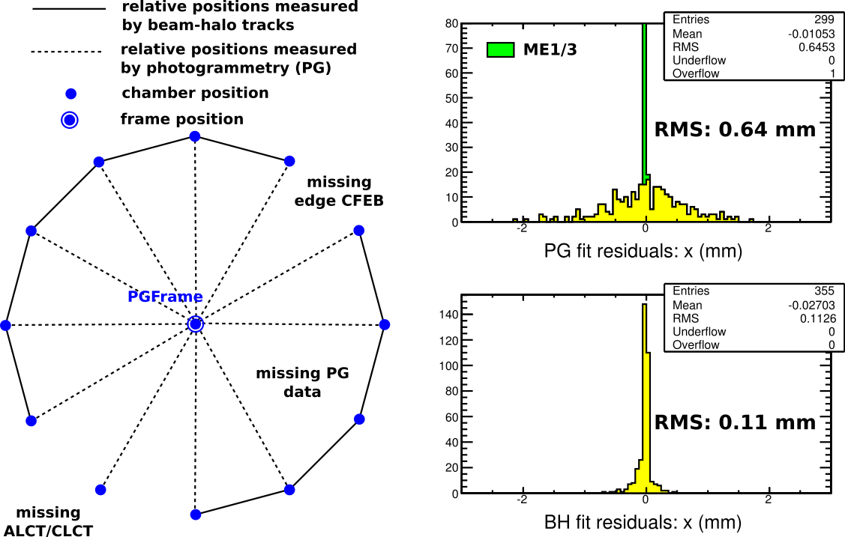
CSC Chamber Alignment
Combines beam-halo and photogrammetry for a complete (and mutually consistent) alignment
Combined fit prefers high-precision beam-halo, but differences from photogrammetry are only ~0.64 mm
(no beam-halo overlaps)‏

Slide 11
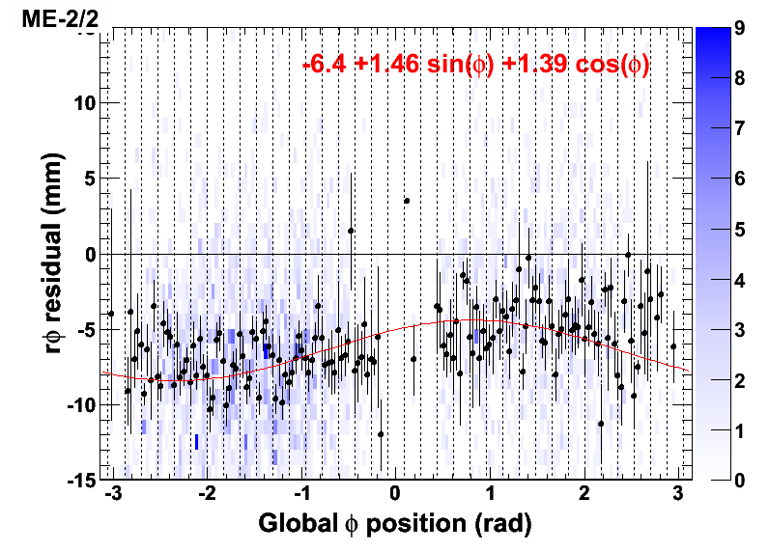
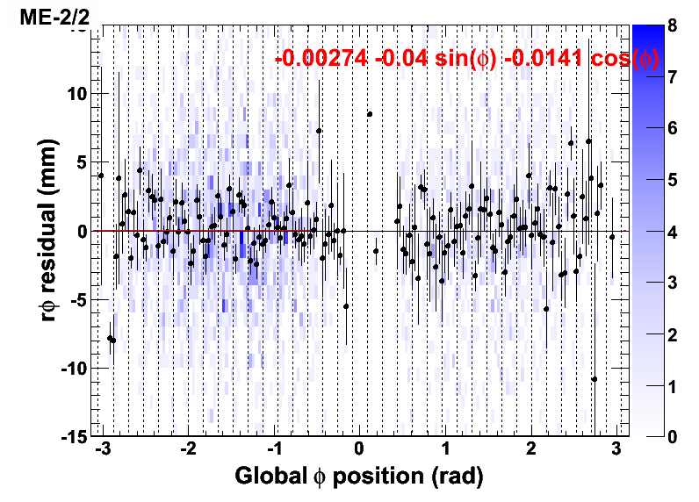
CSC Disk Alignment
High-momentum cosmic ray globalMuons
Same method as in CRAFT-09,
new disk positions
(Note: the “before” plot is ideal, not 09)‏
Align disks

Slide 12
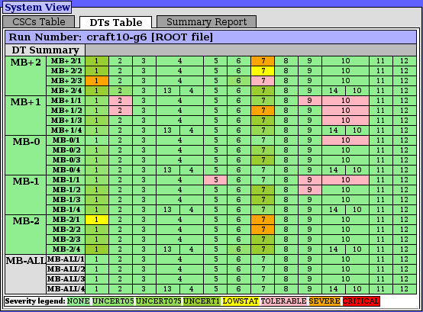
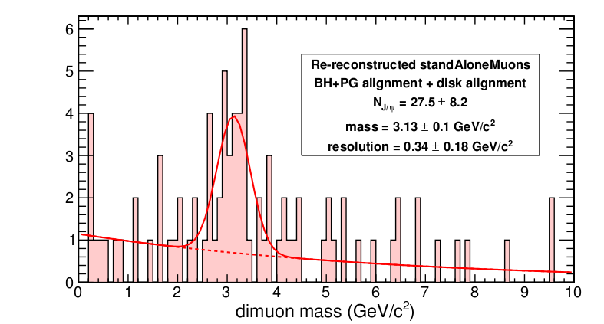
Testing
Alignment quality monitor: green is good, pink is okay, sectors 1 & 7 expected to be low-stats
All standard sanity checks and cross-checks performed
Testing recipe successfully reconstructs standAloneMuons, including standAlone-only J/psi peak
Note: events selected in tracker by mass--- the significance of this plot is the resolution, not the height of the peak

Slide 13
Conclusions
Delivered well-validated constants for muon alignment
Fairly good agreement between track-based and hardware: discovered systematic effect
CSC alignment for all chambers by taking advantage of photogrammetry
Thoroughly tested, including re-reconstruction

