Slide 1
Proposed Muon Alignment
Jim Pivarski
Aysen Tatarinov
Vadim Khotilovich
Alexei Safonov

Slide 2
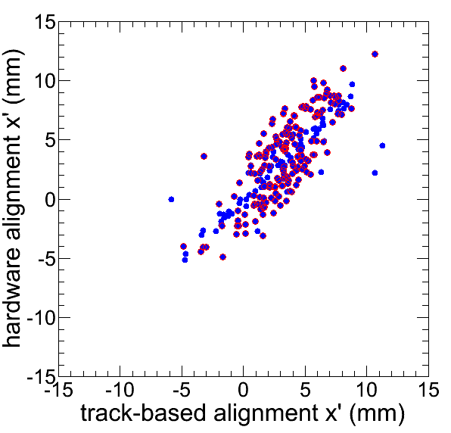
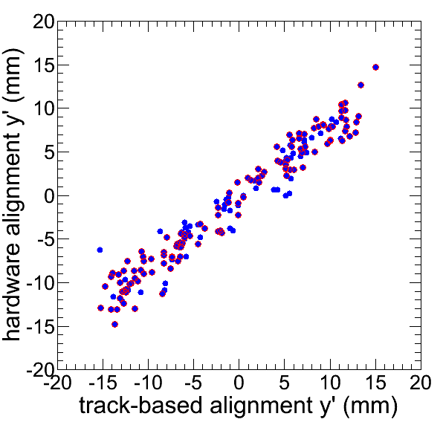
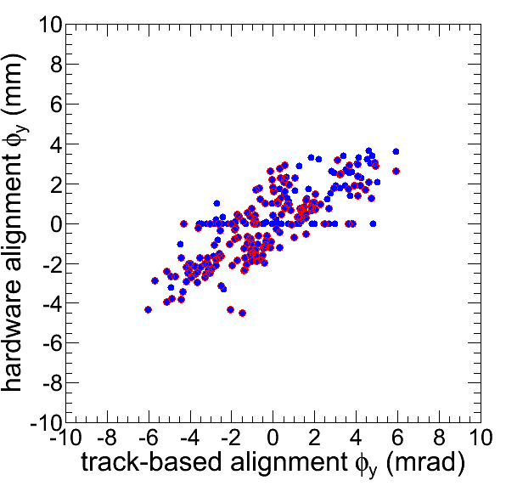
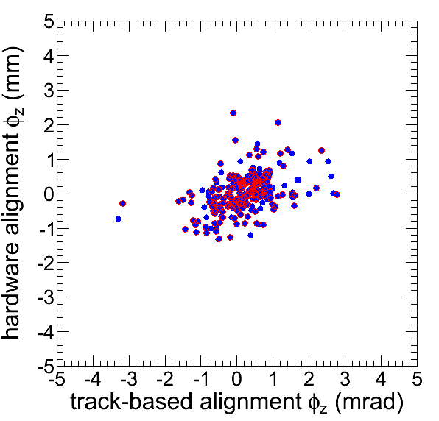
DT Alignment
Page 2/7
Near-agreement between track-based and hardware geometries
We propose to update 4/6 d.o.f. for chambers with > 2 sigma discrepancy in x
(red circles)‏

Slide 3
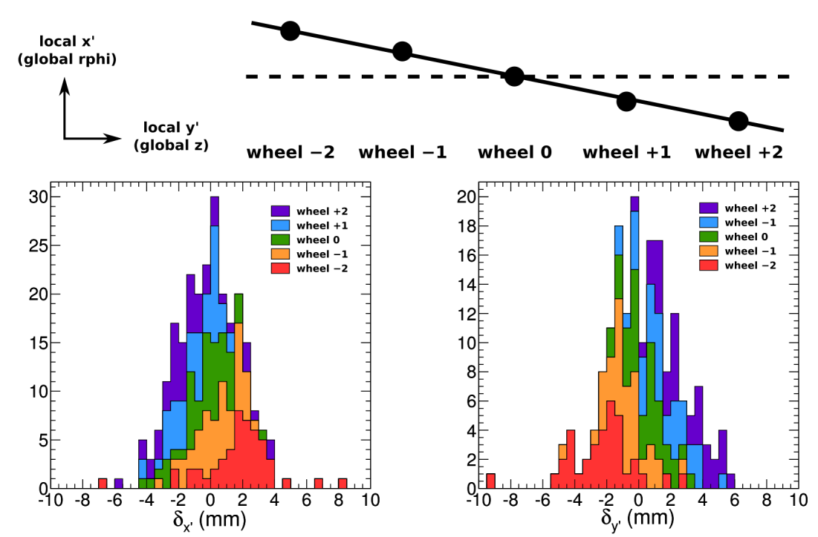
Systematic trend
Page 3/7
Most of the track-based/hardware difference is correlated with wheel number, like a twist and stretch
Only ~1 mm differences within each wheel

Slide 4
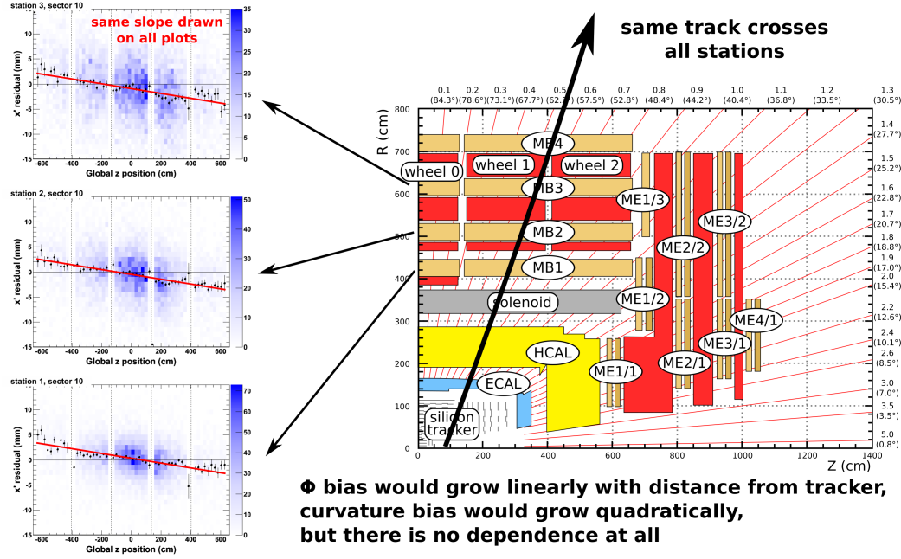
Cannot be interpreted as track bias
Page 4/7

Slide 5
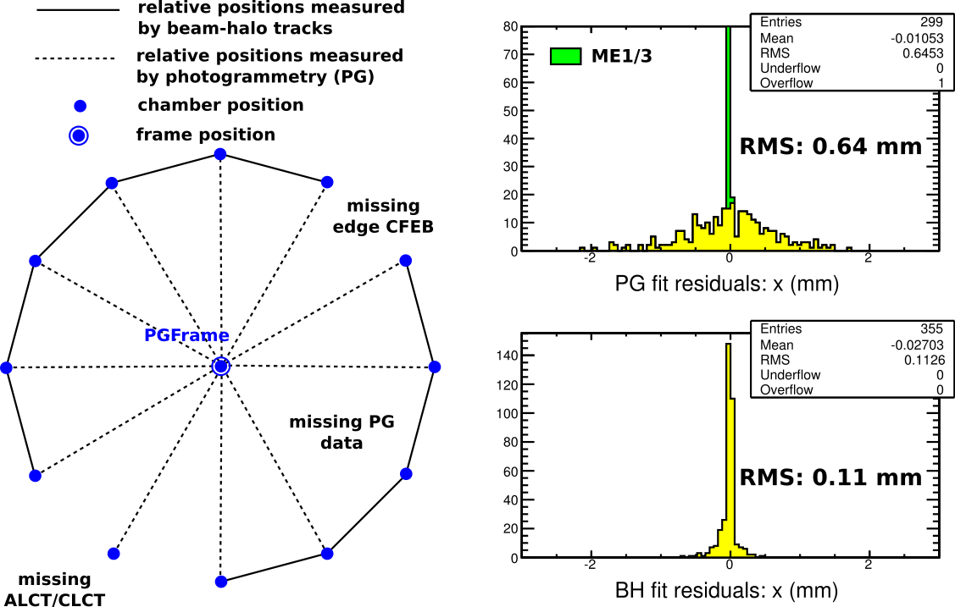
CSC Chamber Alignment
Page 5/7
Combines beam-halo and photogrammetry for a complete (and mutually consistent) alignment

Slide 6
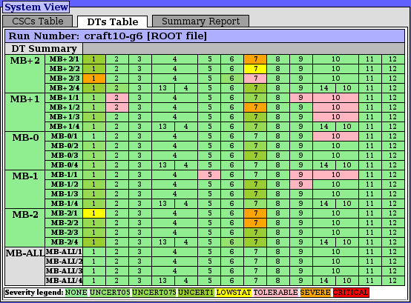
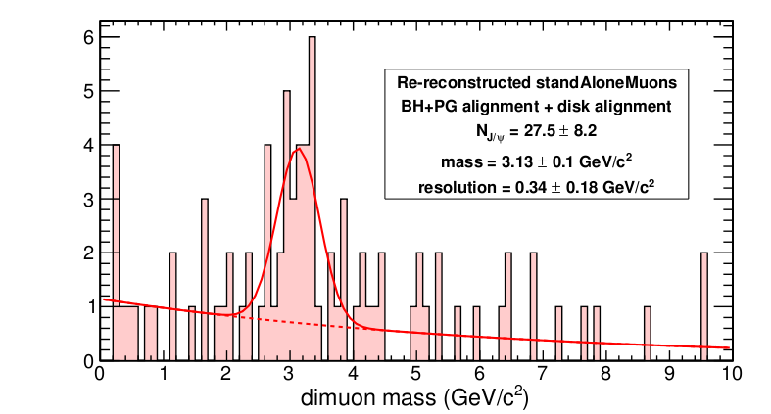
Monitoring and Testing
Page 6/7
Alignment Quality Monitor: green is good, pink is okay
Observe low stat-related effects in stations 1 & 7
Used recipe to reconstruct collisions
standAloneMuon J/psi peak

Slide 7
Conclusions
Page 7/7
Delivered well-validated constants for muon alignment
Fairly good agreement between track-based and hardware: discovered systematic effect
CSC alignment for all chambers by combined fit with (still-valid) photogrammetry
Thoroughly tested, including re-reconstruction

Slide 8
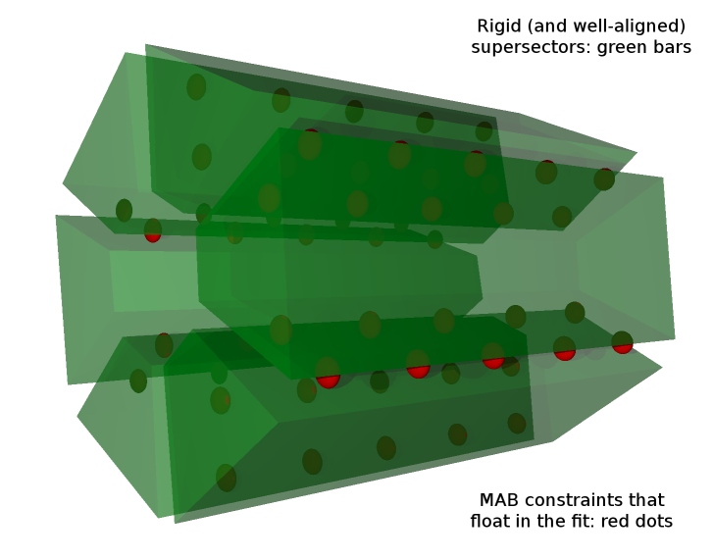
Geometric interpretation

Slide 9
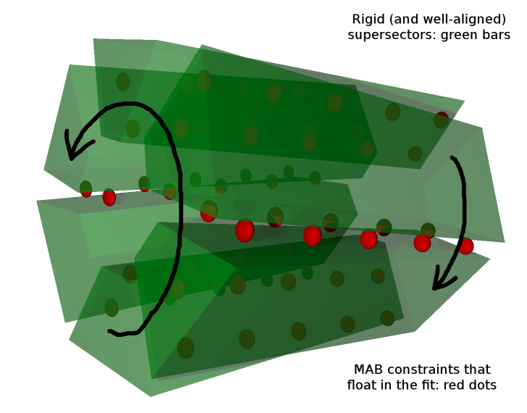
Geometric interpretation

Slide 10
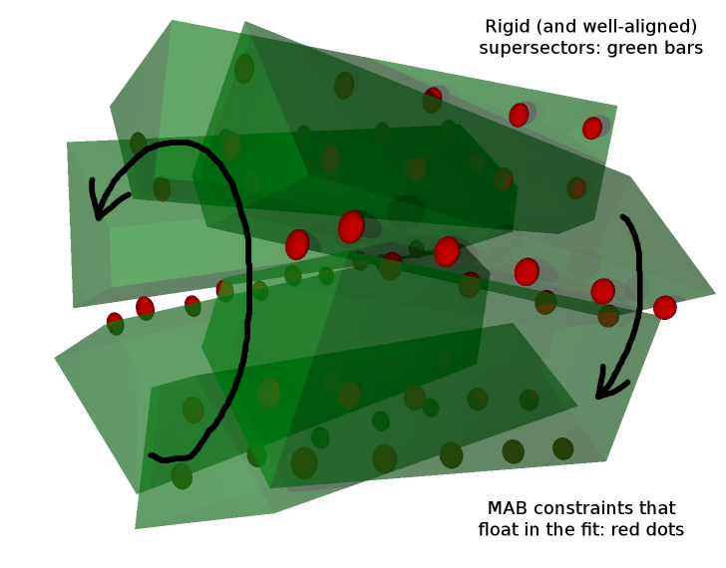
Geometric interpretation
Global twist of hardware alignment system could be chi^2 invariant (or weakly constrained) in the measurements

Slide 11
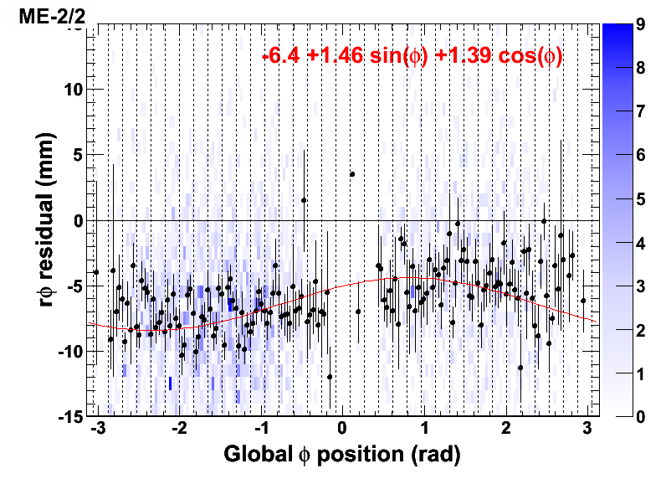
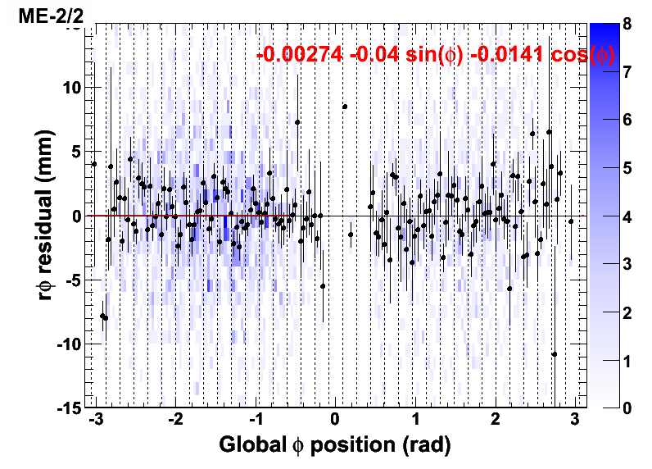
CSC Disk Alignment
High-momentum cosmic ray globalMuons
Align disks

