Slide 1
Status of track-based alignment
Unexpected dependence of residuals on position within the chamber (“sawtooth effect”) and on track curvature are now both explained:
  Due to a typo, RPC hits were allowed to bias tracker-to-muon propagation
  With this corrected, many long-standing mysteries have been resolved
Consequences:
  Can lower pT > 100 GeV/c cut used in alignment
  Must revise resolution vs. integrated luminosity estimates (“5-20 pb-1 for 200 microns” derived from affected code, likely to be too optimistic)

Slide 2
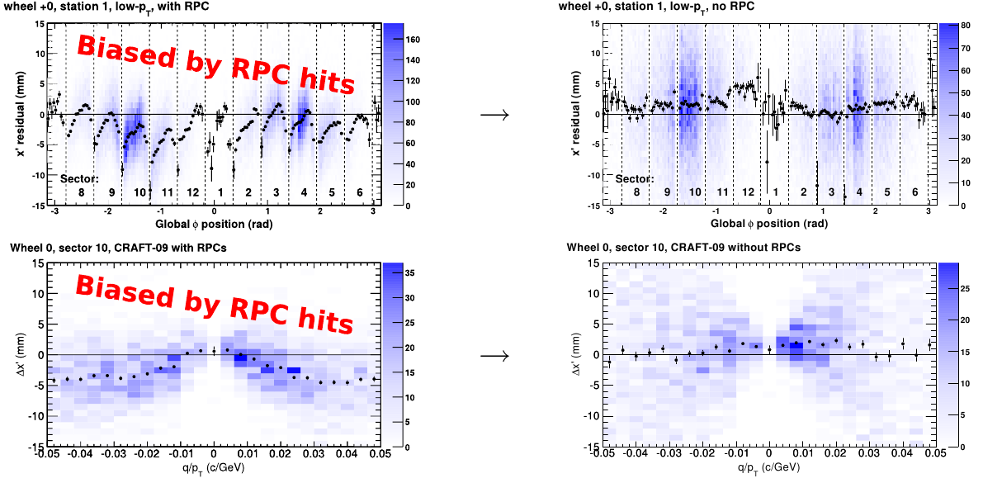
Removing the RPC-hit bias
Both of these effects had the same cause
All barrel residuals distributions now behave as expected; new alignment produced

Slide 3
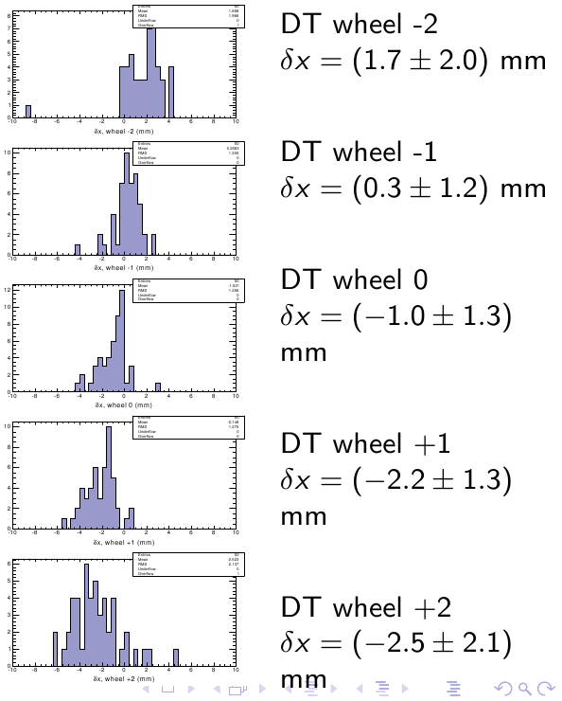
Comparison of the new track-based geometry with the hardware result
Chamber-to-chamber agreement at the level of 1.3 mm
  Outliers in these TB-HW rphi difference plots are low-statistics chambers
Largest remaining discrepancy: trend vs. wheel
Independent of RPC-hit bias

Slide 4
Ongoing analysis of differences
Track-based analysis:
  Confirmed at the level of raw residuals: no sharp breaks at chamber boundaries indicates either a track bias or a coherent rotation of the supersectors
  Not proportional to station number, as would be expected of rotated tracks (effect is clearly constant with respect to station number)
Hardware analysis:
  End-to-end difference measured by link: 1.1 +- 0.6 mm, not 4 mm as it appears from tracks
  Inclinometers and transfer lines can provide additional independent cross-checks
Using independence of the TB/HW datasets to find remaining problems and converge upon a solution

