Slide 1
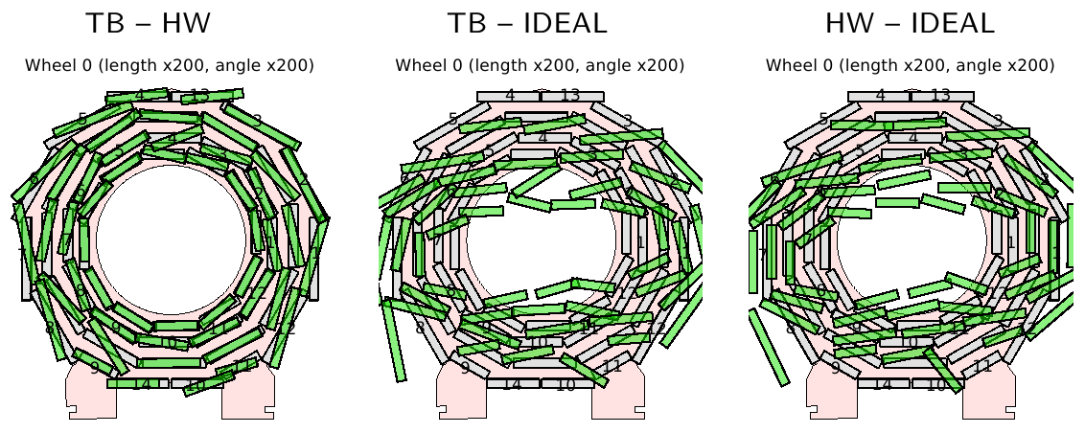
Status of Muon Alignment
Barrel: track-based (TB) and hardware (HW) systems are operating and producing constants
Constants are highly correlated, but systematic issues remain
(4 mm “twist” discrepancy from one end of the barrel to the other)
Alignment currently used is derived from the hardware result
both methods identify the same large differences with
respect to the design geometry (mostly gravitational sag)

Slide 2
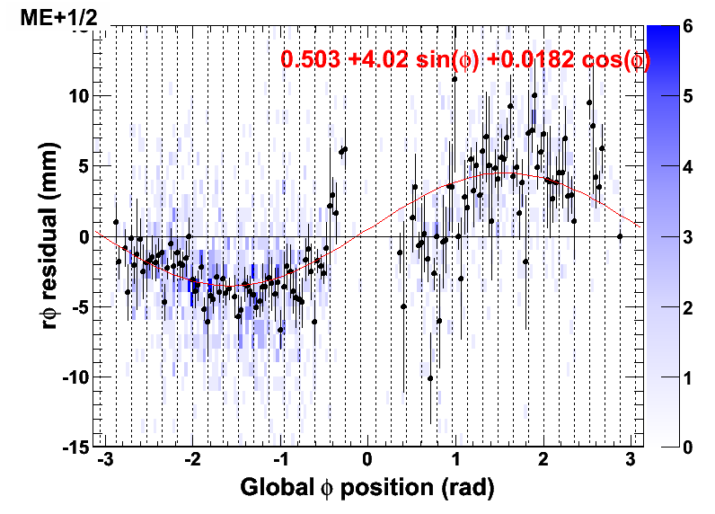
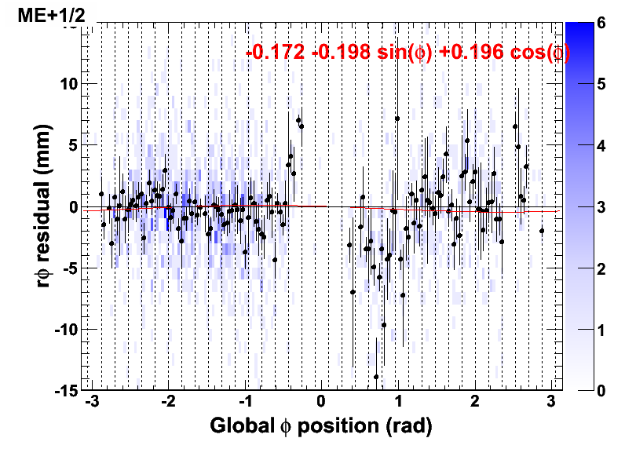
Status of Muon Alignment
Endcap: track-based and hardware systems are operating and producing constants. The methods are more orthogonal than in the barrel, making direct comparisons more difficult (ongoing study)
Endcap alignment constructed from both sources: transverse degrees of freedom (x, y, rotation around z) from beam-halo tracks and longitudinal (z, bending of disk in magnetic field) from hardware
Track-based results from 2010 beam-halo agree well (0.6 mm RMS) with 2007 photogrammetry
Example from disk-alignment using cosmic rays:
before
after
cosmics are mostly
only on top and bottom;
collisions will fill gaps

Slide 3
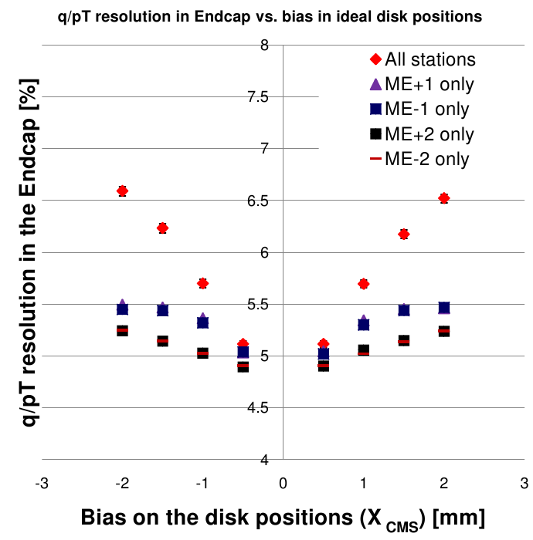
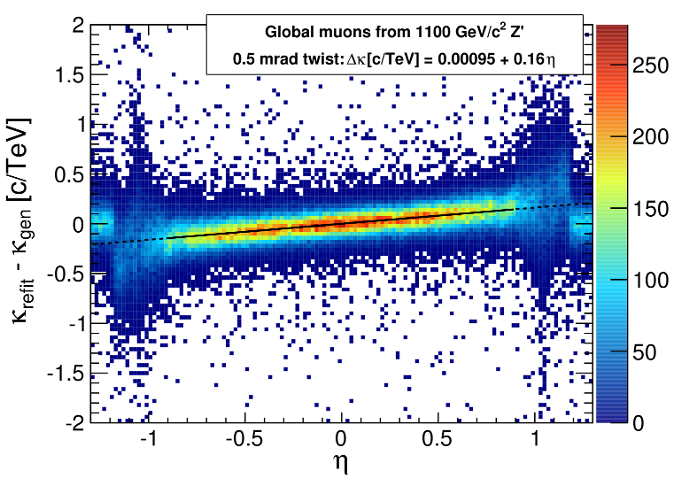
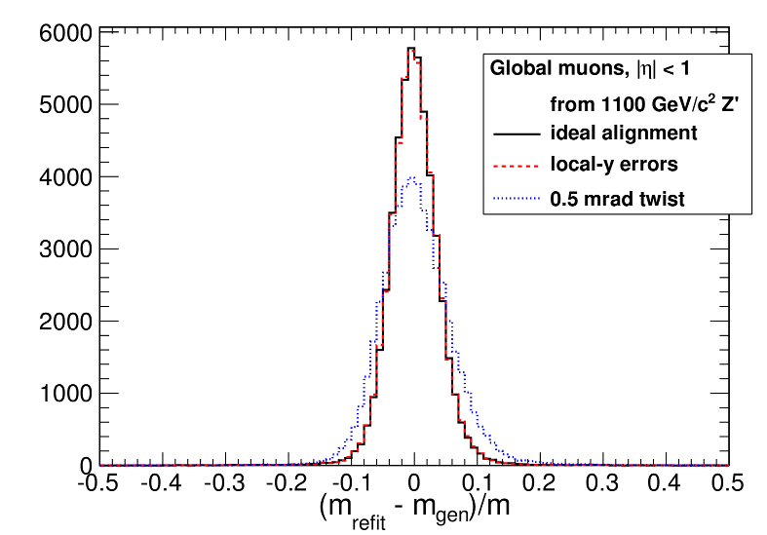
Muon alignment uncertainties
Barrel: largest uncertainty from TB-HW discrepancy
Wrong alignment would introduce ~0.2 c/TeV bias in momentum (vs eta)
1.1 TeV/c² Z' mass would be smeared about 40% more than
Endcap: largest uncertainty in placement of endcap disks: about 2-3 mm (statistical)
Also leads to a few percent increase in smearing of high-momentum track curvatures
with ideal
geometry

