Slide 1
Endcap Disks Alignment
Relative to the Tracker
Vadim Khotilovich
Texas A&M University
Alignment Meeting
November XX, 2010

Slide 2
CSC disks alignment intro
Before: fit 2D map-plot of rphiz residual vs. phi to a sinusoidal to find corrections to disks (rings) x and y positions and phiz rotation (global)
  Were observing underestimated uncertainties: were not taking into account systematic effects
Now: improved procedure, including better estimation of phiz rotation and of systematic uncertainties, corrections for B-field imprecision, better initial geometries, results from tracker and global muons
With cosmics in CSC we are quite limited with how well we can do the disks alignment
  Statistical limitations for many chamber types
  Asymmetry in phy (even asymmetry in top-bottom)
Moved to collisions data
  Almost 22 ipb certified as of Friday, Oct 29
  Still have a tracker vs. global muons puzzle to resolve

Slide 3
Data Samples
For ALCARECO global muons
  Before technical shutdown: reprocessed collisions data
  /Mu/Run2010A-MuAlCalIsolatedMu-Sep17ReReco_v2/ALCARECO
  After tech. shutdown:
  /Mu/Run2010B-MuAlCalIsolatedMu-v2/ALCARECO
For tracker muons
  /Mu/Run2010A-Sep17ReReco_v2/RECO
  /Mu/Run2010B-PromptReco-v2/RECO
Used the official good lumis JSON from last friday
  Runs 135821-144114 & 146428-148864
  Luminosity: 3.1+18.8 = 21.9 ipb
Apply p_{T}>15 GeV/c cut to not acquire bias from higher pt muon trigger prescaled in recent data
Initial BH+PG geometry options from Jim (the most recent):
  ~pivarski/public/OCT23_PG-HW-phiy-BHPG.db
  ~pivarski/public/OCT23_PG-HW-phiy-BHPGholes.db

Slide 4
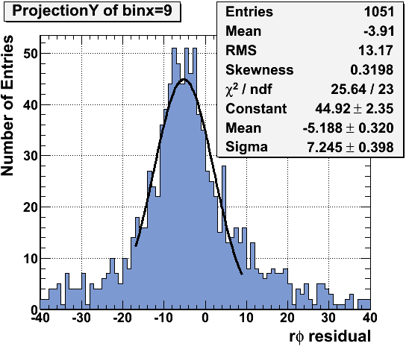
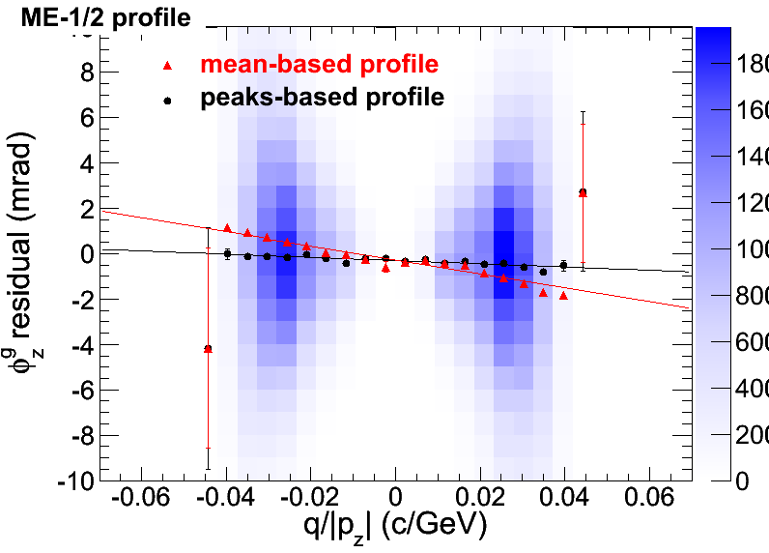
Importance of robust estimators
Our distributions often have significant non-gaussian tails with often significant skewness
  Position of peaks can be rather different then sample mean
  Uncertainty on mean is often unreliable
More robust solution:
  Use peaks instead of sample means
To find peaks and their uncertainties:
  Quick Gaussian fit in Mean ± D range
    With D being either ±RMS, ±2RMS or ±Sigma from a previous Gaussian fit in full range
For profiles:
  We used mean-based profiles
  Moved to “peak-based” profiles
    peaks estimated in every x-axis bin

Slide 5
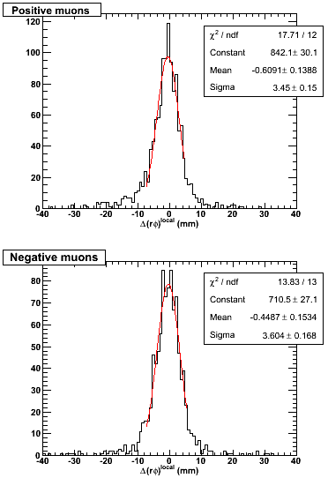
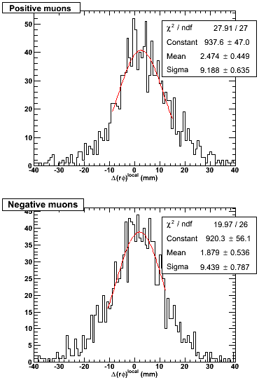
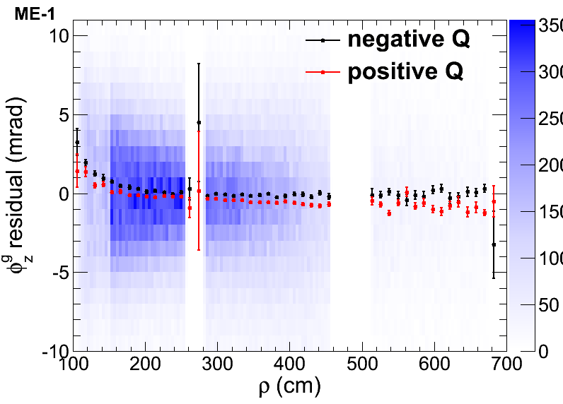
Imprecise magnetic field in CSC
First sign was large segment differences in neighboring stations residuals
  Large spreads that don’t not improve much with alignment and depend on distance between chambers
  ME- mostly shows larger RMS’s then ME+
  Different position for +- charge muons
ME+3/1/10 - ME+2/1/10:
ME-3/1/10 - ME-2/1/10:
φ_{z}^{g} residuals vs. ρ for all stations in a CSC ring
  Different for +- charge muons
  With differences varying with ρ
Some φ_{z}^{g} residuals vs. ρ slope might be caused by chambers’ φ_{z} or internal misalignments

Slide 6
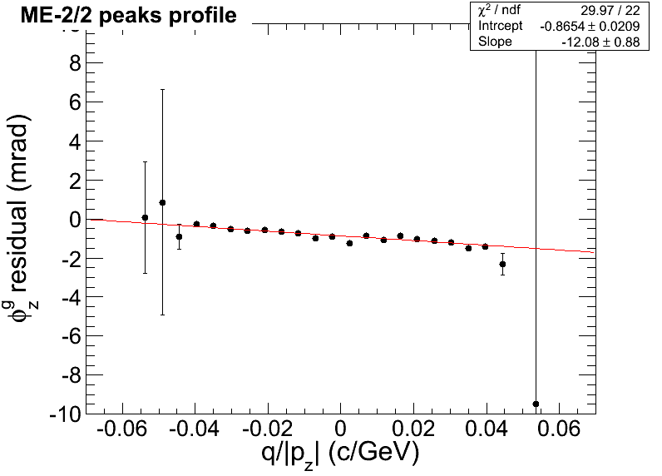
B-field corrections
Angular deviation in uniform magnetic field
φ₂- φ₁~qBL/p⊥
  If B = B_{z}: p⊥ = p_{T} and L = ρ
  If B = B_{r}: p⊥ = p_{z} and L ~ z
  In barrel chambers ρ ~ const
  In endcap chambers z ~ const
If B is correctly known, residual δ(φ₂- φ₁) should not depend on q/p⊥
Else, it would be ~ proportional
  In barrel: δρ(φ₂- φ₁)~ q/p_{T}
  In endcaps: δ(φ₂- φ₁)~ q/p_{z}
    For both B_{z} and B_{r} components
To correct for imprecise B-field in CSC,
use results of linear fit of φ_{z}^{g} residuals
vs. q/p_{z} peak-based profiles for every
type of chambers (rings)
  From the intercept we also obtain the ring dphiz rotation corrections
p⊥
+ B
L (circle chord)
p_{T}
p_{z}
ρ
φ₂- φ₁
z
p_{T}/p_{z}≈ρ/z

Slide 7
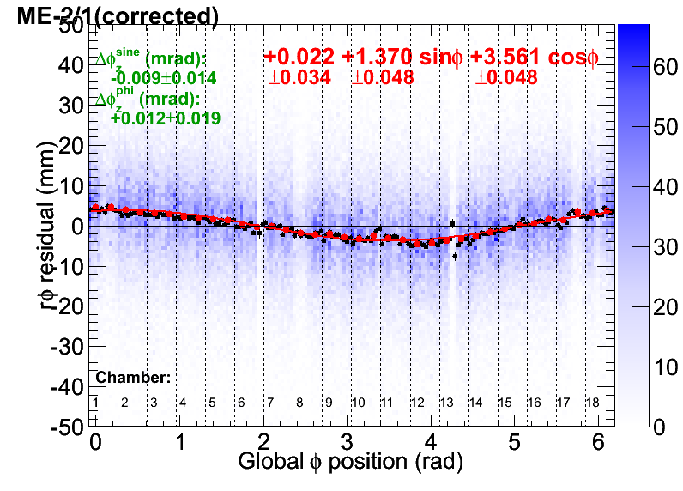
The procedure for ring corrections
From the results of linear fit of φ_{z}^{g} residuals vs. q/p_{z} peak-based profiles we get
  dphiz correction numbers with statistical uncertainty
  Corrections to residual to compensate for imprecise knowledge of magnetic filed
Use the correction obtained in previous step to draw mapplots of corrected rφ_{z}^{g} residuals vs. global φ position
Do a sinusoidal fit of a peaks-based profile of such mapplots (in red)
  sin and cos coefficients define
  the dx and dy corrections and their statistical uncertainties correspondingly
Determine systematic uncertainties (next slide)

Slide 8
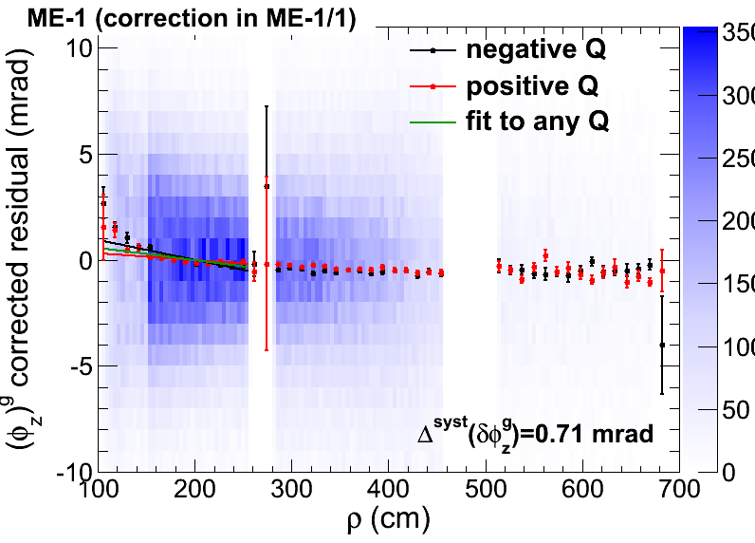
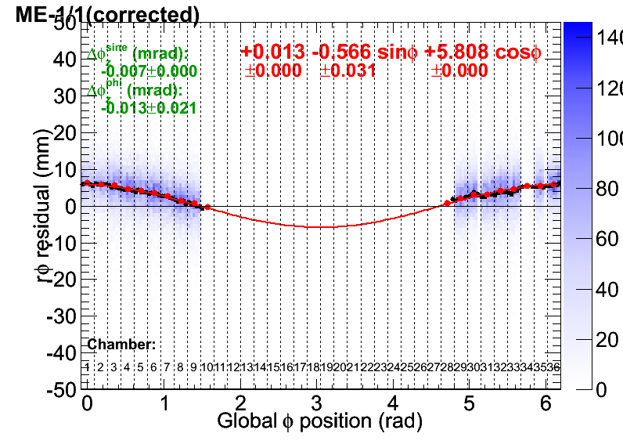
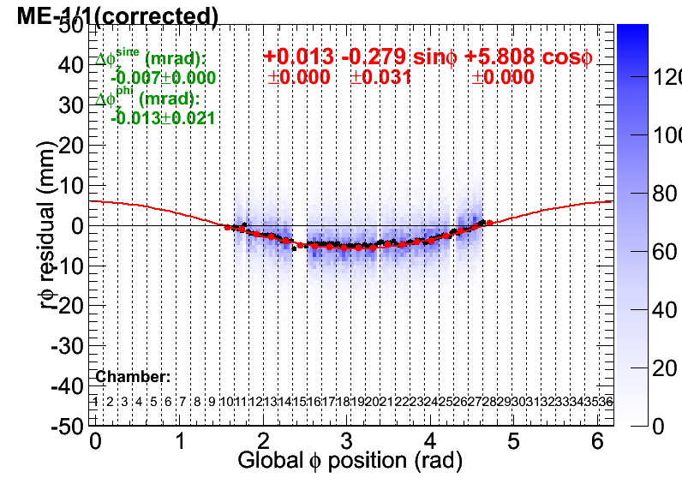
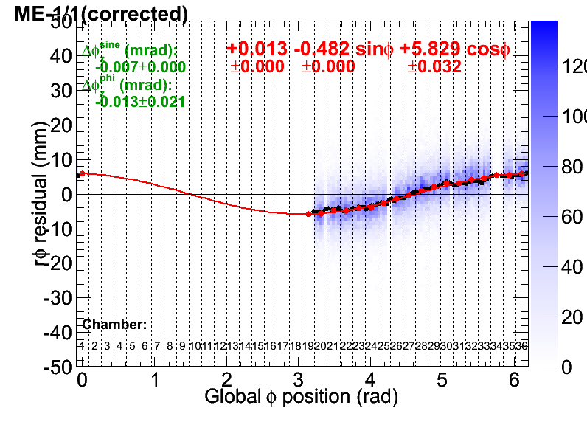
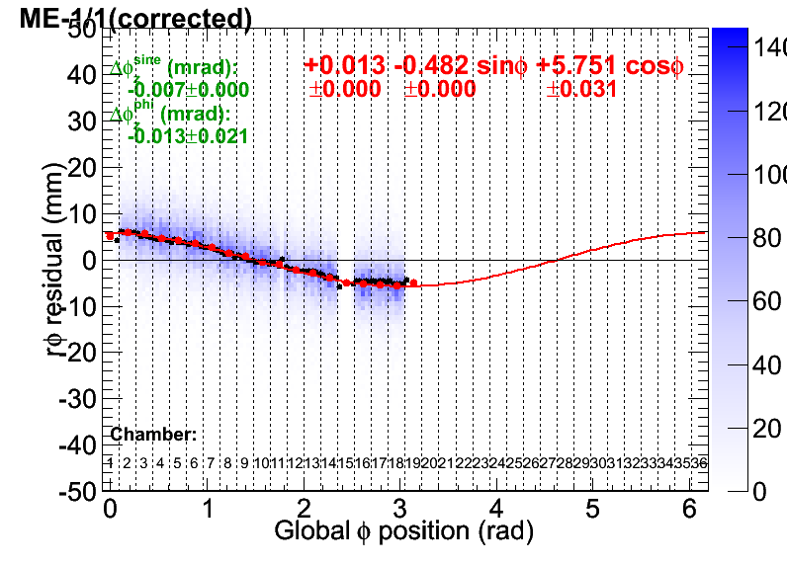
Systematic uncertainties
φ_{z}^{g} correction systematic uncertainty:
  Linear-fit the +-Q peaks-based profiles of corrected φ_{z}^{g} residuals vs. ρ
  Determine intercepts of the fits with top & bottom chamber boundaries
    Uncertainty = (max(intercept)-min(intercept))/2
  Causes: Imprecise knowledge of B-field vs. ρ and chamber level misalignments
dx and dy corrections systematics:
  How a sinusoid is different in different parts of a ring?
  Do sinusoidal fits separately for +x, -x, +y and –y chambers (while other parameters are fixed)
    Uncertainty = half-difference between
    + and – results
  Cause: chamber level misalignments
    B-field is not supposed to influence
    transverse translations

Slide 9
The corrections results
Initial geometry: OCT23_PG-HW-phiy-BHPGholes.db
Tracker muons
Uncertainties are dominated by systematics!
dPhiZ corrections are mostly negligible: phiz is well aligned in initial geometry
dX(mm) dY(mm) dPhiZ(mrad)
ME+4/1 +0.86+-0.09+-0.61 +5.33+-0.09+-0.67 -0.27+-0.03+-0.39
ME+3/2 -0.16+-0.12+-1.85 -0.94+-0.12+-2.50 -0.09+-0.02+-0.27
ME+3/1 +0.03+-0.07+-0.30 +0.15+-0.07+-0.51 +0.28+-0.02+-0.31
ME+2/2 +0.57+-0.11+-1.46 +0.59+-0.11+-1.69 +0.06+-0.02+-0.27
ME+2/1 +0.31+-0.05+-0.32 -0.24+-0.05+-0.39 +0.32+-0.02+-0.42
ME+1/3 +4.35+-0.35+-0.57 +3.37+-0.34+-0.10 -0.00+-0.05+-0.15
ME+1/2 +3.56+-0.07+-1.31 +1.71+-0.07+-1.94 +0.21+-0.02+-0.27
ME+1/1 +4.30+-0.02+-0.46 -2.10+-0.02+-0.40 +0.03+-0.02+-0.57
ME-1/1 -0.48+-0.02+-0.14 -5.81+-0.02+-0.04 -0.14+-0.02+-0.71
ME-1/2 +0.87+-0.06+-0.76 -2.97+-0.06+-0.89 +0.30+-0.02+-0.20
ME-1/3 +0.83+-0.33+-0.06 -2.57+-0.37+-0.17 +0.41+-0.04+-0.21
ME-2/1 +1.37+-0.05+-0.51 -3.56+-0.05+-0.43 +0.54+-0.02+-0.56
ME-2/2 +1.79+-0.11+-1.13 -2.76+-0.11+-1.47 +0.87+-0.02+-0.21
ME-3/1 +2.07+-0.07+-0.41 -4.72+-0.07+-0.20 +0.47+-0.02+-0.52
ME-3/2 +3.16+-0.12+-0.03 -3.51+-0.12+-1.06 +0.90+-0.02+-0.17
ME-4/1 -0.02+-0.09+-0.31 -4.84+-0.09+-0.12 +0.19+-0.03+-0.63

Slide 10
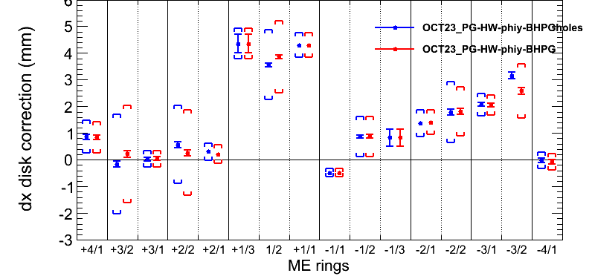
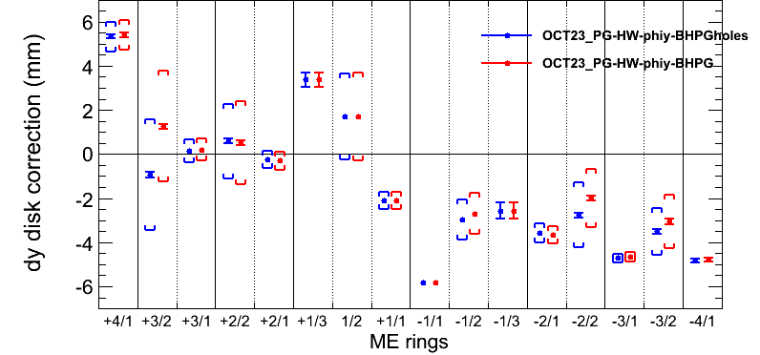
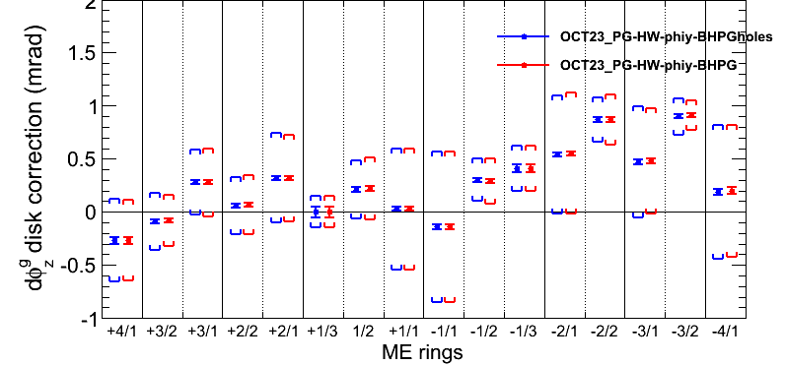
PG with/without holes comparison
Comparing individual ring corrections to
OCT23_PG-HW-phiy-BHPGholes and OCT23_PG-HW-phiy-BHPG initial geometries
Using tracker muons
[Brackets] mark systematic uncertainties
Practically no difference in dphiz
  Expected
Rather small differences in dx & dy except slightly bigger in some rings
  e.g., +-3/2 & +-2/2

Slide 11
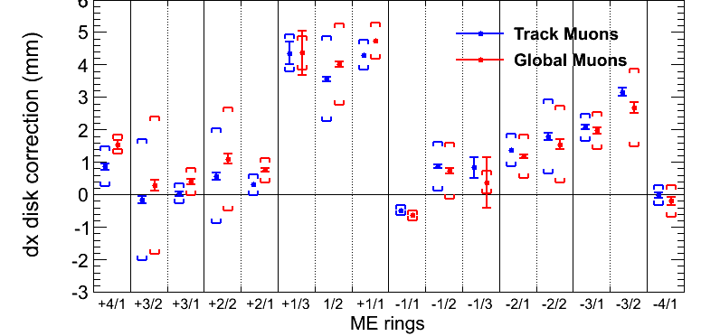
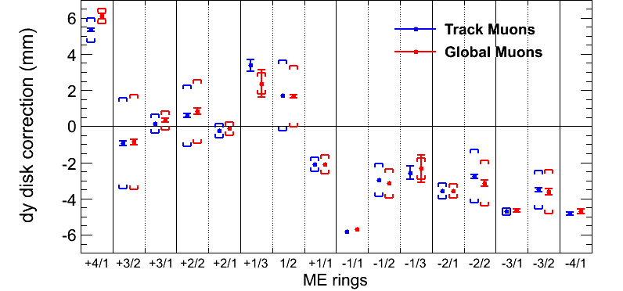
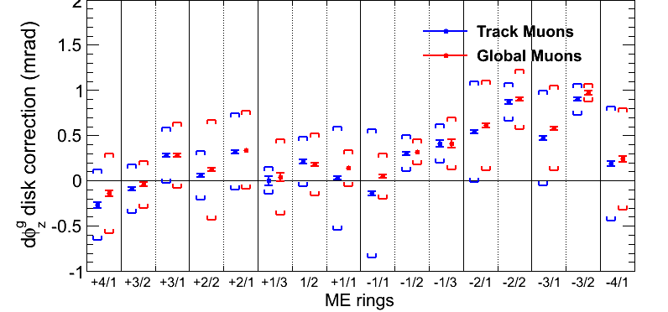
Corrections with tracker and global muons
Small differences in corrections with tracker or global muons
  Often even within statistical uncertainties
The uncertainties are also similar
  Stats are slightly higher for the globals
  Systematic in ME11 dphiz in tracker muons is driven by ME1/a (see next slide)
ME+2 and ME+3 are roughly consistent with being aligned against each other
  Slight ME-2 against ME-3 shift in dx & dy

Slide 12
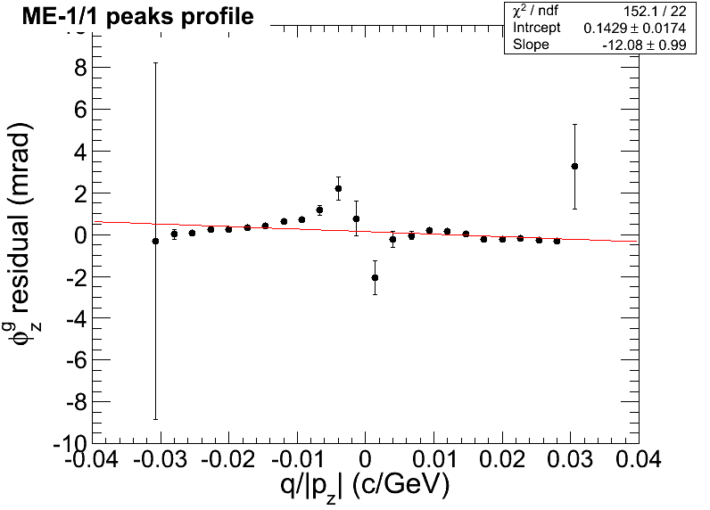
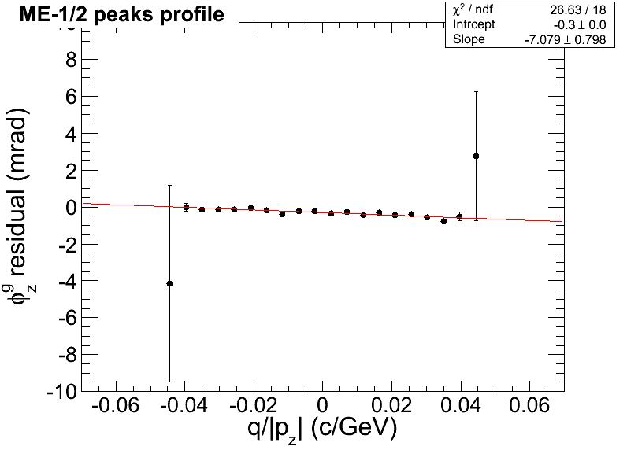
Comparing tracker and global muons
(flip between two slides)
B-field effects differ between tracker and global muons
  Difference between +-Q is usually larger in global muons
    Refitting or propagation must be the cause
φ_{z} alignment vs. ρ is more smooth with tracker muons
  However ME1/a shows some unusual twist with tracker muons
Tracker muons

Slide 13
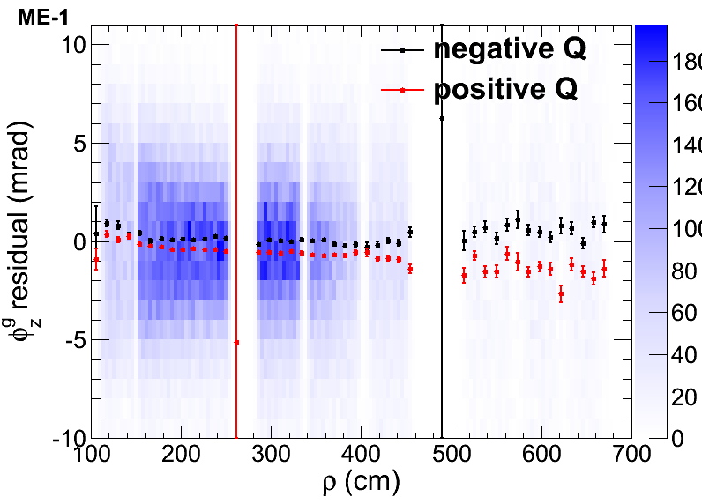
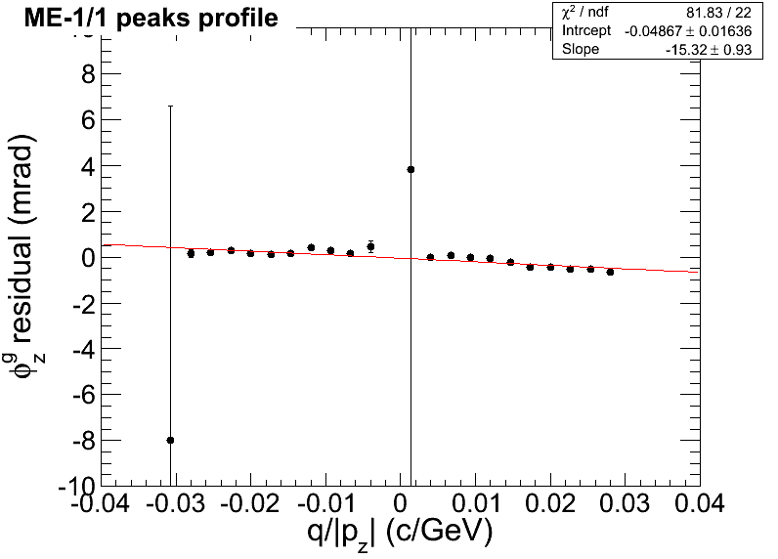
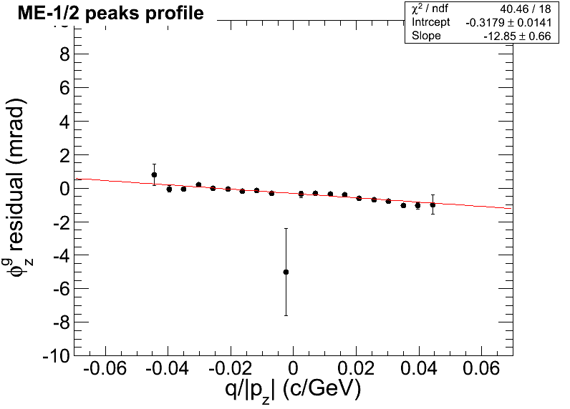
Comparing tracker and global muons
(flip between two slides)
B-field effects differ between tracker and global muons
  Difference between +-Q is usually larger in global muons
    Refitting or propagation must be the cause
φ_{z} alignment vs. ρ is more smooth with tracker muons
  However ME1/a shows some unusual twist with tracker muons
Global muons

Slide 14
Conclusions
a

Slide 15
Backup

Slide 16
a
a
a
a

