Slide 1
Muon Endcap Rings Alignment
Relative to the Tracker
Vadim Khotilovich, Jim Pivarski
Texas A&M University
Muon Alignment Meeting
November 5, 2010

Slide 2
CSC rings alignment intro
Before: fit 2D map-plot of rphiz residual vs. phi to a sinusoidal to find corrections to disks (rings) x and y positions and phiz rotation (global)
  Were observing underestimated uncertainties: were not taking into account systematic effects
Now: improved procedure, including better estimation of phiz rotation and of systematic uncertainties, corrections for B-field imprecision, better initial geometries, results from tracker and global muons
With cosmics in CSC we are quite limited with how well we can do the disks alignment
  Statistical limitations for many chamber types
  Asymmetry in phy (even asymmetry in top-bottom)
Moved to collisions data
  Almost 22 ipb certified as of Friday, Oct 29
  Still have a tracker vs. global muons puzzle to resolve

Slide 3
Data Samples
For ALCARECO global muons
  Before technical shutdown: reprocessed collisions data
  /Mu/Run2010A-MuAlCalIsolatedMu-Sep17ReReco_v2/ALCARECO
  After tech. shutdown:
  /Mu/Run2010B-MuAlCalIsolatedMu-v2/ALCARECO
For tracker muons
  /Mu/Run2010A-Sep17ReReco_v2/RECO
  /Mu/Run2010B-PromptReco-v2/RECO
Used the official good lumis JSON from last friday
  Runs 135821-144114 & 146428-148864
  Luminosity: 3.1+18.8 = 21.9 ipb
Apply p_{T}>15 GeV/c cut to not acquire bias from higher pt muon trigger prescaled in recent data
Initial BH+PG geometry options from Jim (the most recent):
  ~pivarski/public/OCT23_PG-HW-phiy-BHPG.db
  ~pivarski/public/OCT23_PG-HW-phiy-BHPGholes.db

Slide 4
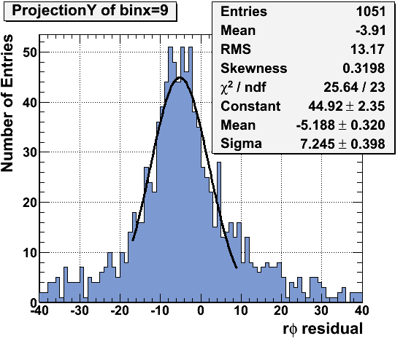
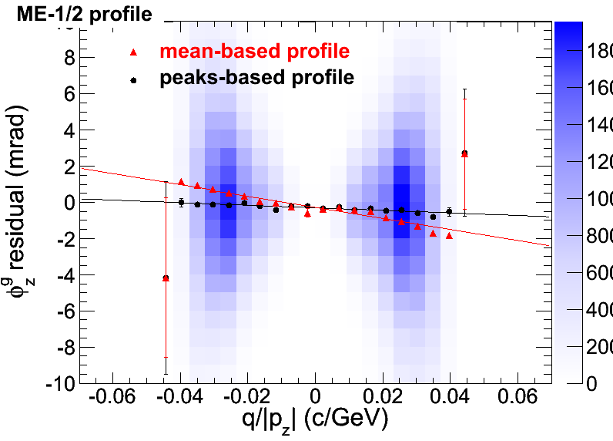
Importance of robust estimators
Our distributions often have significant non-gaussian tails with often significant skewness
  Position of peaks can be rather different then sample mean
  Uncertainty on mean is often unreliable
More robust solution:
  Use peaks instead of sample means
To find peaks and their uncertainties:
  Quick Gaussian fit in Mean ± D range
    With D being either ±RMS, ±2RMS or ±Sigma from a previous Gaussian fit in full range
For profiles:
  We used mean-based profiles
  Moved to “peak-based” profiles
    peaks estimated in every x-axis bin

Slide 5
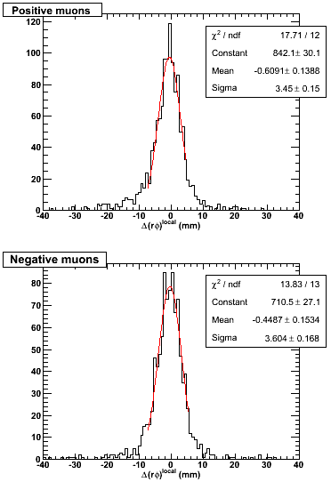
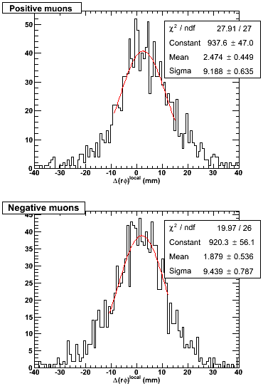
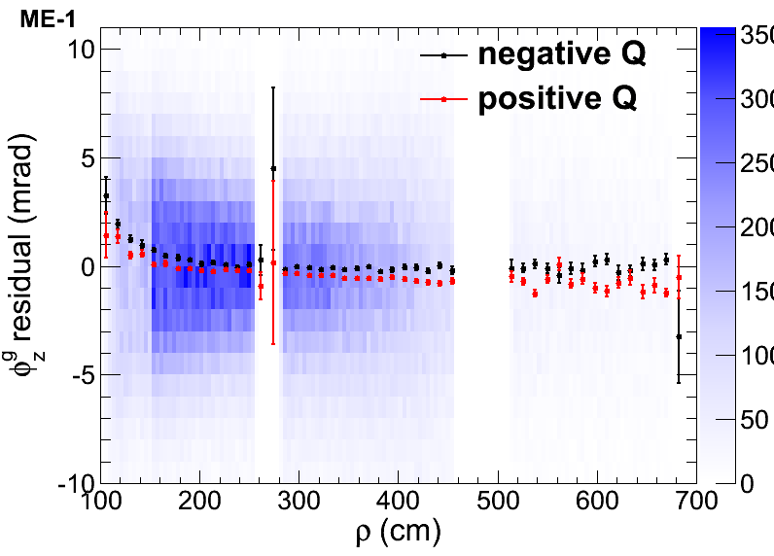
Imprecise magnetic field in CSC
First sign was large segment differences in neighboring stations residuals
  Large spreads that don’t not improve much with alignment and depend on distance between chambers
  ME- mostly shows larger RMS’s then ME+
  Different position for +- charge muons
ME+3/1/10 - ME+2/1/10:
ME-3/1/10 - ME-2/1/10:
φ_{z}^{g} residuals vs. ρ for all stations in a CSC ring
  Different for +- charge muons
  With differences varying with ρ
Some φ_{z}^{g} residuals vs. ρ slope might be caused by chambers’ φ_{z} or internal misalignments

Slide 6
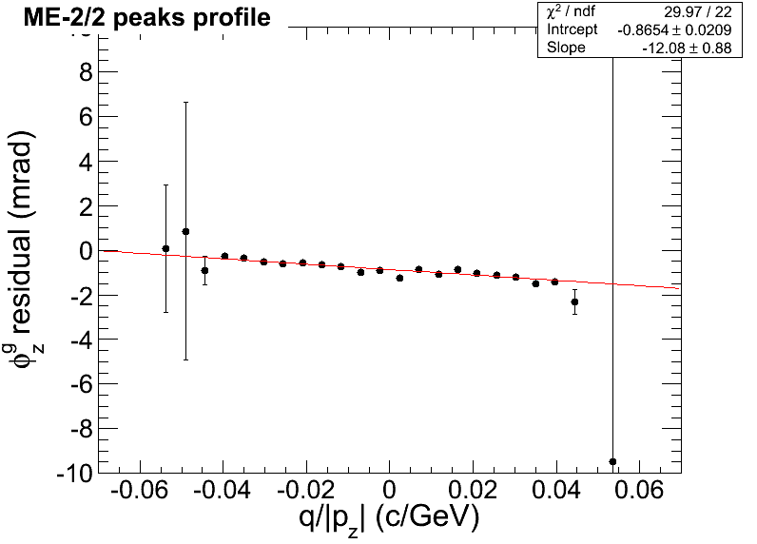
B-field corrections
Angular deviation in uniform magnetic field
φ₂- φ₁~qBL/p⊥
  If B = B_{z}: p⊥ = p_{T} and L = ρ
  If B = B_{r}: p⊥ = p_{z} and L ~ z
  In barrel chambers ρ ~ const
  In endcap chambers z ~ const
If B is correctly known, residual δ(φ₂- φ₁) should not depend on q/p⊥
Else, it would be ~ proportional
  In barrel: δρ(φ₂- φ₁)~ q/p_{T}
  In endcaps: δ(φ₂- φ₁)~ q/p_{z}
    For both B_{z} and B_{r} components
To correct for imprecise B-field in CSC,
use results of linear fit of φ_{z}^{g} residuals
vs. q/p_{z} peak-based profiles for every
type of chambers (rings)
  From the intercept we also obtain the ring dphiz rotation corrections
p⊥
+ B
L (circle chord)
p_{T}
p_{z}
ρ
φ₂- φ₁
z
p_{T}/p_{z}≈ρ/z

Slide 7
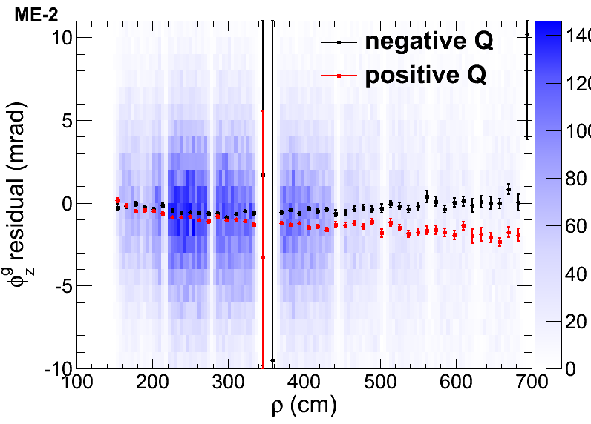
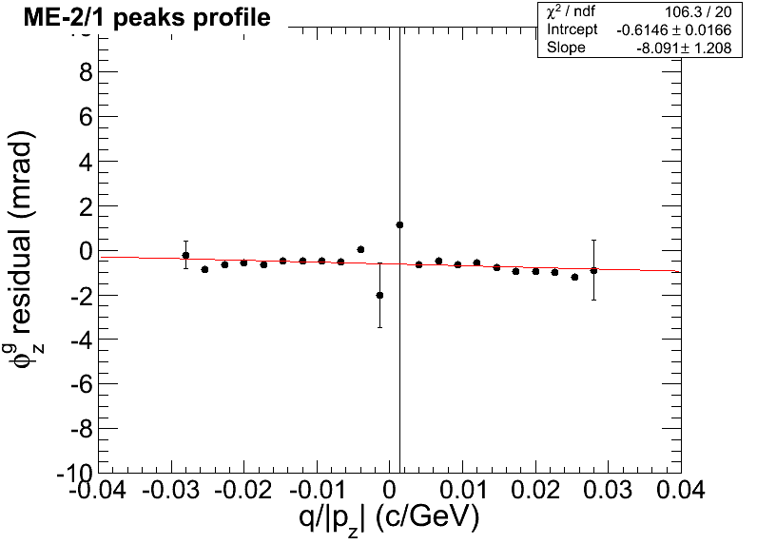

Comparing tracker and global muons
(flip between two slides)
B-field effects differ between tracker and global muons
  Difference between +-Q is usually larger in global muons
    Refitting or propagation must be the cause
φ_{z} residual vs. ρ looks more smooth with tracker muons
Global muons

Slide 8
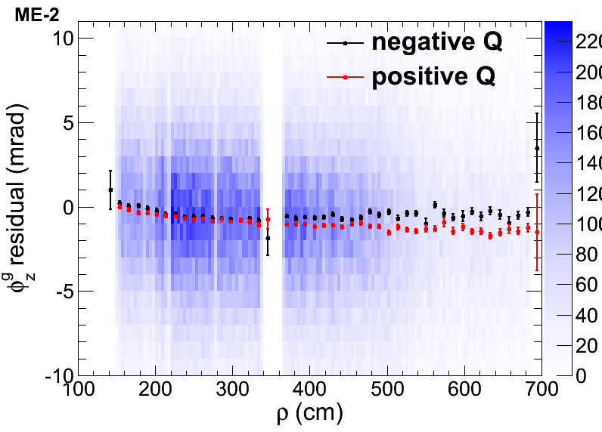
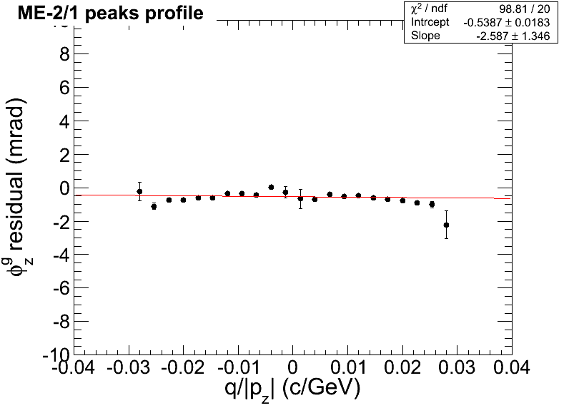
Comparing tracker and global muons
(flip between two slides)
B-field effects differ between tracker and global muons
  Difference between +-Q is usually larger in global muons
    Refitting or propagation must be the cause
φ_{z} residual vs. ρ looks more smooth with tracker muons
Will use
tracker muons
for alignment
Tracker muons

Slide 9
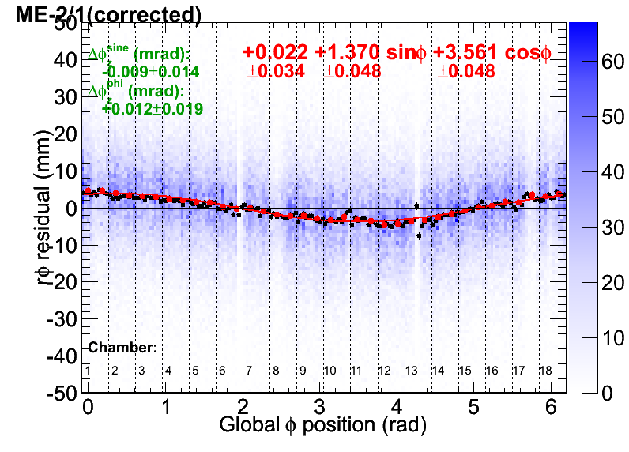
The procedure for ring corrections
From the results of linear fit of φ_{z}^{g} residuals vs. q/p_{z} peak-based profiles we get
  dphiz correction numbers with statistical uncertainty
  Corrections to residual to compensate for imprecise knowledge of magnetic filed
Use the correction obtained in previous step to draw mapplots of corrected rφ_{z}^{g} residuals vs. global φ position
Do a sinusoidal fit of a peaks-based profile of such mapplots (in red)
  sin and cos coefficients define
  the dx and dy corrections and their statistical uncertainties correspondingly
Repeat the above in 2nd iteration
  Needed b/c phiz corrections are obtained independently from dx and dy ones

Slide 10
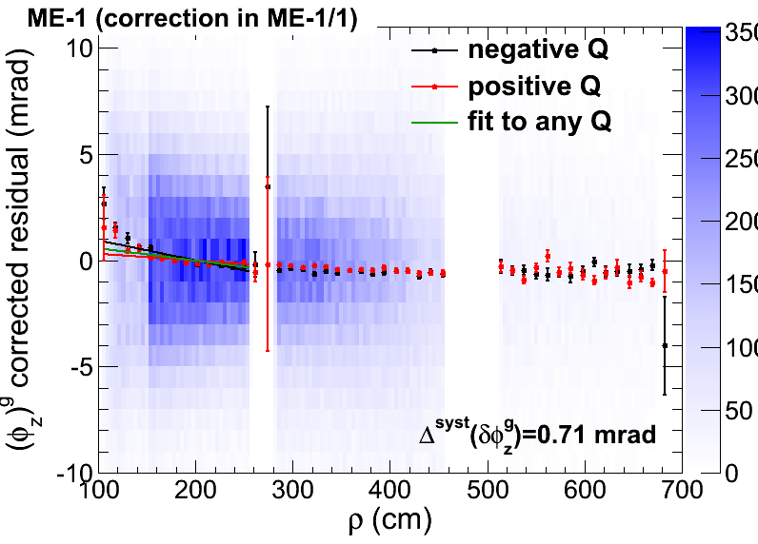
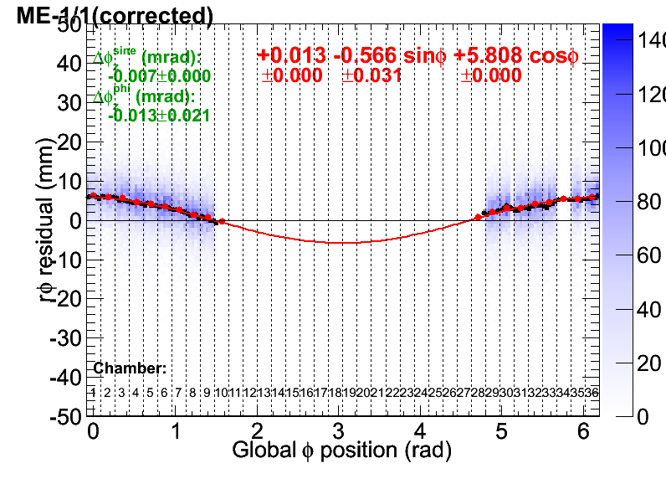
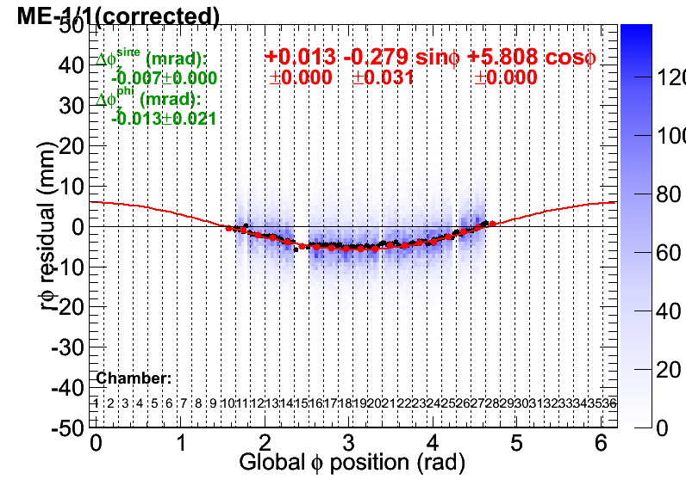
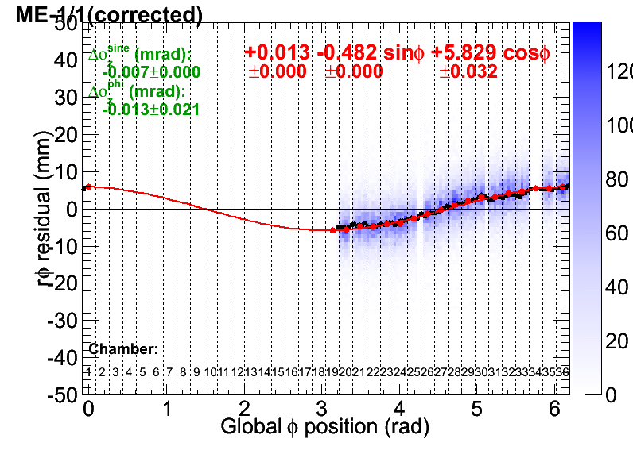
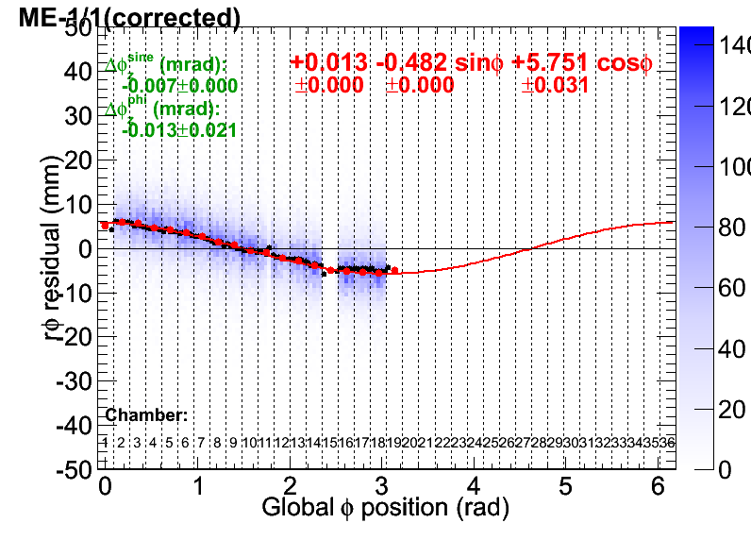
Systematic uncertainties
φ_{z}^{g} correction systematic uncertainty:
  Linear-fit the +-Q peaks-based profiles of corrected φ_{z}^{g} residuals vs. ρ
  Determine intercepts of the fits with top & bottom chamber boundaries
    Uncertainty = (max(intercept)-min(intercept))/2
  Causes: Imprecise knowledge of B-field vs. ρ and chamber level misalignments
dx and dy corrections systematics:
  How a sinusoid is different in different parts of a ring?
  Do sinusoidal fits separately for +x, -x, +y and –y chambers (while other parameters are fixed)
    Uncertainty = half-difference between
    + and – results
  Cause: chamber level misalignments
    B-field is not supposed to influence
    transverse translations

Slide 11
Corrections results (1st iteration)
Tracker muons, initial geometry: OCT23_PG-HW-phiy-BHPGholes.db
Uncertainties are dominated by systematics!
dPhiZ corrections are mostly negligible: phiz is well aligned in initial geometry
  ME+4/2 is a special case…
dX(mm) dY(mm) dPhiZ(mrad)
ME+4/2 +0.86+-0.09+-0.61 +5.33+-0.09+-0.67 -1.28+-0.06+-0.21
ME+4/1 +0.86+-0.09+-0.61 +5.33+-0.09+-0.67 -0.27+-0.03+-0.39
ME+3/2 -0.16+-0.12+-1.85 -0.94+-0.12+-2.50 -0.09+-0.02+-0.27
ME+3/1 +0.03+-0.07+-0.30 +0.15+-0.07+-0.51 +0.28+-0.02+-0.31
ME+2/2 +0.57+-0.11+-1.46 +0.59+-0.11+-1.69 +0.06+-0.02+-0.27
ME+2/1 +0.31+-0.05+-0.32 -0.24+-0.05+-0.39 +0.32+-0.02+-0.42
ME+1/3 +4.35+-0.35+-0.57 +3.37+-0.34+-0.10 -0.00+-0.05+-0.15
ME+1/2 +3.56+-0.07+-1.31 +1.71+-0.07+-1.94 +0.21+-0.02+-0.27
ME+1/1 +4.30+-0.02+-0.46 -2.10+-0.02+-0.40 +0.03+-0.02+-0.57
ME-1/1 -0.48+-0.02+-0.14 -5.81+-0.02+-0.04 -0.14+-0.02+-0.71
ME-1/2 +0.87+-0.06+-0.76 -2.97+-0.06+-0.89 +0.30+-0.02+-0.20
ME-1/3 +0.83+-0.33+-0.06 -2.57+-0.37+-0.17 +0.41+-0.04+-0.21
ME-2/1 +1.37+-0.05+-0.51 -3.56+-0.05+-0.43 +0.54+-0.02+-0.56
ME-2/2 +1.79+-0.11+-1.13 -2.76+-0.11+-1.47 +0.87+-0.02+-0.21
ME-3/1 +2.07+-0.07+-0.41 -4.72+-0.07+-0.20 +0.47+-0.02+-0.52
ME-3/2 +3.16+-0.12+-0.03 -3.51+-0.12+-1.06 +0.90+-0.02+-0.17
ME-4/1 -0.02+-0.09+-0.31 -4.84+-0.09+-0.12 +0.19+-0.03+-0.63

Slide 12
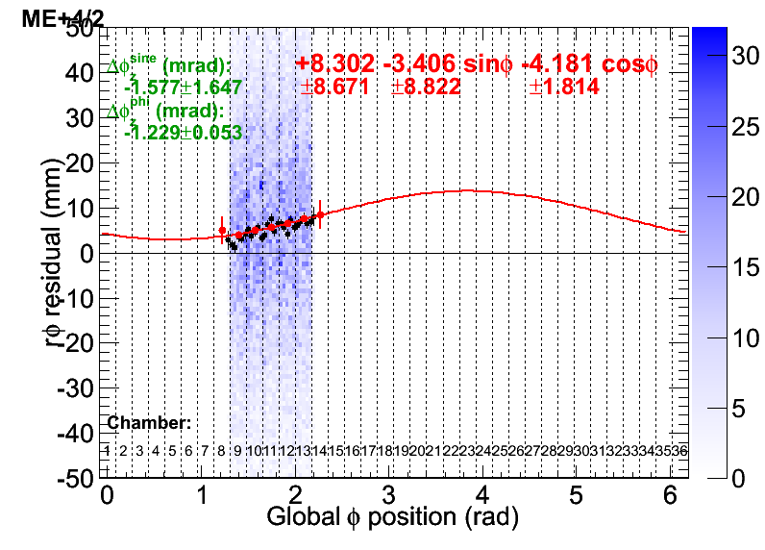
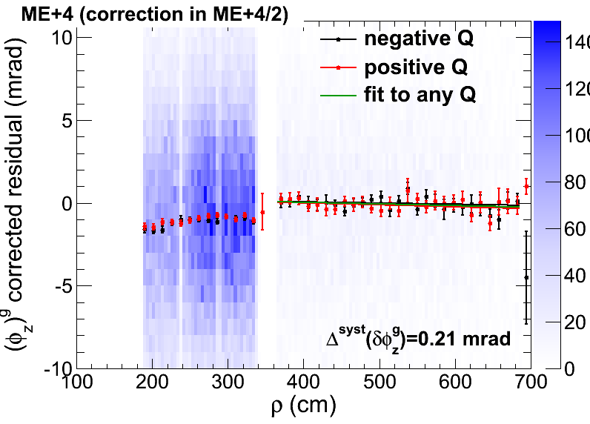
ME+4/2 case
ME+4/2 only has 5 chambers installed
The chambers are aligned relative to each other, but not positioned properly
The dphiz correction for ME+4/2 is significant and can be reliably determined
The dx and dy corrections cannot be reliably determined due to small number of chambers for sinusoidal fit
  But these corrections look similar as for ME+4/1
  Thus: take dx and dy corrections numbers for ME+4/2 from ME4/1

Slide 13
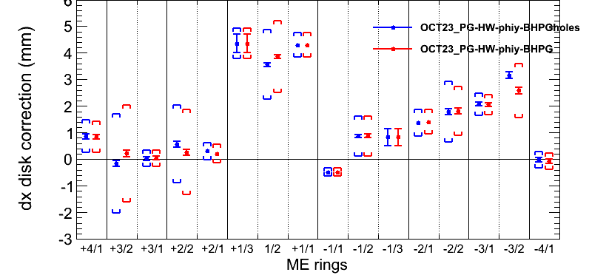
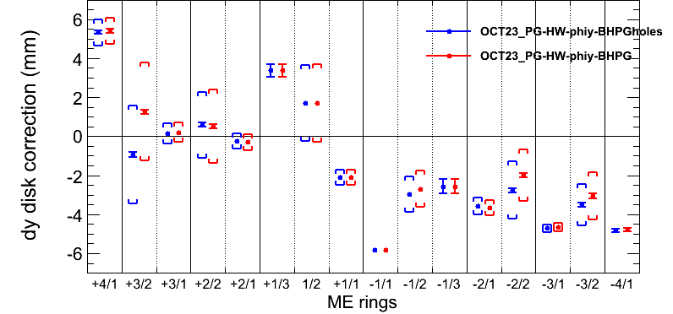
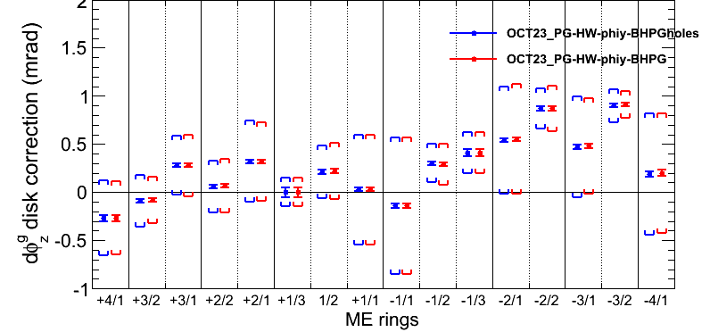
PG with/without holes comparison
Comparing individual ring corrections to
OCT23_PG-HW-phiy-BHPGholes and OCT23_PG-HW-phiy-BHPG initial geometries
Using tracker muons
[Brackets] mark systematic uncertainties
Practically no difference in dphiz
  Expected
Rather small differences in dx & dy except slightly bigger in some rings
  e.g., +-3/2 & +-2/2

Slide 14
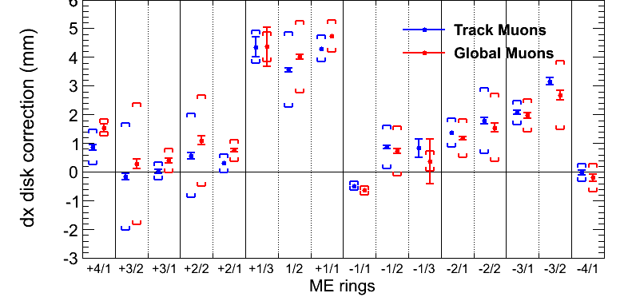
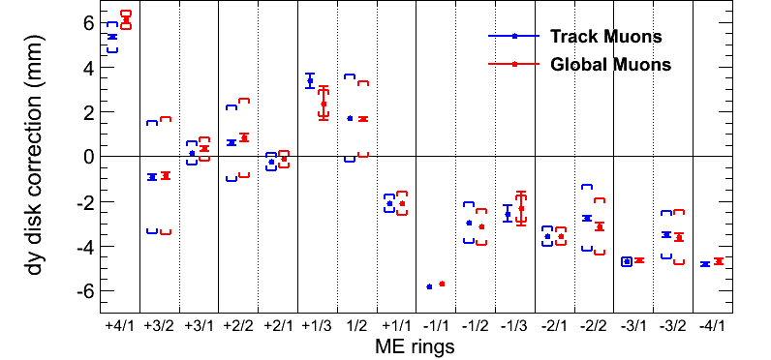
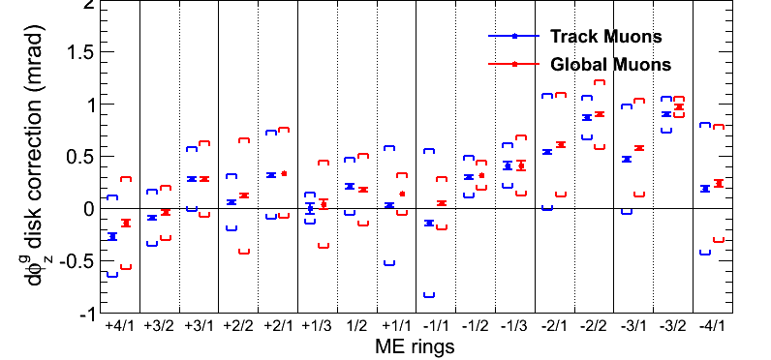
Corrections with tracker and global muons
Small differences in corrections with tracker or global muons
  Often even within statistical uncertainties
The uncertainties are also similar
  Stats are slightly higher for the globals
  Systematic in ME11 dphiz in tracker muons is driven by ME1/a (see next slide)
ME+2 and ME+3 are roughly consistent with being aligned against each other
  Slight ME-2 against ME-3 shift
  in dx & dy

Slide 15
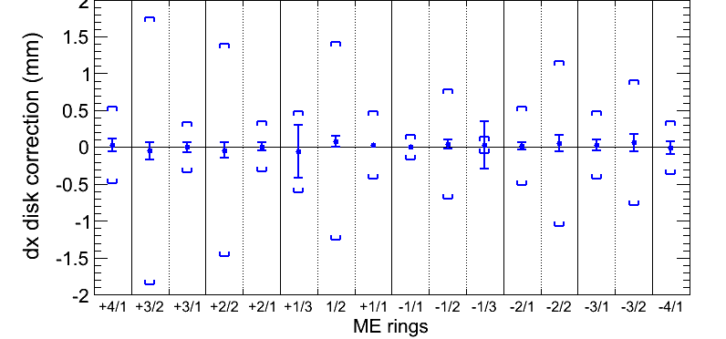
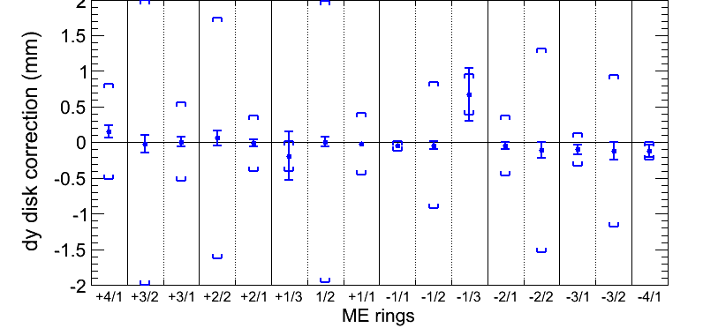
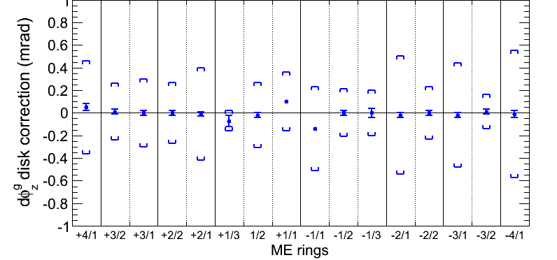
Corrections during 2nd iteration
Illustrate the convergence
Everything is very close to zero
ME11’s get some additional small dphiz corrections
  b/c in previous iteration the phiz corrections were obtained before and independently from the dx and dy ones
ME+4/2 also gets some corrections (not shown here)
  Only b/c its dx and dy corrections are glued to ME+4/1

Slide 16
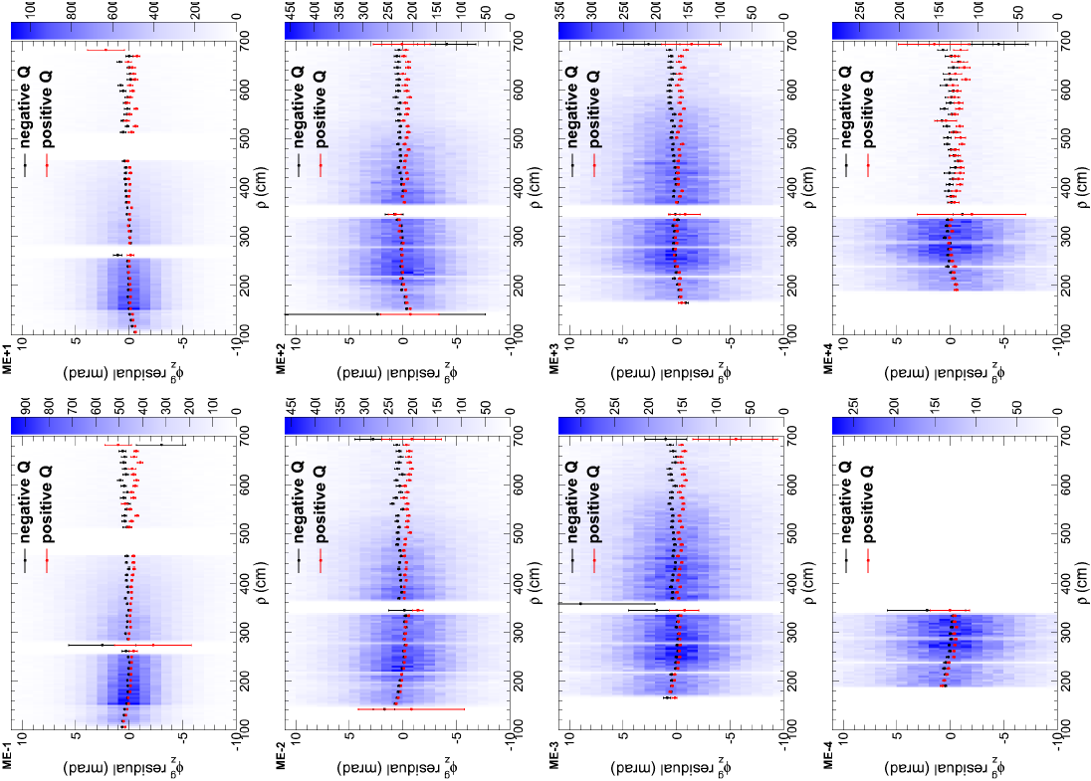
φ_{z}^{g} residual vs ρ (after 1st iteration)
Displays B-field +-Q discrepancies and φ_{z}^{loc} misalignments in ring1

Slide 17
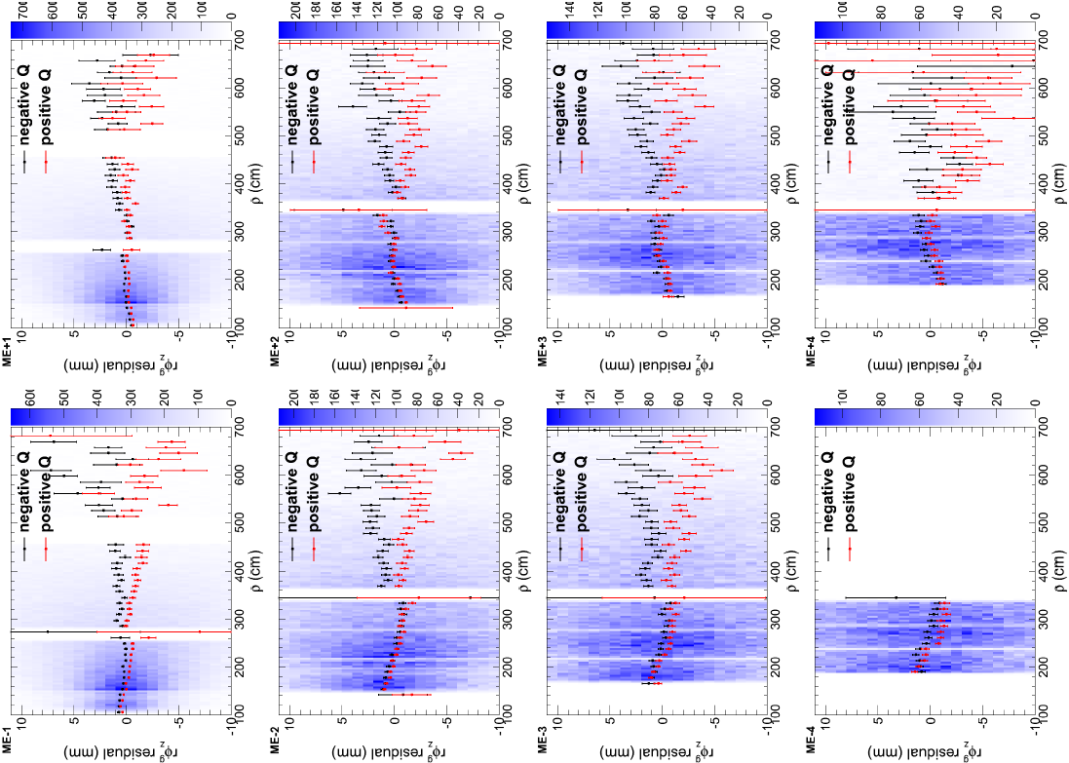
ρφ_{z}^{g} residual vs ρ (after 1st iteration)
“Magnifies” B-field discrepancies and φ_{z}^{loc} misalignments

Slide 18
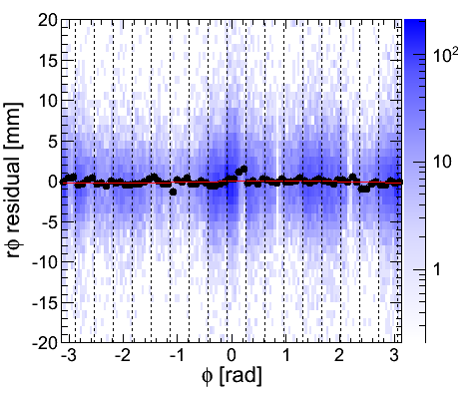
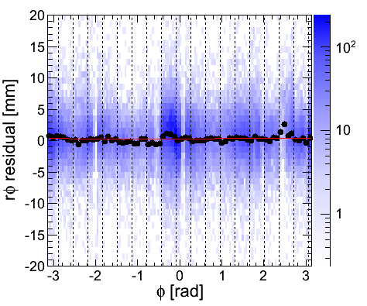
Cross-check with beam halo
Use the resulting alignment geometry as input to the beam halo alignment procedure
  Looks very consistent
ME+4
ME-4

Slide 19
Conclusions
Muon endcap rings x&y position and φ_{z} rotation alignment using tracker muons was performed
  Corrected for averaged over chamber’s radius B-field discrepancies
    Clear need for improvement of the endcaps B-map
  Uncertainties dominated by systematic effects from imprecise B-map and remaining individual chamber misalignments
    φ_{z}^{loc} misalignments are still large
  Global muons give similar corrections but there are some small differences and there are reasons to believe that using tracker muons is more correct at the moment
  The resulting alignment satisfies cross-check with beam halo

