Slide 1
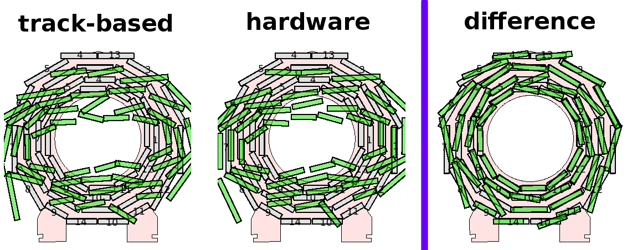
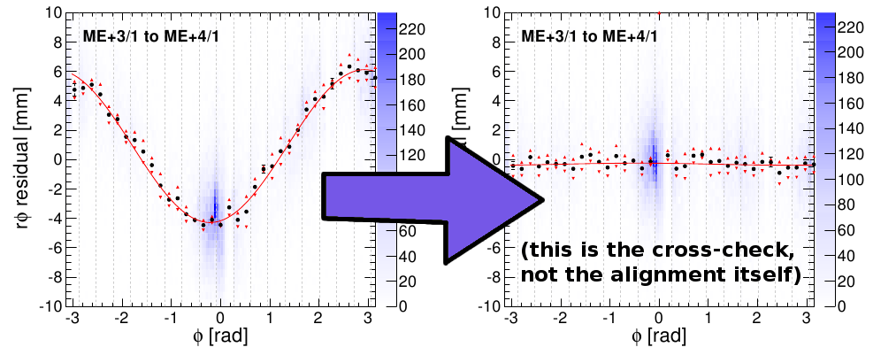
Muon Alignment: current status
Two alignments for comparison: track-based and hardware
  They agree on the mm-scale positions of chambers, but differ by a “twist” of 2 mm amplitude: sin(phi) x eta bias in track pT for TeV-scale muons (~0.2 c/TeV)
  Resolving this is our highest priority (several ongoing studies)
  Current geometry from hardware
Endcap aligned using a combination of hardware, beam-halo, and collisions tracks
Beginning new project to supply APEs (misalignment-dependent weights for track-fits) to improve TeV-scale track-fitting
Barrel alignment comparison (exaggerated by a factor of 200)
Sample plot from endcap alignment
before alignment
after alignment

Slide 2
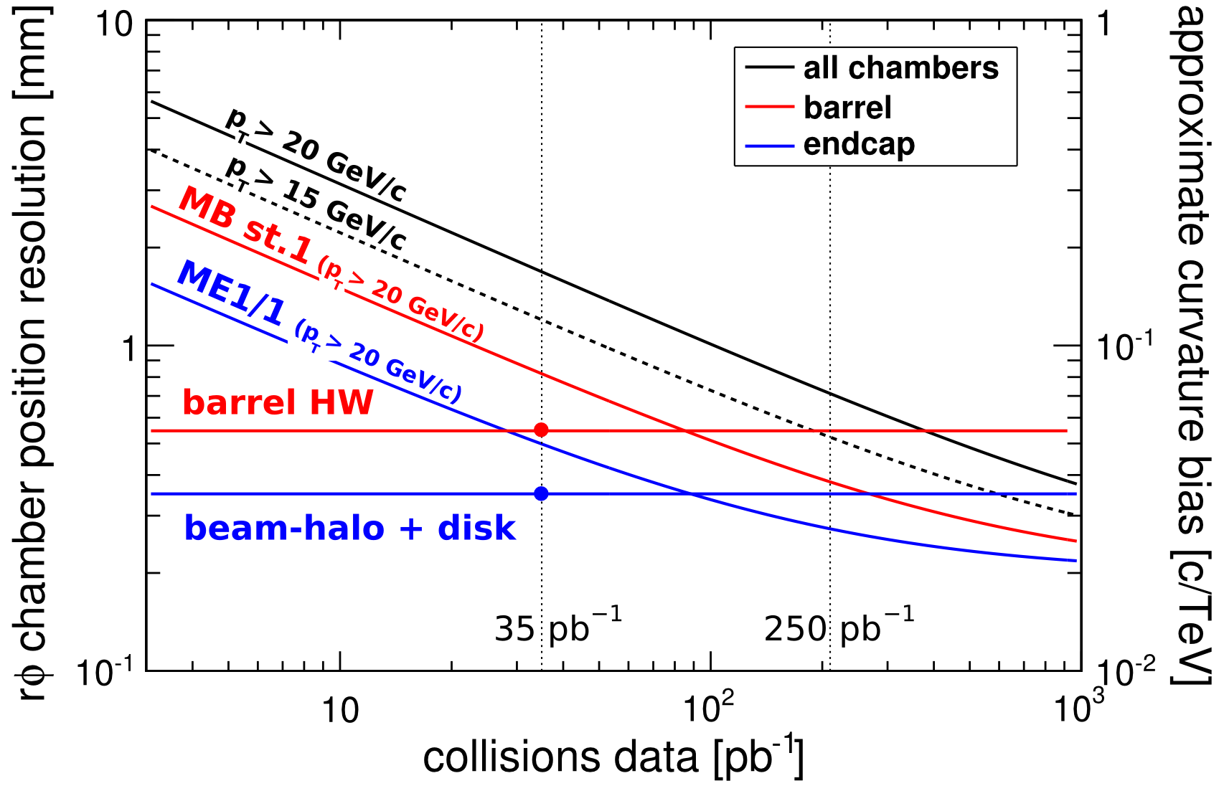
Muon Alignment: projections and plans
Projections:
Plans:
pT > 15 vs 20 GeV/c → 30% effect
Best track-based resolution for first-station chambers
Reaches systematic limit at ~1 fb⁻¹
Systematic issues (e.g. “twist”) do not scale with integrated lumi
Continue working with comparisons of TB collisions, cosmics/BH, and HW

