Slide 1
GraphQL
James Pizagno
7 October 2019

Slide 2
GraphQL Introduction
History
React.JS Conf 2015
Facebook invented and open source
Features:
client specifies data
Server has single end point that responds to client
Compare to REST
REST is strict
API reqests: 1 vs many
API changes: „v1“ vs no change on client side (so says GraphQL doc, but I am not convinced)
Data exploration (API not fixed)
Similar to Netflix/Falcor
Typical Users and use-cases
Facebook mobile
Yelp
Coursera
Shopify
References:
https://www.howtographql.com
https://graphql.org

Slide 3
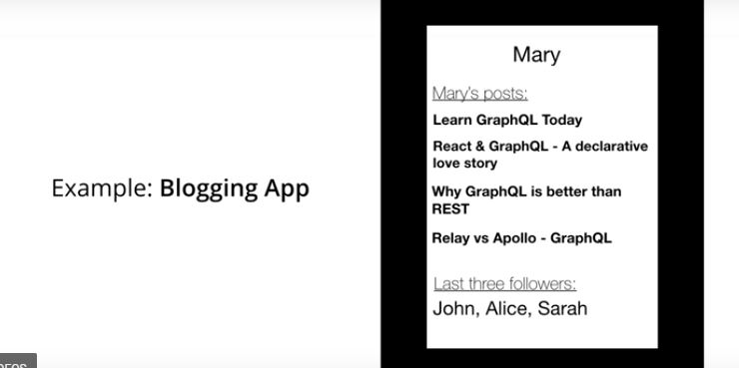
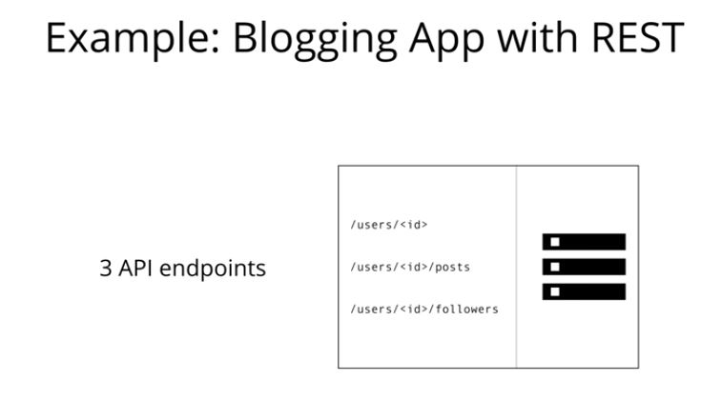
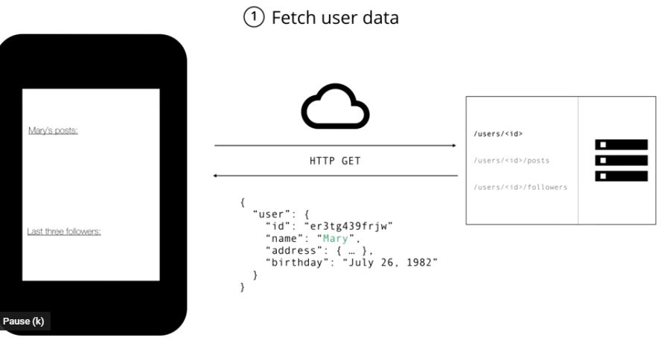
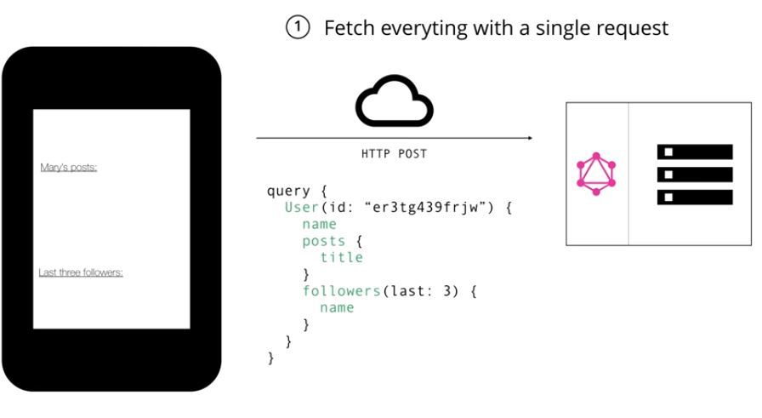
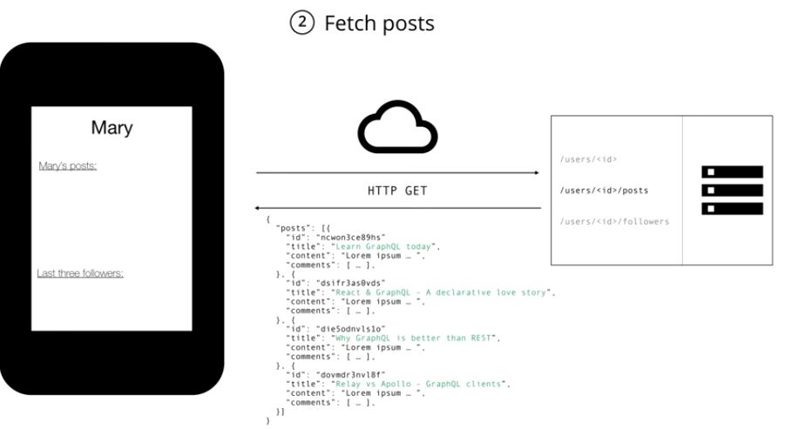
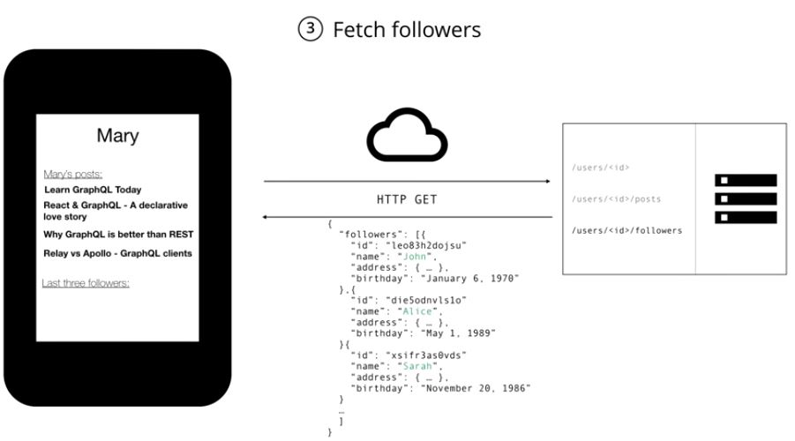
Concrete Example GraphQL vs REST
Use Case:
Example: Blogging App with GraphQL
Note:
REST returns unnecessary data
Many calls (3)

Slide 4
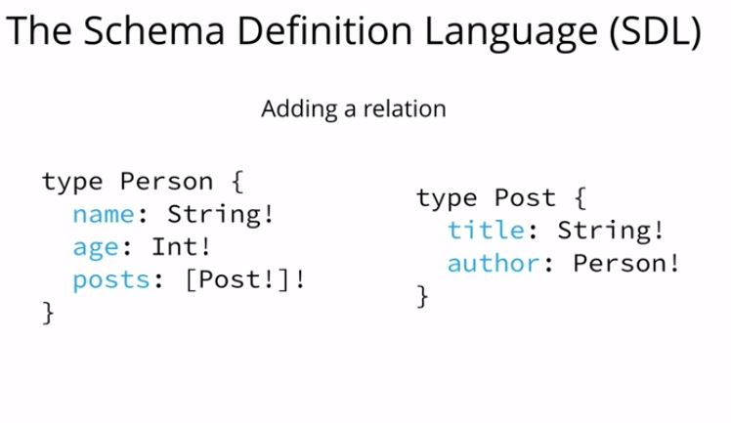
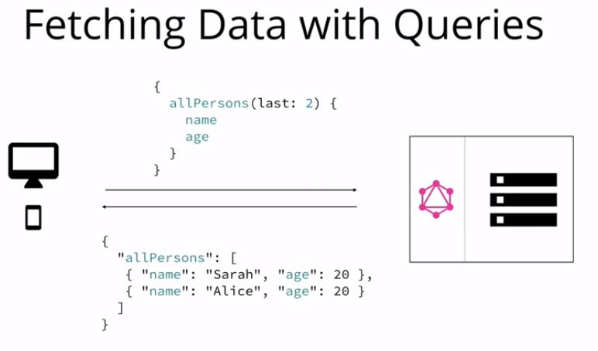
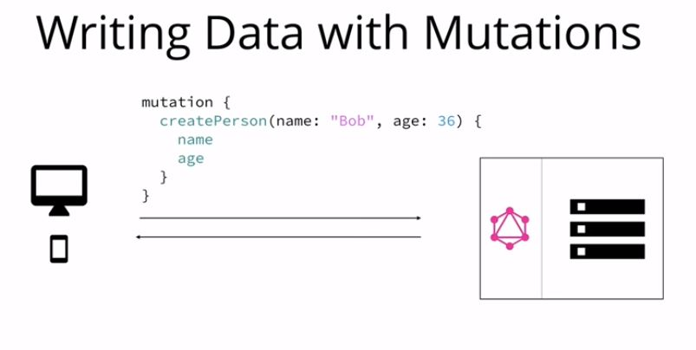
Concepts
Schema Definition Language
Queries
JSON
„data classes“ i.e. Plain-Old-Java-Objects
„resolvers“ model queries and have resolver functions
(i.e. bind repo to objects)
Mutations
Data modification (CUD from CRUD)
Difference between REST/POST vs GraphQL?
Subscription to when data changes
i.e. when new Persion is created, then a subscription will get the stream of data sent to client

Slide 5
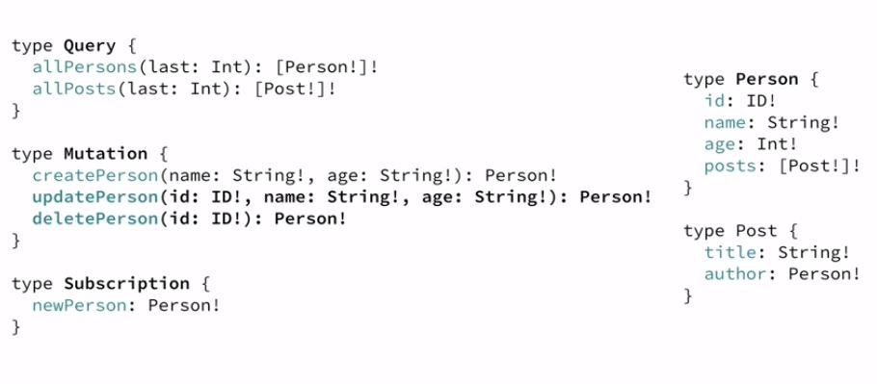

Slide 6
Examples
Show code….

Slide 7
Summary
Alternative to REST
Less network traffic
More exploratory (but still restricted by schema)
Differ from gRPC or RMI
I don‘t know

