Slide 1
Web Networking
An overview of the underpinnings of the Web

Slide 2
Agenda
The Network Protocol Stack
How a Browser Downloads a Web Page
Common Networking Infrastructure

Slide 3
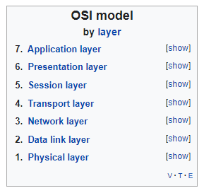
The Network Protocol Stack – The OSI Model
Always referenced, never followed
The OSI model defines seven “network layers”
Layers are distinguished by functionality provided
They’re ordered (loosely) by degree of abstraction
Main place you see it: Firewalls are frequently categorized by how many OSI layers they can inspect and use to filter traffic
Level 4 firewalls can filter by IP address and TCP or UDP port
Level 7 firewalls can also filter by HTTP headers

Slide 4
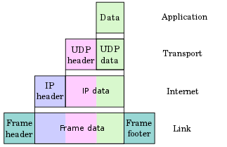
The Network Protocol Stack – The TCP/IP Model
Link Layer – Lowest level, usually meaning hardware (ethernet, MAC addresses)
Internet Layer – IP (the “Internet Protocol”)
Transport Layer
TCP (Transport Control Protocol) – connections and error handling; uses ports
UDP (User Datagram Protocol) – no connections or error handling; uses ports
Application Layer
HTTP (HyperText Transport Protocol) – Headers, paths, verbs, query strings
WebSocket – A real-time two-way messaging protocol compatible with HTTP
FTP (File Transfer Protocol) – Directory listings, binary file transfer
SMTP (Simple Mail Transport Protocol) – Peer-to-peer routing of emails
TDS (Tabular Data Stream) – MS SQL’s native protocol
DNS (Domain Name Service) – Decentralized domain-to-IP lookup
…and more

Slide 5
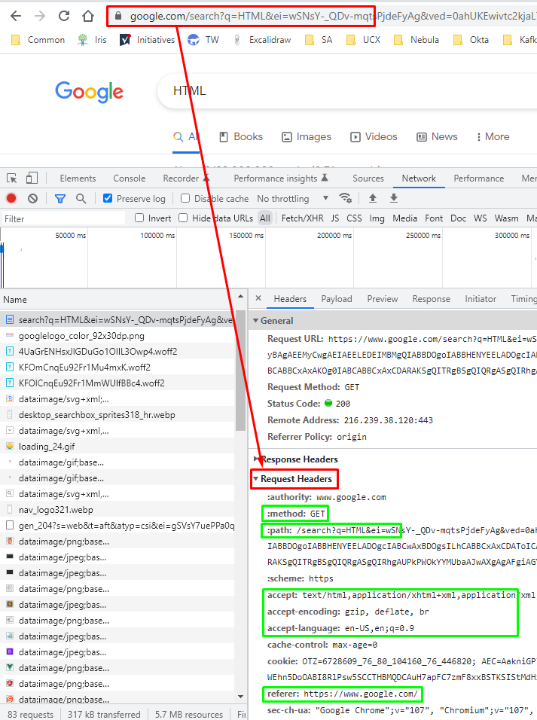
Browsers and Web Pages – Initial Request
DNS lookup of the IP address(es) hosting a domain – google.com here
TCP connection established to one of the IP addresses for the domain
HTTPS tunnel negotiated and established over the TCP connection
HTTP request sent
Verb – Here it’s GET, which means “Send me what’s at the path”
Path – Just /search in this case
Query string – Here it’s ?q=HTML&ei=…
For Google this represents a query for the string “HTML”
Other key/value pairs delimited by ampersands (“&”)
Other headers indicate things like what kinds of responses are accepted, what page (if any) sent the browser here, etc.

Slide 6
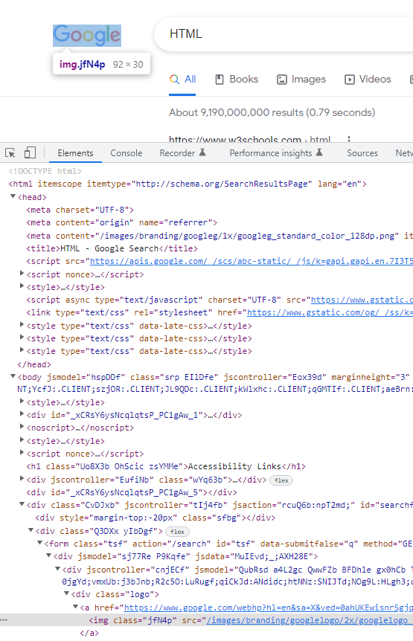
Browsers and Web Pages - HTML
HyperText Markup Language
An XML-ish description of a UI
“Tags” or “elements” define how what should be included in the parent space
Most HTML elements can include other elements
Some tags provide metadata about the page
<head> - Resource references, page metadata, etc.
<meta> - Info about the page like which text encoding is used
<title> - Usually shown in the browser tab containing the page
Some tags reference other resources to download
<script> - Client-side script files
<img> - An image to display
<link type=“text/css”> - Styling (think fonts & colors) that can be applied

Slide 7
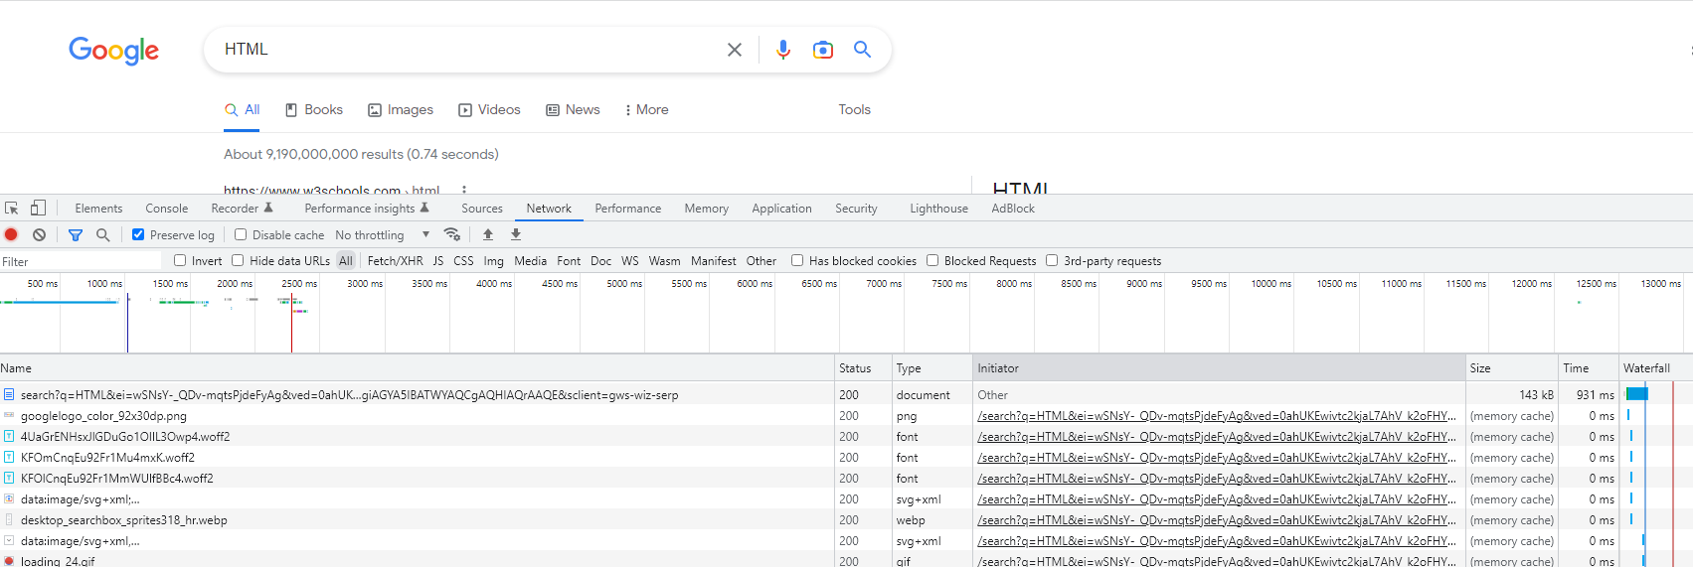
Browsers and Web Pages – Subsequent File Requests
Other files (scripts, images, styles) referenced by the main HTML are now downloaded
Responsibly parallel
Can be recursive, thanks to client-side scripts referencing other scripts
Can be partial, with other resources pulled on-demand by scripts

Slide 8
Common Network Infrastructure - Firewalls
Firewalls block or allow network traffic between “network segments”
Can use metadata from many protocols in the initial request to decide whether it’s allowed
Frequently thought of as a “door” through which “external” traffic must pass to get to “internal” servers
Network segments are logically connected only by the firewall itself, with the router forcing traffic from one segment to another to go through the firewall
Some common “network segments”
External network or WAN – The Internet and all the unknown actors that lurk there
Internal network or LAN – Your “local area network” of devices owned and managed by you
DMZ – A “De-Militarized Zone” is a network segment frequently configured to be the only segment that can both be accessed from the Internet and also access internal servers. Is a way to limit surface area for attack.

Slide 9
Common Network Infrastructure - Others
Router
Connects physical networks and has rules to know what the “next hop” is for a destination
Frequently has special rules to send traffic through a firewall if one is present
Gateway – Generally an adapter between dissimilar physical network architectures
Proxy
A deliberate “man in the middle” attack designed to protect either the requester or (for a reverse proxy) the server
Usually modifies the request in some way to anonymize whatever it’s protecting
Usually located in the DMZ network segment
Load Balancer
Balances user traffic among multiple servers
Can use DNS to “round robin” IP responses to domain queries
The most advanced usually act as reverse proxies, and can move traffic off of servers that are slow or not responding

