Slide 1
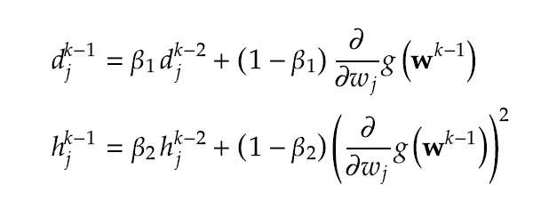

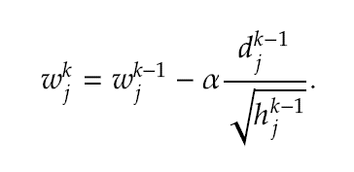
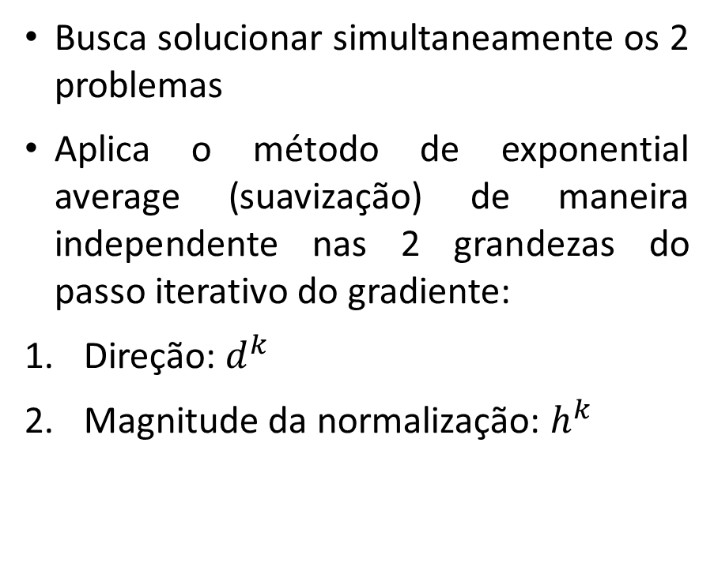
A.5. Adam – Adaptive Moment Estimation
Busca solucionar simultaneamente os 2 problemas
Aplica o método de exponential average (suavização) de maneira independente nas 2 grandezas do passo iterativo do gradiente:
Direção: $d^{k}$
Magnitude da normalização: $h^{k}$
Notes:
Adaptive Moment Estimation (Adam) [69] is a component-wise normalized gradient step employing independently-calculated exponential averages for both the descent direction and its magnitude. That is, we compute the jth coordinate of the updated descent direction by first computing the exponential average of the gradient descent direction dkj and the squared magnitude hkj separately along this coordinate as
where β1 and β2 are exponential average parameters that lie in the range [0, 1]. Popular values for the parameters of this update step are β1 = 0.9 and β2 = 0.999. Note that, as with any exponential average, these two updates apply when k > 1, and should be initialized2 at first values from the series they respectively model, i.e.,
The Adam step is then a component-wise normalized descent step using this exponential average descent direction and magnitude, with a step in the jth coordinate taking the form

Slide 2
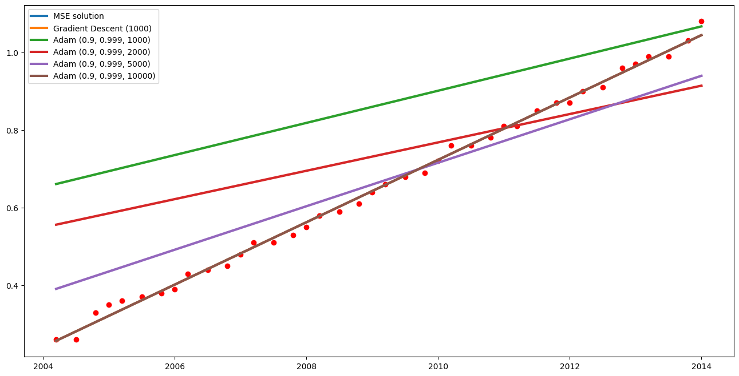
A.5. Adam – Adaptive Moment Estimation

