Slide 1
Introduction to Models

Slide 2
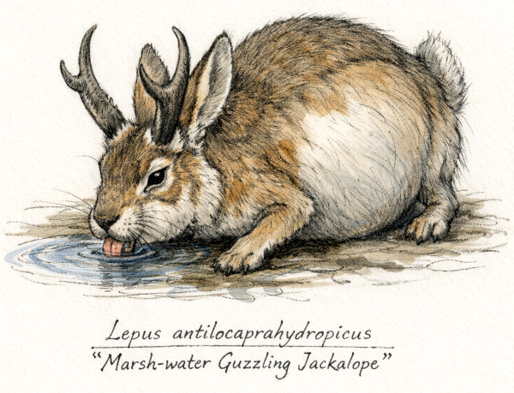
From data to processes
Data are outcomes of processes
Measurements mix signal and noise
Models formalize that mix

Slide 3
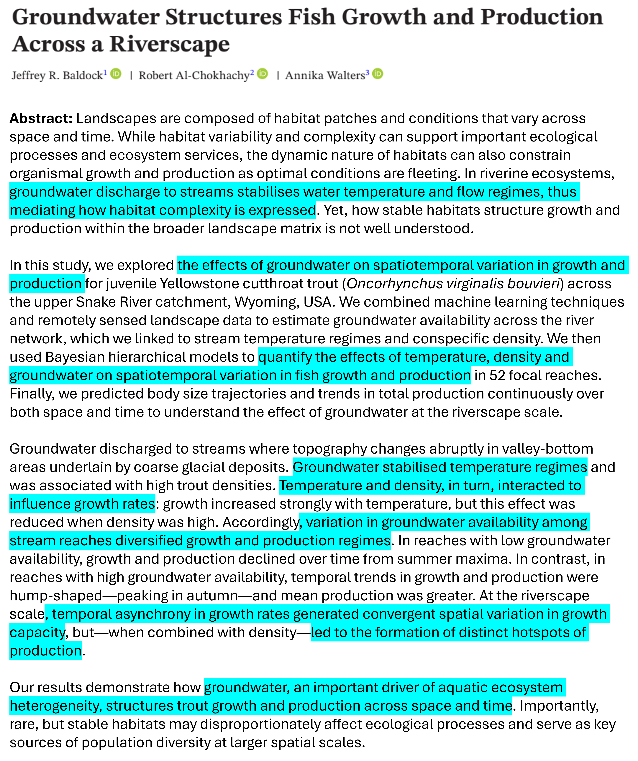
Signal
Signal = systematic structure
Predictors represent mechanisms
Goal: explain mean patterns

Slide 4
Noise
Noise = unmeasured variation
Not “junk”; it’s informative
Distributions describe noise

Slide 5
Distributions as noise models
Values allowed (support)
Discrete vs continuous
Mean–variance relationship

Slide 6
Common distributions
Distribution | Type | Support | MeanVariance
Gaussian | Continuous | (-∞, ∞) | Var constant
Gamma | Continuous | (0, ∞) | Var increases with mean
Poisson | Discrete | {0,1,2,…} | Var = mean
Binomial | Discrete | {0,…,n} | Var = np(1-p)
Beta | Continuous | (0,1) | Var depends on mean + precision
Neg. binomial | Discrete | {0,1,2,…} | Var > mean
Zero-infl. Poisson | Discrete | {0,1,2,…} | Extra zeros inflate Var
Ecology is often non-normal
Choose distributions deliberately
Then choose link functions

Slide 7
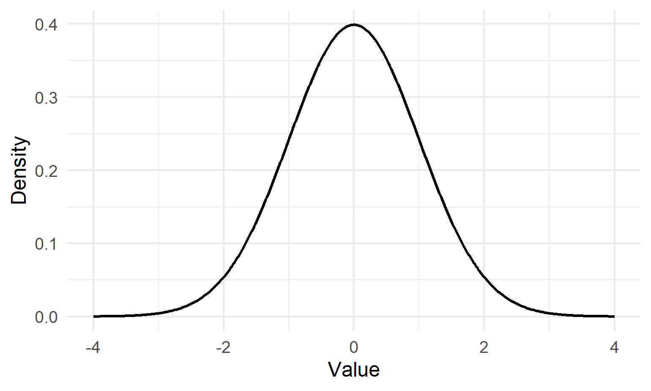
Gaussian: additive noise
Continuous outcomes
Symmetric deviations
Constant variance

Slide 8
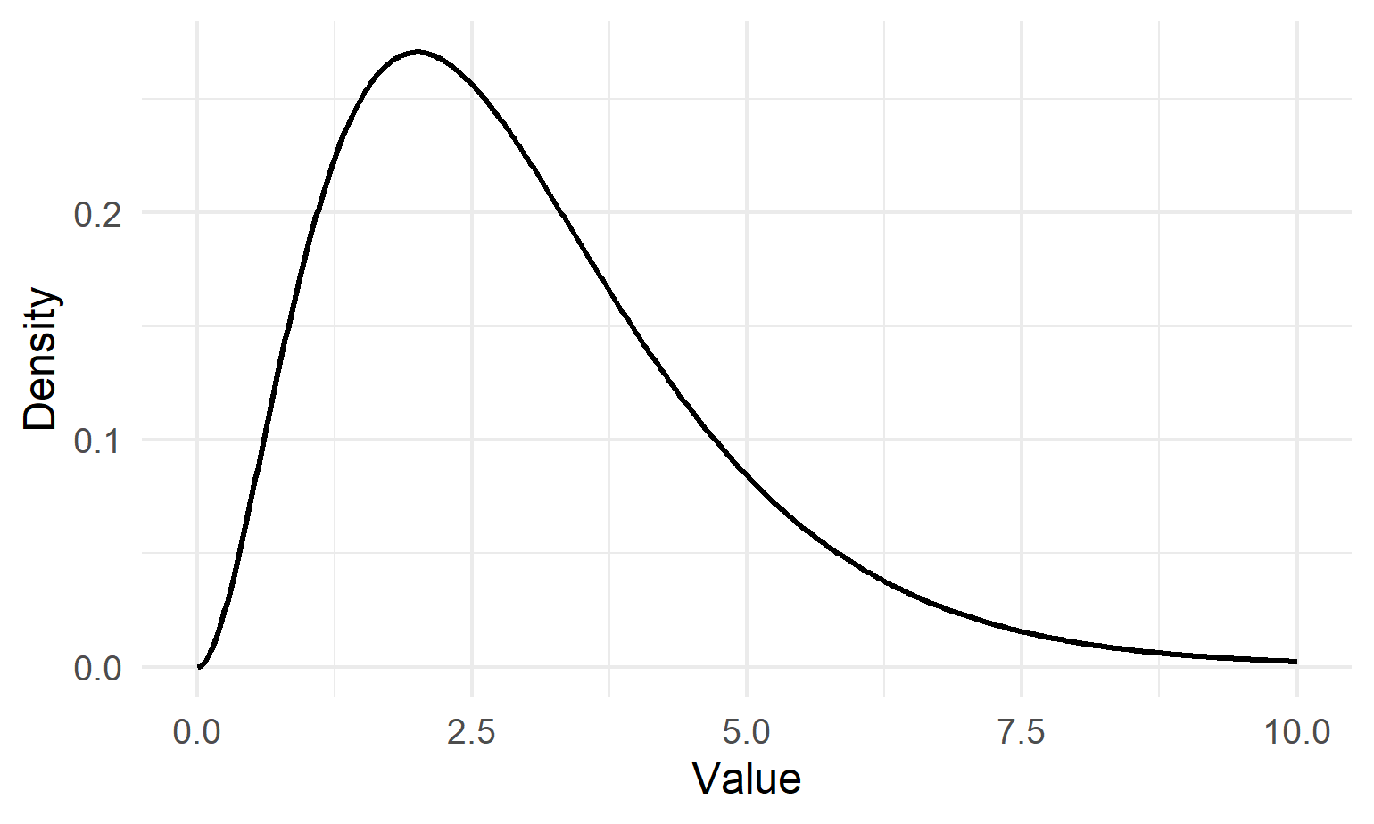
Gamma: positive, skewed
Positive outcomes only
Right-skew common
Variance grows fast

Slide 9
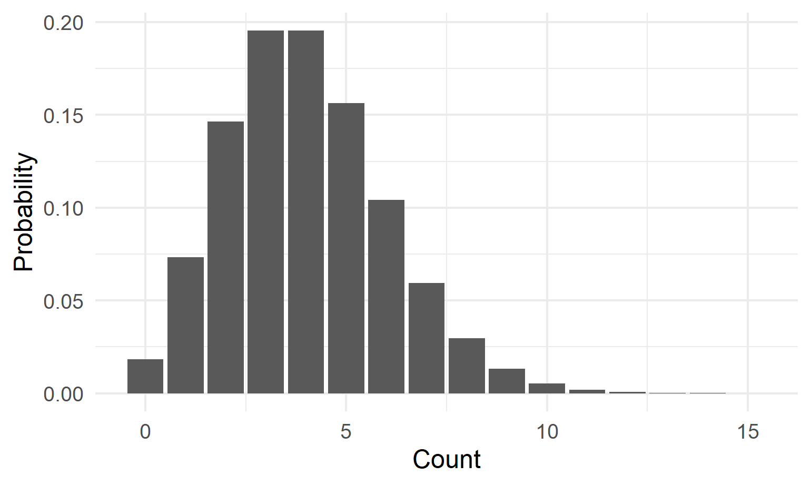
Poisson: counts
Counts: 0,1,2,…
Variance ≈ mean
Mean must be positive

Slide 10
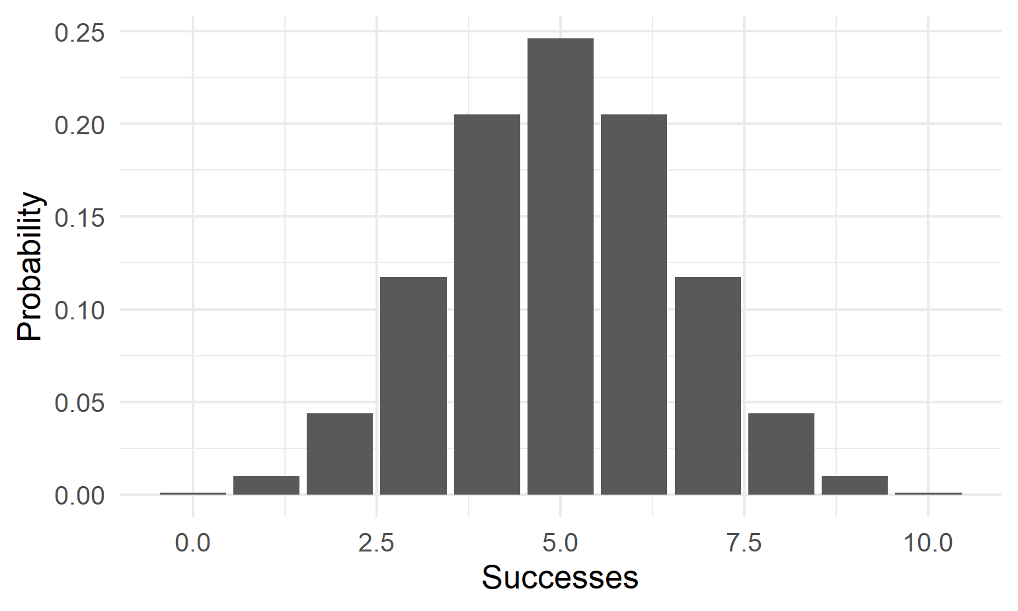
Binomial: successes
Bounded by 0…n
Trials + probability
Variance depends on p

Slide 11
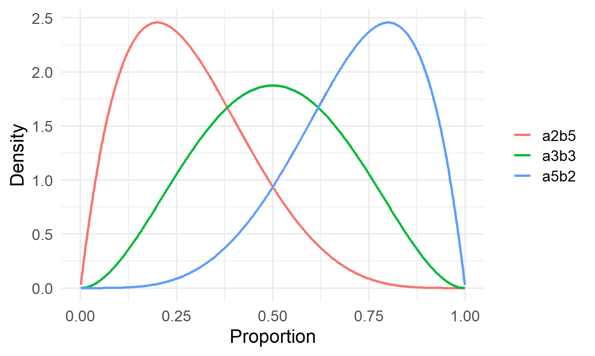
Beta: proportions
Continuous 0–1
Flexible shapes
Precision matters

Slide 12
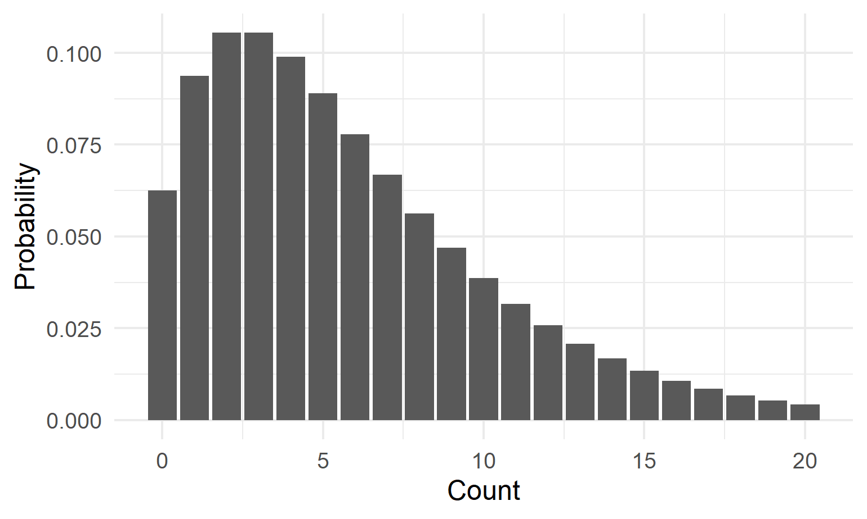
Negative binomial: overdispersed counts
Counts, clustered events
Variance > mean
Common in ecology

Slide 13
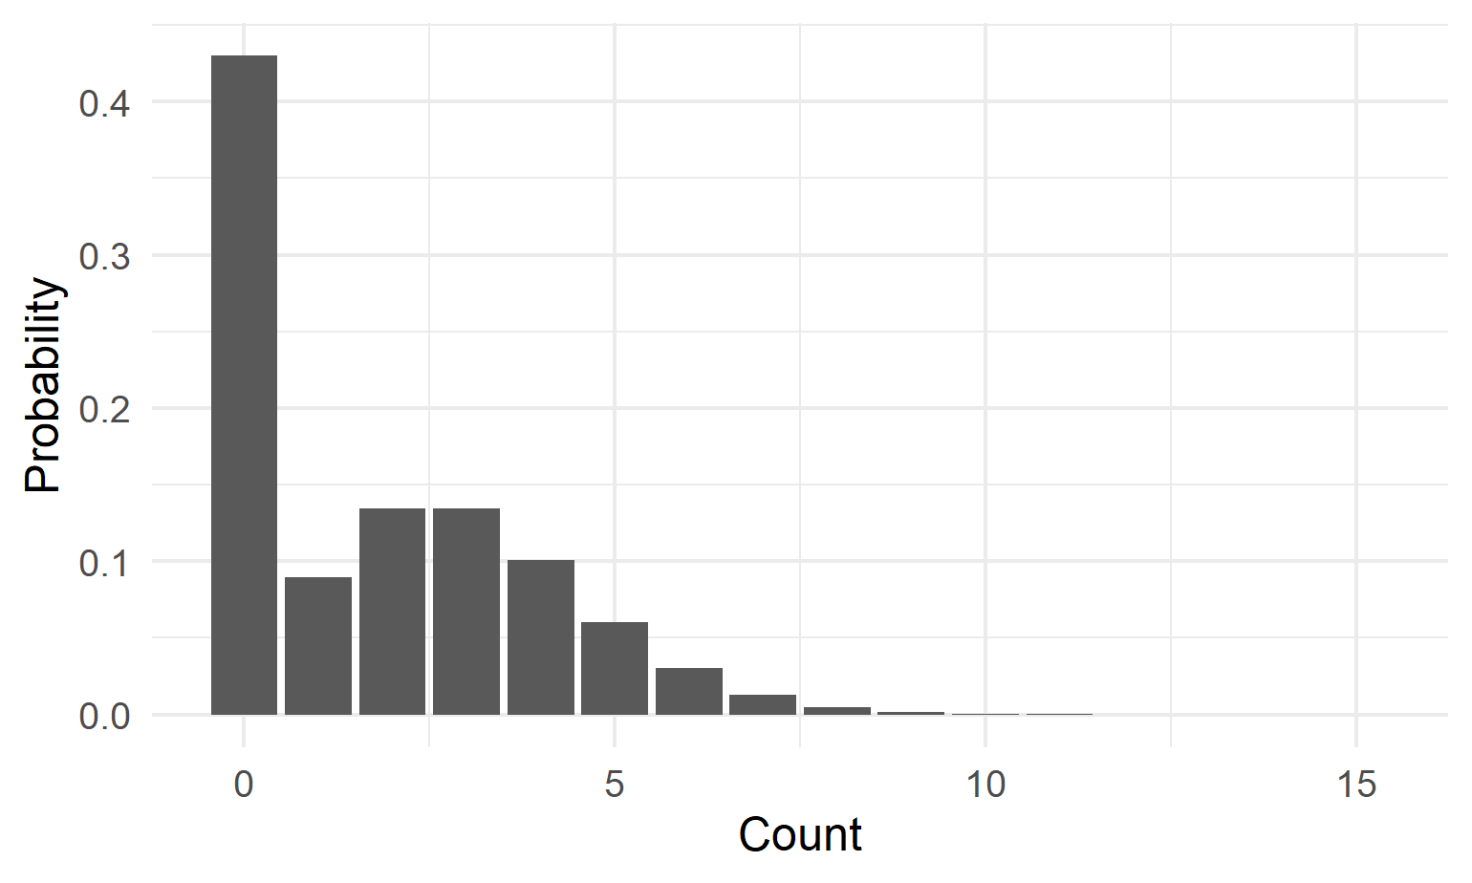
Zero-inflated Poisson: extra zeros
Two processes: zero vs count
Many structural zeros
Variance inflated

Slide 14
Why Poisson GLM (vs Gaussian)?
Counts are discrete
Means must be positive
Variance grows with mean

Slide 15
GLM: three components
Signal: linear predictor
Noise: distribution
Link: connects mean to predictor

Slide 16
Poisson GLM specification
$Y_{i}∼\text{Poisson}\left(μ_{i}\right)$
$η_{i}=β_{0}+β_{1}X_{i}$
$log\left(μ_{i}\right)=η_{i}$

Slide 17
Link function: what it connects
Link acts on the mean
Connects $μ_{i}$ to $η_{i}$
Ensures valid predictions

Slide 18
Take-home
Choose distribution for noise
Choose predictors for signal
Choose link for realism

