Slide 1
Caliber → Rally mapping
Requirement → User Story
Test Case → Test Case

Slide 2
Caliber REQs projects to be moved
JDF_Hera
JDF_DTI
JDF_Harald
JDF_Rimu
JDF_Tcenter
JDF_Tnavi
JDF_ZeusControl (test cases and DTC’s as well, separate project or new mapping)
JDF_ZeusHarvesting
JDF_ZeusPC

Slide 3
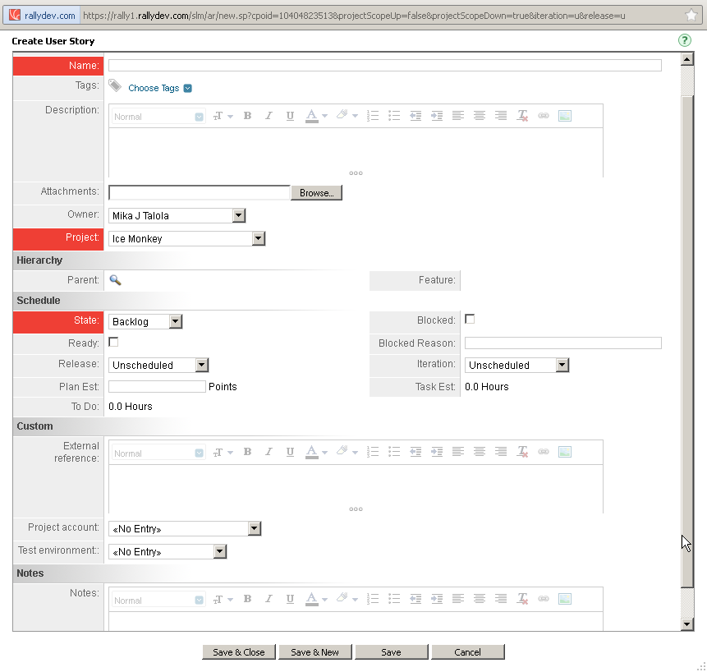
USER STORY mapping
<<hierarchy>> [REQ<<id_number>>]<<name>>
Caliber Purpose
<<JDF Purpose [Pu]>>
Pre-condition
<<JDF Pre-condition [Pr]>>
Basic course
<<JDF Basic Course [Ba]>>
Post-condition
<<JDF Post-condition [Po]>>
Exceptions
<<JDF Exceptions [Ex]>>
Remarks
<<JDF Remarks [Re]>>
Description
<<description>>
for JDF Zeus_Control-project ONLY
Caliber <<validation>>
JDF input
JDfFoutput
for JDF ZeusTCenter-project ONLY
ONLY description field and traces to be imported to Rally
Caliber TRACES (would be ideal to have click-able link to other US)
<JDtraceId> <JDtraceName>
Caliber <<JDF Open issues>>

Slide 4
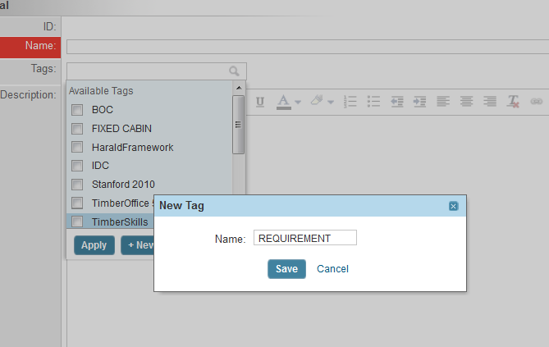
Tag needed for ALL requirements

Slide 5
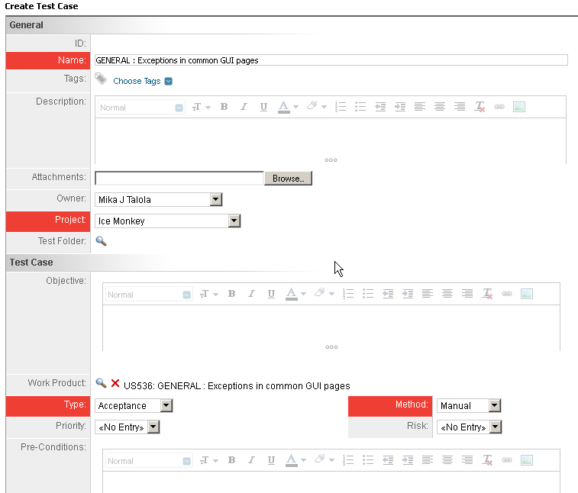
TEST CASE mapping
<<hierarchy>> [TC<<id_number>>]<<name>>
Source [So]
<<JDF Source [So]>>
Purpose [Pu]
<<JDF Purpose [Pu]>>
Pre-condition [Pr]
<<JDF Pre-condition [Pr]>>
Testing course [Te]
<<JDF Testing Course [Te]>>
Validation
<<validation>>
Description
<<description>>
Post-condition [Po]
<<JDF Post-condition [Po]>>
Caliber Traces (can be as was in demo but REQ traces needed as well)
<JDtraceId> <JDtraceName>
Machine Type
<<JDF Machine Type>>
Remarks [Re]
<<JDF Remarks [Re]>>

