Slide 1
Containers in Azure
It’s More than Kubernetes, people
Josh Lane

Slide 2
whois Josh Lane
Principal Engineer at Microsoft
Commercial Software Engineering – We put customers on Azure
Organizer Emeritus of Azure-in-the-ATL
Consultant, team lead, author, speaker, instructor, amateur psychologist
How to find me
The Twitter - @jplane
The LinkedIn - https://www.linkedin.com/in/jplane/

Slide 3
Agenda
Azure Kubernetes Service
Azure Container Instances
App Service + Functions on Linux containers
Container builds on Azure Devops
Container workloads on Azure Batch
Containers in Machine Learning
VS Code dev containers

Slide 4
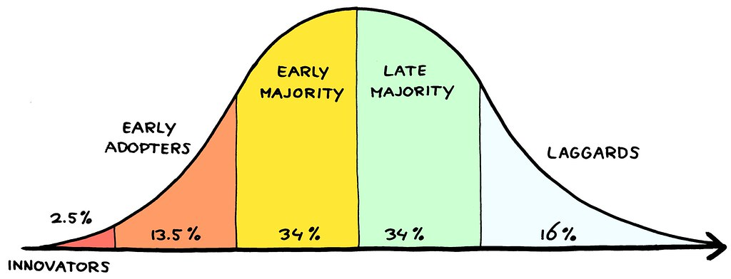
An Imprecise History of Container Adoption
New
Systems programming nerds talking about cgroups
Cool
IT admins bored with nested virtualization
Useful
Server density and consistent deployments FTW
Ubiquitous
Containers are now (mostly) a means to some further end
This Photo by Unknown Author is licensed under CC BY

Slide 5
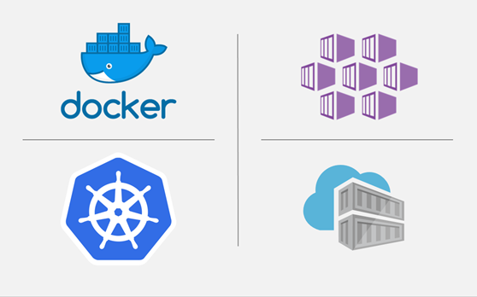
Azure Kubernetes Service
Fully managed k8s platform
Artist formerly known as ACS
Integration
Key Vault
Vnets
AAD
Azure Monitor
Scale
Pods – HPA, KEDA
Nodes – Cluster autoscaler, virtual nodes (ACI)

Slide 6
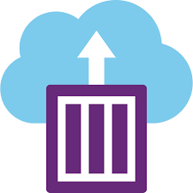
Azure Container Instances
When you want a container(s)… not a cluster
Container groups
single-use
pause-resume
Configuration
networking
env vars
identity
monitoring

Slide 7
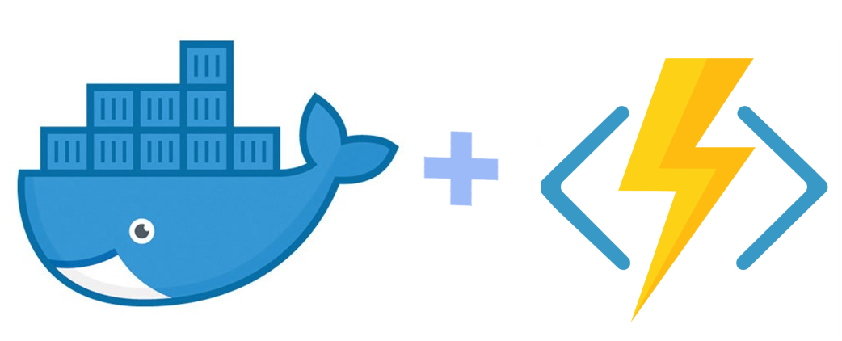
App Service with Linux Containers
PaaS… but *you* define the sandbox
Web apps
Function apps

Slide 8
Container builds on Azure Devops
All CI/CD jobs in AzDO run on a build agent
Use a custom container image!
Why?
Pre-install tools and dependencies
Secure connectivity to sensitive resources
Faster builds

Slide 9
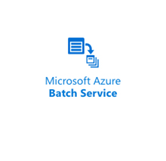
Containers in Azure Batch
Batch workloads
Long-running
Compute- and memory-intensive
Data analysis, simulation, image processing, etc.
Azure Batch
Generic VM clusters
Scheduler and work queue
Logging and output tracking
Containers ensure consistent environment for workload to execute

Slide 10
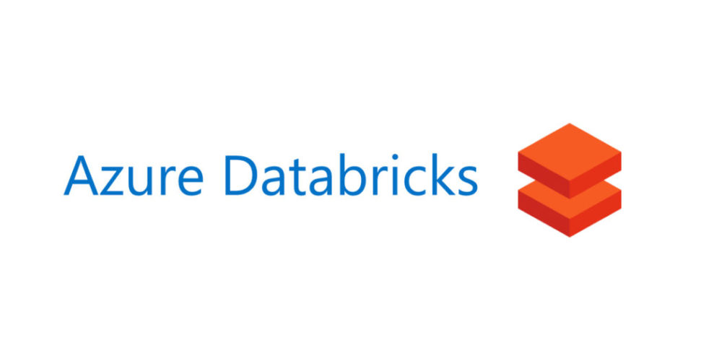
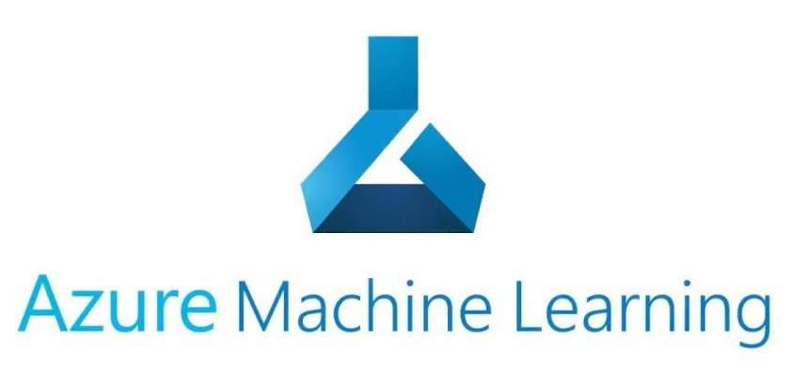
Containers in Machine Learning
Azure ML
Orchestrates data/ML/AI pipelines
Pipeline step = container image + code + data
Standard container images
BYOC
Azure Databricks
Spark-as-a-Service on Azure and AWS
Multiple clusters per workspace
Create cluster – specify a container (optional)

Slide 11
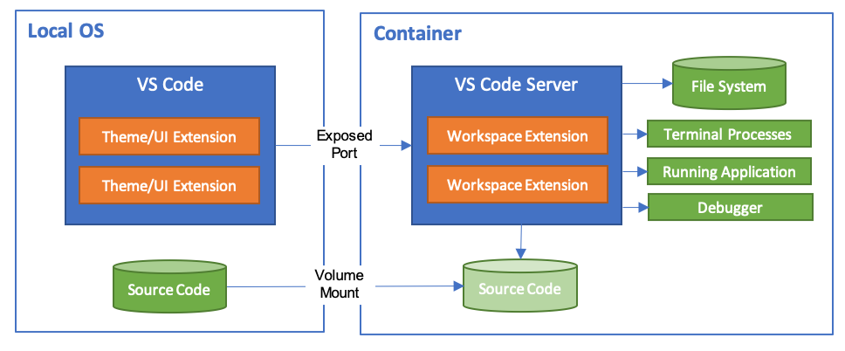
Visual Studio Code Dev Containers
Create a custom Docker image with all dev tools + libs needed for your project
All dev work happens within a container created from that image
Debugger, Git, etc.
One container per dev
Uses
Consistent dev experience for all team members
Rapid onboarding of new team members
Rapidly switch between projects
Dev on a remote host

Slide 12
Bibliography
https://docs.microsoft.com/en-us/azure/container-instances/container-instances-quickstart
https://docs.microsoft.com/en-us/azure/app-service/containers/tutorial-custom-docker-image
https://docs.microsoft.com/en-us/azure/azure-functions/functions-create-function-linux-custom-image
https://code.visualstudio.com/docs/remote/containers
https://docs.microsoft.com/en-us/azure/devops/pipelines/process/container-phases?view=azure-devops
https://docs.microsoft.com/en-us/azure/batch/batch-docker-container-workloads
https://docs.microsoft.com/en-us/azure/databricks/clusters/custom-containers

Slide 13
Thank you! Questions?

