Slide 1
DQ Informatica
Technical Review
Last Updated: January 29, 2021

Slide 2
Agenda
Agenda
Informatica Tools review
Data Anomaly
Data Scorecard
Linux framework
2

Slide 3
IDQ Project Workflow
Informatica Tools
3

Slide 4
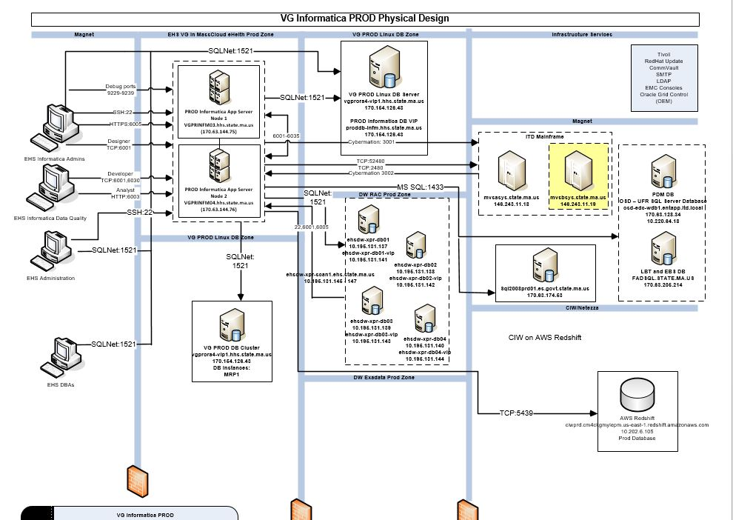
Anomaly Workflow
4

Slide 5
Agenda
Tools review
Power Exchange
PowerCenter
Admin Console
Developer
Analyst
Big Data vs Native
Informatica Intelligent Cloud Services IICS
Data Engineering
5

Slide 6
DI Data Quality Suite Project Timelines
Workstreams/ Activities | 2020 |  |  |  |  |  |  |  |  |  |  |  | 2021 |  |  |  |  |  |  |  |  |  |  |  | 2022
 | Jan | Feb | Mar | April | May | June | July | Aug | Sept | Oct | Nov | Dec | Jan | Feb | Mar | April | May | June | July | Aug | Sept | Oct | Nov | Dec | Jan | Feb | Mar | Apr | May | Jun | Jul | Aug | Sep | Oct | Nov | Dec
Data Anomaly
Mastering Provider Entity
Encounter Scorecard Automation
837 Encounters

Slide 7
IDQ Project Workflow
Data Anomaly
7

Slide 8
Anomaly Workflow
8

Slide 9
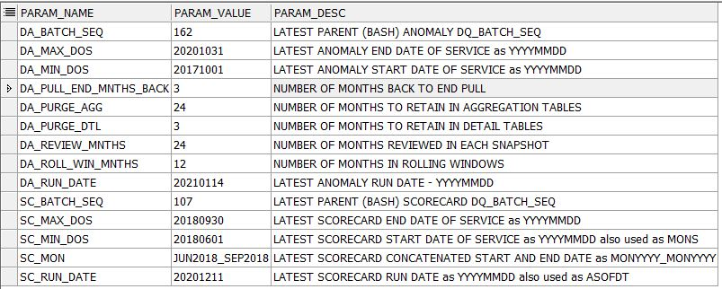
Parameters via param table
9

Slide 10
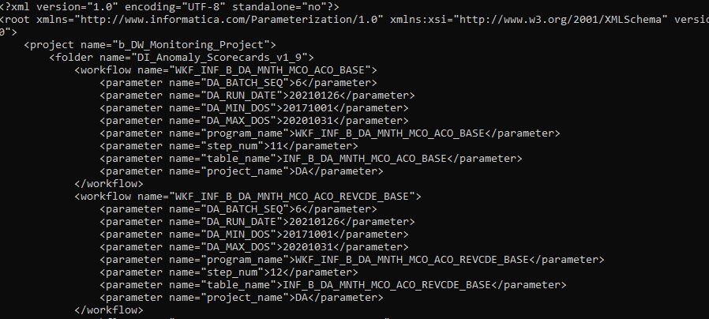
Parameters via XML - DA_PARAMETERS.xml
10

Slide 11
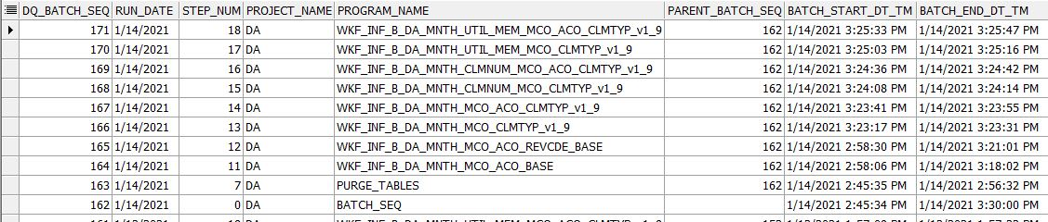
Load Batch Table
11

Slide 12
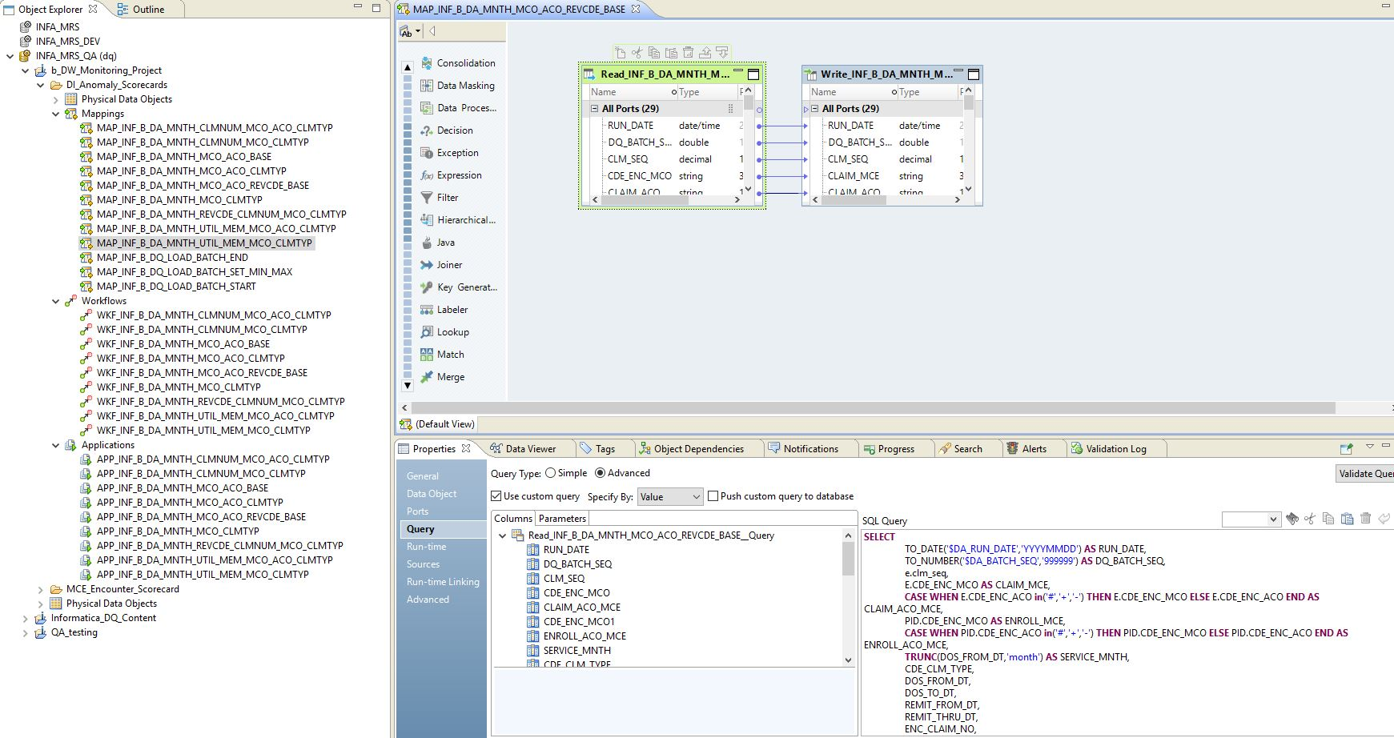
Data Anomaly extracting Encounter to base Staging Table
12

Slide 13
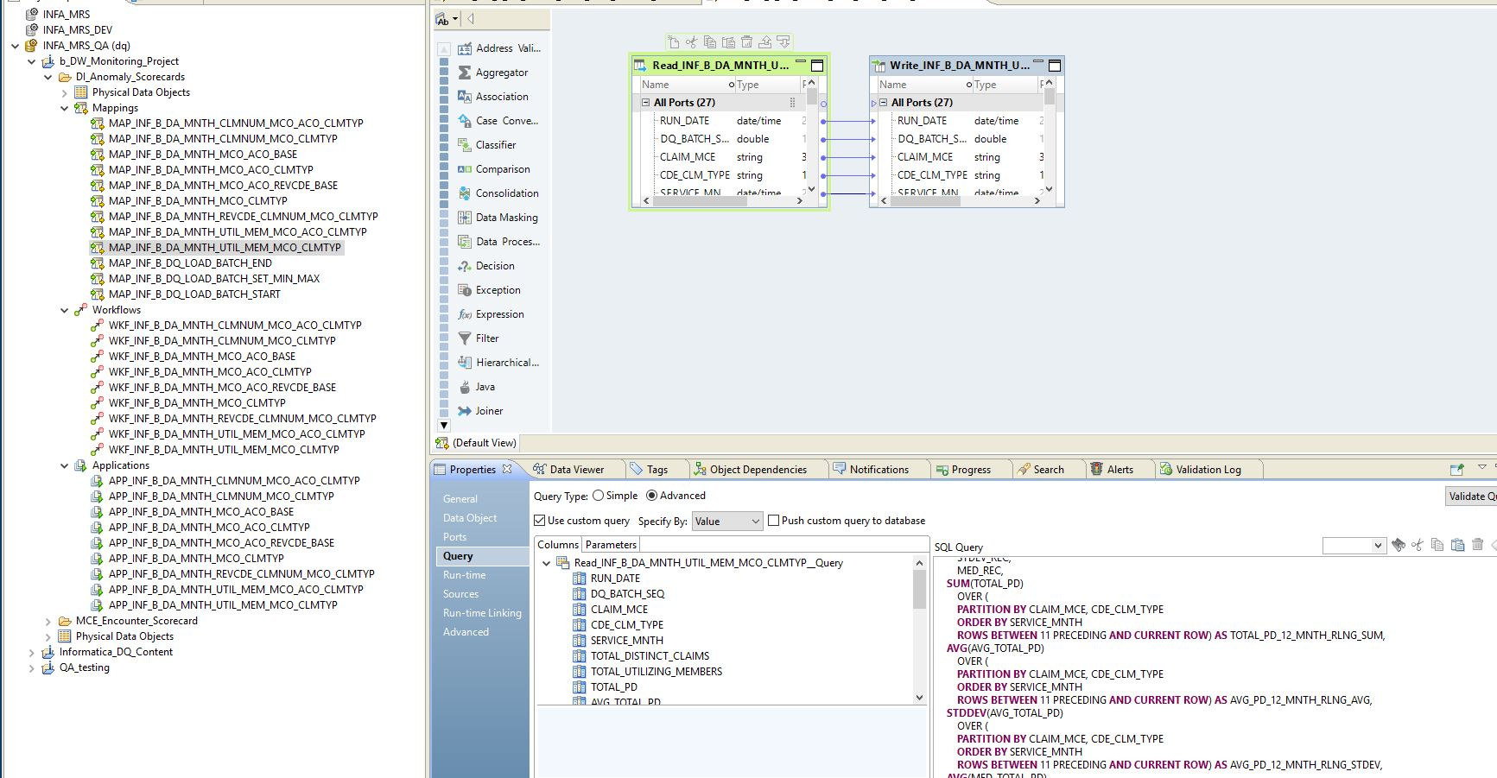
Data Anomaly generating Metrics from Extract Staging Table
13

Slide 14
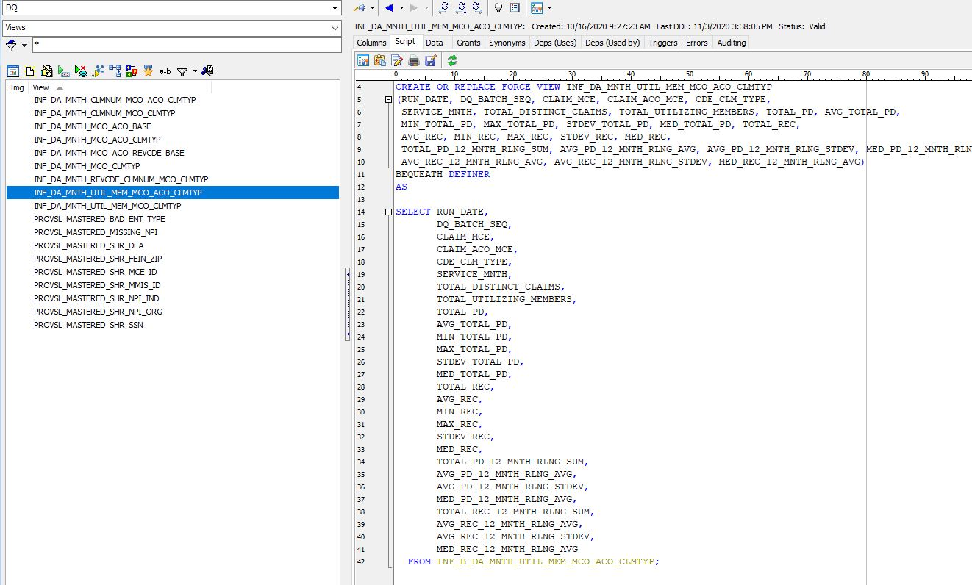
Data Anomaly Views using similar naming as NW
14

Slide 15
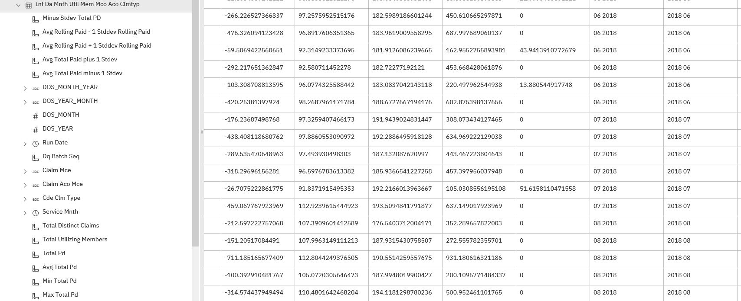
Data Anomaly Data Module showing additional Metrics
15

Slide 16
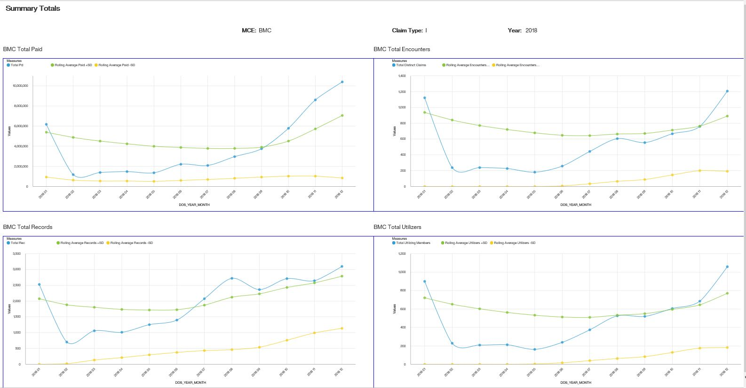
Cognos Report for Data Anomaly Showing STDDEV Bands
16

Slide 17
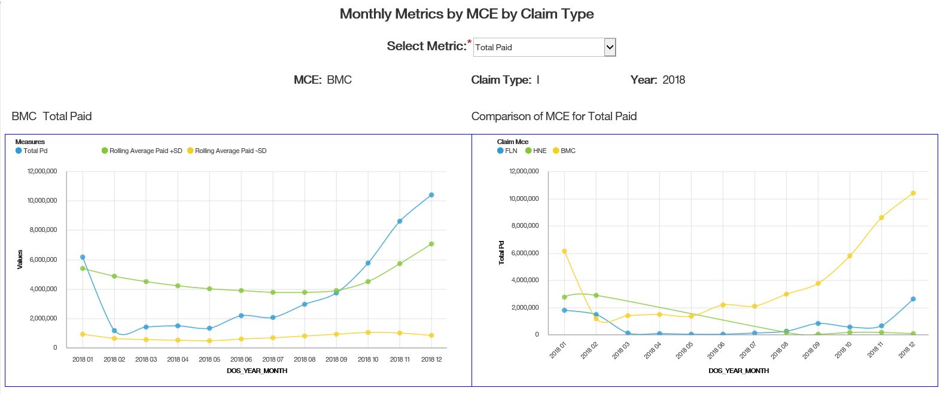
Cognos Report for Data Anomaly with Metric Selection
17

Slide 18
IDQ Project Workflow
Scorecards
18

Slide 19
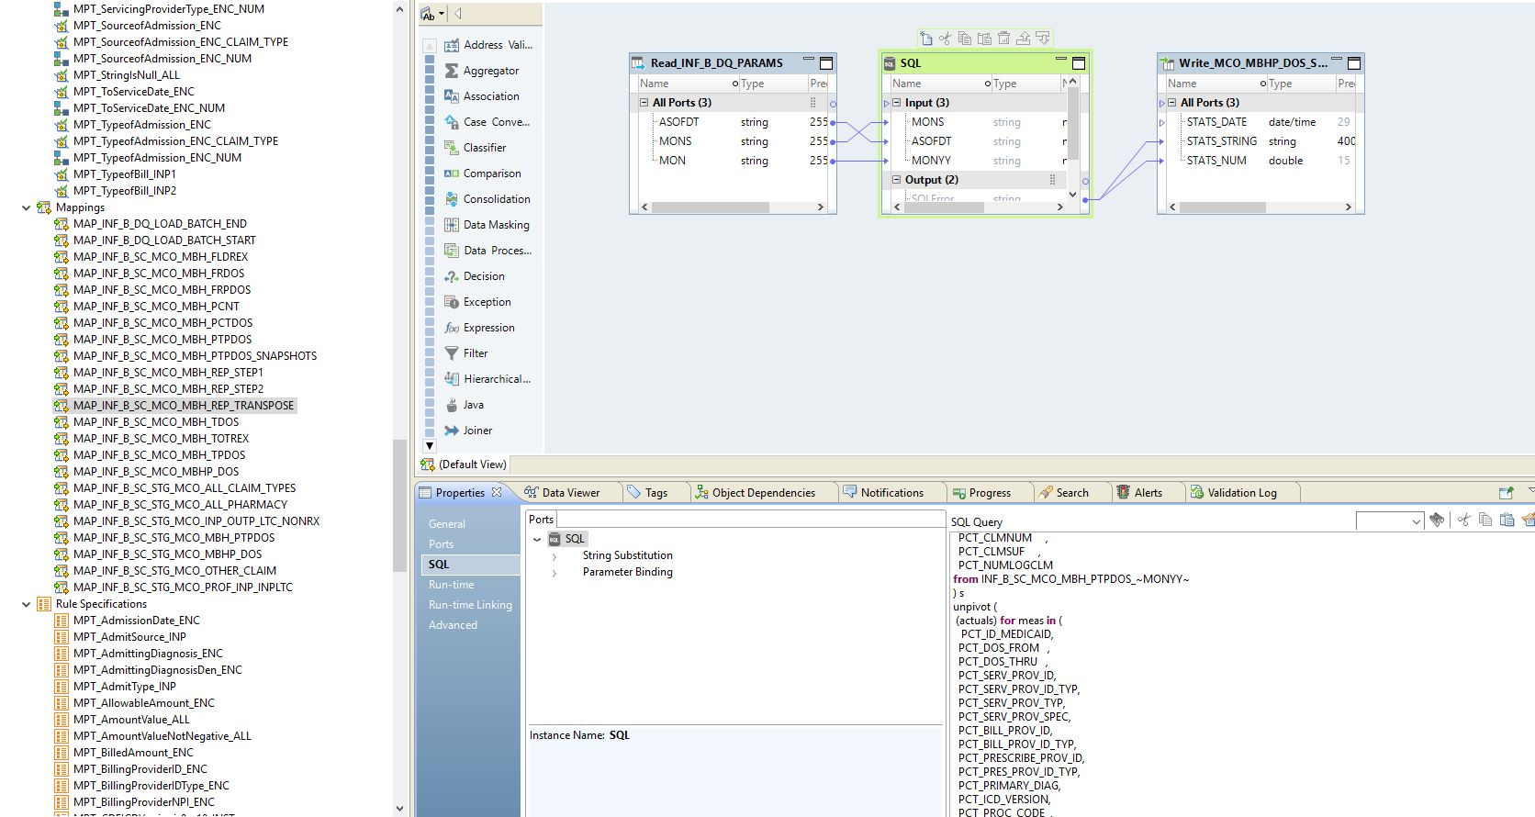
Scorecard Dynamic SQL SAS Pivot via Oracle Unpivot
19

Slide 20
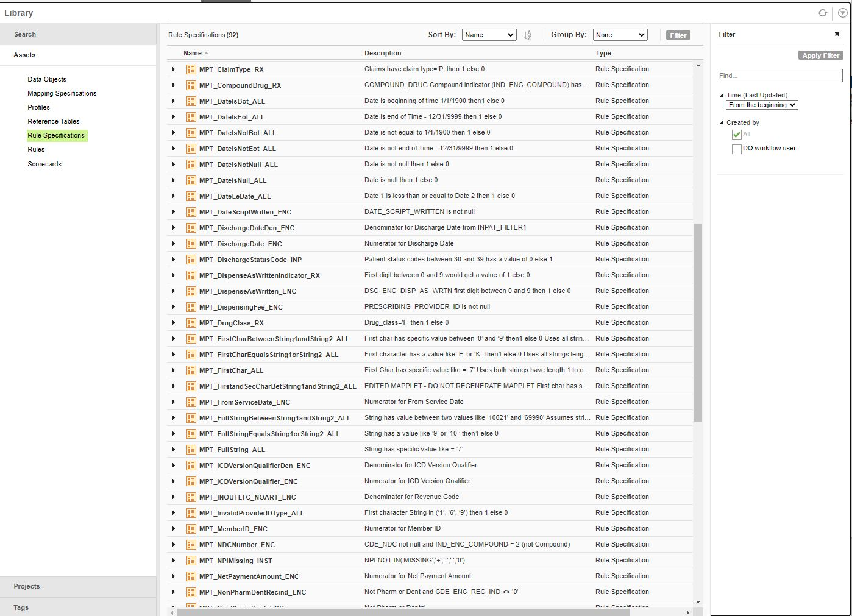
Scorecard Rule Specifications in Analyst
20

Slide 21
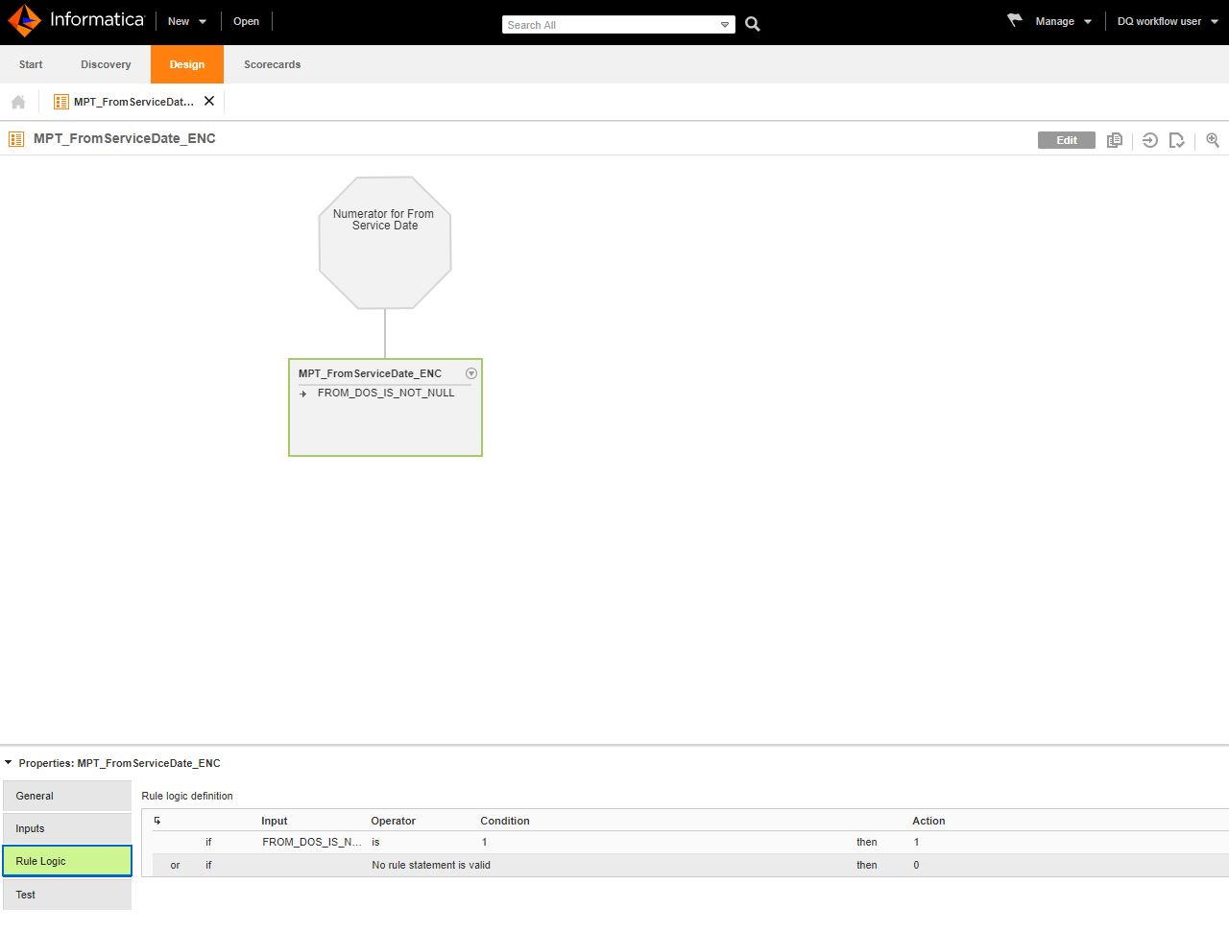
Scorecard From Service Date Numerator as Rule Specification
21

Slide 22
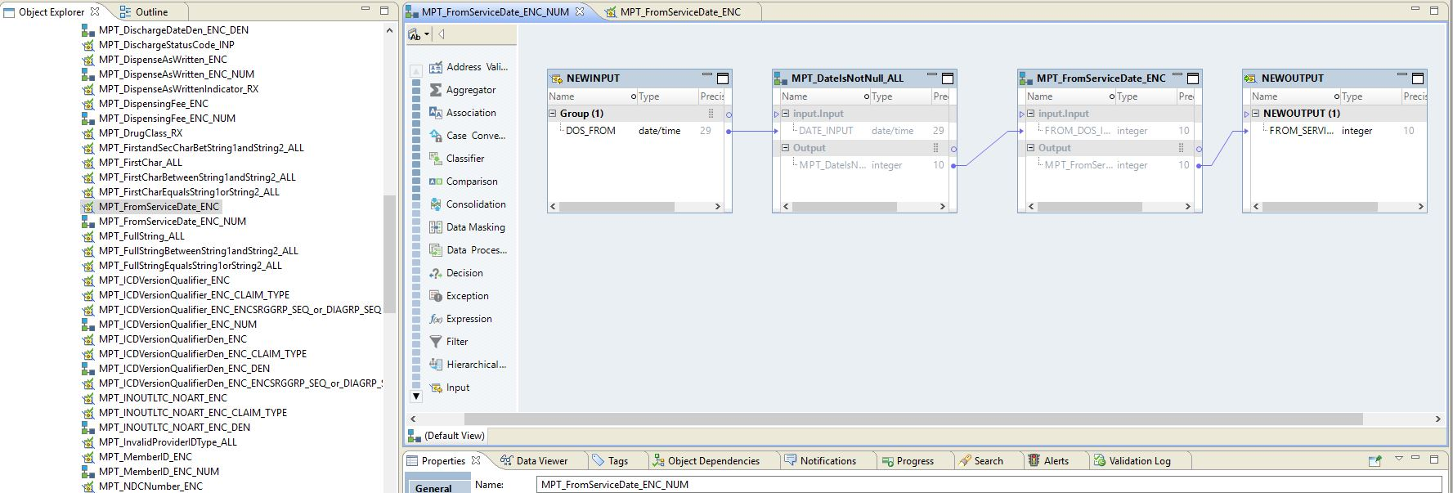
Scorecard From Service Date Numerator as Mapplet
22

Slide 23
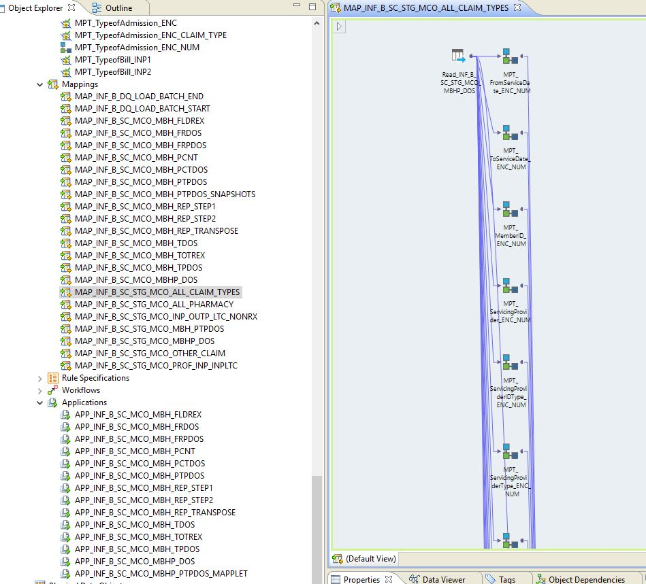
Scorecard ALL Claim Types Mapping
23

Slide 24
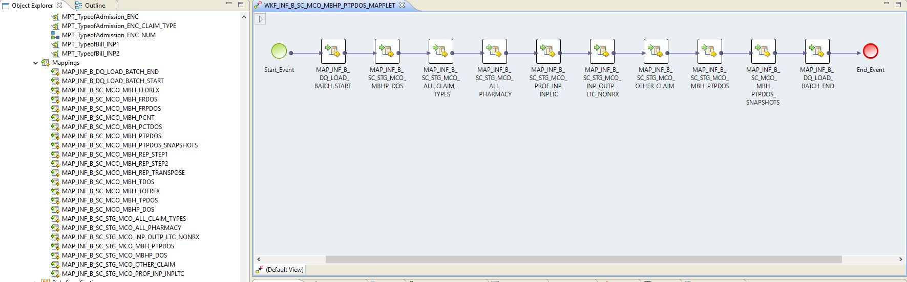
Scorecard Mapplet Workflow
24

Slide 25
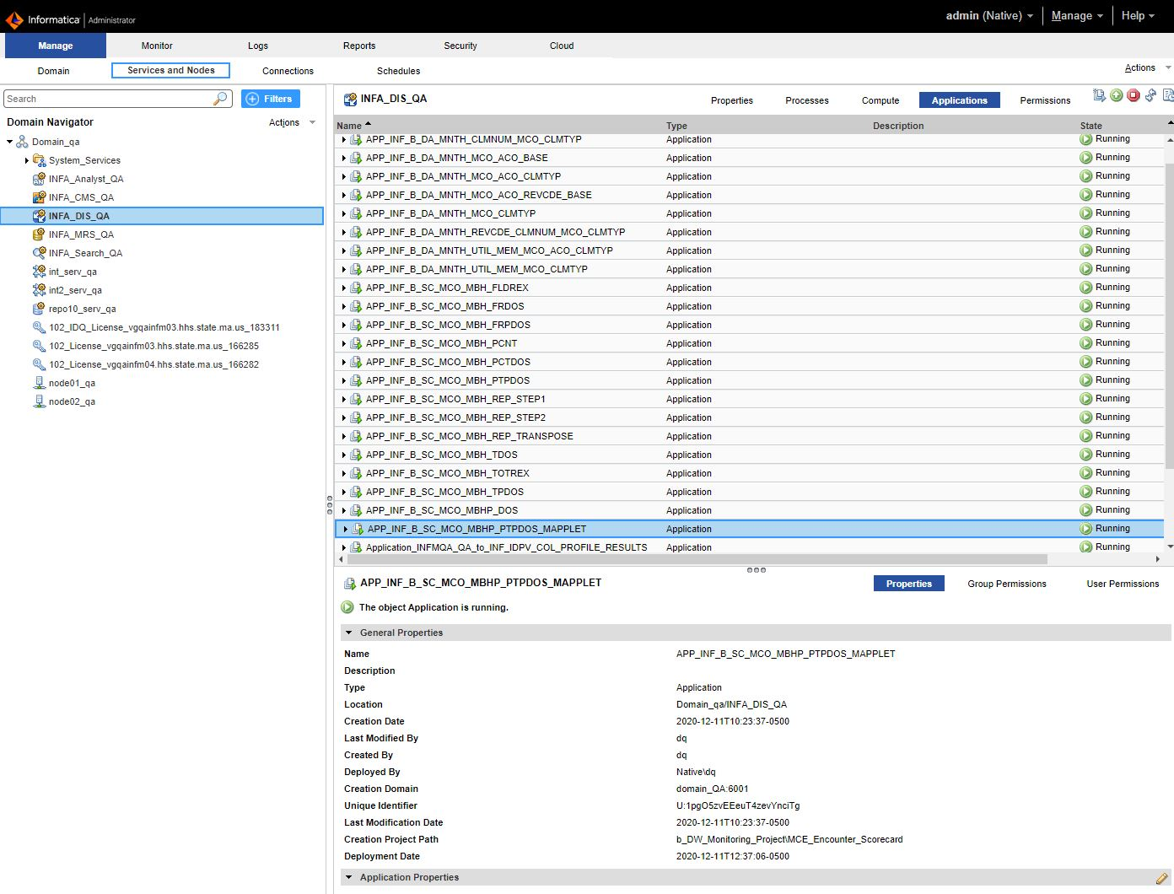
Informatica Administrator Console showing Deployed Applications
25

Slide 26
IDQ Project Workflow
Linux Framework and Scheduling
26

Slide 27
Linux IDQ Infrastructure
27

Slide 28
Parameters via param table
28

Slide 29
Parameters via XML - DA_PARAMETERS.xml
29

Slide 30
Load Batch Table
30

Slide 31
DW Informatica Framework
DW Informatica Framework
runDQ_ANOMALY.sh
DQ_ANOMALY.sh
applications.sh
functions.sh
SQL scripts
31

Slide 32
Thank You
Questions?
32

