Slide 1

Protein Classification
Real Time Learning in Intelligent Systems
Joaquim Leitão

Slide 2
Objectives
Protein function identification from genetic sequence
55 families – 2 classifiers per family
Incremental vs Non-Incremental Approaches
LASVM vs SVM
SCOP40_Minidatabse
2
Joaquim Leitão – Real Time Learning in Intelligent Systems
Notes:
Protein Classification Problem – For any given protein determine its function by analysing its coding sequence; Proteins group into families according to their function, and we have 55 different functions – We developed and trained classifiers to detect proteins of each family: So 1 per family; in fact its 2 because we want to compare incremental and non-incremental approaches

Slide 3
Methodology
Pre-processing
Data Representation
Classifier Training
Results Assessment
3
Joaquim Leitão – Real Time Learning in Intelligent Systems
Notes:
Initial Pre-processing to generate train and test datasets for each family; extract information from the provided files…
Data Representation –> Segmentation (to be detailed) ; 2 types of classifiers to be compared…

Slide 4
Pre-Processing
SCOP40mini.fasta
Genetic coding sequences for several protein sequences
SCOP40mini_sequence_minidatabase_19.cast
Map between sequences to be used in training and testing for each family
4
Joaquim Leitão – Real Time Learning in Intelligent Systems

Slide 5
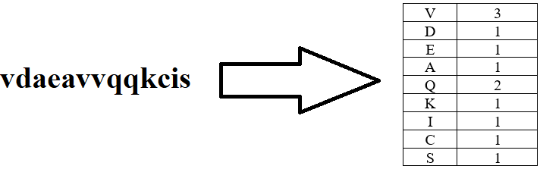
Data Representation
Segmentation
Count number of occurrences of each nucleotide
Exclude “x” nucleotides – Missing Data
5
Joaquim Leitão – Real Time Learning in Intelligent Systems

Slide 6
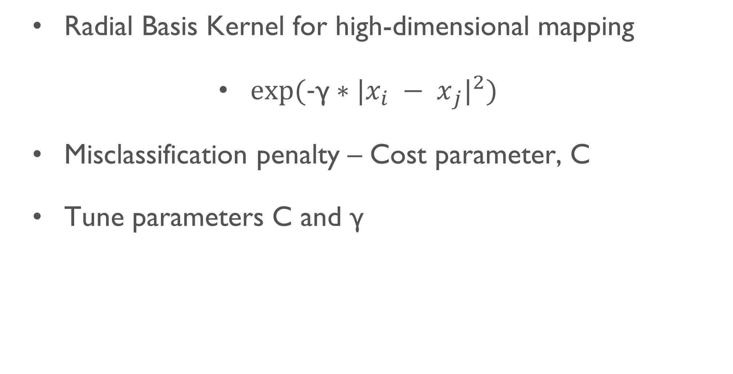
Support Vector Machines
Radial Basis Kernel for high-dimensional mapping
$exp⁡(\text{−}\text{γ}∗{|{x_{i} − x}_{j}|}^{2})$
Misclassification penalty – Cost parameter, C
Tune parameters C and γ
6
Joaquim Leitão – Real Time Learning in Intelligent Systems

Slide 7
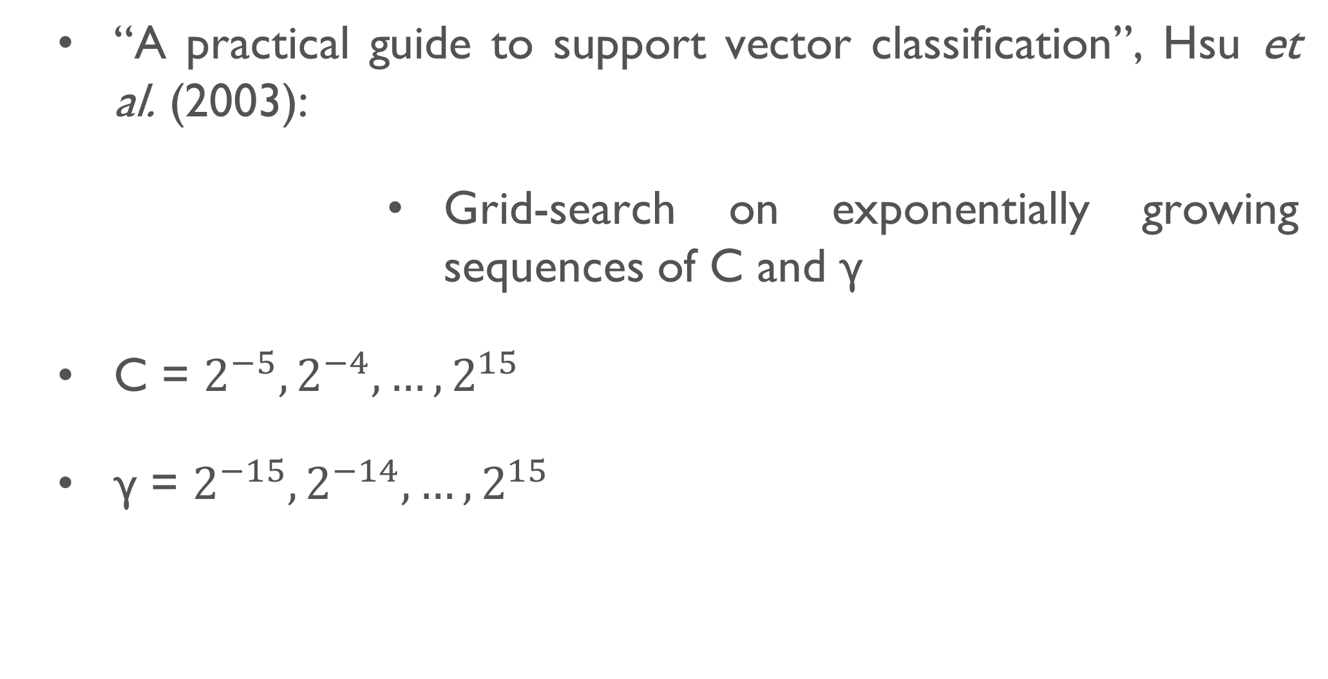
Support Vector Machines - Tuning
“A practical guide to support vector classification”, Hsu et al. (2003):
Grid-search on exponentially growing sequences of C and γ
C = $2^{−5}, 2^{−4}, …, 2^{15}$
γ = $2^{−15}, 2^{−14}, …, 2^{15}$
7
Joaquim Leitão – Real Time Learning in Intelligent Systems

Slide 8
Support Vector Machines - Results
Average AUC of 0.74 in test dataset
Best AUC = 0.99 for family “b.29.1._b.29.1.2.” (C = 256 ; γ = 3.9e-03)
Overfitting in families “c.26.2._c.26.2.1.” and “c.47.1._c.47.1.10.” (Train AUC = 1; Test AUC around 0.5)
Families where no classifier could be learned (Train AUC = Test AUC around 0.5)
8
Joaquim Leitão – Real Time Learning in Intelligent Systems
Notes:
Best AUC – Hard-limit margin (Penalises a lot misclassifications)

Slide 9
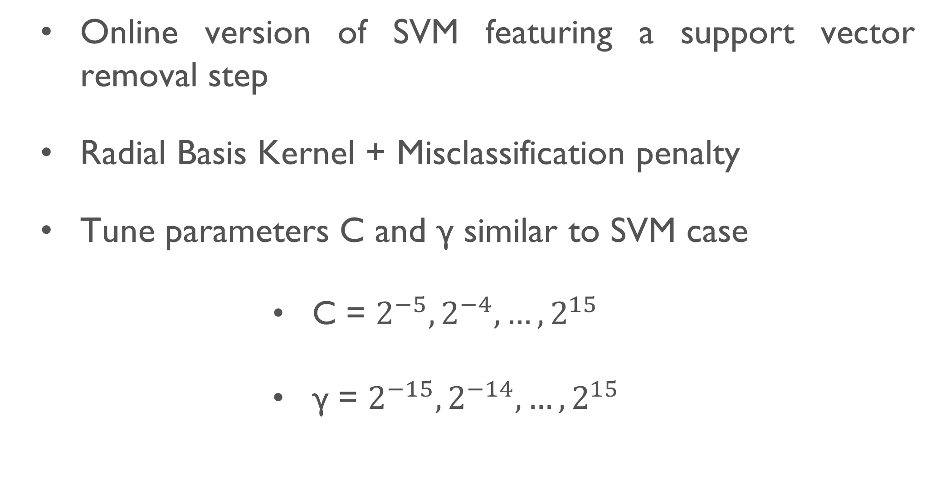
LASVM
Online version of SVM featuring a support vector removal step
Radial Basis Kernel + Misclassification penalty
Tune parameters C and γ similar to SVM case
C = $2^{−5}, 2^{−4}, …, 2^{15}$
γ = $2^{−15}, 2^{−14}, …, 2^{15}$
9
Joaquim Leitão – Real Time Learning in Intelligent Systems

Slide 10
LASVM - Results
Average AUC of 0.81 in test dataset
Best AUC = 0.99 in families “b.29.1._b.29.1.11.” (C = 32 ; γ = 1.22e-04); “b.29.1._b.29.1.2.” (C = 4 ; γ = 9.7e-04); and “c.67.1._c.67.1.4.” (C = 512 ; γ = 2.44e-04)
Does not appear to suffer from overfitting
Families where no classifier could be learned (Train AUC = Test AUC around 0.5)
10
Joaquim Leitão – Real Time Learning in Intelligent Systems
Notes:
Best AUC – Only the last one is hard-limit (or at least is considerably more hard-limit than the others)

Slide 11
Conclusions
LASVM produce better results than SVM and does not appear to suffer from overfitting
Best results in test dataset do not correspond to high performances in the training dataset (AUC = 0.7-0.8)
Average results lower than SCOP40 benchmark
11
Joaquim Leitão – Real Time Learning in Intelligent Systems
Notes:
No overfit in LASVM – Can be explained by LASVM’s incremental training mechanisms

Slide 12
Future Work
Extend parameter fine tuning
Missing data imputation techniques
More powerful representation techniques
Other machine learning techniques, such as neural networks or random forests
12
Joaquim Leitão – Real Time Learning in Intelligent Systems
Notes:
Parameter fine tuning – More exhaustive search of the parameter space
Missing data – Statistical and other predictive approaches to produce estimations for missing nucleotides in protein sequences

Slide 13

Questions?
13
Joaquim Leitão – Real Time Learning in Intelligent Systems

