Slide 1

ARX & ARMAX Parameter Estimation
Real Time Learning in Intelligent Systems
Joaquim Leitão

Slide 2
OBJECTIVES
Recursive identification of two linear systems (ARX and ARMAX)
Estimation of Parameters of the models
2
Joaquim Leitão – Real Time Learning in Intelligent Systems

Slide 3
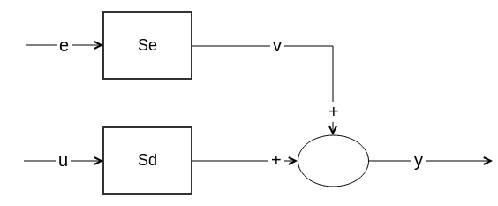
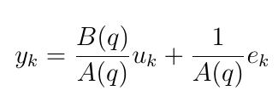
ARX Model
Estimate order of the model (na, nb) and delay (nk)
Estimate A(q) and B(q) from estimation data
2 estimation datasets of the same system
3
Joaquim Leitão – Real Time Learning in Intelligent Systems

Slide 4
RECURSIVE ARX ESTIMATION
Dataset division (70% estimation, 30% validation)
Estimate model order from estimation and validation data (selstruct + delayest)
Disturbance (ek) considered null (most probable value)
Forgetting factor λ = 0.99; recursiveARX + step (Estimation)
Step + compare (Validation)
4
Joaquim Leitão – Research Methods
Notes:
recursiveARX para criar o estimador e função step para “Update model parameter estimates using recursive estimation algorithms and real-time data”

Slide 5
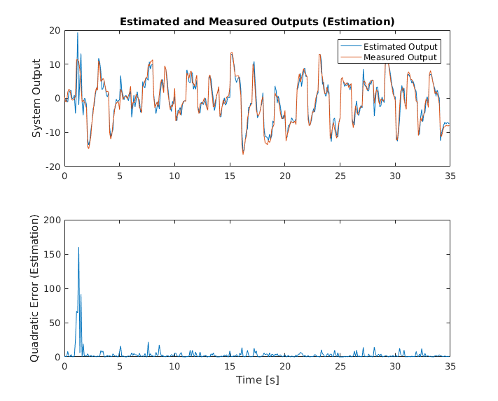
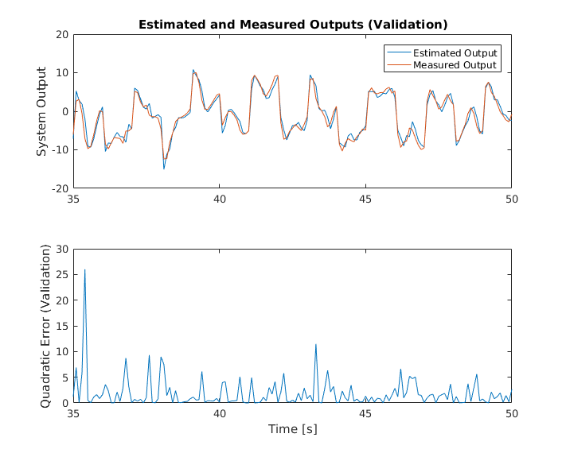
RECURSIVE ARX ESTIMATION #1
[na, nb, nk] = [4, 5, 1]
A = [1 -1.3101 0.4119 0.0986 -0.0948]
B = [0 0.9960 -1.2982 0.2242 0.1695 -0.0670]
Estimation fit = 70.07%; MSE = 3.4019
Validation fit = 74.96% (step); 45.5052% (compare); MSE = 1.8455
5
Joaquim Leitão – Real Time Learning in Intelligent Systems

Slide 6
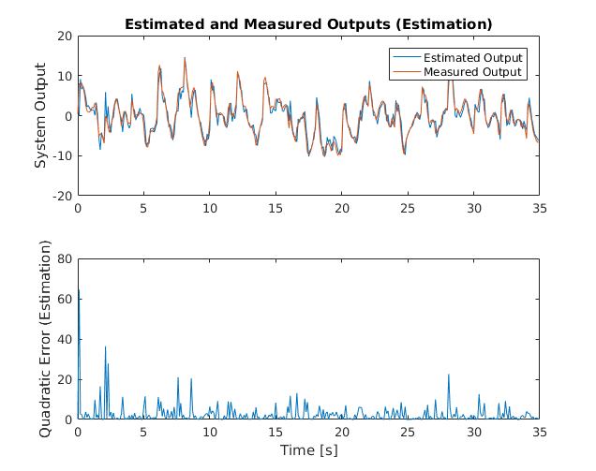
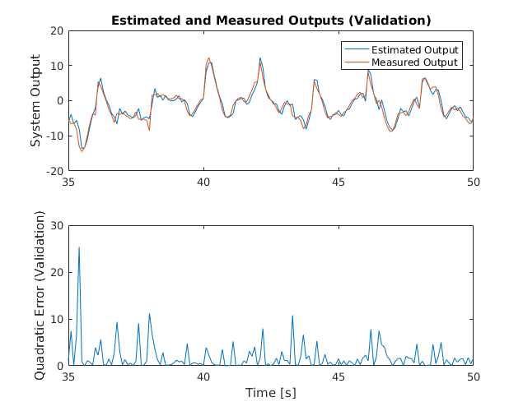
RECURSIVE ARX ESTIMATION #2
[na, nb, nk] = [2, 3, 1]
A = [1 -1.3059 0.4511]
B = [0 0.9686 -1.2622 0.2578]
Estimation fit = 65.70%; MSE = 2.5223
Validation fit = 69.62% (step); 32.1336% (compare); MSE = 1.8668
6
Joaquim Leitão – Real Time Learning in Intelligent Systems

Slide 7
RECURSIVE ARX COMPARISON
ARX #1 validated with ARX #2 validation data
Validation fit = 65.23% (step); 30.7064% (compare)
MSE = 2.4457
ARX #2 validated with ARX #1 validation data
Validation fit = 65.42% (step); 22.4408% (compare)
MSE = 1.8668
7
Joaquim Leitão – Real Time Learning in Intelligent Systems

Slide 8
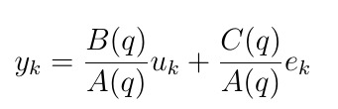
ARMAX MODEL
Estimate order of the model (na, nb, nc) and delay (nk)
Estimate A(q), B(q) and C(q) from estimation data
8
Joaquim Leitão – Real Time Learning in Intelligent Systems

Slide 9
RECURSIVE ARMAX ESTIMATION
Dataset division (70% estimation, 30% validation)
Estimate model order with armax for all combinations of orders
Disturbance (ek) considered null (most probable value)
Forgetting factor λ = 0.99; recursiveARMAX + step (Estimation)
Step + compare (Validation)
9
Joaquim Leitão – Real Time Learning in Intelligent Systems
Notes:
Estimar model order - Usámos dados de estimação e validação e escolhemos a que deu melhor fit nos dados de validação

Slide 10
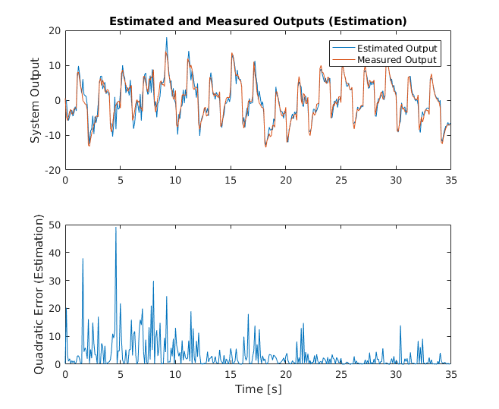
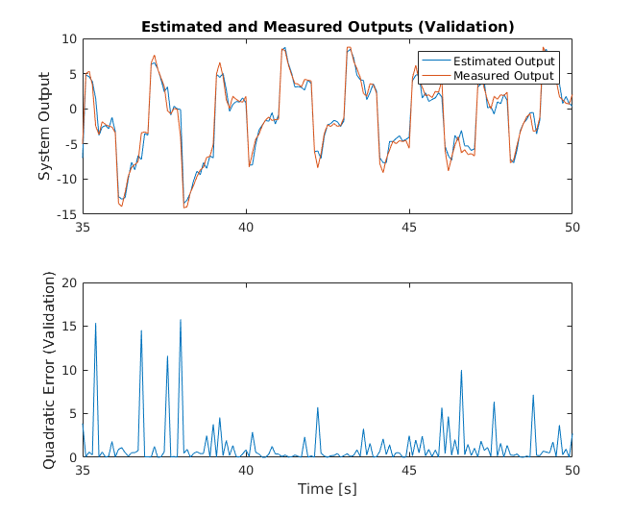
RECURSIVE ARMAX ESTIMATION
[na, nb, nc, nk] = [7, 7, 10, 1]
A = [1 -0.6594 -0.7420 -0.0457 0.6375 0.5912 -0.9068 0.1648]
B = [0 0.9032 -0.6362 -0.9096 -0.0934 0.7044 0.7503 -0.8708]
C = [1 0.3564 -0.7181 -0.5632 0.4154 0.7232 -0.1983 -0.1687 0.0836 0.0836 0.0139]
Estimation fit = 68.25%; MSE = 3.2293
Validation fit = 74.12% (step); 64.7406% (compare); MSE = 1.2521
10
Joaquim Leitão – Real Time Learning in Intelligent Systems

Slide 11
CONCLUSION
ARX #1, ARX #2 and ARMAX register similar values of fit
ARX#1 presents best estimation and validation fit
ARMAX lowest MSE in validation
Fit in estimation and validation could be higher
Need to collect more data?
Low signal/noise ratio (signal and noise very similar)
11
Joaquim Leitão – Real Time Learning in Intelligent Systems
Notes:
Resultados validação offline diferem dos da validação online… Existem diferenças nas condições iniciais… Pode ser problema da forma como estou a utilizar a toolbox…
Fazendo estimação e validação em batch os resultados aproximam-se dos obtidos em tempo-real, o que sugere que pode ser ou algum erro na utilização que dei à toolbox, eventualmente podem ser necessários efectuar outros passos para processar um input por um modelo treinado de forma recursiva (e que são diferentes dos utilizados num modelo treinado em batch)

