Slide 1

Protein Classification
Real Time Learning in Intelligent Systems
Joaquim Leitão

Slide 2
Objectives
Protein function identification from genetic sequence
55 families – 1 classifier per family
Incremental vs Non-Incremental Approaches
LASVM vs SVM
SCOP40_Minidatabse
2
Joaquim Leitão – Real Time Learning in Intelligent Systems

Slide 3
Methodology
Pre-processing
Data Representation
Classifier Training
Results Assessment
3
Joaquim Leitão – Real Time Learning in Intelligent Systems
Notes:
Initial Pre-processing to generate train and test datasets for each family; extract information from the provided files…
Data Representation –> Segmentation (to be detailed) ; 2 types of classifiers to be compared…

Slide 4
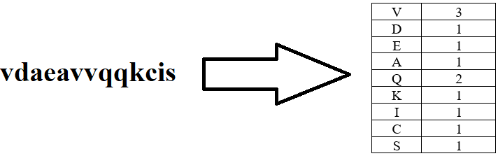
Data Representation
Count number of occurrences of each nucleotide
Exclude “x” nucleotides – Missing Data
4
Joaquim Leitão – Real Time Learning in Intelligent Systems

Slide 5
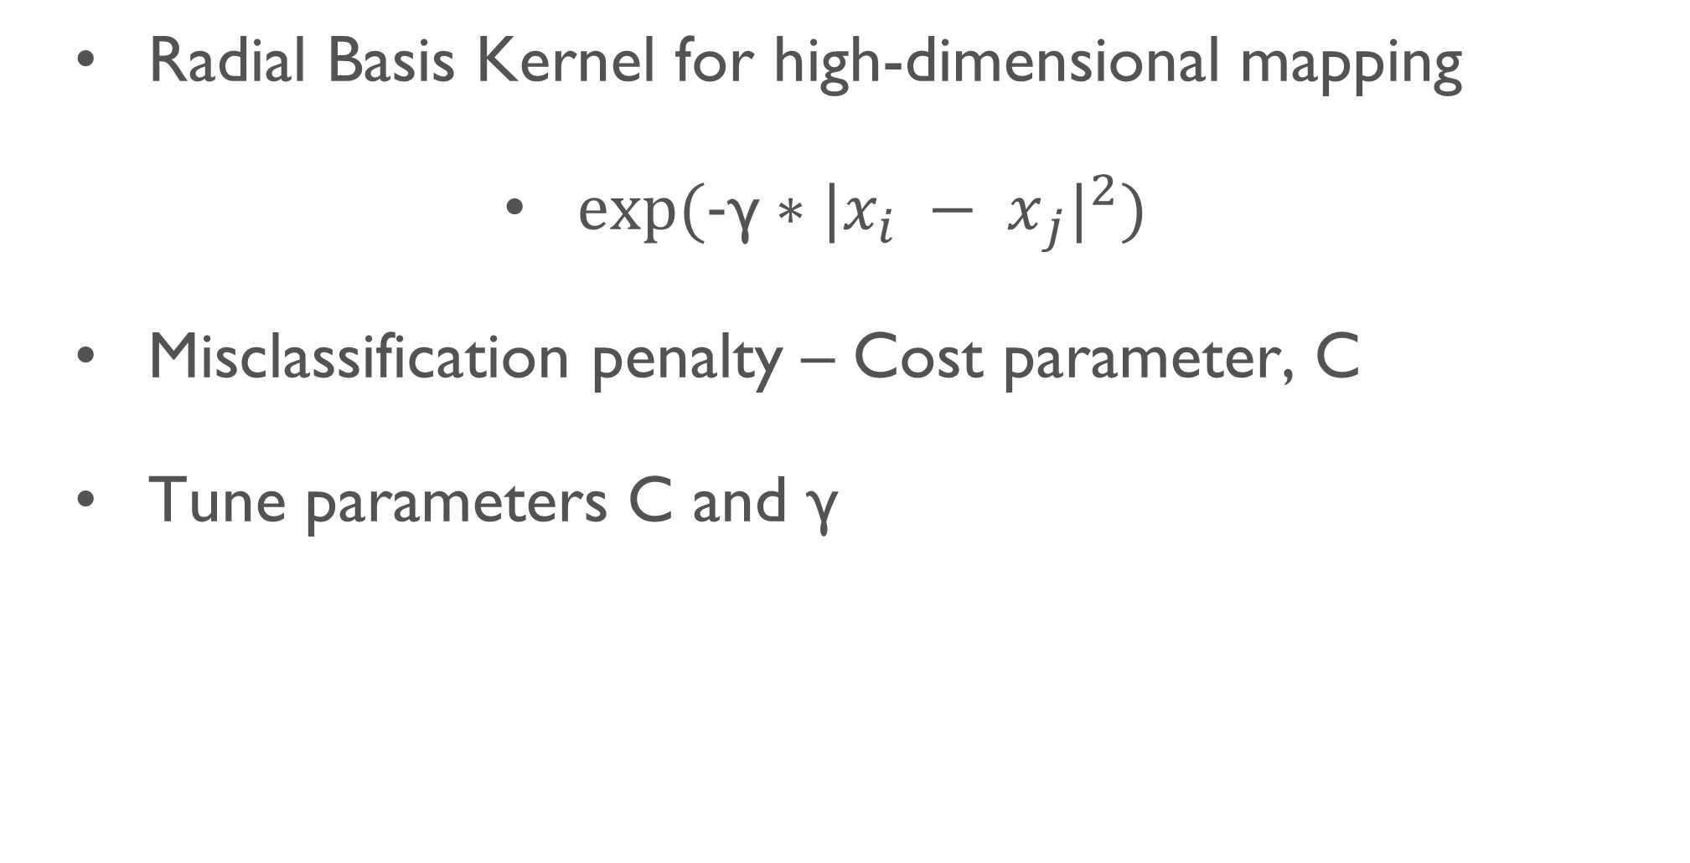
Support Vector Machines
Radial Basis Kernel for high-dimensional mapping
$exp⁡(\text{-}\text{γ}∗{|{x_{i} − x}_{j}|}^{2})$
Misclassification penalty – Cost parameter, C
Tune parameters C and γ
5
Joaquim Leitão – Real Time Learning in Intelligent Systems

Slide 6
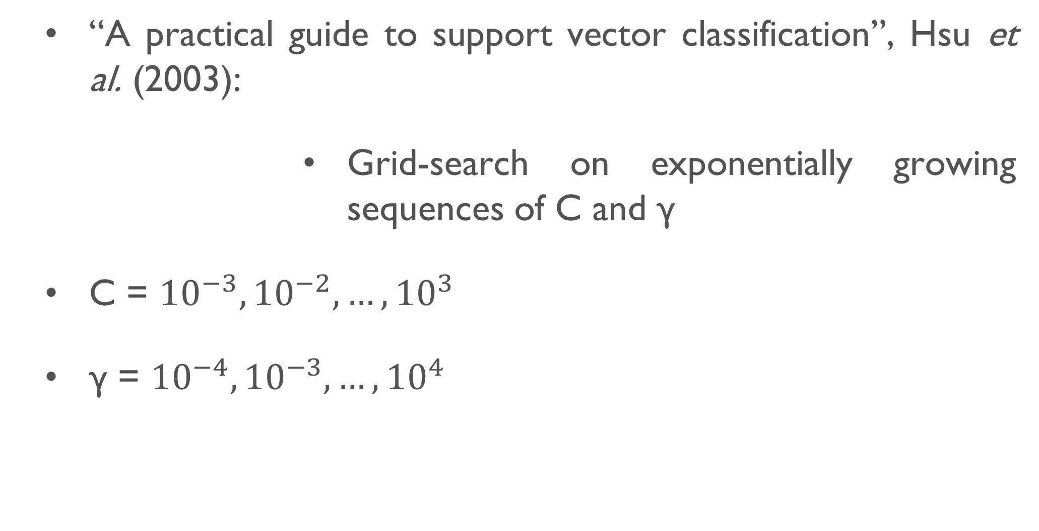
Support Vector Machines - Tuning
“A practical guide to support vector classification”, Hsu et al. (2003):
Grid-search on exponentially growing sequences of C and γ
C = ${10}^{−3}, {10}^{−2}, …, {10}^{3}$
γ = ${10}^{−4}, {10}^{−3}, …, {10}^{4}$
6
Joaquim Leitão – Real Time Learning in Intelligent Systems

Slide 7
Support Vector Machines - Results
Average AUC of 0.74 in test dataset
Best AUC = 0.99 for family “b.29.1._b.29.1.2.” (C = 256 ; γ = 3.9e-03)
Overfitting in families “c.26.2._c.26.2.1.” and “c.47.1._c.47.1.10.” (Train AUC = 1; Test AUC around 0.5)
Families where no classifier could be learned (Train AUC = Test AUC around 0.5)
7
Joaquim Leitão – Real Time Learning in Intelligent Systems
Notes:
Best AUC – Hard-limit margin (Penalises a lot misclassifications)

Slide 8
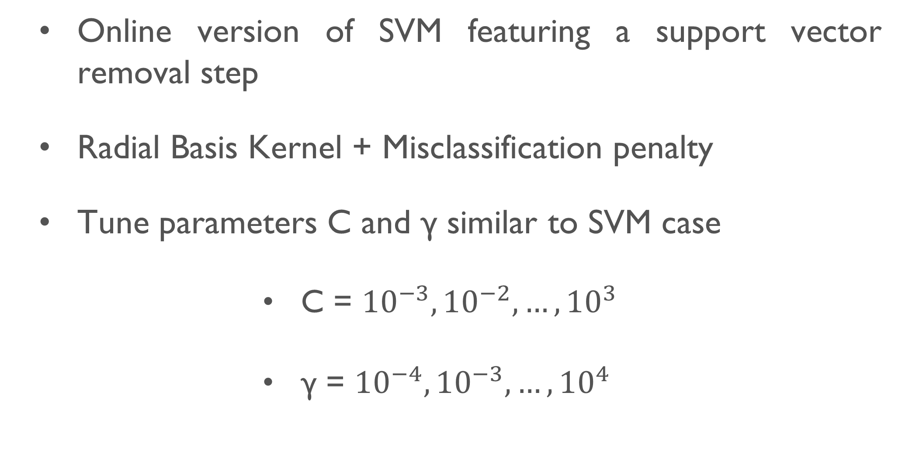
LASVM
Online version of SVM featuring a support vector removal step
Radial Basis Kernel + Misclassification penalty
Tune parameters C and γ similar to SVM case
C = ${10}^{−3}, {10}^{−2}, …, {10}^{3}$
γ = ${10}^{−4}, {10}^{−3}, …, {10}^{4}$
8
Joaquim Leitão – Real Time Learning in Intelligent Systems

Slide 9
LASVM - Results
Average AUC of 0.81 in test dataset
Best AUC = 0.99 in families “b.29.1._b.29.1.11.” (C = 32 ; γ = 1.22e-04); “b.29.1._b.29.1.2.” (C = 4 ; γ = 9.7e-04); and “c.67.1._c.67.1.4.” (C = 512 ; γ = 2.44e-04)
Does not appear to suffer from overfitting
Families where no classifier could be learned (Train AUC = Test AUC around 0.5)
9
Joaquim Leitão – Real Time Learning in Intelligent Systems
Notes:
Best AUC – Only the last one is hard-limit (or at least is considerably more hard-limit than the others)

Slide 10
Conclusions
LASVM produce better results than SVM and does not appear to suffer from overfitting
Best results in test dataset do not correspond to high performances in the training dataset (AUC = 0.7-0.8)
Average results lower than SCOP40 benchmark
2
Joaquim Leitão – Real Time Learning in Intelligent Systems
Notes:
No overfit in LASVM – Can be explained by LASVM’s incremental training mechanisms

Slide 11
Future Work
Extend parameter fine tuning
Missing data imputation techniques
More powerful representation techniques
Other machine learning techniques, such as neural networks or random forests
11
Joaquim Leitão – Real Time Learning in Intelligent Systems
Notes:
Parameter fine tuning – More exhaustive search of the parameter space
Missing data – Statistical and other predictive approaches to produce estimations for missing nucleotides in protein sequences

